Slide 1

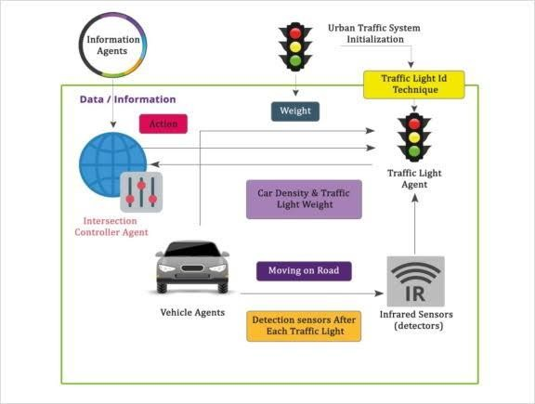
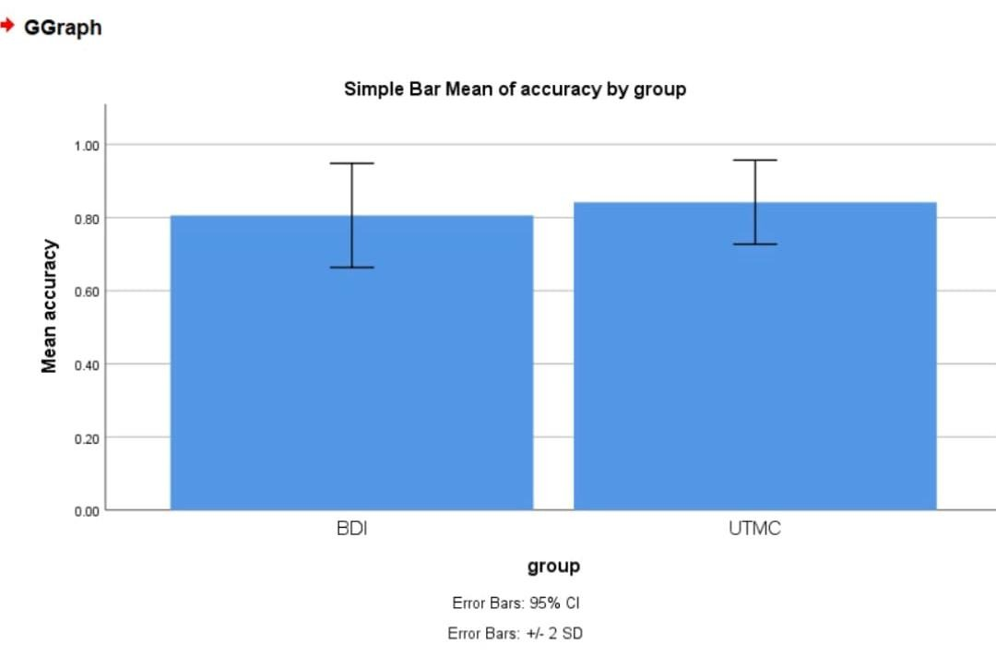
Name: Mr.B.Rajesh Register Number: 192311443 Guided by Dr. M.Buvanesvari
Smart traffic light Scheduling Algorithms Using Dynamic Traffic Signal Control (DTSC) with ciso’s Smart To Improve Accuracy
INTRODUCTION
Traffic congestion is a significant issue in urban areas, leading to delays, increased fuel consumption, and environmental pollution.
raditional fixed-time traffic signal control systems often fail to adapt to changing traffic conditions, exacerbating congestion and inefficiency.
Dynamic Traffic Signal Control (DTSC) algorithms, such as ciso's Smart, utilize real-time
data to dynamically adjust signal timings and optimize traffic flow.
This study explores the application of ciso's Smart DTSC algorithm to improve traffic management and alleviate congestion in urban areas.
MATERIALS AND METHODS
Collect Real-Time Traffic Data
Process Data to Extract Relevant Information
Analyze Traffic
Data to Identify Patterns and Trends
Utilize ciso's Smart Algorithm for Real- Time Adjustment
Data Collection and Processing
Analyze Traffic
Data to Identify
Patterns and Trends
Monitor Traffic
Conditions and
Update Signal Timings
Iteratively Repeat Process
for Optimal Traffic Flow
Dynamic Traffic Signal Control
RESULTS
Implementing smart traffic light scheduling algorithms using Dynamic Traffic Signal Control (DTSC) with Cisco's Smart technology, augmented by the Belief-Desire-Intention (BDI) architecture and the Urban Traffic Management and Control (UTMC) system, significantly enhances traffic management accuracy.
By integrating real-time data analysis with proactive decision-making, the system dynamically
adjusts traffic signal timings to optimize traffic flow, minimize congestion, and reduce travel time for vehicles.
This holistic approach ensures efficient traffic management by leveraging advanced algorithms and comprehensive traffic modeling techniques, resulting in smoother traffic flow and improved
overall urban mobility.
DISCUSSION AND CONCLUSION
Dynamic Traffic Signal Control (DTSC) algorithms, such as ciso's Smart, aim to optimize traffic flow by dynamically adjusting signal timings based on
real-time traffic conditions.
Implementation of smart traffic light scheduling algorithms like ciso's Smart leads to improved accuracy in predicting traffic patterns and optimizing
signal timings accordingly.
Optimized signal control contributes to safer road conditions by reducing the likelihood of accidents and decreasing vehicle emissions through smoother traffic flow.
Dynamic Traffic Signal Control algorithms, such as ciso's Smart, offer a promising approach to improve traffic management and efficiency by dynamically adjusting signal timings based on real-time traffic conditions.
BIBLIOGRAPHY
Li, J., Zhang, X., Li, S., Guo, Z., Guo, L. (2017). "A novel traffic signal control strategy based on dynamic traffic prediction." IEEE Transactions on
Intelligent Transportation Systems, 18(3), 597-609. DOI: 10.1109/TITS.2016.2593649
Lu, L., Wu, L., Liu, X., & Wang, Y. (2015). "Dynamic traffic signal control for urban road networks with traffic estimation uncertainty." Transportation Research Part C: Emerging Technologies, 52, 117-136. DOI: 10.1016/j.trc.2015.01.013.
Ren, W., Cao, D., & Du, J. (2018). "An adaptive traffic signal control strategy based on deep reinforcement learning." Transportation Research Part C: Emerging Technologies, 90, 166-179. DOI: 10.1016/j.trc.2018.03.002.
Li, X., Wang, Y., & Li, X. (2019). "Multi-objective optimization for real-time traffic signal control in urban road networks." Transportation Research Part C: Emerging Technologies, 103, 27-48. DOI: 10.1016/j.trc.2019.03.017.

