Slide 1
Technology
Maven
JRE
Spring Boot
Drools

Slide 2
Packaging
Jar
Hardware/Software requirements
Linux/Windows, Maven 3.2.2, JDK 1.8
War
Hardware/Software requirements
Linux/Windows, Maven 3.2.2, JDK 1.8, Tomcat/Jboss/WebLogic,etc...

Slide 3

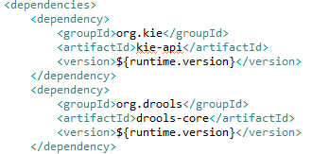
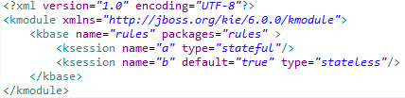
Embedded Drools Enterprise Architectures
Rest Request
Return the
Response
Business Layer
Rest Service
/scheduleAssignmentDerivations
/agentValidations
End
Point
KieSession(obtained from embedded jar)
Data Model
Fire Rule

Slide 4

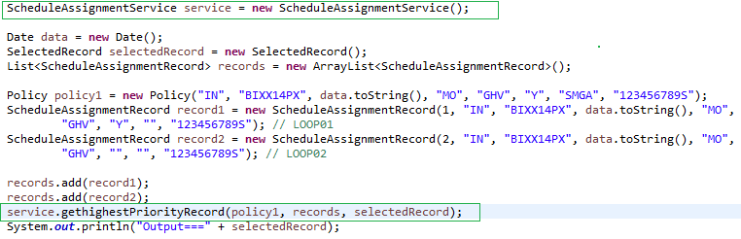
Maven Dependencies
The Consumer requires Embedded Drools Schedule-derivations Service and so the POM.xml in the Consumer folder has the appropriate dependency entry in it
Fire the Drools(Consume Schedule Assignment Service to fire the Rules)

Slide 5
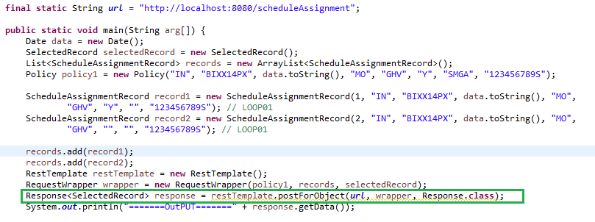
Consuming a RESTFul Schedule assignment Service and Retrieving Response POJO instead of JSON( Without Maven Dependencies)
Use POST to Fire a Rules using RestTemplate

