Slide 1
Jenkins: Introduction - Understanding continuous integration
Developers pushes software to a repository
Operations builds and deploys the application to one or many environments like testing staging)
QA team performs performance tests and releases it to production use
Continuous Integration (CI) is the process of automating the build and testing of code every time a team member commits changes to Version Control System

Slide 2
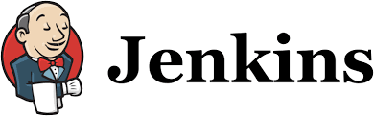
Jenkins: Introduction - Understanding continuous integration
Developers pushes software to a repository
Operations builds and deploys the application to one or many environments like testing staging)
QA team performs performance tests and releases it to production use
Can automate most of the repetitive tasks! This facilitates continuous integration!

Slide 3
Jenkins: Introduction - Understanding continuous integration
A Build Pipeline Components
Unit Test
Acceptance Test
Packaging
Reporting
Deployment
Notification/Alerts
Can automate most of the repetitive tasks! This facilitates continuous integration!

Slide 4
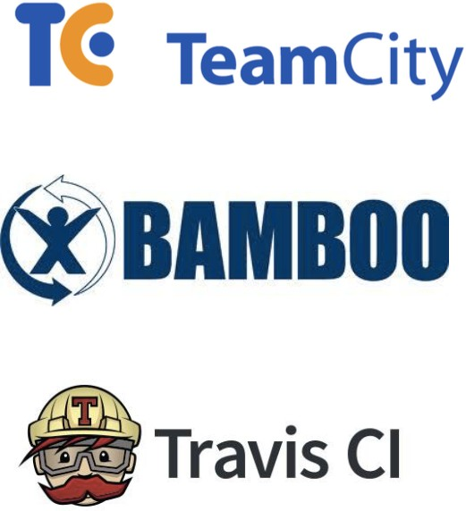
Jenkins: Introduction - Understanding continuous integration

Slide 5
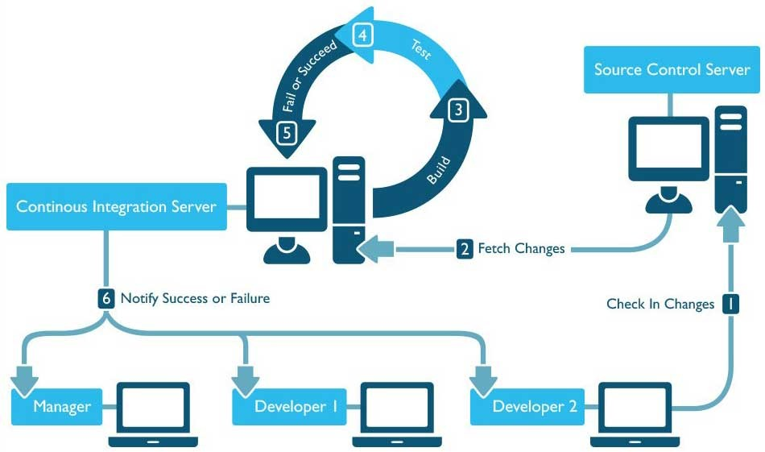

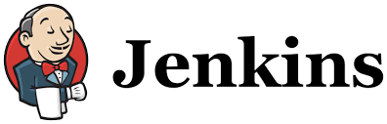
Jenkins: Introduction - Understanding continuous integration

Slide 6
Jenkins: Introduction - Introduction about Jenkins
Jenkins is an open source automation server written in Java. Jenkins helps to automate the non-human part of software development process, with continuous integration and facilitates technical aspects of continuous delivery.
It is a server-based system that runs in servlet containers such as Apache Tomcat. It supports version control tools, including AccuRev, CVS, Subversion, Git, Mercurial, Perforce, ClearCase and RTC, and can execute Apache Ant, Apache Maven and sbt based projects as well as arbitrary shell scripts and Windows batch commands.

Slide 7
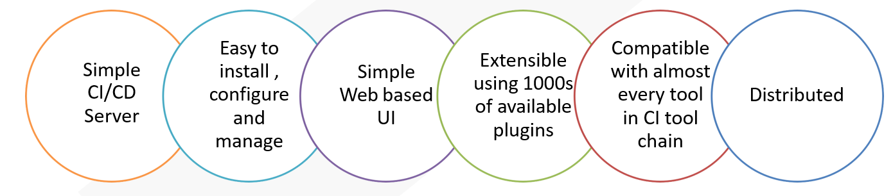
Jenkins: Features
.

Slide 8
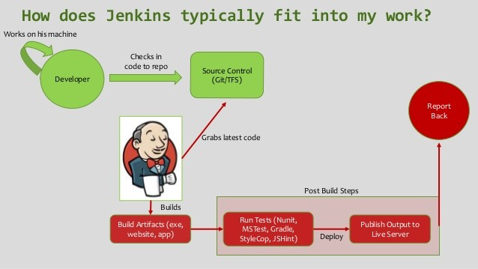
Jenkins: Introduction - Introduction about Jenkins

Slide 9
Jenkins: Introduction - Build Lifecycle
A build lifecycle is the process of building and distributing a particular artifact (project).
Build Lifecycle phases:
validate - validates the project
compile - compiles the source code of the project
test - tests the compiled source code using a suitable unit testing framework.
package - take the compiled code and package it in a distributable format
verify – run integration tests
install - install the package into the local repository (may be for dependencies)
deploy - copies the final package to the remote repository for sharing with others

Slide 10
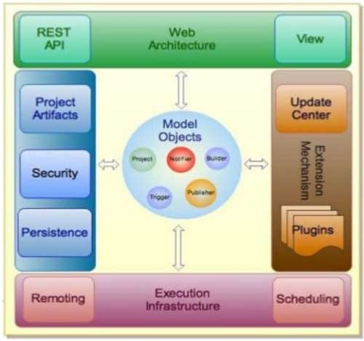
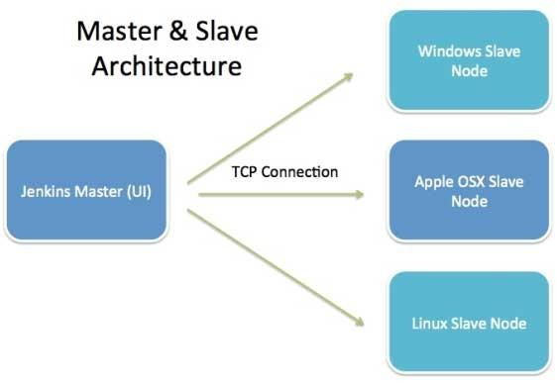
Jenkins: Introduction - Jenkins Architecture

Slide 11
Jenkins: Introduction - Jenkins Architecture
Master:
Schedule Build Job
Dispatches Builds to the Slave for Actual job Execution
Monitoring the Slave and recording the build Results
Slave :
Execute Builds jobs dispatched by master

Slide 12

Jenkins: Installation - Obtaining and installing Jenkins
Url: https://jenkins.io/doc/book/getting-started/installing/
Debian/Ubuntu
wget -q -O - https://pkg.jenkins.io/debian/jenkins.io.key | sudo apt-key add - sudo sh -c 'echo deb http://pkg.jenkins.io/debian-stable binary/ > /etc/apt/ sources.list.d/jenkins.list'
sudo apt-get update
sudo apt-get install jenkins
MacOS [installer package also available] brew install jenkins
Docker
docker pull jenkins/jenkins
Windows
Using installer package

Slide 13
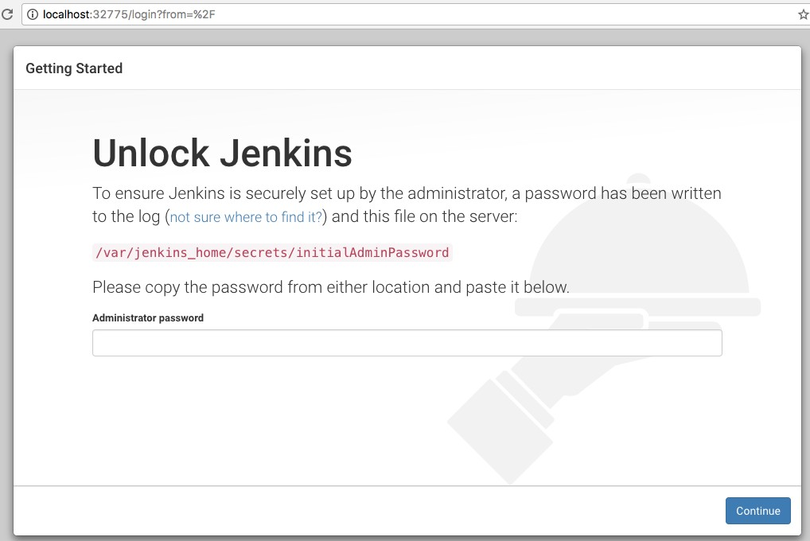
Jenkins: Installing

Slide 14
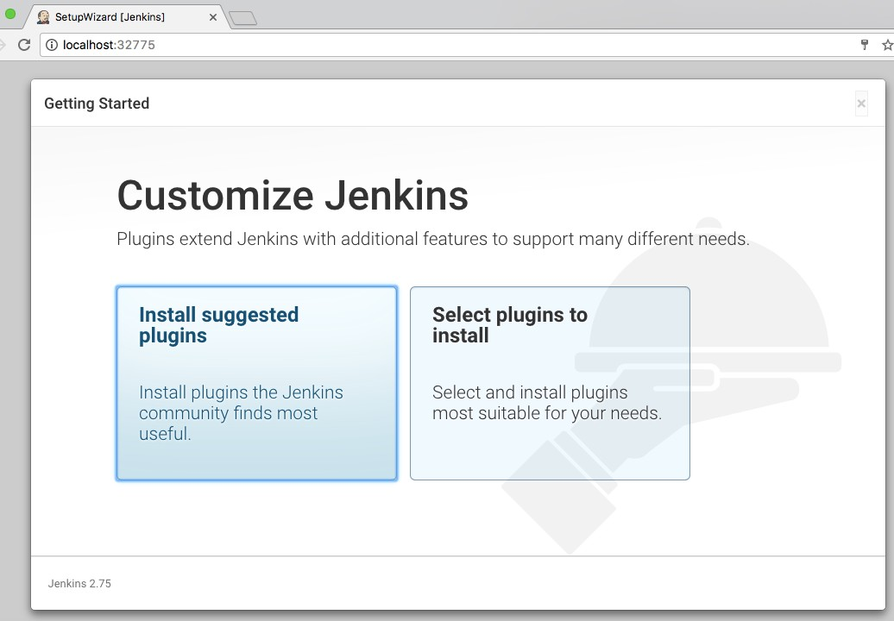
Jenkins: Installation - Docker + Jenkins: Browsing

Slide 15
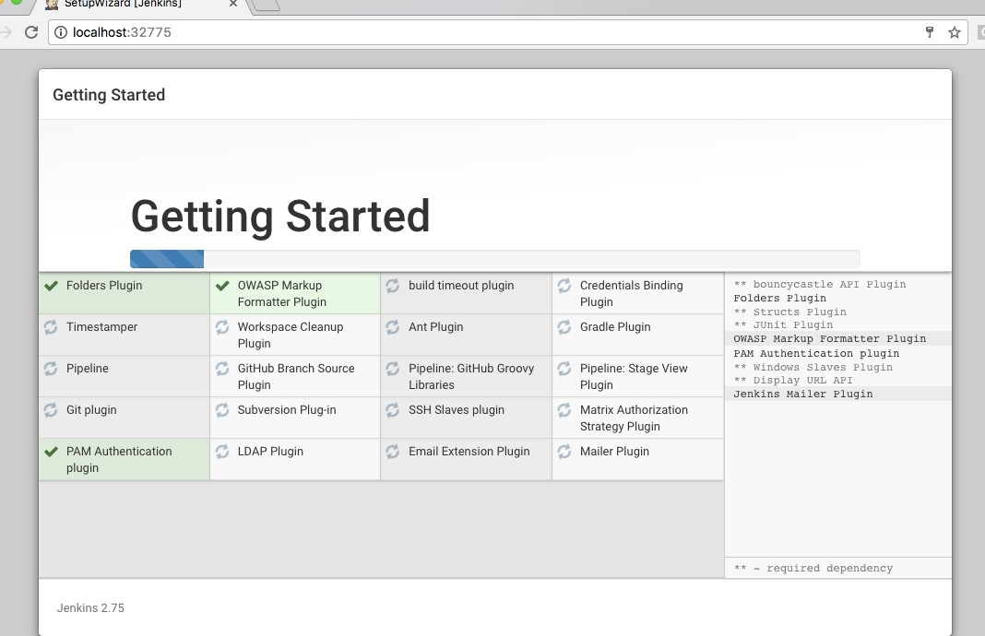
Jenkins: Installation – Install Suggested Plugins

Slide 16
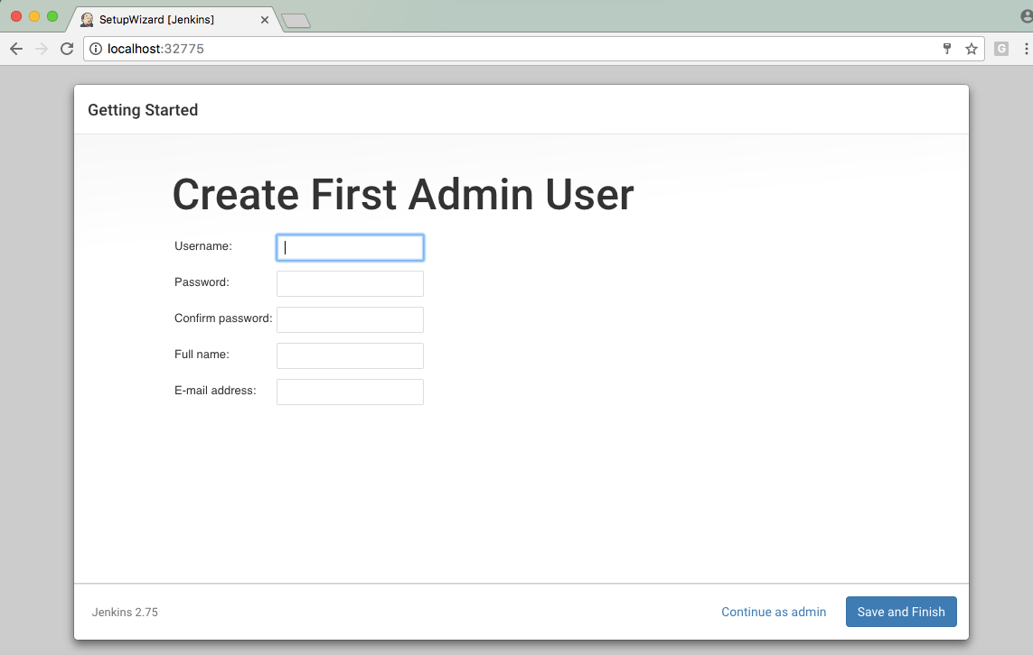
Jenkins: Installation – Create First Admin User

Slide 17
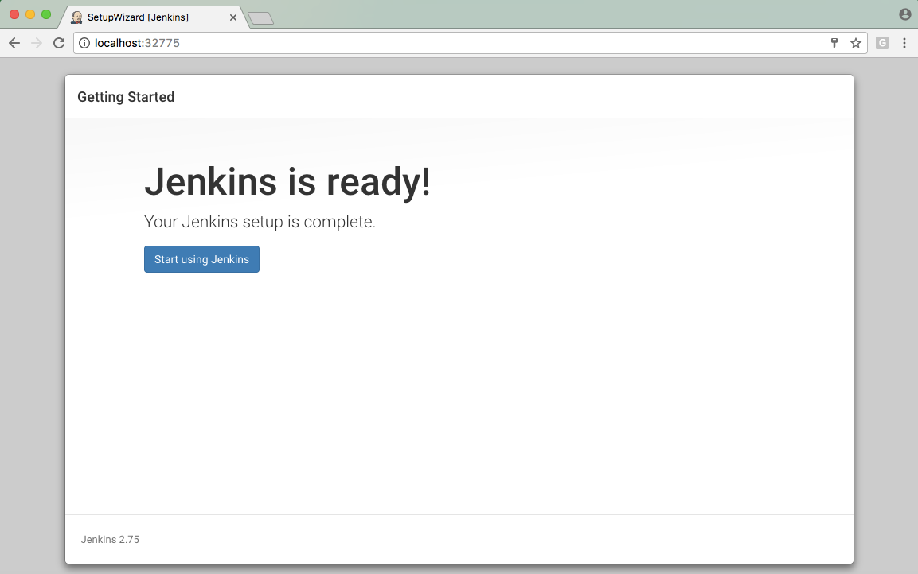
Jenkins: Installation – Ready to View Jenkins Dashboard

Slide 18
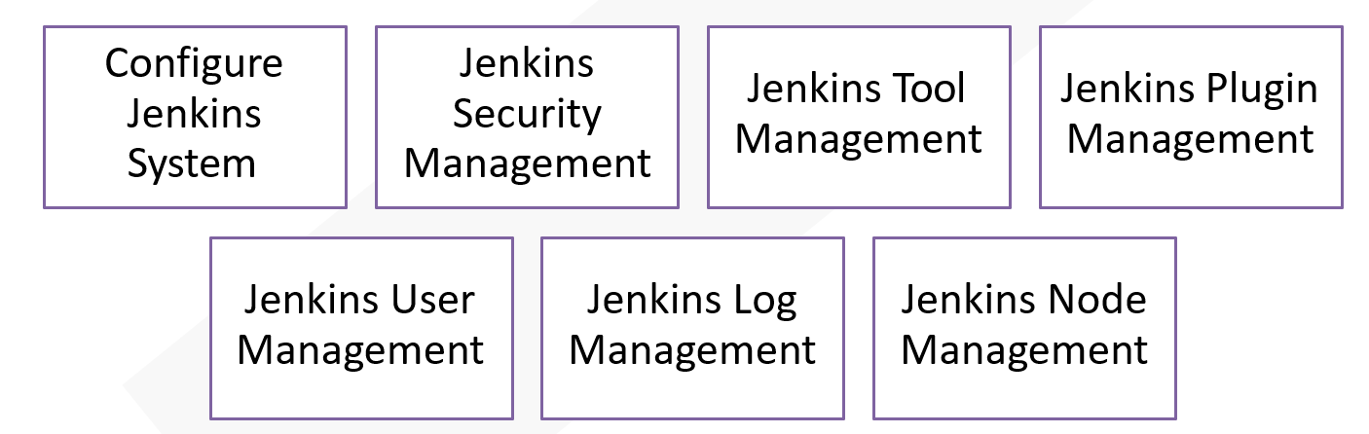
Jenkins: Management

Slide 19
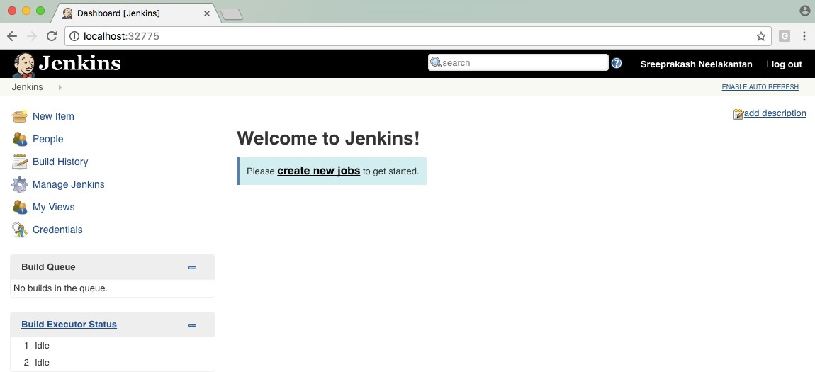
Jenkins: Installation – Ready to View Jenkins Dashboard

Slide 20
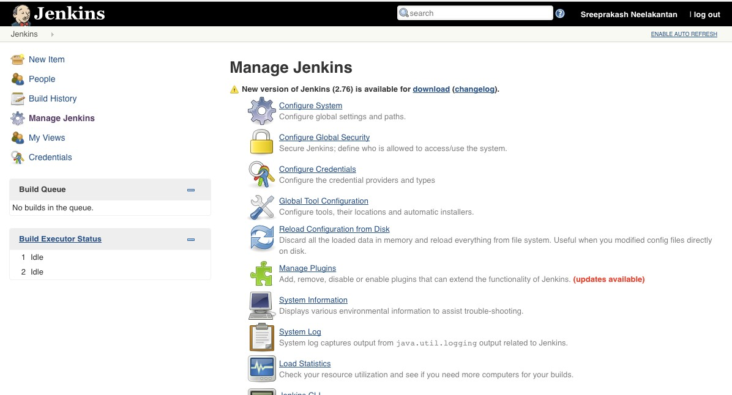
Jenkins: Securing Jenkins

Slide 21
Jenkins: Securing Jenkins - Authentication
1. Configure Global Security

Slide 22
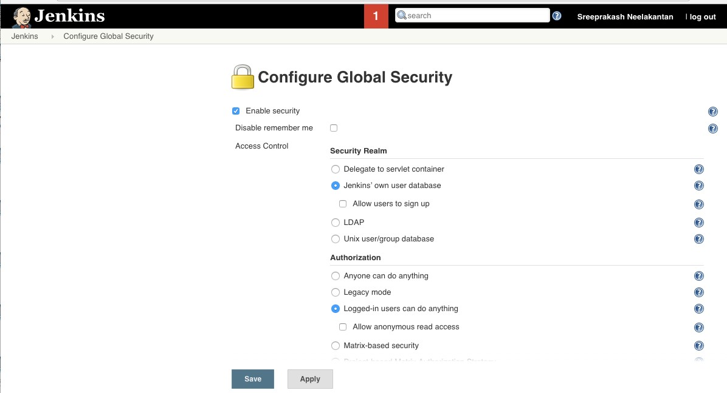





Jenkins: Securing Jenkins - Authentication
After you create admin users, choose Matrix-based security

Slide 23
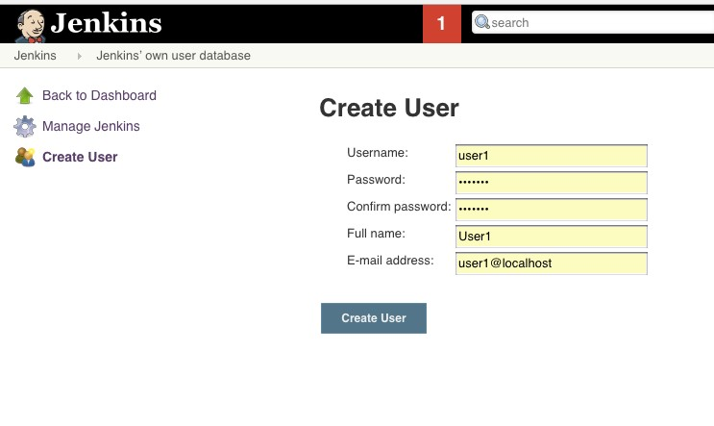
Jenkins: Securing Jenkins - Creating users
1. Login as Admin -> Manage Jenkins -> Manage Users -> Create User

Slide 24
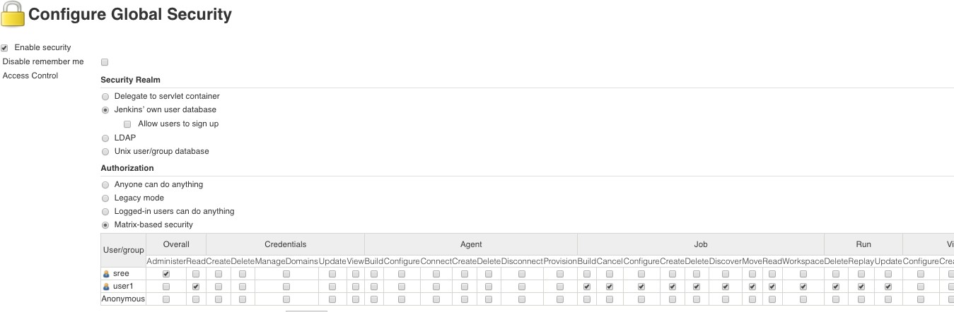
Jenkins: Securing Jenkins - Creating users
Login as Admin -> Manage Jenkins -> Configure Global Security -> Matrix-based
Allow only essential features for the users. Remember to check admin for at least one.
Be careful when allowing users to delete jobs

Slide 25
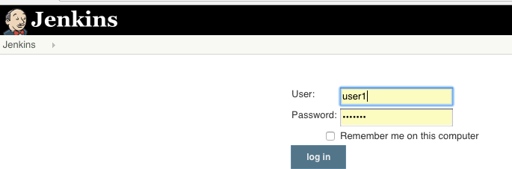
Jenkins: Securing Jenkins - Creating users
1. Logout and Login as User1

Slide 26
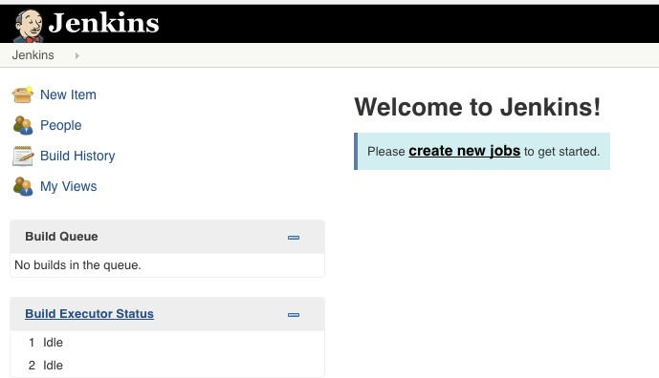
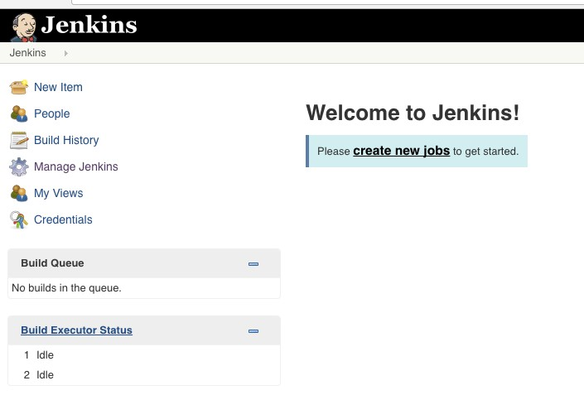
Jenkins: Securing Jenkins - Creating users
1. User1 logged in (see the difference between the admin user and user1)
User1
Admin

Slide 27
Jenkins: Installation - Exploring Jenkins Dashboard

Slide 28
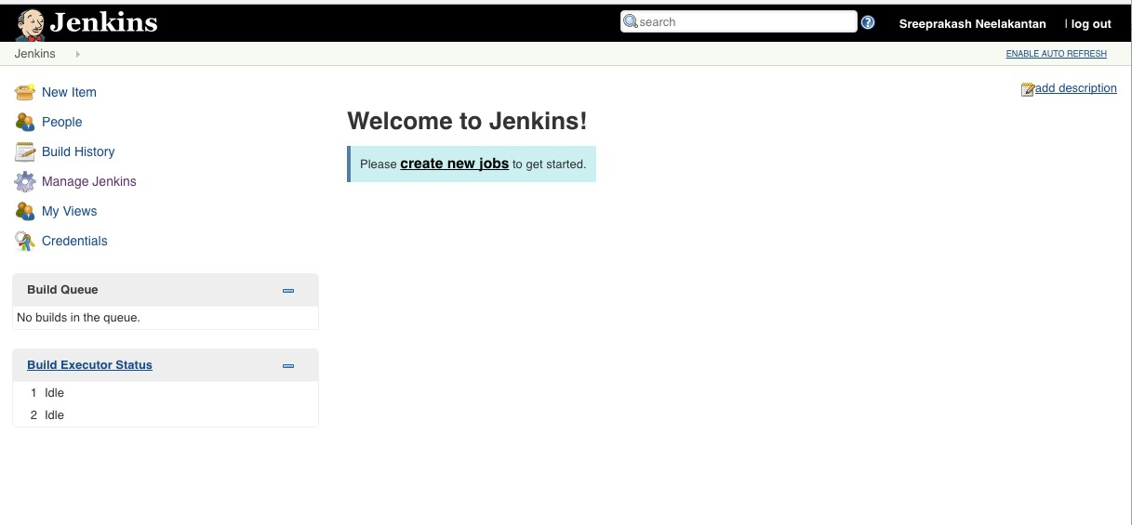
Jenkins: Jobs - Creating Jobs

Slide 29
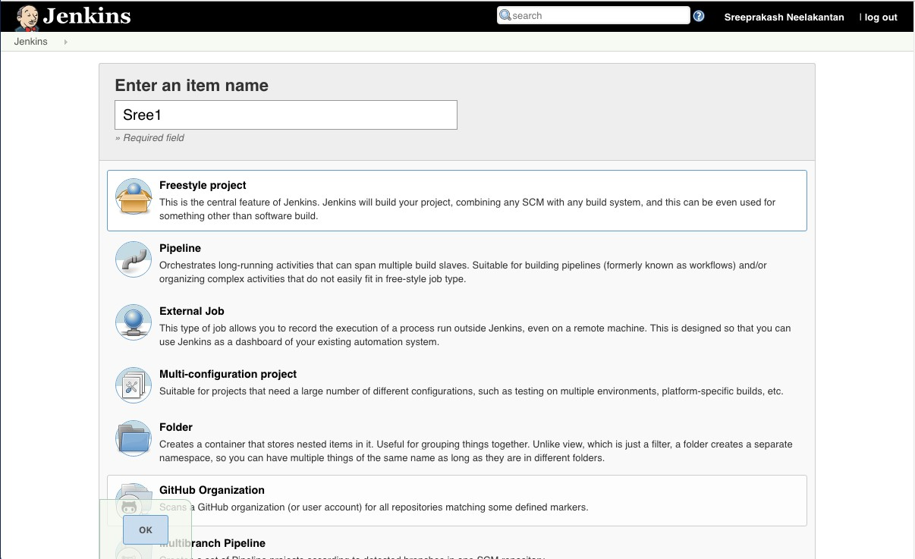
Jenkins: Jobs - Creating Jobs

Slide 30
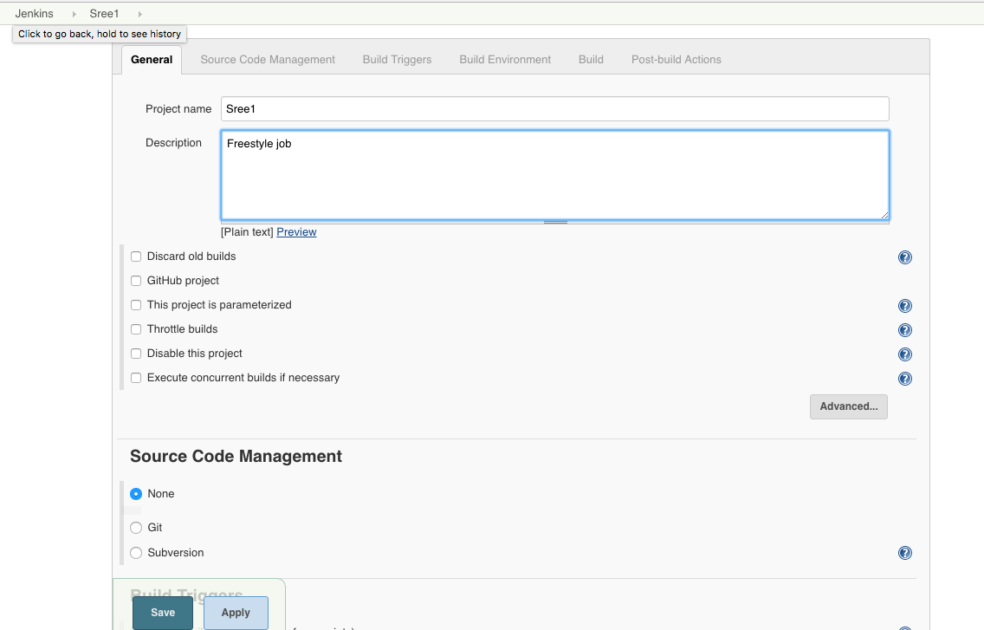
Jenkins: Jobs - Creating Jobs

Slide 31
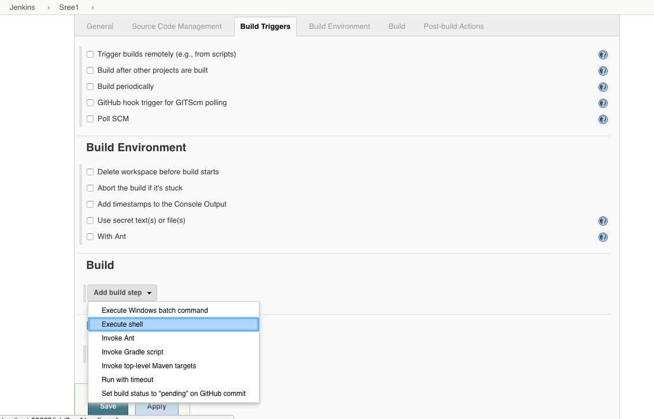
Jenkins: Jobs - Creating Jobs

Slide 32
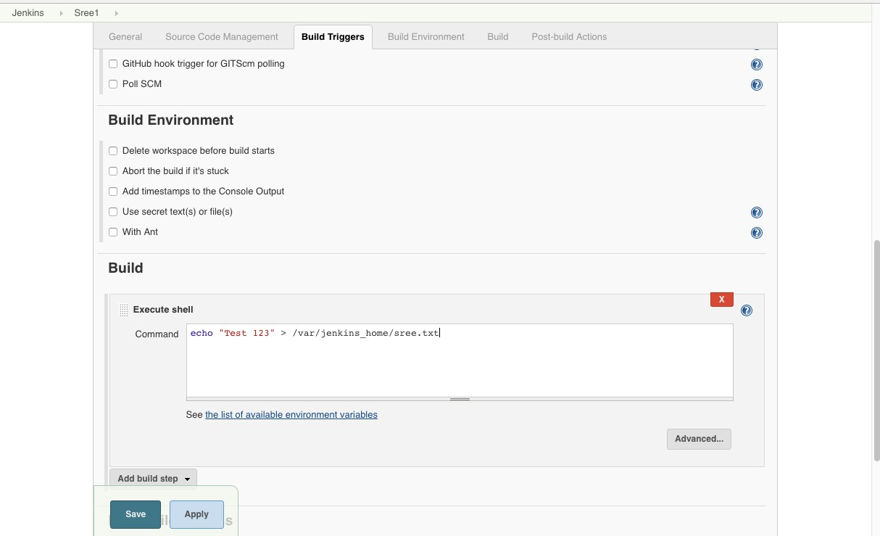
Jenkins: Jobs - Creating Jobs

Slide 33
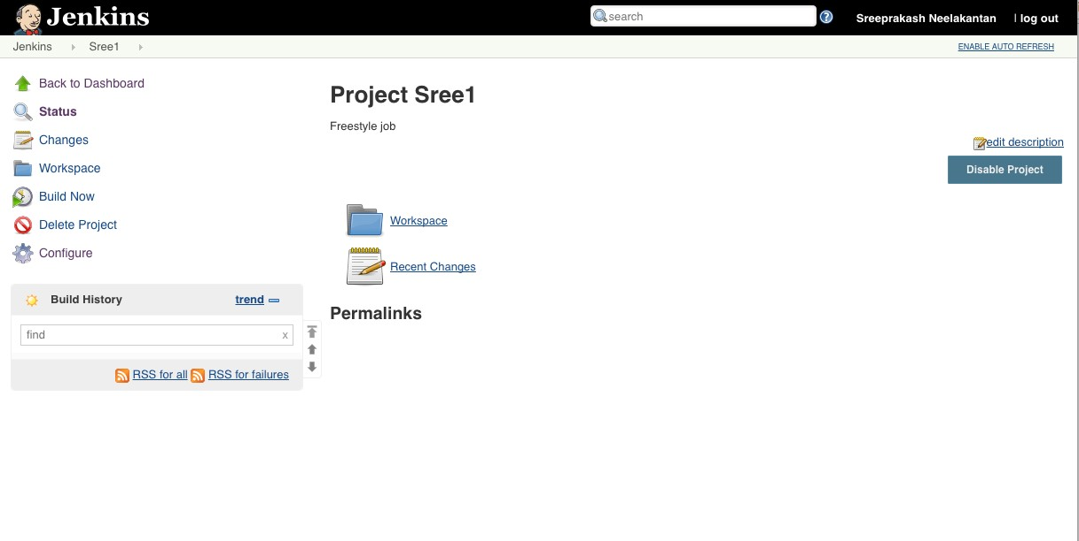
Jenkins: Jobs - Running the Jobs – Jobs Details

Slide 34
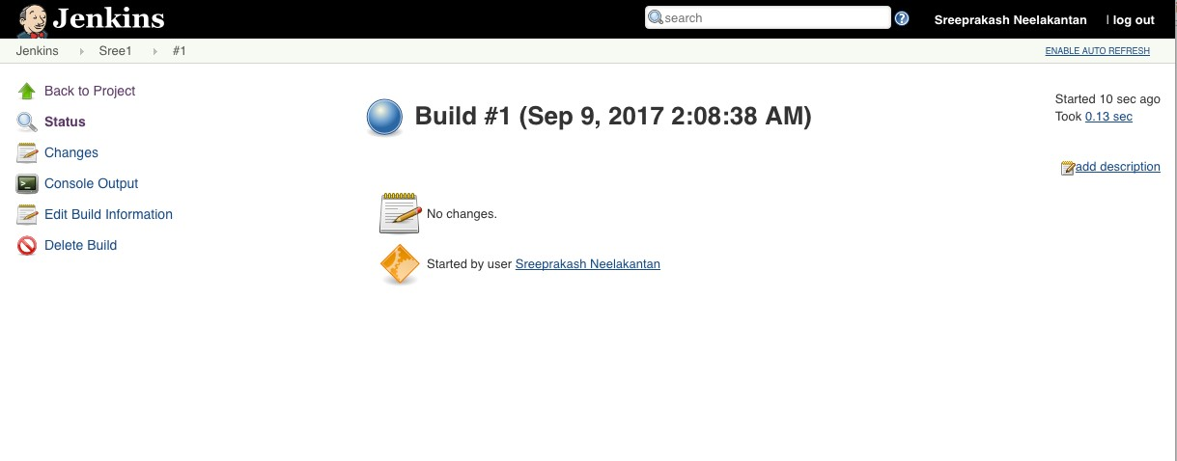
Jenkins: Jobs - Running the Jobs – Build Details

Slide 35
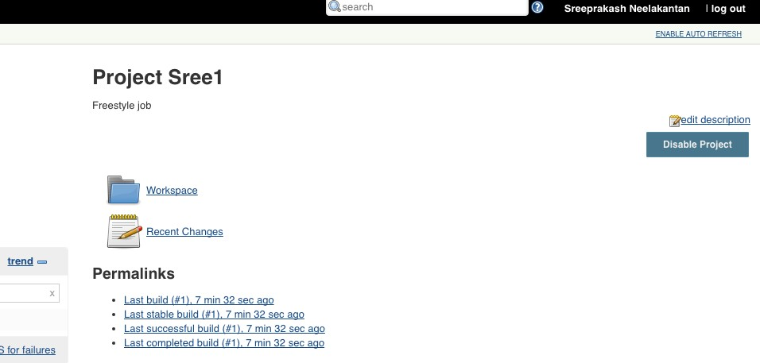

Jenkins: Jobs - Disabling and Enabling jobs

Slide 36
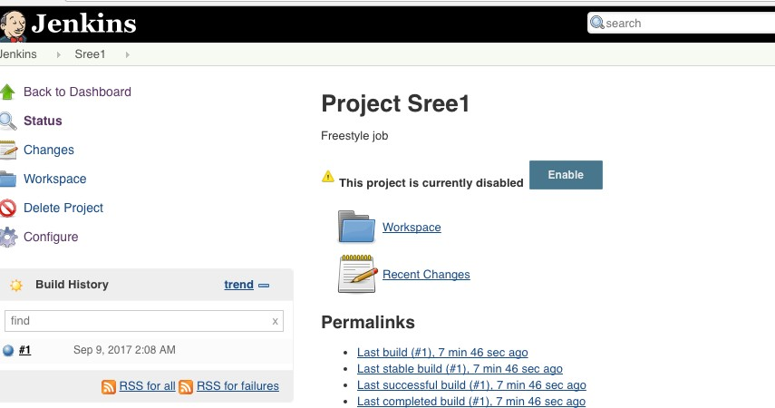


Jenkins: Jobs - Disabling and Enabling jobs

Slide 37
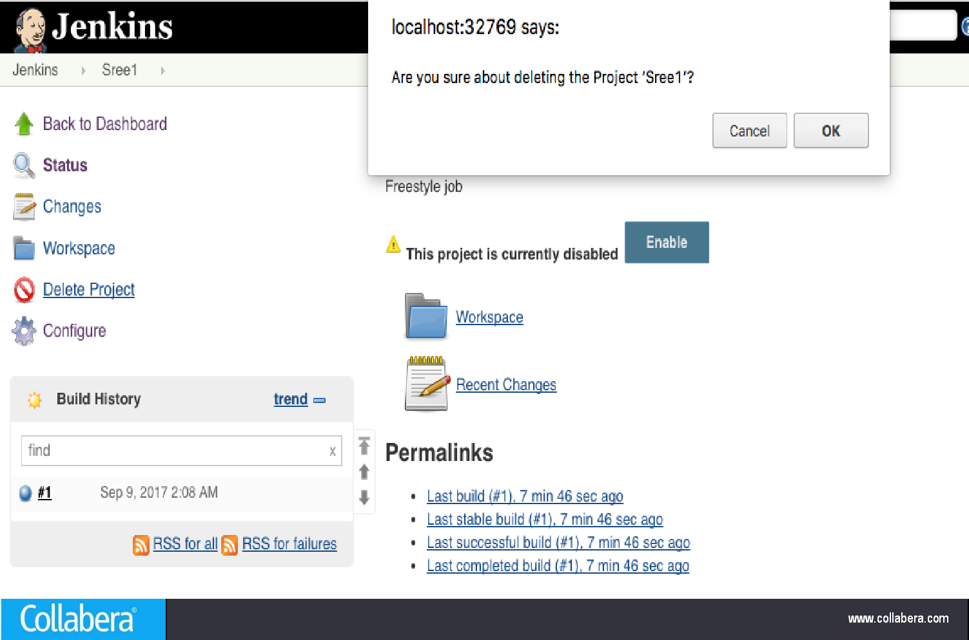
Jenkins: Jobs - Deleting jobs

Slide 38
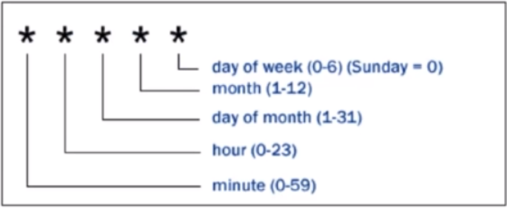
Jenkins: Schedule Build
In cron, Each line consists of 5 fields separated by tab or Whitespace
To specify the Multiple Values for one field
-> all values
M-N A range of values
A,B,Z Enumerates multiple values
0 0 * * * : Every data at midnight
0 2-4 * * * : 2 a.m , 3 a.m ,4 a.m Every day
GIT HUB Hook
https://wiki.jenkins-ci.org/display/JENKINS/GitHub+Plugin

Slide 39
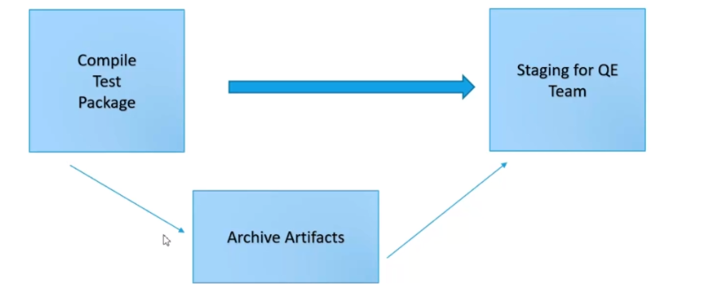
Jenkins: Artifacts
.

Slide 40
Jenkins : Tomcat
Tomcat is an Open source HTTP webserver that will deploy and run applications inside the tomcat container
Default port no of tomcat was :8080
If we want to change the port for tomcat ,you can go through conf/server.xml and search for connector port and change your port no
IF you want to run the server , you need to go bin directory and running startup from command prompt
we need to keep WAR file inside the WebApps folder
Once we kept WAR file inside then need to restart /start the server

Slide 41
Jenkins : Deploy Artifacts
Install copy artifact and deploy to container plugin
Deploy our application to staging environments

Slide 42
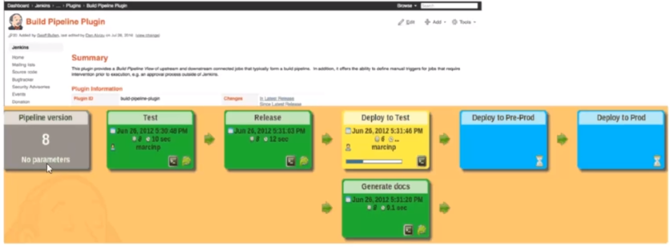
Jenkins: Build Pipeline
Configure and install build pipe line
Create own custom view dashboard

Slide 43
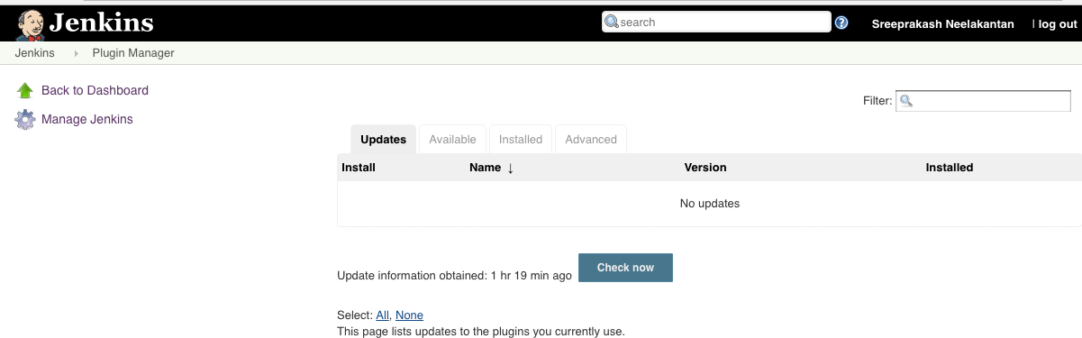
Jenkins: Jobs - Adding and updating Plugins

Slide 44
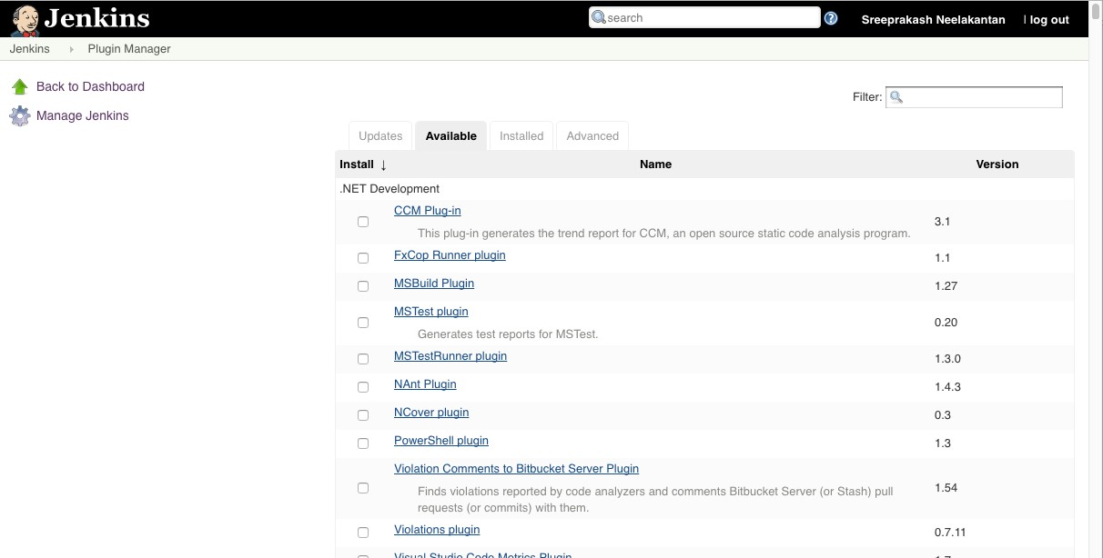
Jenkins: Jobs - Adding and updating Plugins

Slide 45
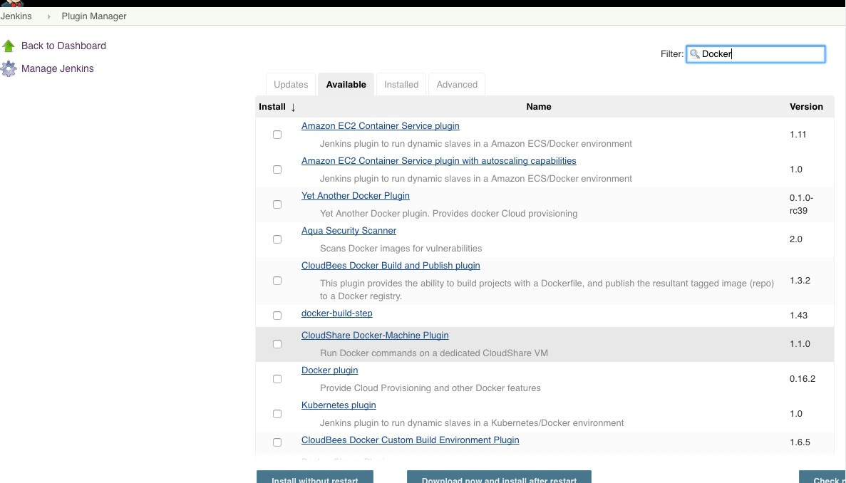


Jenkins: Jobs - Adding and updating Plugins

Slide 46
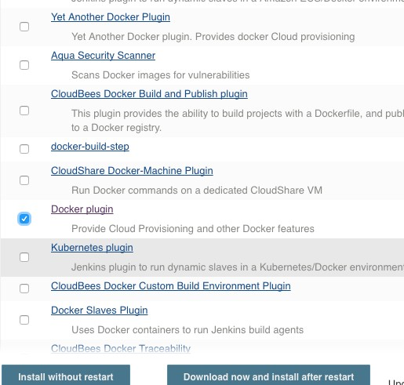

Jenkins: Jobs - Adding and updating Plugins

Slide 47
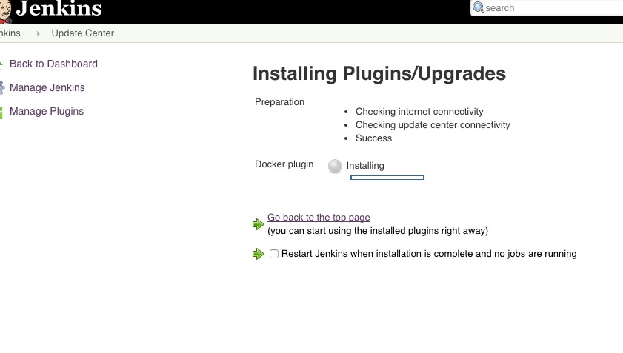
Jenkins: Jobs - Adding and updating Plugins

Slide 48
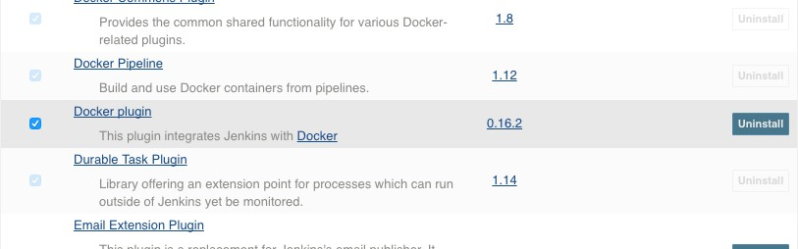
Jenkins: Jobs - Adding and updating Plugins

Slide 49
Jenkins: Build Deployments – Java with Tomcat
TASK #1: Build the Java Application:
docker run –rm -v $PWD/.m2:/root/.m2 -v $PWD/my_host_folder/SreeJavaExample:/project -w /project maven mvn clean package
TASK #2: Deploy the application to Tomcat
docker rm -f my-tcc docker run -d \
-p 8123:8080 \
--name my-tcc \
-v $PWD/my_host_folder/SreeJavaExample/target/SreeJavaExample.war:/usr/local/tomcat/webapps/sree-example.war \
tomcat
NOTES:
When using docker commands in Jenkins NEVER use the –ti option.
Initially, while testing, preferably use the full path instead of $PWD because $PWD points to your task’s workspace which may not have your files.
To browse the application: http://localhost:8123/gsa-example/

Slide 50
Jenkins: Build Deployments – Java with Tomcat
In case you are not a Java developer and you want to quickly create a sample Java Web Application to test the pipeline flow, use the ‘scaffolding’ option of Maven
docker run --rm -it -v $PWD/my_host_folder:/external \
-v $PWD/.m2:/root/.m2 \
-w /external maven mvn archetype:generate \
-DgroupId=com.schogini.dockermvn.example \
-DartifactId=GsaJavaExample \
-DarchetypeArtifactId=maven-archetype-webapp \
-DinteractiveMode=false
Remember, the .m2 folder that you are mapping should be a valid maven repository. If you are not sure what that is then, remove it from the command before you execute it.

Slide 51
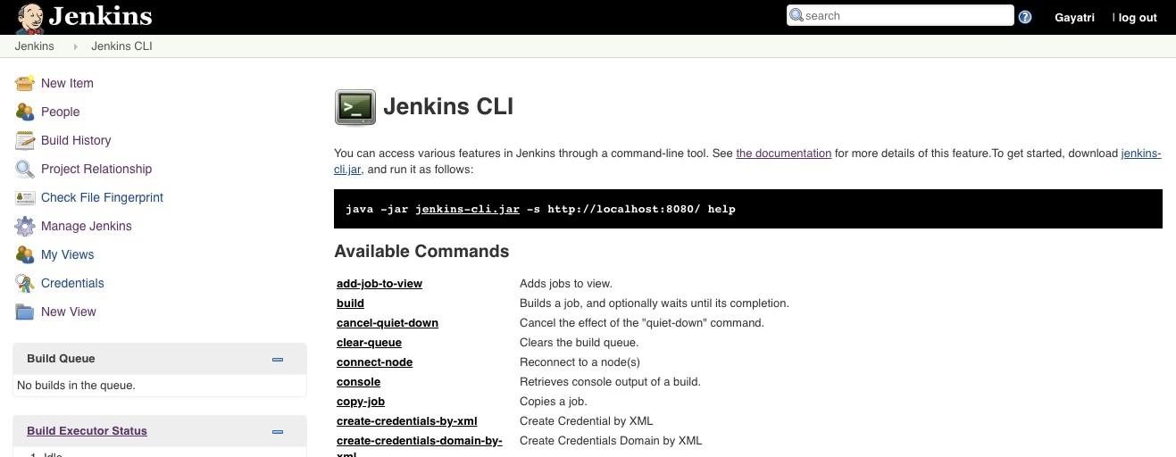
Jenkins: CLI
Ensure that you have the latest version of Java installed else, you may get an error like this:
Exception in thread "main" java.lang.UnsupportedClassVersionError: hudson/cli/CLI : Unsupported major.minor version 52.0

Slide 52
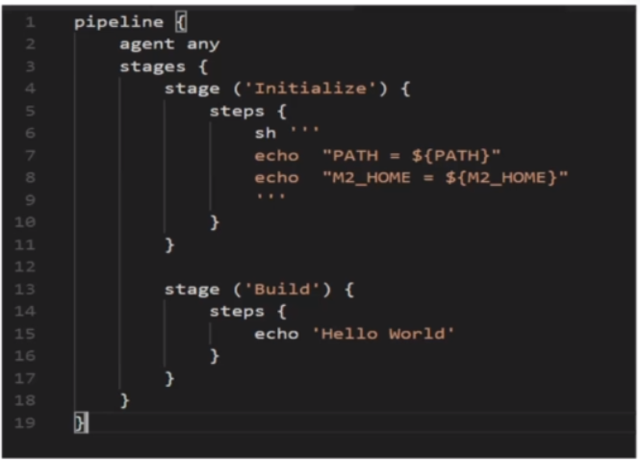
Jenkins: Pipeline As Code
Pipeline code uses a DSL
DSL allows you to perform the tests
Jenkins text file defied in a txt file, called a Jenkinsfile
Can defined version controls of Jenkinsfile
less error –prone execution of jobs
logic based execution of steps
pipeline : This pipe line is a set of instructions given in the form of code for continues delivery of entail build process
Node : The machine on which Jenkins is running
Agent :An agent is an directive multiple builds will runs in single Jenkins instance
Stage :A stage block containers serous of steps in the pipeline , That is build ,test , and deploy process are in one stage
Step : A step is a single task that executes a specific process

Slide 53
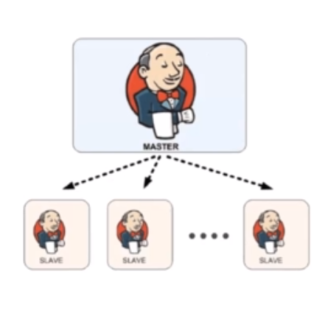
Jenkins – Distributed Builds
Master:
Schedule build job
Dispatches Builds to the slave for actual job execution
Monitoring the slaves and recording the build results
Slave :
Executes builds jobs dispatched by master

Slide 54
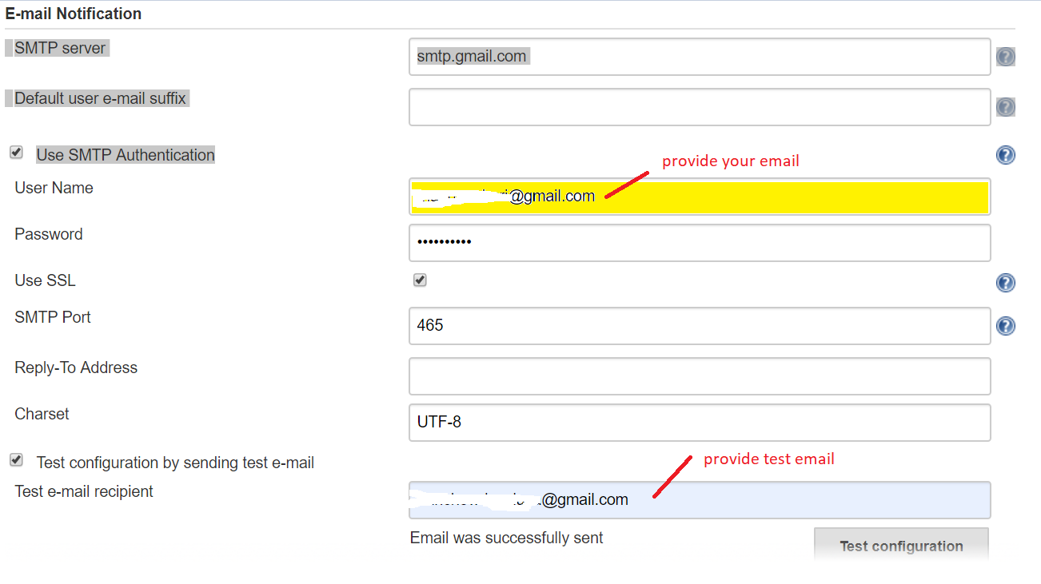
Jenkins – Email configuration

Slide 55
Jenkins - Best Practices
Always secure Jenkins.
In larger systems, don't build on the master.
Always build from Source Control – Clean Builds
Connect Issue Management or Help Desk System with Jenkins
Backup Jenkins Home regularly.
Limit project names to a sane (e.g. alphanumeric) character set
The most reliable builds will be clean builds, which are built fully from Source Code Control.
Integrate tightly with your issue tracking system, like JIRA or bugzilla, to reduce the need for maintaining a Change Log
Always configure your job to generate trend reports and automated testing when running a Java build
Set up Jenkins on the partition that has the most free disk-space
Archive unused jobs before removing them.
Setup a different job/project for each maintenance or development branch you create
Prevent resource collisions in jobs that are running in parallel.
Avoid scheduling all jobs to start at the same time
Set up email notifications mapping to ALL developers in the project, so that everyone on the team has his pulse on the project's current status.
Take steps to ensure failures are reported as soon as possible.
Write jobs for your maintenance tasks, such as cleanup operations to avoid full disk problems.
Tag, label, or baseline the codebase after the successful build.

