Slide 1
Real-time data streaming
- Ranjith R

Slide 2
index
Goal of the Project
Technologies
Architecture Diagram
Data Model
Project Walkthrough
Conclusion

Slide 3
Goal of the Project
The goal is to create a robust Real-Time Data Pipeline to ingest the data from PostgreSQL to Snowflake using Kafka.
Kafka acts as a streaming system to Capture Data Change (CDC) from PostgreSQL. Python scripts will leverage the upstream data from Kafka, and ingest the data into Snowflake Data warehouse.

Slide 4
Technologies
PostgreSQL
Kafka
Debezium
Python
Snowflake

Slide 5
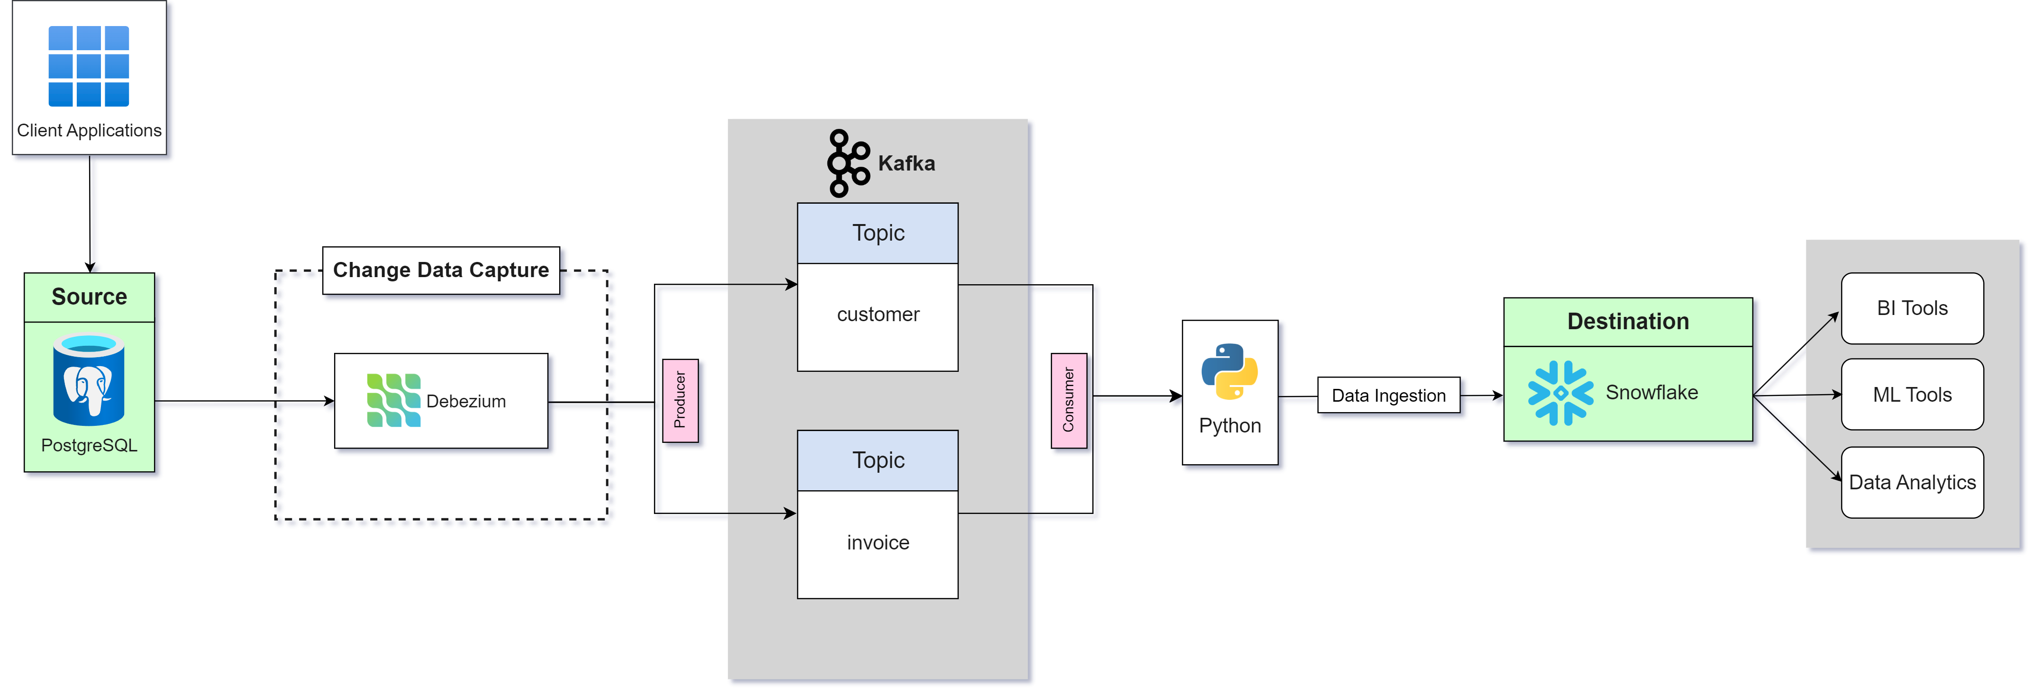
architecture Diagram

Slide 6
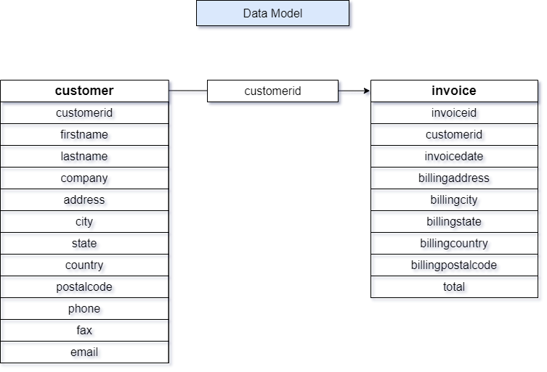

Slide 7
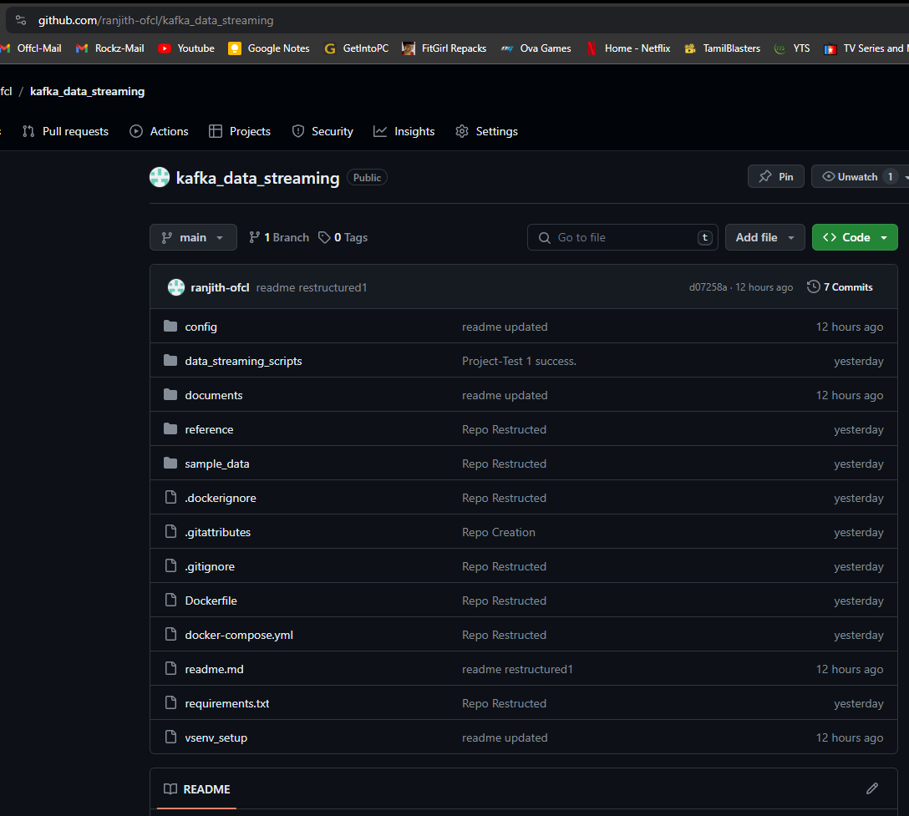
Project Walkthrough
Github:
Starting with Github, we have our project stored in the repository, https://github.com/ranjith-ofcl/kafka_data_streaming

Slide 8
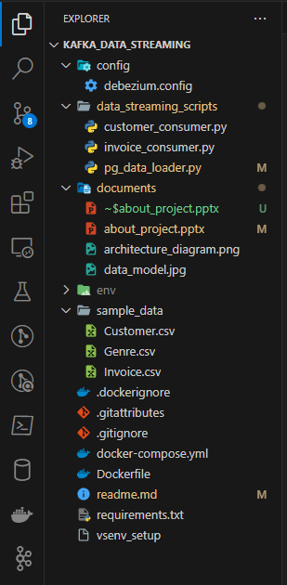
Code
Config – debezium.config This file has the connection configuration of Debezium with PosgreSQL
Data_streaming_scripts This folder contains the python scripts to initiate Kafka consumers (customer_consumer.py and invoice_consumer.py), and a script to load data from csv file to PostgreSQL
Sample_data This folder contains our sample csv files ready to load.
Docker-compose.yaml Docker image and docker container configurations are enlisted here.
Requirements This file contains the information about required technologies, packages for this project

Slide 9
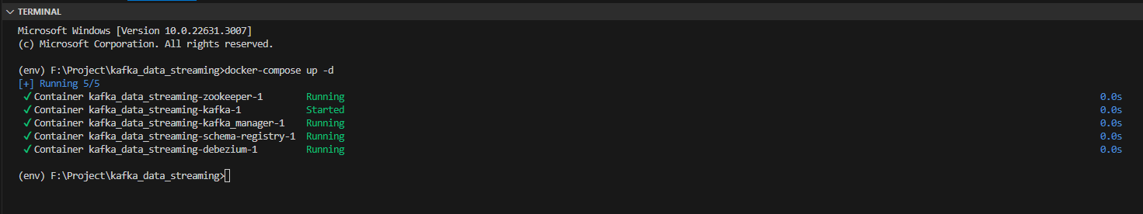
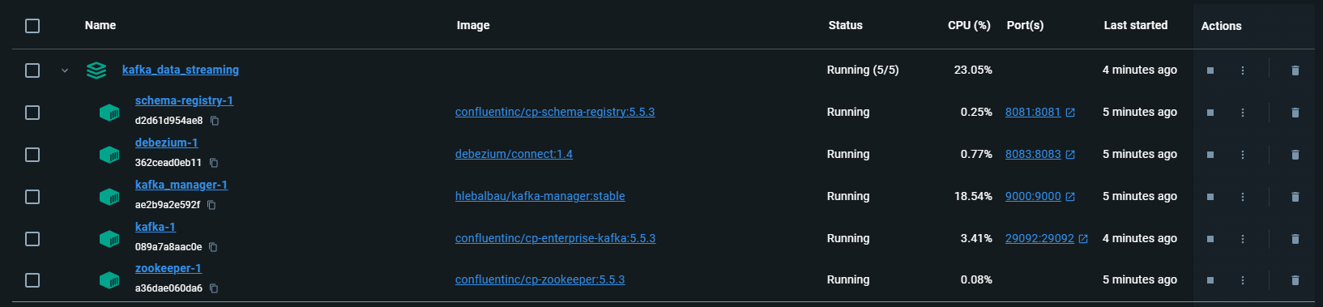
Start Docker
make sure the container is up and running
We can also make sure the ports of our images

Slide 10
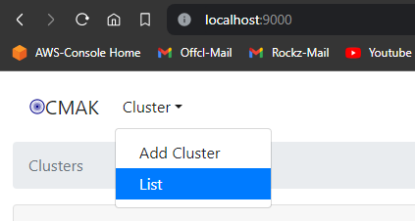
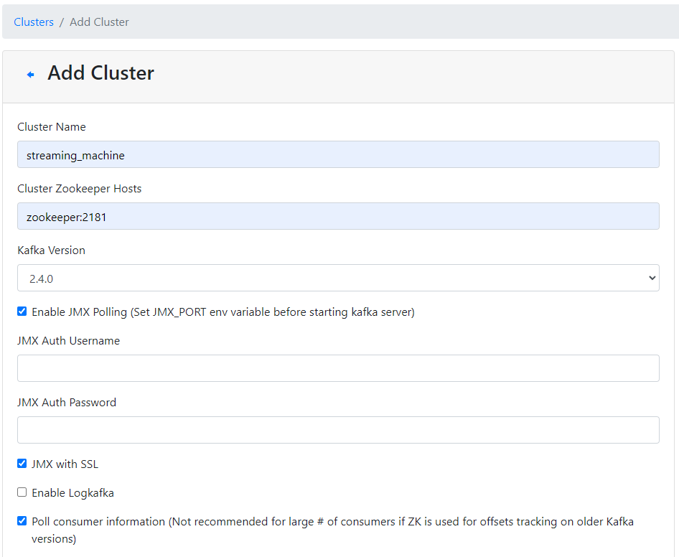
Environment walkthrough
1. Kafka cluster creation
Visiting “localhost:9000” on our browser
Clicking on “Add Cluster” to add a cluster
Naming our cluster as “streaming_machine”
Setting cluster zookeeper hosts as “zookeeper:2181” as our zookeeper is running on port localhost:2181
Enabling JMX polling to poll the consumer messages
Enabling “Poll consumer information” to obtain the current offset information.

Slide 11
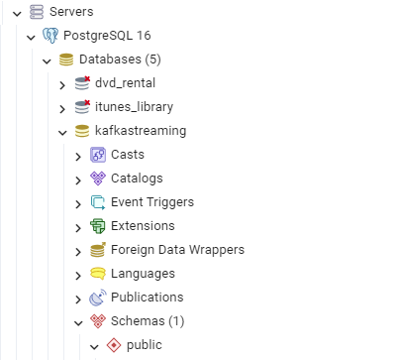
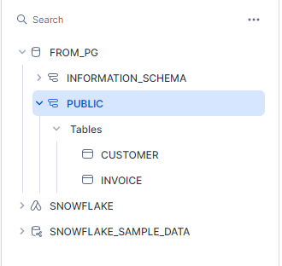
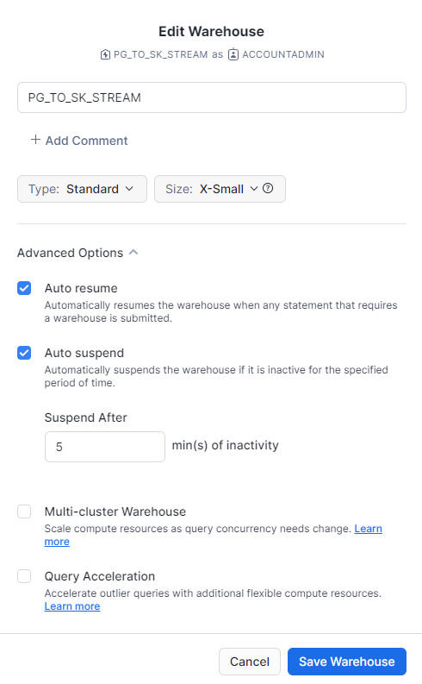

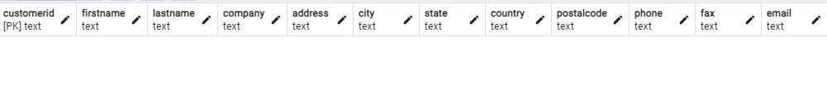
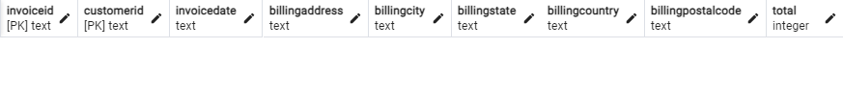
2. Database setup
PostgreSQL | Snowflake
No data
No data

Slide 12
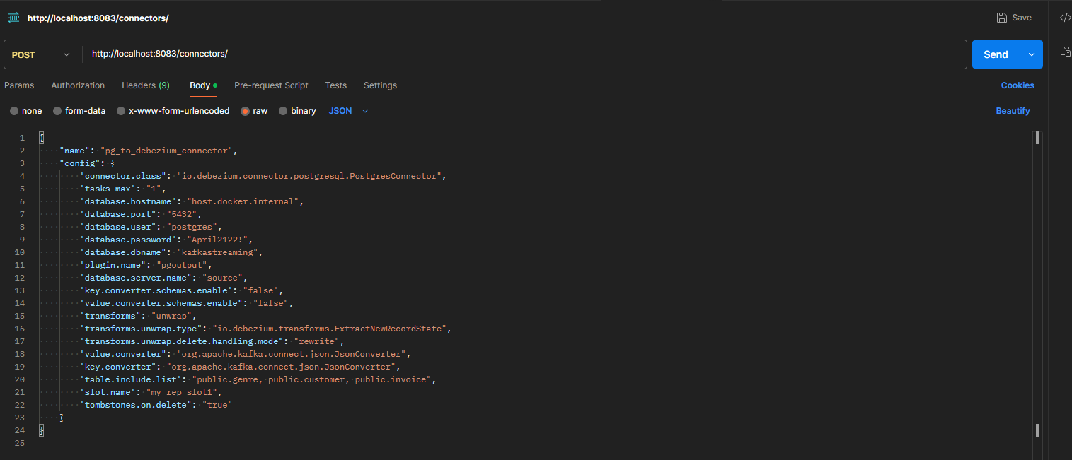
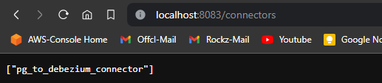
3. Debezium connection setup
We are using the Postman application to do a RestAPI creation in post method to the port “localhost:8083/connectors” where our debezium is currently running

Slide 13
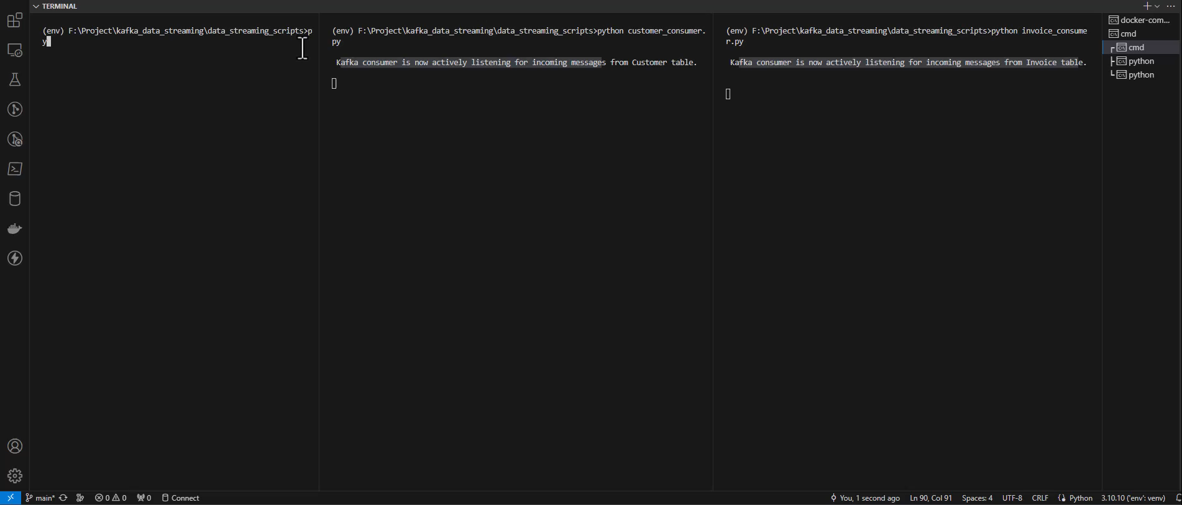
4. Running the Script
We are starting the kafka scripts to let kafka listen for messages from consumer (PostgreSQL table transactions).
If there is a transaction made to tables (insert or update or delete), kafka will capture the message and our script will decode the message and do the same transaction to our Snowflake table

Slide 14
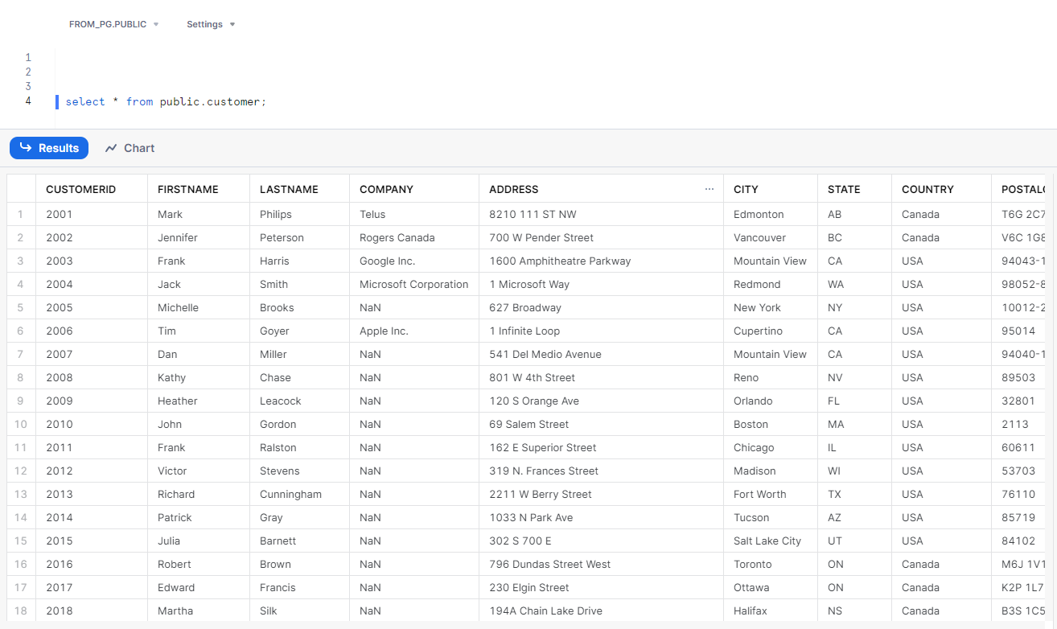
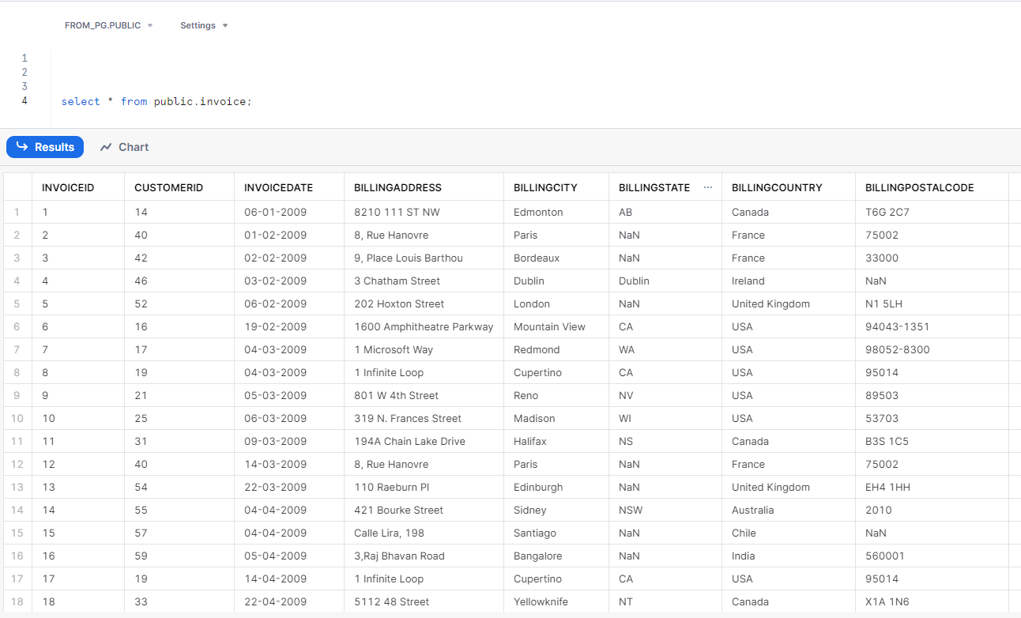
5. Checking the data in Snowflake
As we have did some transactions in PostgreSQL by running a python script, kafka captured those changes and our consumer python scripts made the same transactions to our Snowflake tables.

Slide 15
conclusion
We have demonstrated a successful implementation of a real-time data streaming pipeline from PostgreSQL to Snowflake using Kafka. By integrating various technologies and containerizing the environment with Docker, we have created a scalable and efficient solution for handling real-time data ingestion and processing.

Slide 16
Project Link
https://github.com/ranjith-ofcl/kafka_data_streaming

