Slide 1
How Covid 19 impacts studies
Key questions
1. How has the COVID-19 pandemic affected your academic performance?
2. Were online classes effective for your learning process ?
3. Did you experience feelings of loneliness during the lockdowns?
4. Did the pandemic limit your participation in extracurricular activities?
5. Did the pandemic increase your stress or anxiety levels?
6. Did your institution provide sufficient support for adapting to online learning?

Slide 2
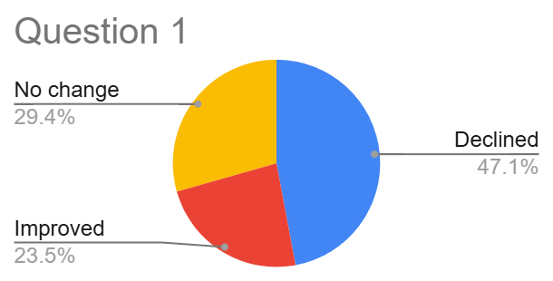
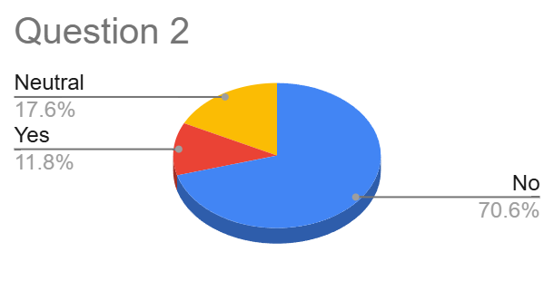
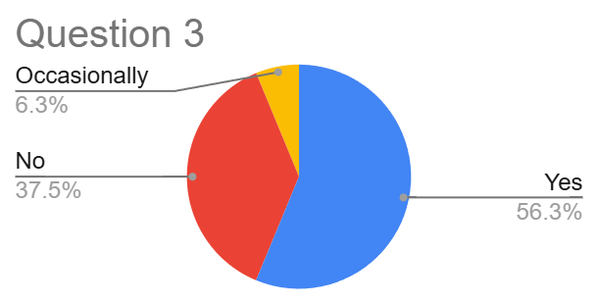
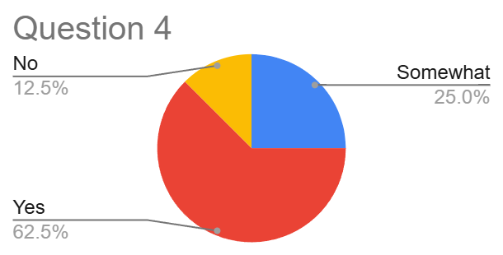
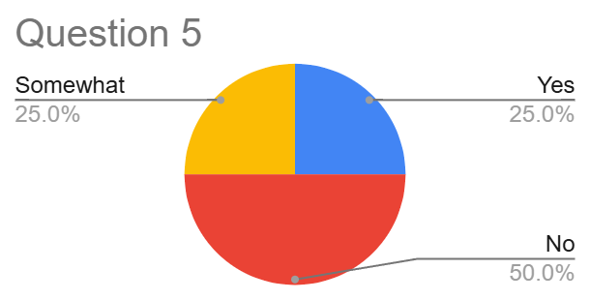
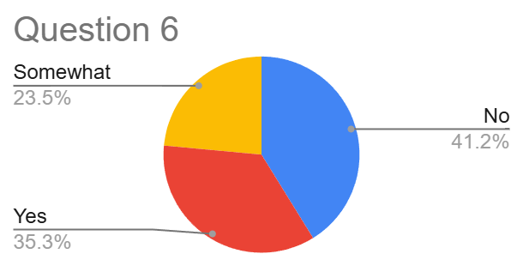
Survey results

