Slide 1
CMPE 275 - Term Project
SurveyApe
Team Members(Group-14)
Anjana Pradeep
Divya Thazhathethil
Rajeshri Sonwane
Ujjval Soni

Slide 2
Introduction
Created SurveyApe using Spring Boot, MySQL, React
Created Model-View-Controller application
Allows user to signup to create a survey
Allows surveyees to take a survey using participation link
Supports creation of text, dropdown, radio, star rating, checkbox type of questions
Sends invitation mails and confirmation mail
Provides surveyor with stats of surveys created by him

Slide 3
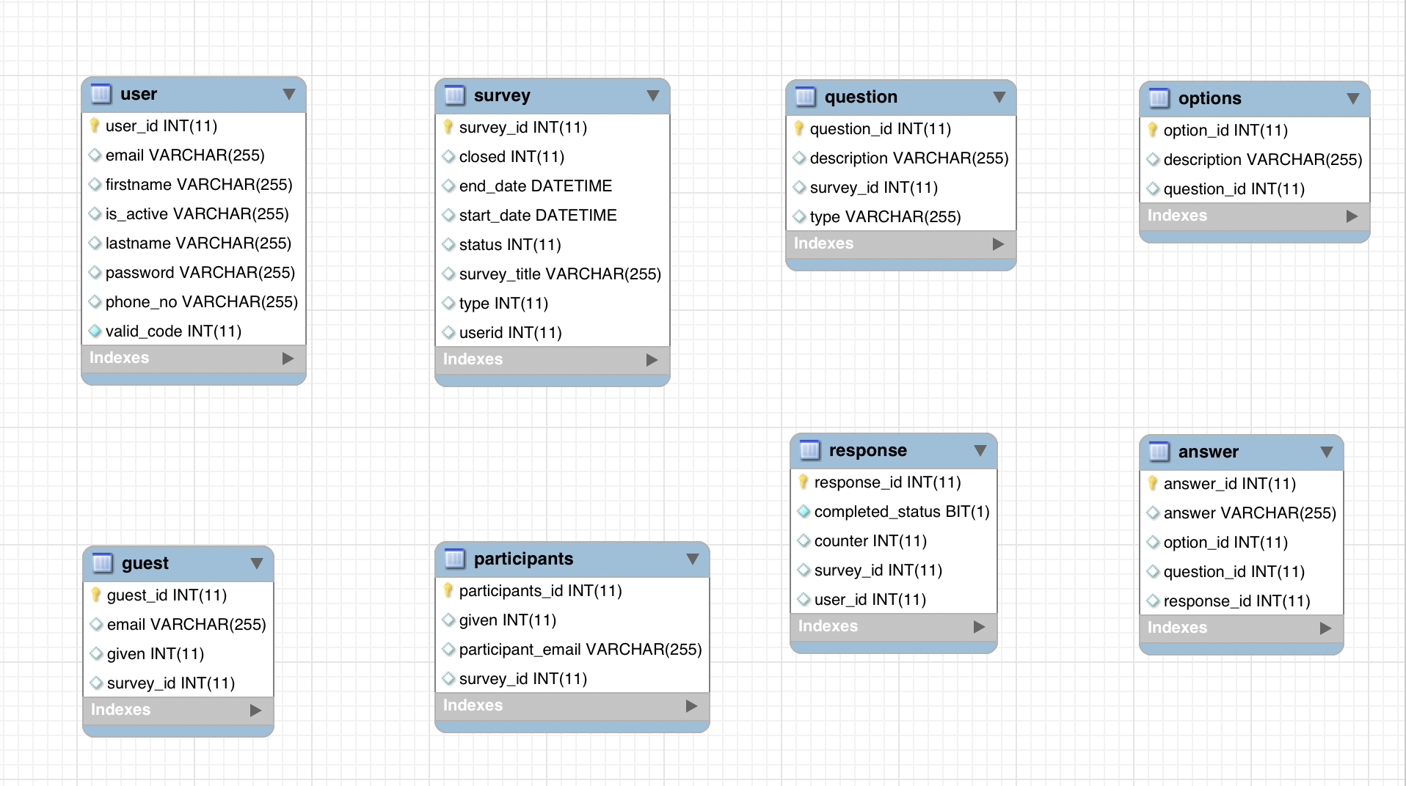
Data Model

Slide 4
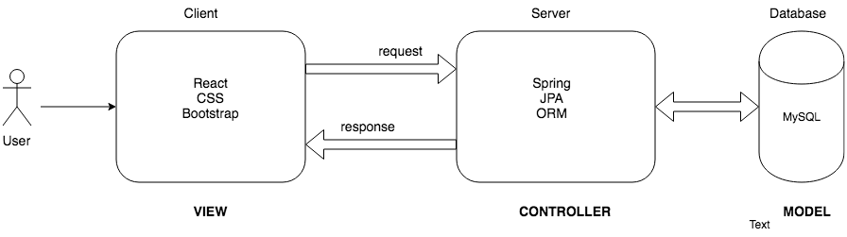
High Level Design

Slide 5
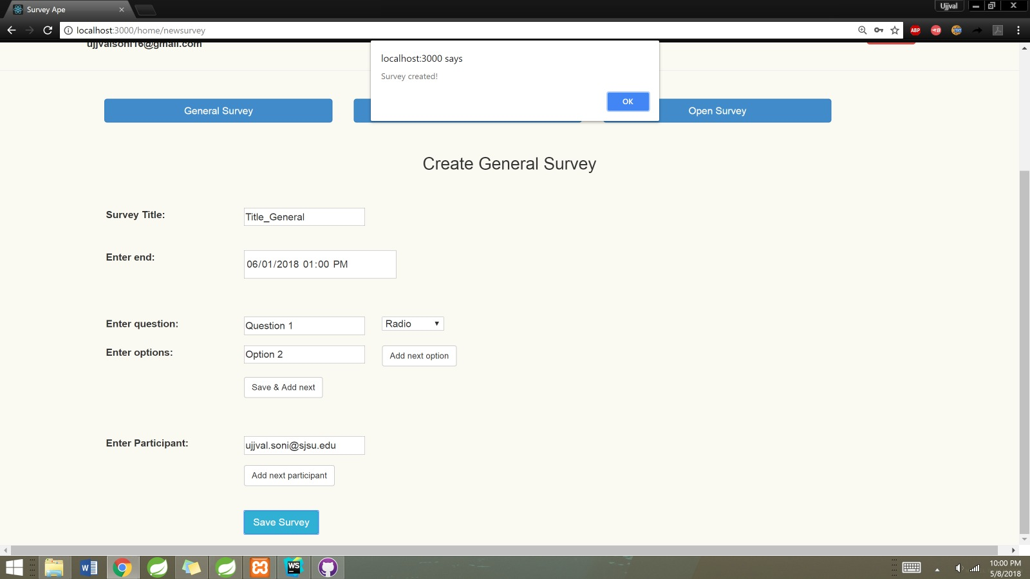
Features
Create/Edit Survey (General, Closed, Open)

Slide 6
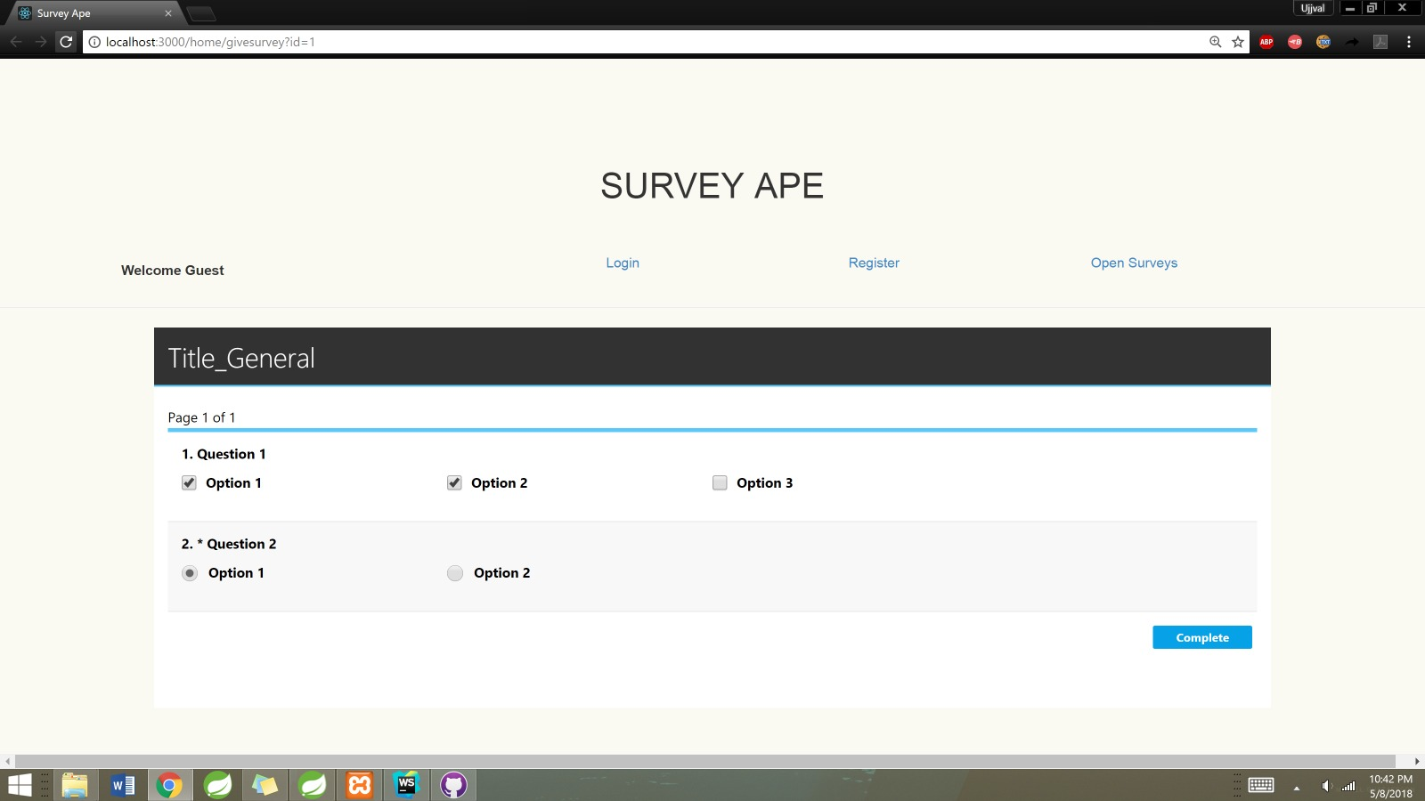
Give Survey

Slide 7
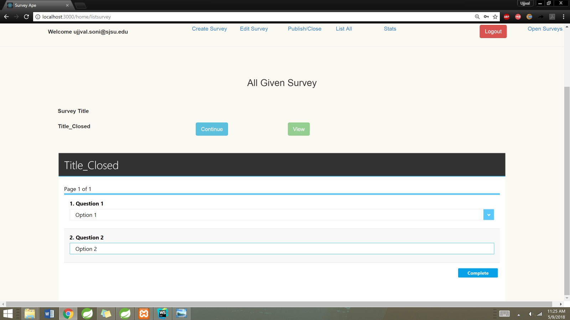
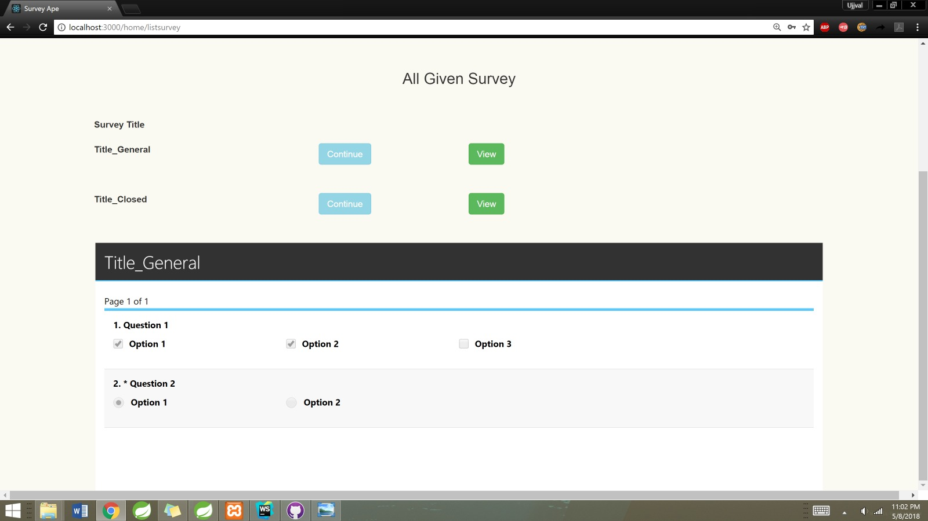
Continue Incomplete Surveys / View Completed Survey

Slide 8
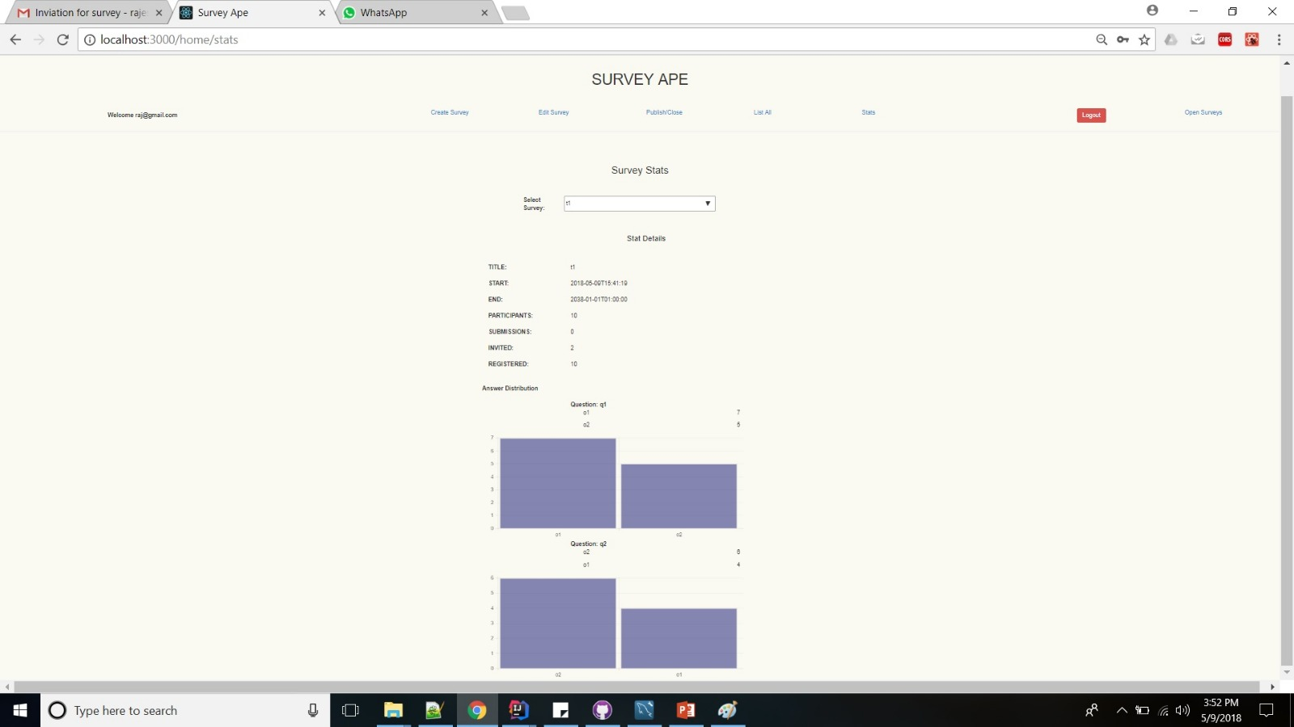
Survey Stats

