Slide 1

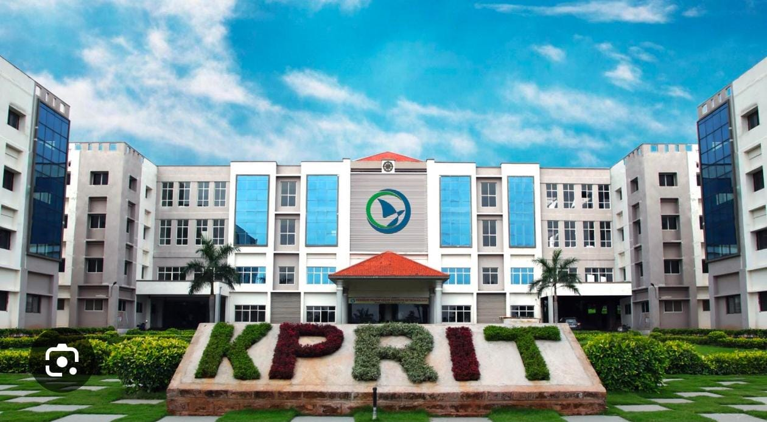
KOMMURI PRATAP REDDY
INSTITUTE OF TECHNOLOGY
Department of Computer Science & Engineering
MAJOR PROJECT REVIEW
IV B.Tech – CSE | A.Y. 2026 – 2027
PROJECT TITLE
A Decentralized Blockchain and Agentic AI Framework for Proactive Insider Threat Detection in Examination Systems
GUIDE
SECTION
TEAM
Mrs.V.Sowjanya
IV-I CSE – B
4 Members
REVIEW
27-10-2026

Slide 2
Team Details
None
S. No.
Name
Roll No.
Role / Responsibility
1
K.Rajeshwari
23RA11A05A9
AI Developer
2
A.Ranadeep
23RA1A05B3
Backend Developer
3
B.Manikanta
23RA1A0575
Frontend Developer
4
V.Manodeesh
23RA1A0579
Testing & Security
PROJECT GUIDE
SECTION
Mrs.V.Sowjanya [Assistant Professor]
B
Department of Computer Science & Engineering | KPRIT | A.Y. 2026–2027

Slide 3
1. Project Title
1
A Decentralized Blockchain and Agentic AI Framework for Proactive Insider Threat Detection in Examination Systems
DOMAIN
[AI / ML & Cybersecurity ]
Department of Computer Science & Engineering | KPRIT | A.Y. 2026–2027

Slide 4
2. Abstract
2
Examination systems face security risks such as unauthorized access, question paper leakage, impersonation, data manipulation, and misuse of privileged accounts. These threats can affect the integrity, fairness, and reliability of examinations.
This project proposes a Decentralized Blockchain and Agentic AI Framework for Proactive Insider Threat Detection in Examination Systems. The system uses Agentic AI to continuously monitor user activities, analyze behavior patterns, identify anomalies, and predict potential insider threats. Blockchain technology securely records important examination activities in a tamper-resistant and decentralized ledger.
The framework provides proactive threat detection, secure data storage, real-time alerts, transparency, and accountability. By combining intelligent behavioral analysis with blockchain-based security, the proposed system aims to prevent insider attacks before major incidents occur and provide a secure, fair, reliable, and trustworthy digital examination environment.
ABSTRACT
Department of Computer Science & Engineering | KPRIT | A.Y. 2026–2027

Slide 5
3. Problem Statement
3
Current Issue: Examination systems are vulnerable to insider threats such as unauthorized access, question paper leakage, data manipulation, and misuse of privileged accounts.
Why It Is Important: Such threats can compromise examination security, fairness, confidentiality, and data integrity.
Who Is Affected: Students, faculty, examination administrators, and educational institutions are affected by security breaches and fraudulent activities.
Existing Gap: Traditional security systems mainly detect threats after incidents occur and lack proactive behavioral analysis and tamper-proof activity records. A combined Agentic AI and Blockchain-based solution is needed for early threat detection and secure examination management.
?
Department of Computer Science & Engineering | KPRIT | A.Y. 2026–2027

Slide 6
4. Objectives
4
OBJECTIVE 01
OBJECTIVE 02
Develop an Agentic AI system to continuously monitor examination activities and detect suspicious user behavior.
Implement Blockchain technology to securely store examination activities and maintain tamper-resistant records.
OBJECTIVE 03
OBJECTIVE 04
Enable proactive insider threat prediction by analyzing user behavior, access patterns, and abnormal activities.
Provide real-time alerts and transparent threat tracking to help examination administrators respond quickly to potential security incidents.
Department of Computer Science & Engineering | KPRIT | A.Y. 2026–2027

Slide 7
5. Scope
5
✓ IN SCOPE
✕ OUT OF SCOPE / FUTURE WORK
Agentic AI for continuous monitoring of examination activities.
Insider threat detection and prediction using user behavior analysis.
Blockchain-based secure and tamper-resistant activity records.
Real-time alerts for suspicious or unauthorized activities.
Integration with large-scale national examination systems.
Advanced biometric and facial recognition features.
Fully automated legal or disciplinary actions against users.
Integration with external government or third-party databases.
Department of Computer Science & Engineering | KPRIT | A.Y. 2026–2027

Slide 8
6. Literature Survey
6
Paper / Year
Approach / Key Finding
Limitation / Gap
Deltrux: Insider Threat Detection of End-User Behavior Analysis Using Machine Learning (2024)
Uses machine learning and user behavior analysis to detect abnormal activities and insider threats in real time.
Focuses mainly on enterprise endpoints and does not address examination-specific threats or blockchain-based evidence.
DTITD: Intelligent Insider Threat Detection Framework (2023)
Uses Digital Twin, deep learning, BERT/RoBERTa, and temporal user-behavior analysis for insider threat detection.
Complex architecture and mainly focused on organizational environments rather than examination systems.
An Advanced and Secure Framework for Conducting Online Examination Using Blockchain (2022/2023)
Uses blockchain to secure online examination data, question delivery, and examination records against tampering and cheating.
Provides blockchain-based security but lacks proactive AI-driven insider threat prediction.
ExamGuard: Smart Contracts for Secure Online Test (2025)
Combines smart contracts, blockchain, PoseNet, and object detection to monitor examination activities and securely store evidence.
Focuses on exam monitoring and evidence storage but does not provide an agentic AI framework for predicting insider threats.
Existing studies separately address insider threat detection or blockchain-based examination security. Our project integrates Agentic AI for proactive insider threat prediction with decentralized Blockchain for tamper-resistant, transparent, and traceable examination records.
Department of Computer Science & Engineering | KPRIT | A.Y. 2026–2027

Slide 9
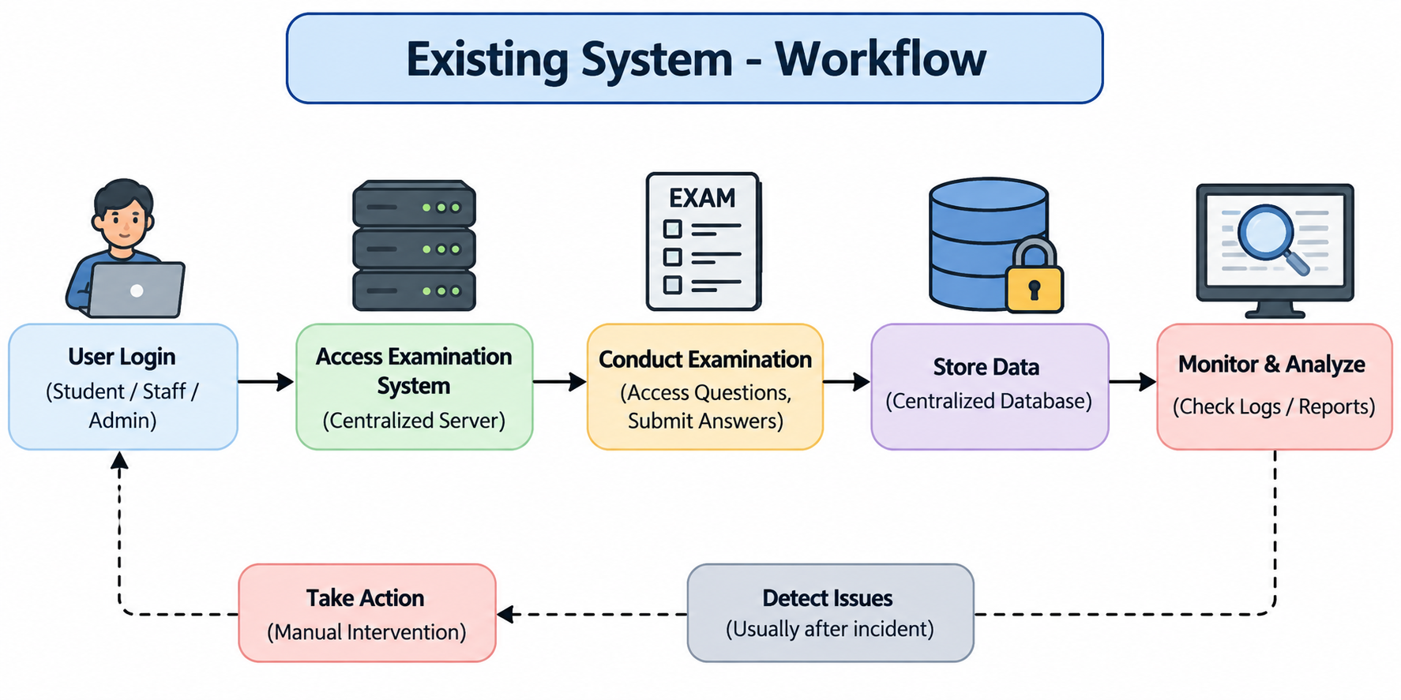
7. Existing System
7
Traditional Examination Security: Uses centralized servers, passwords, and access controls to protect examination data.
Basic Monitoring: Exam activities are monitored using login records, access logs, and conventional proctoring methods.
Threat Detection: Suspicious activities are generally identified after an incident occurs, with limited behavioral prediction.
Major Limitations: Centralized storage can be vulnerable to data manipulation, unauthorized access, and single-point failures, while existing systems lack integrated Agentic AI and decentralized Blockchain for proactive insider threat detection.
IDEA
Department of Computer Science & Engineering | KPRIT | A.Y. 2026–2027

Slide 10
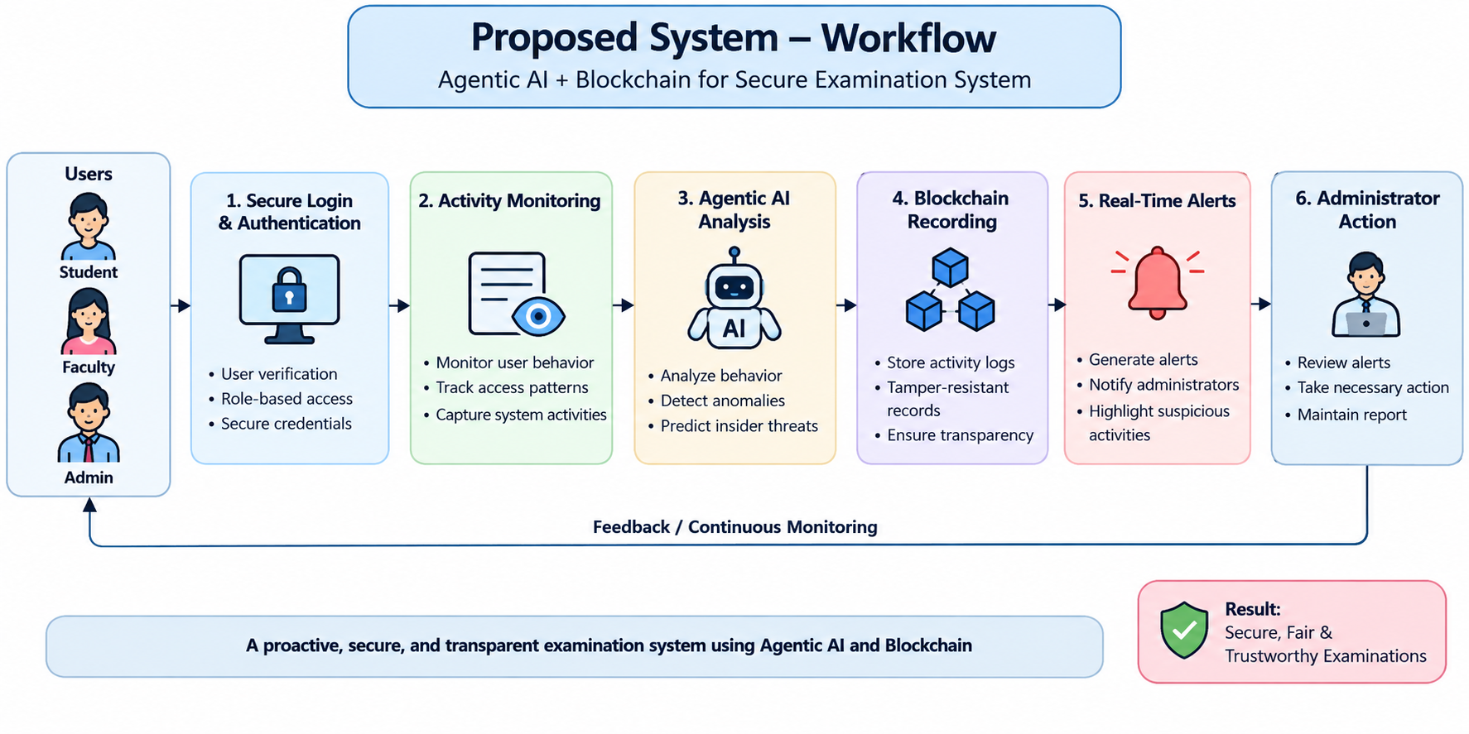
7. Proposed System
7
Proposed Solution: A decentralized framework combining Agentic AI and Blockchain to proactively detect and prevent insider threats in examination systems.
Key Features / Modules: Behavior Monitoring, AI Threat Prediction, Blockchain-Based Secure Logging, and Real-Time Alerts.
Advantages: Provides early threat detection, tamper-resistant records, transparency, accountability, and improved examination security.
Innovation / Unique Contribution: Integrates autonomous Agentic AI with decentralized Blockchain to predict suspicious behavior and maintain a trustworthy chain of examination activities.
IDEA
Department of Computer Science & Engineering | KPRIT | A.Y. 2026–2027

Slide 11
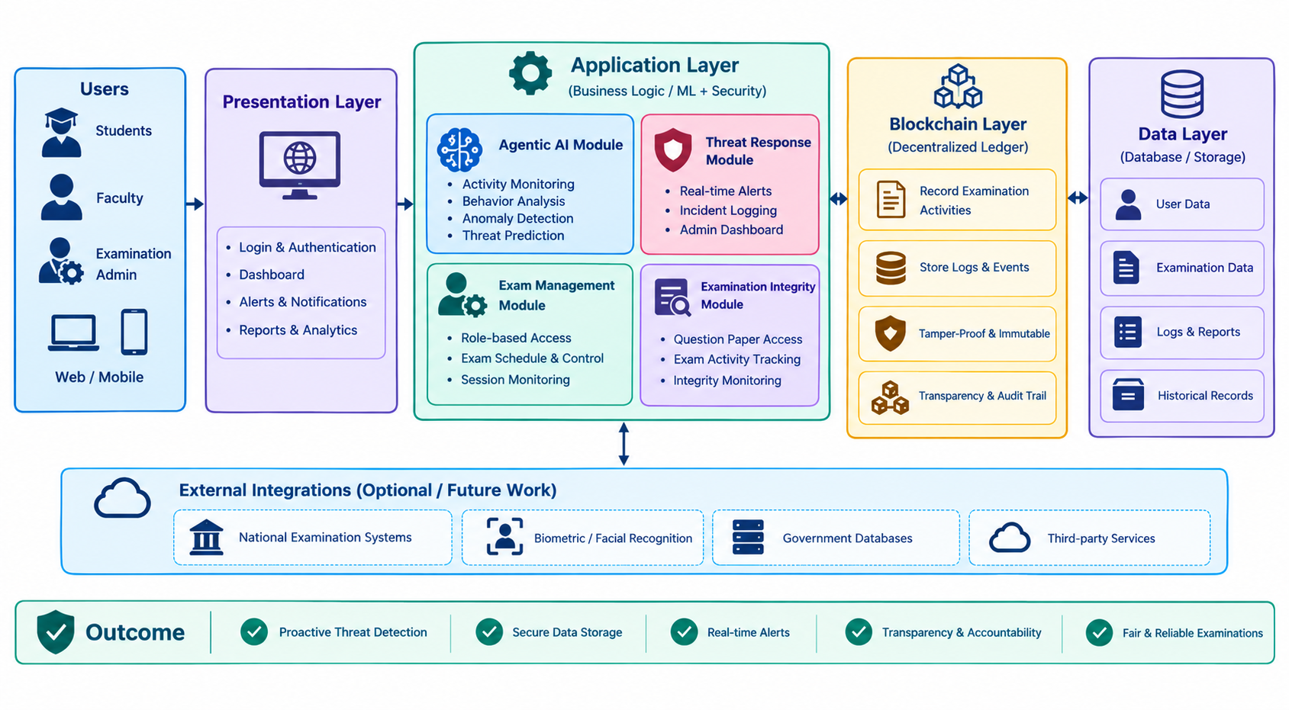
8
7
8. System Architecture
High-level architecture — customize module names to the approved project
Department of Computer Science & Engineering | KPRIT | A.Y. 2026–2027 • 8

Slide 12
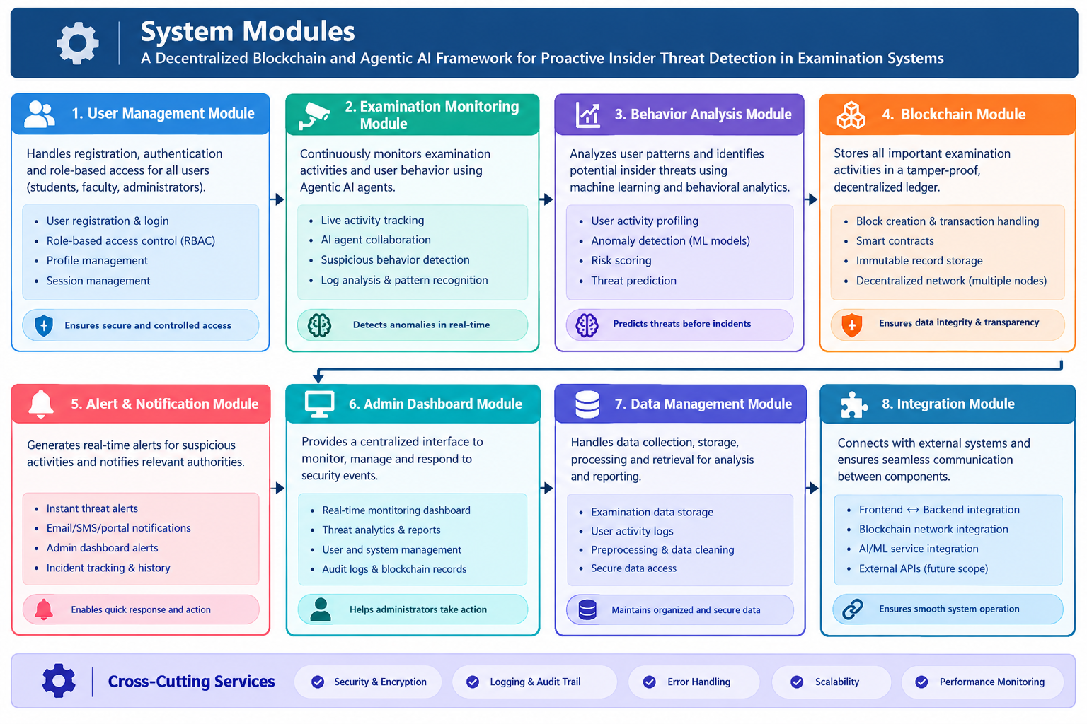
9. Modules
9
Modules
Data
Department of Computer Science & Engineering | KPRIT | A.Y. 2026–2027

Slide 13
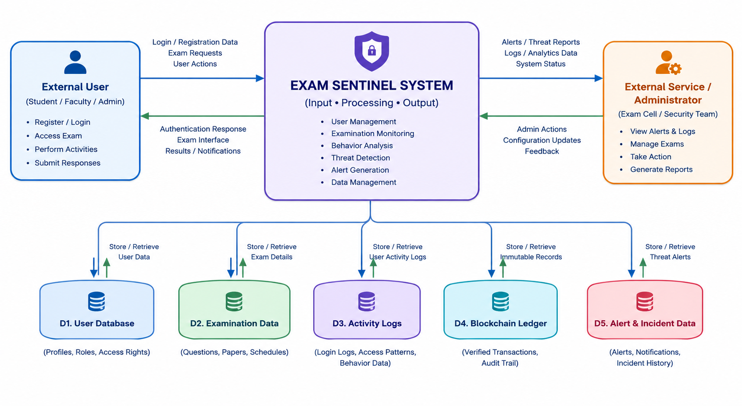
10
9. Data Flow Diagram — Level 0
Context-level view of the complete system
Department of Computer Science & Engineering | KPRIT | A.Y. 2026–2027

Slide 14
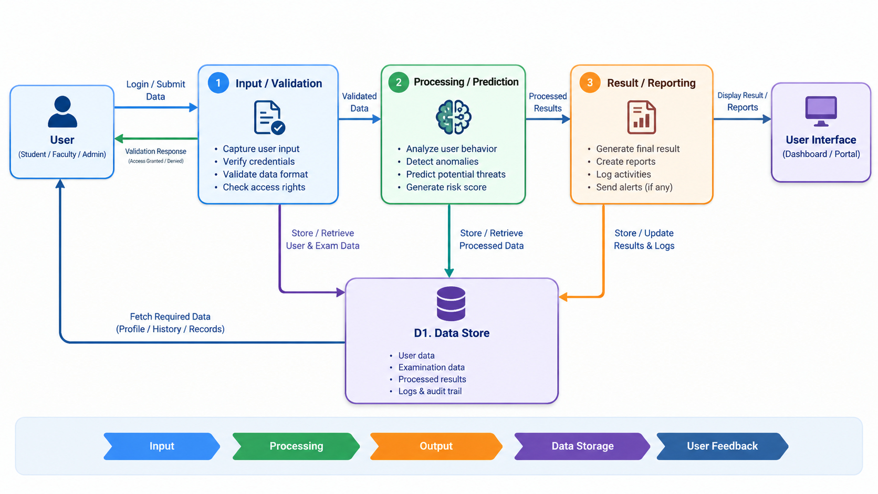
11
10. Data Flow Diagram — Level 1
Detailed decomposition of the main system process
Department of Computer Science & Engineering | KPRIT | A.Y. 2026–2027

Slide 15
12
11. References
Use project-specific papers, datasets, frameworks, standards, and official documentation
[1]
A Review of Recent Advances, Challenges, and Opportunities in Malicious Insider Threat Detection Using Machine Learning Methods. IEEE Access, vol. 12, pp. 30907–30927, 2024.
[2]
“An Advanced and Secure Framework for Conducting Online Examination Using Blockchain Method.” Cyber Security and Applications, vol. 1, article 100005, 2023
[3]
Software Engineering Institute, Carnegie Mellon University, “Insider Threat Test Dataset,” November 28, 2016.
[4]
Hyperledger Fabric Documentation, “A Blockchain Platform for the Enterprise.”
[5]
Scikit-learn Developers, “Scikit-learn: Machine Learning in Python — User Guide.”
Department of Computer Science & Engineering | KPRIT | A.Y. 2026–2027

Slide 16

KOMMURI PRATAP REDDY
INSTITUTE OF TECHNOLOGY
DEPARTMENT OF COMPUTER SCIENCE & ENGINEERING
K.Rajeshwari
Thank You
A.Ranadeep
For Your Valuable Attention
B.Manikanta
Guide: Mrs.V.Sowjanya • Section: B • Review-II
IV B.Tech CSE | A.Y. 2026–2027
V.Manodeesh

