Slide 1
Y.Rajeshwari
keylogger and security system
3/21/2024 Annual Review

Slide 2
PROJECT TITLE:
keylogger and security system
3/21/2024 Annual Review

Slide 3
AGENDA:
•Introduction to keylogger
•Problem statement
•Project overview
•End users
•Modelling
•Result
3/21/2024 Annual Review

Slide 4
Introduction :
A keylogger in cybersecurity is a type of software or hardware that is designed to record every keystroke you make on your computer or device. This means it can capture sensitive information like passwords, credit card numbers, or messages you type.
keyloggers can be used for both legitimate and malicious purposes. Legitimate uses include monitoring children's online activities or employee computer usage. However, cybercriminals can use keyloggers to steal personal information, financial details, or login credentials.
To protect yourself from keyloggers, you can use antivirus software, be cautious of clicking on suspicious links or downloading unknown files, and consider using virtual keyboards for sensitive information entery.
3/21/2024 Annual Review

Slide 5
PROBLEM STATEMENT
1.Privacy concerns:
Keyloggers raise significant privacy issues as they can capture sensitive information like passwords, personal messages, and financial details without the user's consent, leading to potential breaches of privacy and confidentiality .
2.Security risks:
Keyloggers pose security risks by potentially exposing confidential data to unauthorized individuals. If the captured keystrokes include login credentials or other sensitive information, it can result in identity theft, financial loss, or unauthorized access to accounts.
3.Detection challengers:
Keyloggers can be challenging to detect as they often operate stealthily in the background without the user's knowledge. Advanced keyloggers may evade traditional antivirus software, making it difficult for users to identify and remove them from their systems.

Slide 6
PROJECT OVERVIEW
1.Project Title:
•keylogger and security system
2.Project objective:
•To develop a comprehensive key logging system with robust security
3/21/2024 Annual Review

Slide 7
End users of this system :
1. Individuals monitoring own computer use.
2. Parents tracking kids' online behavior.
3. Employers watching over employees.
4. Organizations boosting cybersecurity.
5. Law enforcement for investigations.
6. Schools monitoring student activities.
7. Individuals for productivity.
3/21/2024 Annual Review

Slide 8
SOLUTION AND ITS VALUE PROPOSITION
1.Antivirus software:
Using reputable antivirus software helps detect and remove keyloggers, ensuring the security and privacy of personal information.
2.Education:
Educating individuals on safe online practices helps prevent keylogger installation, reducing the risk of unauthorized monitoring.
3.Multi factor authentication:
Implementing multi-factor authentication for accounts adds an extra layer of security, making it harder for keyloggers to compromise sensitive information.
4.Legal guidance:
Seeking legal advice ensures the permissible use of keyloggers, helping individuals and organizations comply with relevant laws and regulations.
3/21/2024 Annual Review

Slide 9
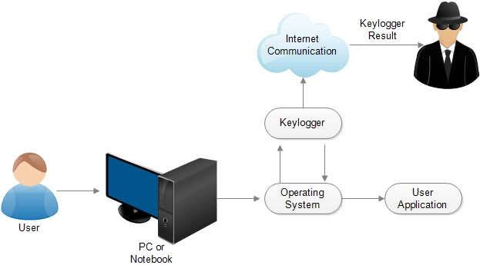
MODELLING
3/21/2024 Annual Review
9

Slide 10
RESULTS
Detection and Prevention:- 1. Antivirus and Anti-malware Software: 2. Behavioral Analysis Tools: 3. Anti-Keylogging Software
Security Measures:-
1. Software Updates: 2. Strong Password Policies: 3. User Education:
3/21/2024 Annual Review
10

Slide 11
PROJECT RESOURCES :
https://github.com/Rajeshwari14343/Rajeshwari.git

