Slide 1



WEBSITE FOR LOYALO SCHOOL
PROJECT MEMBERS
RAJESWARI M - 23ITR125
YUVARAJ B - 22ITR182
(19ITR014)
PROJECT GUIDE
MR D.VIJAY ANAD
Associate Professor(SLG)/Department of IT
Kongu Engineering College

Slide 2
Problem Statement
Many schools still use outdated or basic websites that fail to clearly communicate their vision, curriculum, and student development initiatives. This makes it difficult for parents and stakeholders to access relevant information and understand the school’s strengths. Therefore, there is a need for a modern, user-friendly, and visually appealing website that effectively represents the school’s identity and supports better communication.

Slide 3
OBJECTIVE
To develop a modern and professional school website that highlights the institution’s focus on future-ready education, leadership, and holistic student development. The platform will clearly communicate the school’s philosophy, curriculum, activities, and facilities to parents, students, and stakeholders. It will also strengthen the school’s brand presence through a user-friendly and visually engaging digital experience.

Slide 4
COMPANY DETAILS
Company Name:
LOYALO SCHOOL
Owner:
Address:
Contact:

Slide 5
TECHNOLOGY STACK
Frontend:
React Vite – Used for building a fast and optimized frontend environment
JavaScript – Used for implementing interactive functionality and logic
Backend:
PostgreSQL – Used as the database for secure and efficient data storage
Tools:
Visual Studio Code – Used as the primary development environment
Git – Used for version control and source code management

Slide 6
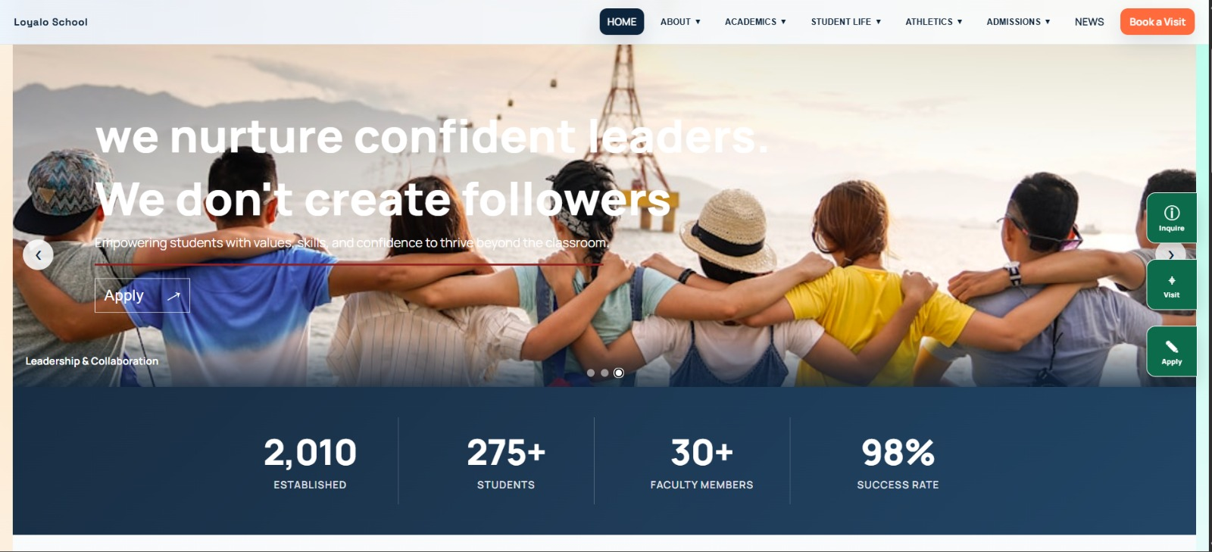
Frontend Development

Slide 7
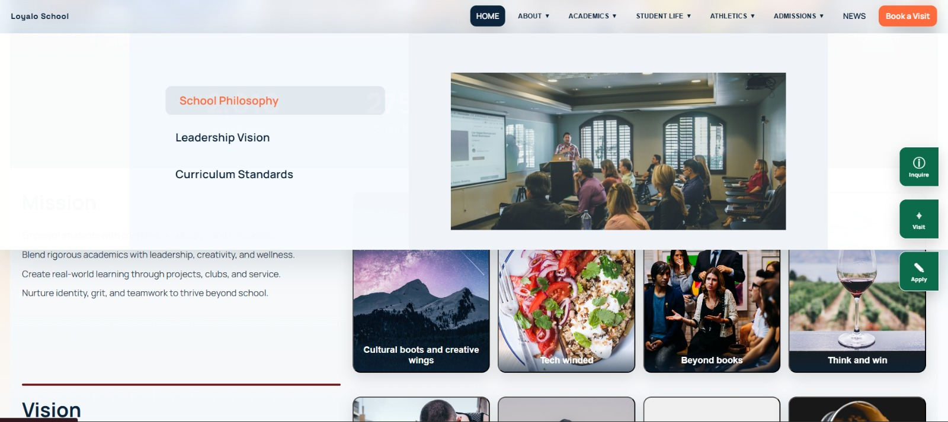
Frontend Development

Slide 8
API REFERENCES
The system uses RESTful APIs built with Node.js and Express.js to manage communication between the frontend and backend.
APIs handle core operations such as authentication and CRUD-based data management.
All endpoints follow standard HTTP(GET,PUT,DELETE,POST), methods and return JSON responses for consistency.
Proper error handling and status codes are implemented to ensure secure and reliable request processing

Slide 9
THANK YOU!

