Slide 1
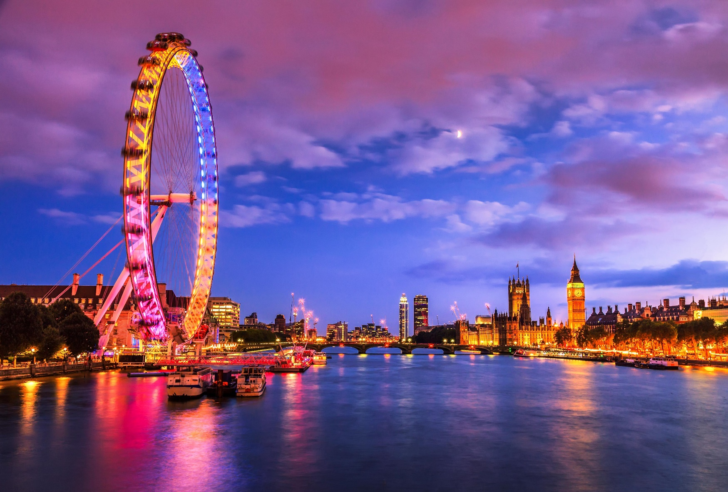
City of London
Traveler's guide for Online Travel Agencies
By,
Rajeswaran Srinivasan

Slide 2

Reason of choice
London being a top tourist destination in the world, the choice of selection of hotels becomes extremely important.
It is important the travelers enjoy the best comforts for relaxing and at the same time maximize the places of visits during their stay

Slide 3

Objective
To make use of the existing data against a city like London and suggest the best possible hotel to stay with and enjoy the city for both the travelers and the online travel agencies.

Slide 4
Approach and Data used
Foursquare API to get the list of hotels in and around the city of London
Dataset from data.London.gov.uk used to get the list of places around each borough
Rating and likes are also taken using the Foursquare API against each of the hotels for better suggestions
Rating/likes along with number of possible places of interests around each is considered for the selection of the best place to stay in the city

Slide 5
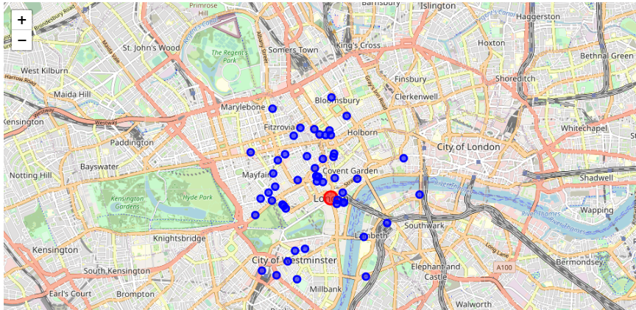
Results – Map of London showing hotels

Slide 6
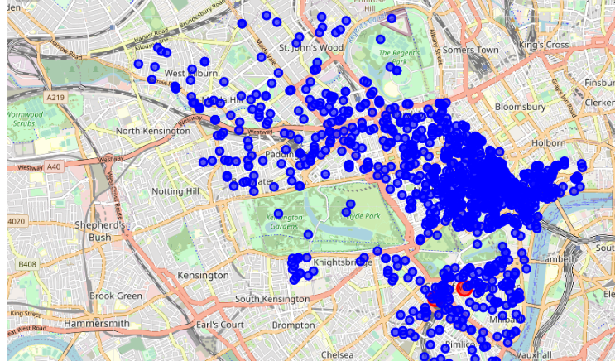
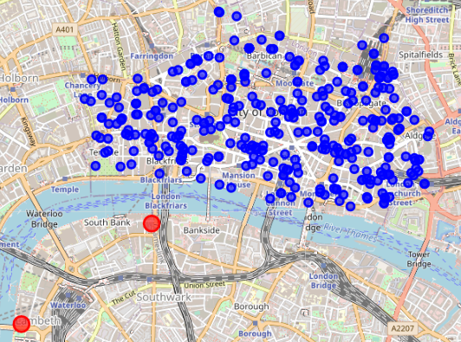
Results – Map of City of Westminster and City of London with hotels and places of interests
VS
City of Westminster
City of London

Slide 7
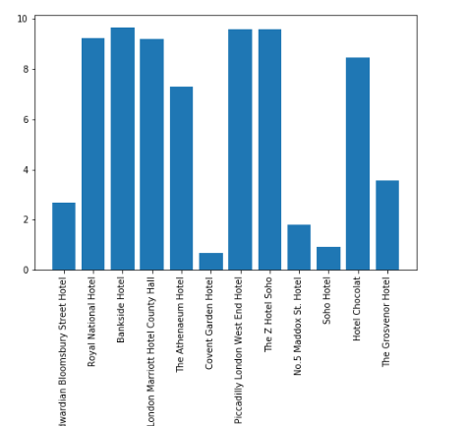
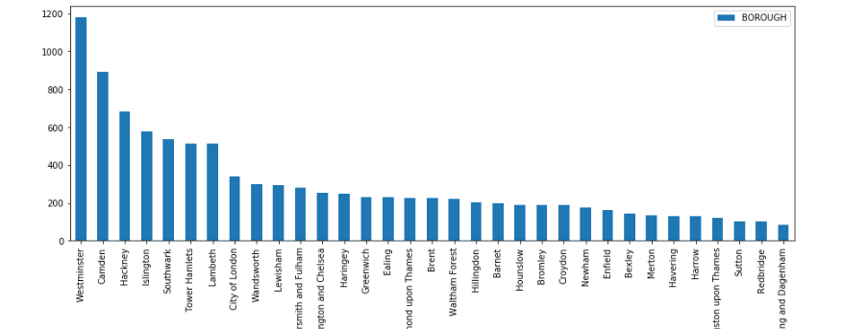
Results – Bar Charts showing the best hotels & boroughs with places of interest
Hotels vs Ratings
Boroughs vs Number of places of interest

Slide 8
Conclusion
Given the data used and analysis done, City of Westminster has the most places of interest for people visiting London.
Hence it is good, if the tourists or online travel agencies show the top rated hotels in and around the City of Westminster followed by the hotels from the City of London.
From the above maps, though City of London borough has places little far away from the best hotels in that place when compared with City of Westminster borough which has the places of interest surrounding the hotels, both can be shown to the users of this model, which gives them the chance to pick the best according to their preference of comfort and travel time.

Slide 9
THANK YOU!

