Slide 1
Assignment -1

Slide 2
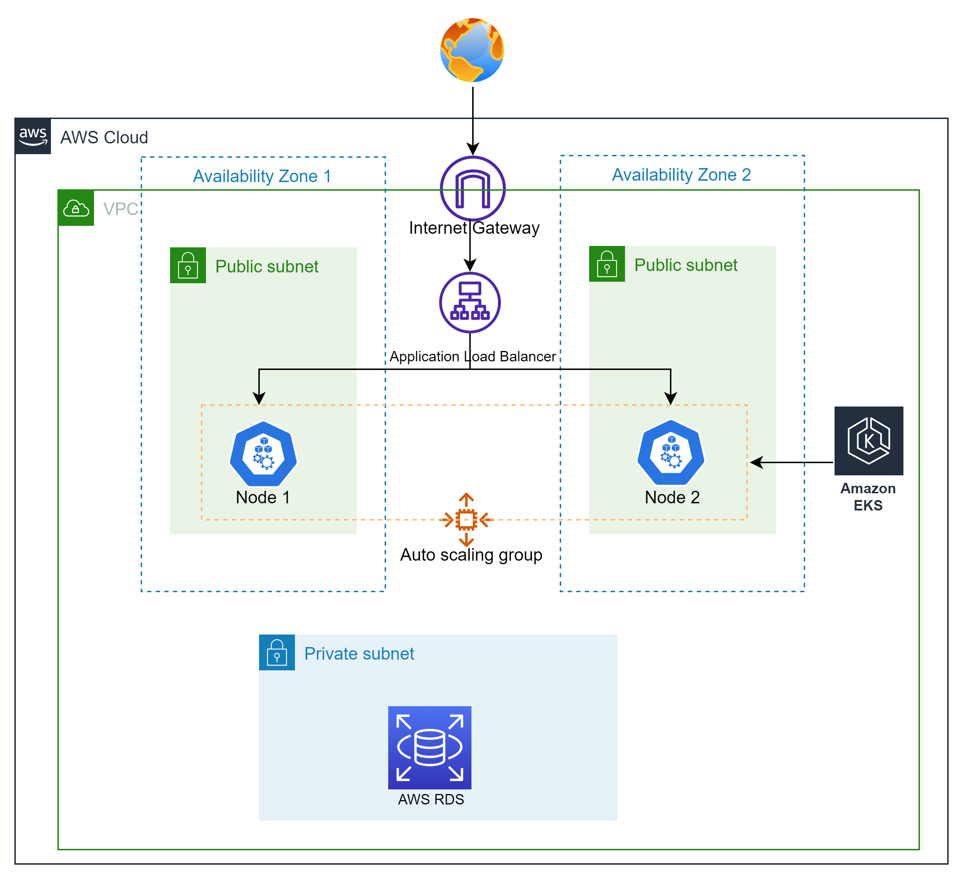
Infrastructure Architecture

Slide 3
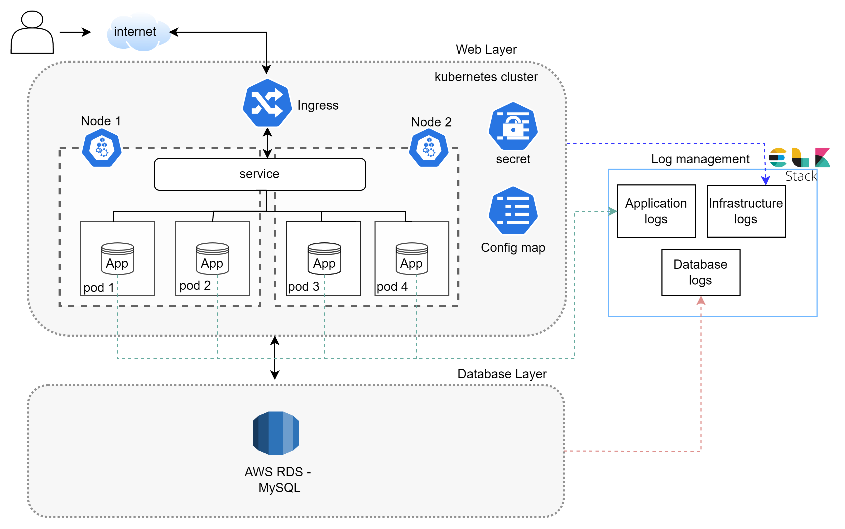
Application Architecture

Slide 4
Design Decision
Assumptions
Application is designed in AWS EKS cluster to provide high availability
With Kubernetes ingress, HTTP/HTTPS traffic will be handled
Firewall is configured to tighten security for database connection. In case web servers are hacked, database can't be connected directly
AWS Managed DB – MySQL database will be used for RDBMS
ELK (Elastic search, Logstash , Kibana) will be integrated with all components for log monitoring and alerting
Devops implementation with Sonarqube, Kubernetes, docker and Atlassian products - Jira , Bamboo , bitbucket
Infrastructure creation (node creation) is automated with Terraform.
Application scaling will be handled by Kubernetes based on pre-defined threshold
Cluster is designed with 2 worker nodes and 4 pods i.e., 2 pods/node
For managed services, patching and maintenance is controlled by AWS
Suggestions
Testing Type | Tool
Functional | Selenium
DAST | Fortify
Performance | Jmeter

Slide 5
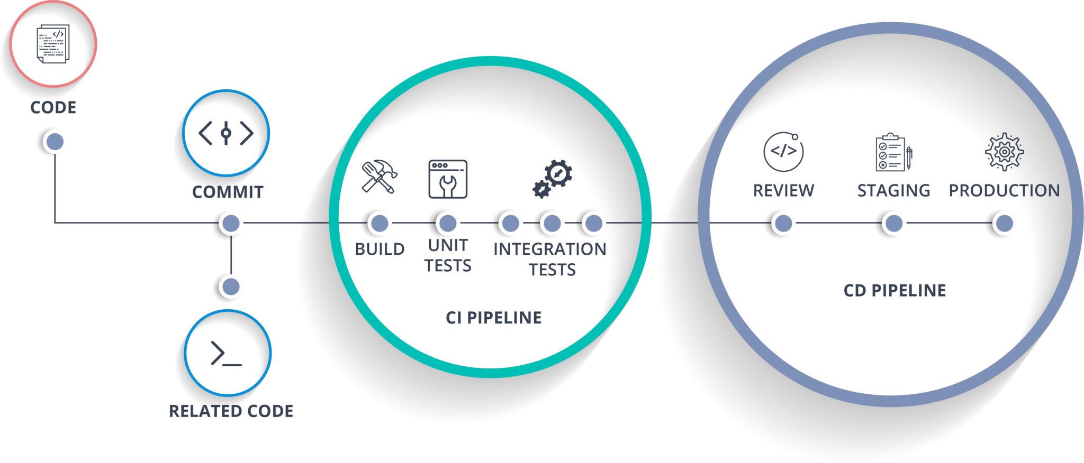
CI / CD
Version Control
Build
Unit test
Deploy
Automated test
Deploy to prod
Logging
Continuous Feedback

Slide 6







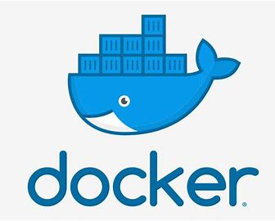


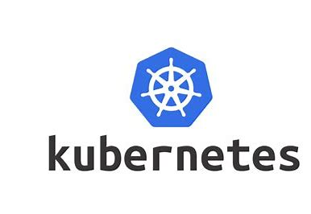





Deployment strategy
Test Deploy
Stage Deploy
Dev
Commit the code
Unit test
Functional Test
User Acceptance test
Code checkout
Artifact creation
Integration Test
Prod deploy
Build
Dev Deploy
DAST
Static code analysis
Developer Validates
Perf Test

Slide 7
CI/CD pipeline stages
Build plan
Code checkout
Build
Static code analysis
Unit testing
Docker build
Docker push
Commit the code
Trigger dev deployment plan
Prod deploy
Stage deploy
Test deploy
Dev deploy
Manual trigger
Conditional trigger
Conditional trigger
Deployment plan
Terraform plan
Terraform apply
Create resources in target
Commit terraform script
Build plan

Slide 8
Design Decision
Assumptions
Separate bamboo plan for application build/deployment and Terraform
Bamboo plan gets triggered with code change
Helm charts is used for versioning the deployments
Rollback to previous version in case of deployment failure
Notification will be triggered at the end of deployment based on requirement
Two separate Bitbucket repo will be created for Application code and infra code
Application rollback will be done with helm
Higher environment deployment plan is triggered based on below criteria
Jira status change
Test result with Plan runner plugin
Production deployments will be triggered manually
Docker Images will be maintained in Docker hub
Testing tools will be integrated with bamboo plan for automated testing

Slide 9
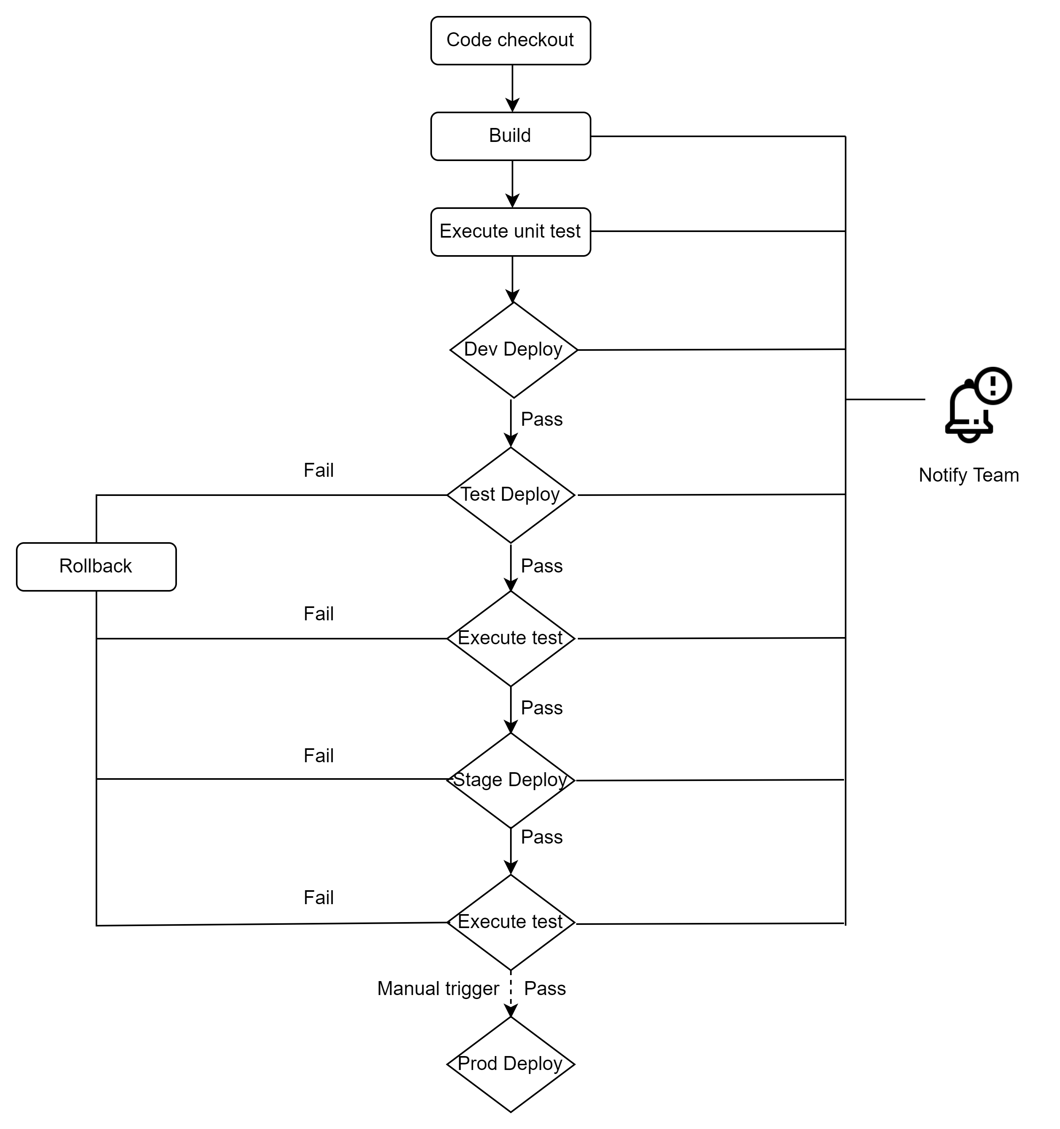
Deployment strategy

Slide 10
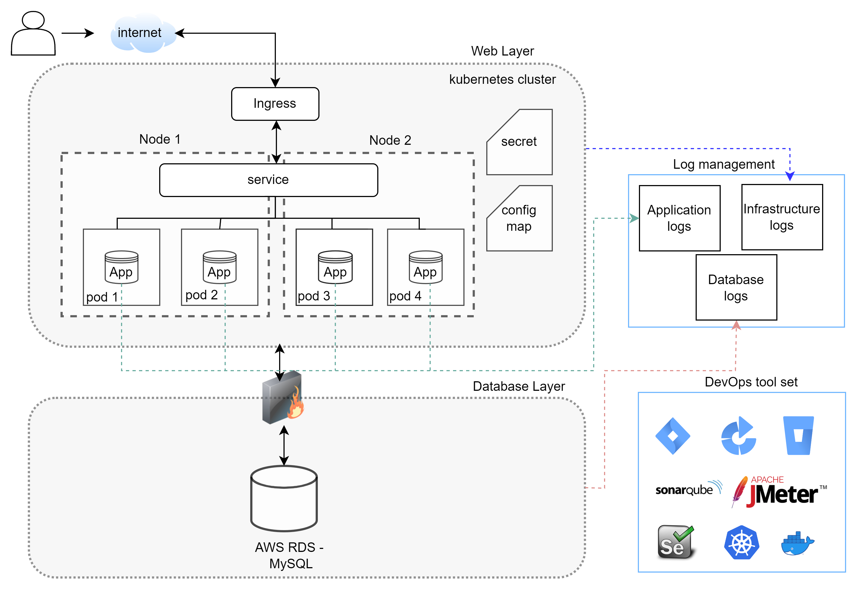
Application Architecture

