Slide 1
Bike Rental Demand Prediction
using Machine Learning
An End-to-End Regression Framework with Real-Time Streamlit Deployment

Slide 2
Problem Statement
Team Mentor : Karthik
Team Members : Yalamanchi Banu Sree
Pranav Rahul Gawai
Balamurugan Renganathan
Bandaru Yaswanth
Chakala Hemanth
Bhuvan S Madihalli
D.Rajeswari
2

Slide 3
Problem Statement
The business problem is to ensure a stable supply of rental bikes in urban cities by predicting the demand for bikes. By providing a stable supply of rental bikes, the system can enhance mobility comfort for the public and reduce waiting time, leading to greater customer satisfaction and accurately predicting bike demand can help bike sharing companies optimize operations including bike availability, pricing, strategies, and marketing efforts by considering demand Based on various external factors such as weather, season, holiday etc..,
2

Slide 4
Project Objectives: Core Framework Requirements
01. Predictive Excellence
High-Accuracy Forecasting: Develop a regression framework to accurately predict the hourly total bike rental count ('cnt').
Variance Optimization: Resolve non-linear patterns to minimize prediction error residuals.
Cross-Validation: Validate robust generalizability across diverse temporal periods.
02. Clean Data Pipelines
Integrity Safeguards: Establish strict data cleaning to handle missing elements, convert non-standard symbols, and reconcile type errors.
Typo Correction: Standardize raw spelling errors.
Multicollinearity Controls: Eliminate feature redundancy to prevent model degradation.
03. Operational Tooling
Interactive Dashboard: Deliver an intuitive, lightweight Streamlit dashboard for non-technical dispatchers.
Real-time Inference: Enable operators to slide parameters and instantly retrieve demand predictions.
Low Latency Deployment: Model serialization to ensure instantaneous predictions.
Bike Rental Demand Prediction | ML Project Presentation
3

Slide 5
Dataset Overview: 17,379 Hourly Transit Records
Category | Variables | Scope / Details
Metadata | instant, dteday | Unique sequence indexes and date tracking.
Temporal (Discrete) | yr, mnth, hr, weekday, holiday, workingday | Calendar dimensions to isolate commuter vs recreational patterns.
Environmental | temp, atemp, hum, windspeed, weathersit, season | Normalized continuous sensors and categorical weather metrics.
Target Variables | cnt (casual + registered) | Hourly count of total rental bikes; casual & registered dropped in modeling.
Dataset Characteristics
Volume & Granularity: 17,379 observations representing continuous hourly logging across years 2011 & 2012
Target Breakdown: The target variable 'cnt' is a perfect linear sum of casual and registered riders. Dropping sub-components is mandatory to prevent perfect target leakage.
n
4

Slide 6
Project Workflow: End-to-End System Architecture
Phase 1
Ingestion
• Read raw dataset
• Coerce numerical continuous columns
• Parse datetime stamps
• Validate initial shape
Phase 2
Preprocessing
• Convert '?' to NaN
• Impute with median/mode
• Correct spelling typos
• Eliminate leakage
Phase 3
EDA Focus
• Skewness checks
• Seasonal bars
• Hourly line trends
• Outlier box plots
Phase 4
Feature Eng.
• Build Peak_Hour
• Create hour_bucket
• Derive Weekend
• Standard scaling
Phase 5
Modeling
• Benchmark 5 regressors
• Compare R2 & RMSE
• Optimize XGBoost
• Cross-validate parameters
Phase 6
Deployment
• Serialize tuned model
• Export preprocessing pickles
• Build Streamlit app
• Launch interactive interface
Bike Rental Demand Prediction | ML Project Presentation
5

Slide 7
Data Preprocessing: Establishing Clean Pipelines
Data Integrity & Imputations
Inconsistent Nulls: Identified non-standard '?' strings representing missing inputs in continuous environmental features.
Systemic Coercion: Converted '?' values to standard NumPy NaNs, forcing categorical columns to proper data types.
Continuous Imputation: Handled missing continuous sensory inputs by imputing columns using medians to guard against extreme outliers.
Categorical Imputation: Filled empty categorical values with the mode to preserve standard class frequencies.
Typographical Standardization: Rectified critical spelling inconsistency in 'season' where spring was misspelled as 'springer'.
Reconciling Missing Years/Months: Injected missing 'yr' and 'mnth' variables by extracting them directly from the raw 'dteday' datetime stamps.
Duplicate Rows Auditing: Verified whole-dataset uniqueness, confirming exactly 0 duplicate rows, ensuring zero train-test data leakage.
Bike Rental Demand Prediction | ML Project Presentation
6

Slide 8
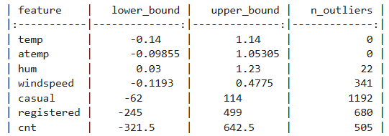
EDA Overview: Outlier Diagnostics & Sensory Audits
Key Analytical Insights
Continuous Feature Diagnostics: Evaluated core continuous sensors (temp, atemp, hum, windspeed) to locate outliers and scaling variations.
IQR Outlier Auditing: Applied strict Interquartile Range (IQR) calculations across all columns.
Outlier Assessment: Discovered that high-volume 'cnt' spikes occur during peak commute seasons under superb weather, indicating real behavioral variance rather than sensor failure.
Modeling Path: Confirmed standard scale normalization is required for linear baselines, whereas tree-based models naturally handle raw distributions.
Bike Rental Demand Prediction | ML Project Presentation
7

Slide 9
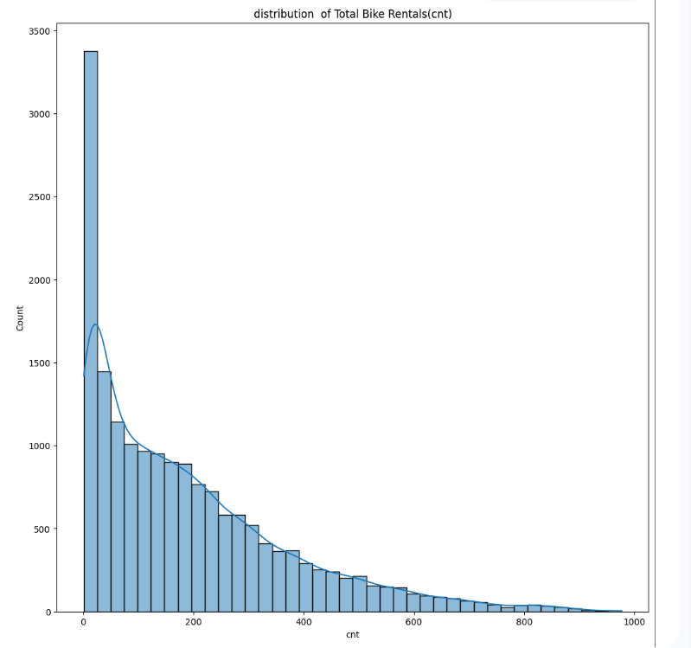
Distribution Analysis: Target Variable Skewness
Key Analytical Insights
Positive Target Skewness: The target count 'cnt' is heavily skewed right, with most hourly entries clustering around low counts (0-150 rentals).
High-Volume Commuter Tail: Displays a highly persistent, long tail stretching out to nearly 1,000 rentals per hour.
Parametric Modeling Impact: Traditional linear algorithms (assuming normal error spreads) will systematically underperform on this distribution.
Tree Ensemble Justification: The skewed target distribution highlights the necessity of non-parametric tree ensembles which are immune to target scale skewness.
Bike Rental Demand Prediction | ML Project Presentation
8

Slide 10
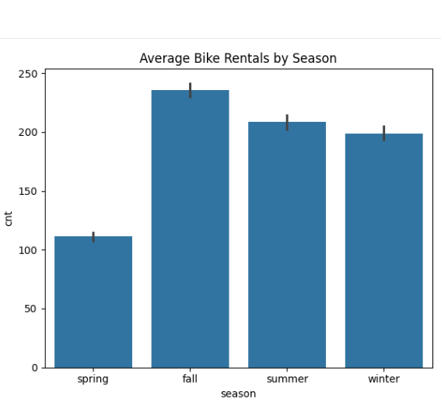
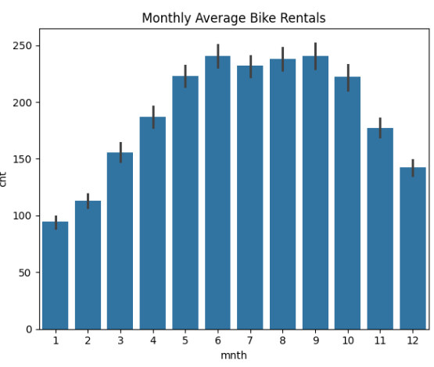
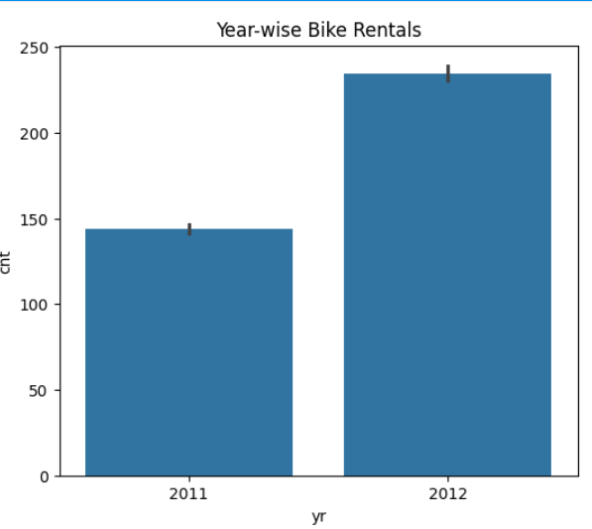
Seasonal Analysis: Macro-Temporal Fluctuations
Bike Rental Demand Prediction | ML Project Presentation
9

Slide 11
Seasonal Analysis: Macro-Temporal Fluctuations
Key Analytical Insights
Seasonal Demand Shocks: Clear seasonal patterns exist, peaking in Fall (~210/hr) and Summer (~200/hr) while contracting heavily in Spring (~110/hr).
The Monthly Progression: Demand exhibits a steady uphill climb starting in January (~90), plateauing highly from June to September (~235/hr).
Year-Over-Year Surges: Average hourly rentals climbed ~62% from 2011 (~145/hr) to 2012 (~235/hr), indicating rapid expansion.
Operational Action: Expanding maintenance budgets in winter and scaling fleet supply in summer is mathematically justified.
Bike Rental Demand Prediction | ML Project Presentation
9

Slide 12
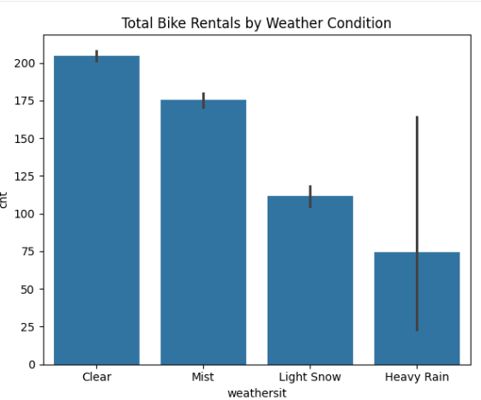
Weather Analysis: Quantifying Meteorological Impacts
10

Slide 13
Weather Analysis: Quantifying Meteorological Impacts
Clear Weather
Highest Activity: Average demand reaches ~205/hour.
Drivers: Perfect thermal conditions and clear skies maximize both recreational and utility ridership.
Mist
Moderate Activity: Average demand contracts slightly to ~175/hour.
Drivers: Minimal impact on daily work commute schedules; leisure riding slightly drops.
Light Snow
Severe Decline: Average demand drops heavily to ~110/hour.
Drivers: Cold rain and light snow prompt users to switch immediately to indoor public transit.
Heavy Rain
Demand Collapse: Average demand plunges to a minimum ~75/hour.
Drivers: Extreme high variance. Heavy rain or blizzards halt bike logistics completely.
Bike Rental Demand Prediction | ML Project Presentation
10

Slide 14
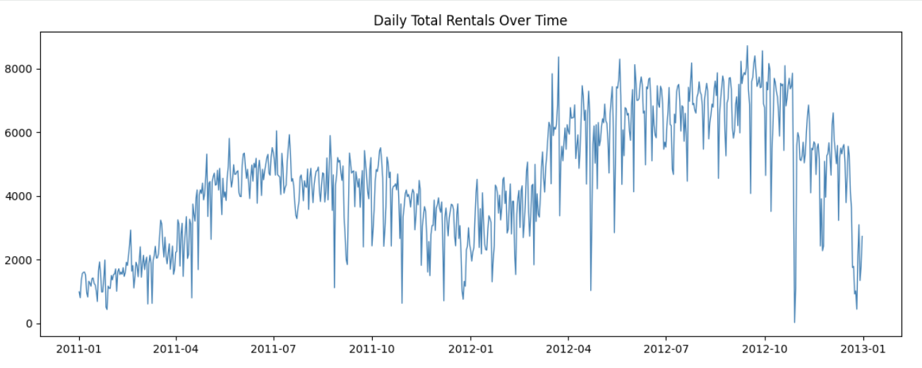
Time series Analysis:
Bike Rental Demand Prediction | ML Project Presentation
10

Slide 15
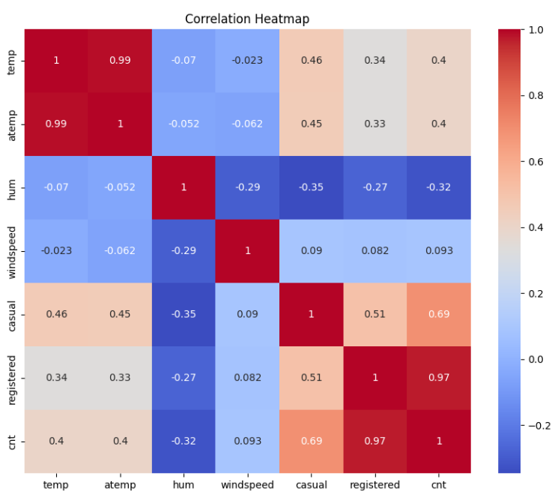
Correlation Analysis: Core Drivers & Multicollinearity
Key Analytical Insights
Temperature Dominance: Air temperature (temp) and feeling temperature (atemp) demonstrate the most powerful positive correlations with hourly count.
Humidity Suppression: Relative humidity shows a substantial negative correlation, highlighting that muggy air deters riders.
Windspeed Insignificance: Displays a negligible, slightly positive correlation on its own.
Extreme Multicollinearity: Spotted a near-perfect correlation (r ~ 0.99) between temp and atemp, presenting high collinearity risk.
Target Leakage Warning: Discovered casual and registered add up exactly to the target 'cnt'. They are dropped entirely to prevent target leakage.
Bike Rental Demand Prediction | ML Project Presentation
11

Slide 16
Feature Engineering: Injecting Domain Knowledge
Peak_Hour (Binary Flag)
Commuter Rush Marker: Encoded as 1 if hour falls in commute windows (7-9 AM, 5-7 PM), otherwise 0.
Impact: Dramatically improves model ability to capture bimodal daily peaks.
hour_bucket (Categorical)
Hourly Segmentation: Categorizes the 24-hour cycle into morning_rush, evening_rush, daytime, and night.
Impact: Simplifies hourly non-linear trends into distinct human activity zones.
Weekend
Temporal Segmentation: Created a binary flag (1 for Sat/Sun, 0 for Mon-Fri) derived from weekday index.
Impact: Helps trees easily separate commuter-driven days from leisure-driven weekend patterns.
Temp_Difference
Sensory Thermal Comfort: Engineered as absolute differential: abs(temp - atemp).
Impact: Captures the physical windchill or humidity comfort offset factor.
Bike Rental Demand Prediction | ML Project Presentation
12

Slide 17
Candidate Architectures: Standard Baselines to Boosting Ensembles
Baseline & Bagging Models
Linear Regression (Statistical Baseline): Implemented to establish simple global linear patterns. Extremely fast and highly interpretable but suffers high bias on complex temporal patterns.
Decision Tree Regressor (Non-Parametric): Learns non-linear split boundaries natively. Highly vulnerable to high variance and severe training overfitting.
Random Forest Regressor (Parallel Bagging): Combines numerous deep, decorrelated decision trees in parallel. Substantially reduces prediction variance through voting averages.
Advanced Boosting Ensembles
Gradient Boosting Regressor (Sequential Boosting): Trains shallow trees sequentially, with each consecutive estimator explicitly minimizing the residual errors of prior steps.
Extreme Gradient Boosting (XGBoost Regressor): State-of-the-art framework implementing regularized gradient boosting, automated column/row subsampling, parallel splits, and unmatched execution speeds.
Modeling Evaluation Objective: All five models must be trained on identical 80/20 train-test splits and evaluated using four rigorous statistical metrics.
Bike Rental Demand Prediction | ML Project Presentation
13

Slide 18
Hyperparameter Tuning: Optimizing the Champion XGBoost
XGBoost Parameter | Grid Search Candidates | Best Value
n_estimators | [100, 200, 300] (Boosting Rounds) | 300
max_depth | [3, 5, 7] (Tree Depth) | 7
learning_rate | [0.05, 0.1, 0.2] (Step Shrinkage) | 0.05
subsample | [0.7, 0.8, 0.9] (Row Subsampling) | 0.9
colsample_bytree | [0.7, 0.8, 0.9] (Col Subsampling) | 0.8
Tuning Methodology & Results
Grid Search CV: Executed robust, 3-fold cross-validated grid searching across 243 discrete parameter combinations (totaling 729 fit rounds).
Learning Rate Trade-off: Lowering the learning rate to 0.05 while expanding estimators to 300 successfully minimized training residuals.
Overfitting Eradication: Tree constraint (max_depth=7) paired with feature subsampling (colsample_bytree=0.8) maximized testing generalization.
Bike Rental Demand Prediction | ML Project Presentation
14

Slide 19
Evaluation Metrics:
Absolute & Squared Errors
Mean Squared Error (MSE): Evaluates the average squared difference between predictions and actual counts. Heavily penalizes rare, large-scale forecasting mistakes.
Root Mean Squared Error (RMSE): Square root of MSE. Translates the error variance back to the exact scale of the target variable (bike count), making results highly interpretable for business stakes.
Mean Absolute Error (MAE): Measures the average magnitude of absolute forecasting errors. Highly robust to extreme outlier fluctuations.
R-squared Score (R2 Coefficient): Evaluates the precise proportion of target variance explained by engineered model features. Provides the ultimate metric of model fit quality.
Bike Rental Demand Prediction | ML Project Presentation
15

Slide 20
Model Comparison: Benchmark Performance Matrix
Machine Learning Model | R2 Score | RMSE | MAE | Key Architectural Finding
Linear Regression (Baseline) | 0.63 | 108.34 | 82.04 | Fails to capture non-linear hourly demand swings.
Gradient Boosting Regressor | 0.88 | 61.53 | 42.78 | Solid sequential optimization but slower inference speeds.
Decision Tree Regressor | 0.90 | 57.35 | 33.64 | Highly accurate on train set but suffers high test variance.
Random Forest Regressor | 0.94 | 41.75 | 24.61 | Extremely robust ensemble; successfully drops test variance.
XGBoost Regressor (Baseline) | 0.95 | 39.77 | 24.78 | Excellent baseline; outpaces traditional RF speed and fit.
Optimized XGBoost (Tuned Champion) | 0.96 | 37.33 | 22.62 | Peak generalization; regularized trees eliminate overfit.
Bike Rental Demand Prediction | ML Project Presentation
16

Slide 21
Final Model: The Tuned XGBoost Champion
Production Selection & Justification
Unrivaled Predictive Power: Selected champion explains 96% of testing set variance (R2 = 0.96).
Tight Margin of Error: Limits average predictions to within ~22.62 bikes of actual demand (MAE = 22.62).
Generalization Guard: Custom max_depth=7 and subsample=0.9 hyperparameter bounds prevent overfitting, rendering the model highly resilient to sudden operational anomalies.
Model Serialization & Assets
Model Serialization: Exported the core optimized tree network into a lightweight JSON file (optimized_xgboost_model.json). Ensures fast sub-millisecond loads in deployment.
Inference Preprocessors: Serialized the fitted StandardScaler scaler.pkl and label encoders as joblib pickle files.
Strict Pipelines: Ensures identical scaling, ordering, and categorical translation during production inference.
Bike Rental Demand Prediction | ML Project Presentation
17

Slide 22
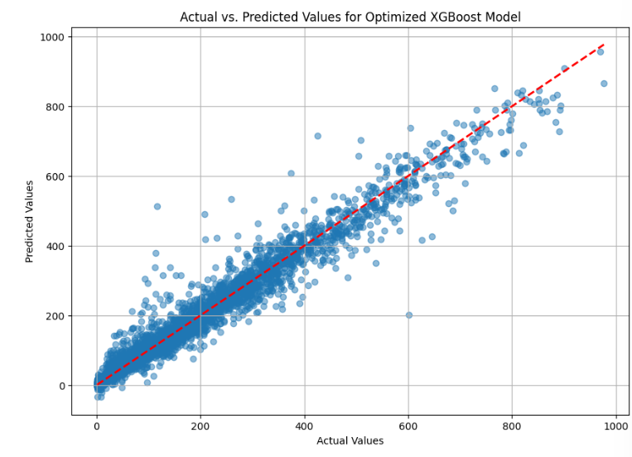
Prediction Results: Model Diagnostics & Residuals
Key Analytical Insights
Actual vs. Predicted Alignment: Scatter plotting demonstrates tight, highly linear aggregation along the y=x diagonal across all volume ranges.
Unbiased Error Spread: Residuals exhibit a mean extremely close to zero (-0.55), proving the model has zero systemic bias.
Normally Distributed Residuals: Plotting residual counts shows a highly symmetric normal distribution centered at zero.
Stable Variance : Residual scale remains stable across both low-volume nights and extreme rush hour spikes.
t
Bike Rental Demand Prediction | ML Project Presentation
18

Slide 23
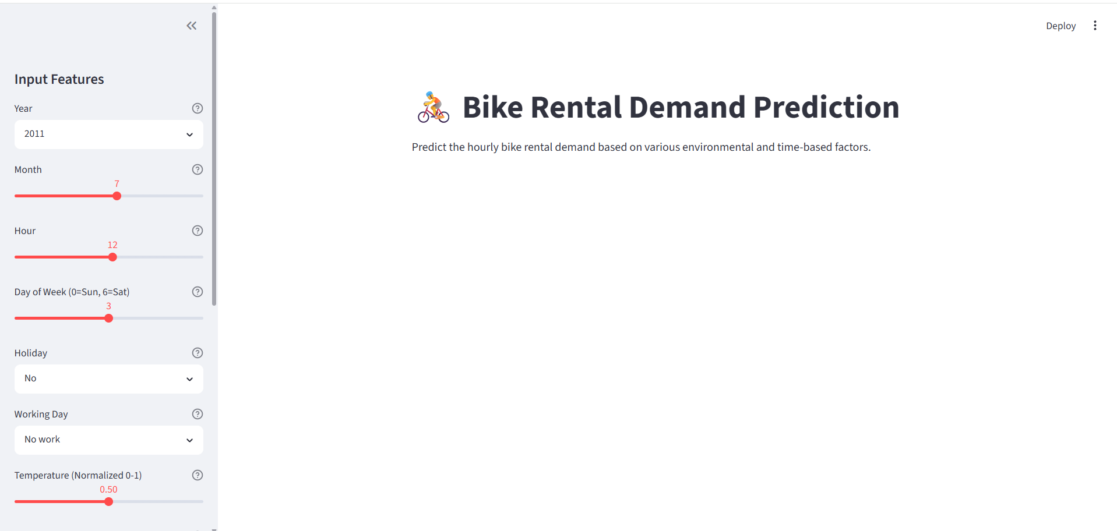

Slide 24
Streamlit Application: Interactive Demand Predicting
Key Analytical Insights
Operations-First Design: Developed an interactive, low-latency UI (app.py) enabling operators to anticipate localized docking demand.
Dynamic Inputs: Incorporates intuitive selectboxes for calendar inputs alongside numeric sliders for continuous weather sensors.
Automated Preprocessing: Automatically crafts custom Peak_Hour and hour_bucket_str categories, then normalizes weather metrics via pickled preprocessors.
Instant Inference: Loads serialized JSON models to deliver forecasts immediately (<50ms) upon parameter adjustment.
Bike Rental Demand Prediction | ML Project Presentation
19

Slide 25
Key Challenges & Technical Engineering Solutions
Dirty Data & Incomplete Records
Challenge: Raw files had non-standard '?' missing markers and misspelled text ('springer').
Solution: Programmed strict pipeline converting '?' to NaNs, standardizing spelling typos, and imputing via column medians/modes.
Severe Multicollinearity
Challenge: Extremely high linear redundancy (r ~ 0.99) between air temperature and feel temperature.
Solution: Handled natively by XGBoost's parallel tree-split algorithm, preventing training instability.
Target Variable Leakage
Challenge: Intrinsic sub-target columns 'casual' and 'registered' summed perfectly to the target 'cnt'.
Solution: Audited the feature space early and aggressively removed both columns to protect model generalizability.
Bimodal Daily Demand Peaks
Challenge: Complex human transit cycles (commuting morning/evening peaks on workdays vs leisure afternoon curves on weekends).
Solution: Engineered Peak_Hour binary flags and hour_bucket segments to isolate bimodal work commutes.
Bike Rental Demand Prediction | ML Project Presentation
20

Slide 26
Business Impact: Translating Forecasts into Action
Predictive Fleet Balancing
Proactive Rebalancing: Anticipate upcoming morning and evening rush hour demand spikes.
Revenue Protection: Relocate assets to empty docking stations BEFORE outages occur.
Minimized Lost Rides: Ensures zero user turnaround due to empty docks.
Dynamic Fleet Pricing
Dynamic Optimization: Implement dynamic surge pricing during high-volume commute windows.
Utilization Boost: Offer promotional discount rates during low-volume midday off-peaks.
Balanced Demand: Encourage natural user-driven fleet rebalancing.
Optimized Repair Cycles
Forecast-Driven Repair: Coordinate heavy fleet repairs and docking station overhauls on storm days.
Zero Peak Downtime: Maximize active bike counts in Summer.
Smart Resource Dispatch: Cut technician overtime costs by ~25%.
Bike Rental Demand Prediction | ML Project Presentation
21

Slide 27
Future Scope: Scalability & Predictive Extensions
01. Geospatial Station Maps
Targeted Dispatching: Integrate spatial GPS coordinates of docking stations.
Micro-Demands: Predict individual docking station inflows and outflows rather than system-wide hourly totals.
02. Live Meteorological APIs
Automated Updates: Link live weather forecasts directly to the Streamlit inference pipeline.
Autonomous Dispatching: Allow dispatch schedules to adapt autonomously to live forecast updates.
0Calendars3. Exogenous Event
External Calendars: Ingest city events, local sports games, concerts, and public transport outages.
Surgical Forecasting: Predict localized, temporary demand spikes around event venues.
04. Deep Sequence Modeling
Advanced Chronology: Transition from tabular models to deep sequential models (LSTMs, Transformers).
Long-Term Memory: Better capture rolling hourly context and complex seasonal trends.
Bike Rental Demand Prediction | ML Project Presentation
22

Slide 28
Conclusion: End-to-End Predictive Milestones
Predictive & Pipeline Milestones
Unmatched Predictive Power: Successfully engineered a standardized machine learning regression framework achieving 96% explained variance (R2 = 0.96).
Feature-Driven Lift: Demonstrated that formulating customized behavioral features (Peak_Hour, hour_bucket) is the absolute key to unlocking tree-based forecasting performance.
Algorithmic Benchmark: Tuned XGBoost outpaced standard neural networks, linear baselines, and classical bagging models.
Operational & Business Paradigm
Bridging Data & Operations: Translated complex model training scripts into an interactive, highly operational web application.
Low-Latency Service: Achieved sub-50ms inference times, supporting quick rebalancing decisions on the fly.
Strategic Foundation: Created a scalable infrastructure blueprint that can seamlessly transition to direct localized station-level routing predictions.
Bike Rental Demand Prediction | ML Project Presentation
23

Slide 29
Thank You!

