Slide 1
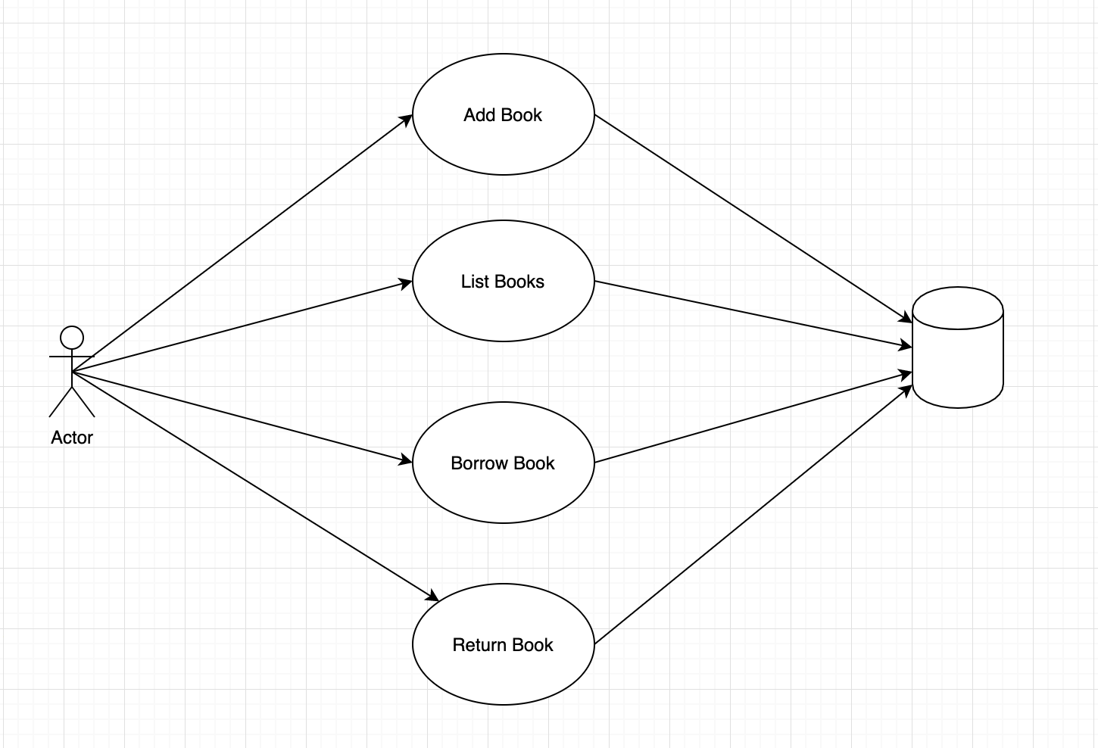
Use Case Diagram
Manage home Library

Slide 2
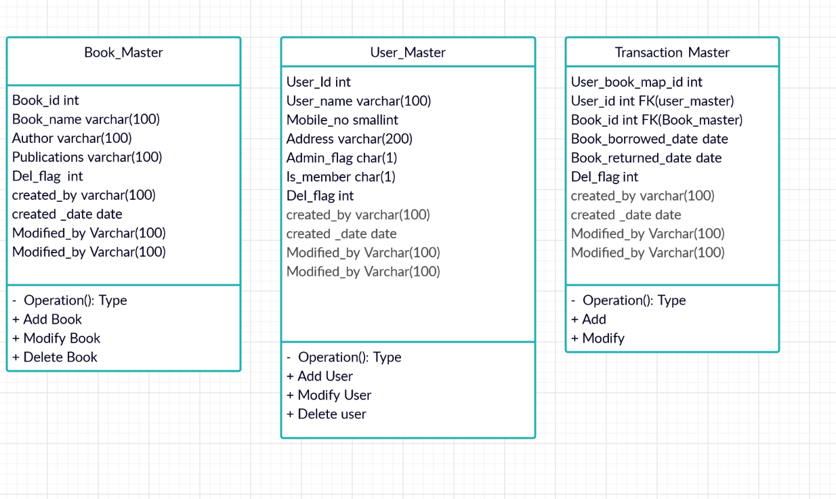
Data model

