Slide 1
Employee salary prediction
CAPSTONE PROJECT
Presented By:
Student Name- Penumalle Jaya Naga Rajeswari
College Name- Bonam Venkata Chalamayya Engineering collage
Department : Artifical Intelligence & Data Science

Slide 2
OUTLINE
Problem Statement
System Development Approach
Algorithm & Deployment
Result
Conclusion
Future Scope
References

Slide 3
Problem Statement
This project is centered on developing a predictive tool to classify an individual's income level. The core task is to predict whether an employee's annual income is greater than $50K or less than or equal to $50K based on various demographic and employment attributes. The project involves creating a user-friendly web application where a user can input information such as age, gender, occupation, and hours worked per week. The system then utilizes a machine learning model to process this information and provide an instant prediction. The primary goal is to make the predictive power of machine learning accessible and easy to use for insights into income classification.

Slide 4
System Approach
This section outlines the strategy and tools used for the project's development and implementation.
System Requirements
Python: The core programming language for the project.
Pre-trained Machine Learning Model: A saved best_model_pipeline.pkl file containing the trained classification model.
Pre-fitted Encoders: A encoders.pkl file to transform categorical user inputs into a format the model understands.
Libraries Required
Streamlit: Used to build and run the interactive web application.
Pandas: For creating and managing the data structure (DataFrame) to feed into the model.
Joblib: Essential for loading the pre-trained model pipeline and encoders from saved files.

Slide 5
Algorithm & Deployment
Load Artifacts: The application starts by loading the trained model pipeline and the saved encoders into memory using joblib.
Build User Interface: A user-friendly interface is constructed using Streamlit. It features sliders for numerical inputs like Age and Hours per Week, and select boxes for categorical data like Work Class, Occupation, and Marital Status.
Capture User Input: The UI is organized into "Demographics," "Employment," and "Personal Life" sections. The app collects the user's selections from these fields.
Initiate Prediction: The user clicks the "Predict Salary Class" button to trigger the prediction process.
Prepare Data for Model: The captured inputs are assembled into a single-row Pandas DataFrame. The categorical inputs are then transformed using the pre-loaded encoders.
Execute Prediction: The prepared DataFrame is passed to the loaded model pipeline. The pipeline handles scaling the data and making the final prediction. It also calculates the confidence score (probability) for the prediction.
Display Result: The final prediction (>50K or <=50K) is displayed prominently, along with the confidence percentage of the prediction.

Slide 6
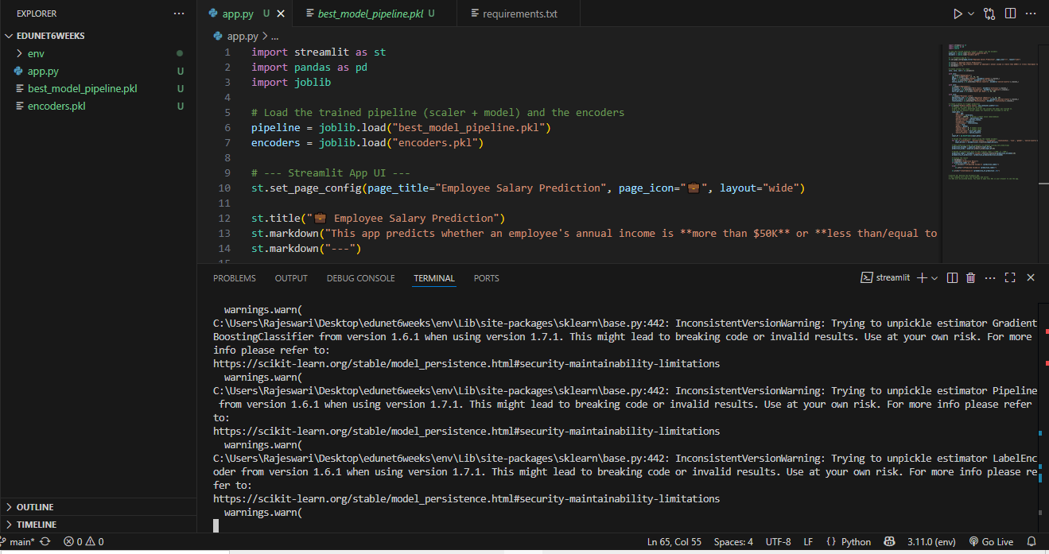
Result
Git link : https://github.com/Rajeswaril4/edunet6weeksintership/tree/main

Slide 7
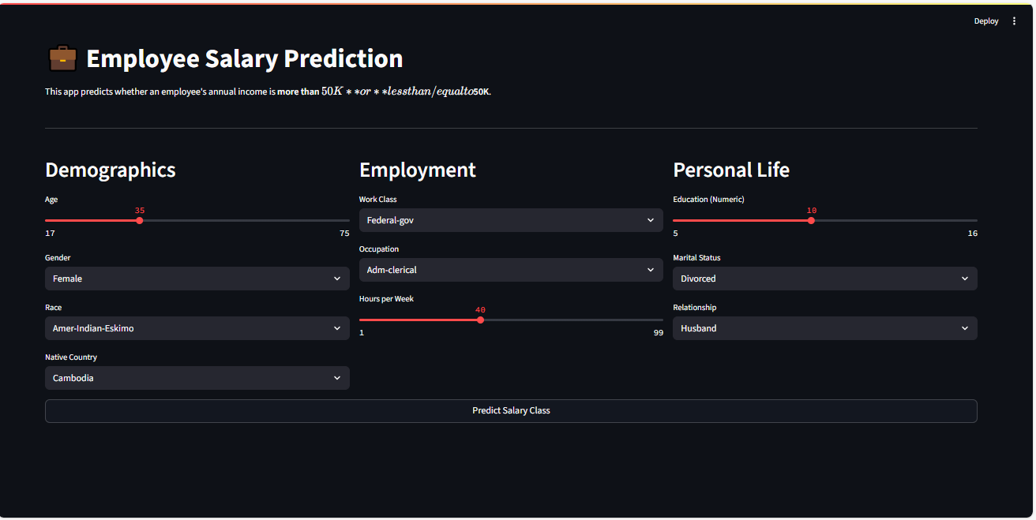
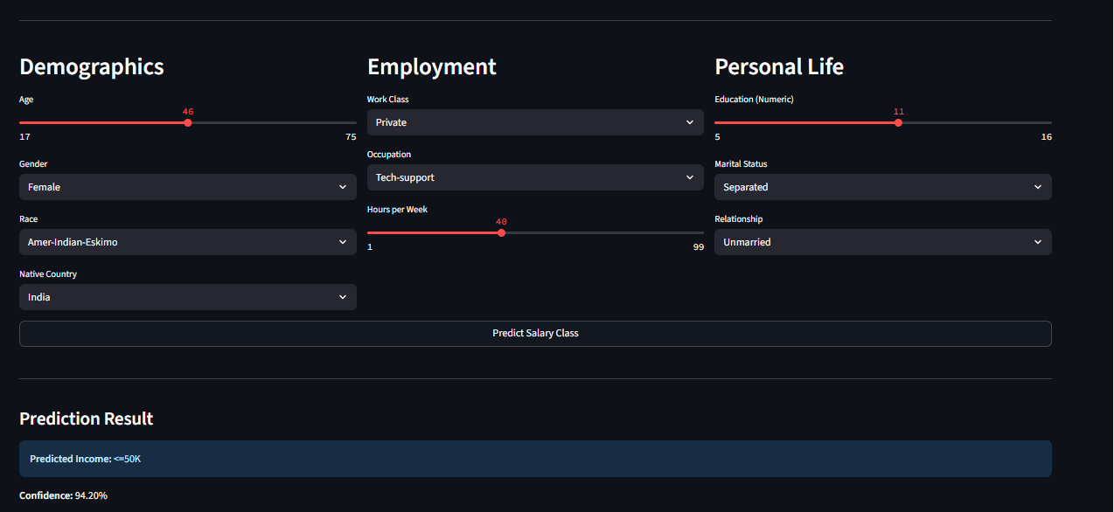
Result

Slide 8
Conclusion
The project successfully delivered a functional salary prediction tool by deploying a machine learning model within an interactive Streamlit application. The findings show that this approach is effective for making complex models accessible to end-users. A primary challenge encountered was ensuring that the live user input was preprocessed to perfectly match the format expected by the trained model. The project effectively bridges the gap between a trained model and a practical, usable application

Slide 9
Batch Prediction: Allow users to upload a file (e.g., CSV) with multiple employee records to get predictions for all of them at once.
Dashboard and Analytics: Add a new section to the app that provides visualizations and summary statistics of the underlying dataset.
Model Explainability: Integrate SHAP or LIME to show users which features contributed most to their specific prediction, making the model less of a "black box."
Future scope

Slide 10
References
Dataset:
Dua, D., & Graff, C. (2017). UCI Machine Learning Repository. Irvine, CA: University of California, School of Information and Computer Science. Retrieved from http://archive.ics.uci.edu/ml
Software and Libraries:
Pedregosa, F., Varoquaux, G., Gramfort, A., Michel, V., Thirion, B., Grisel, O., ... & Duchesnay, E. (2011). Scikit-learn: Machine Learning in Python. Journal of Machine Learning Research, 12, 2825-2830.
The Pandas Development Team. (2024). pandas: Python Data Analysis Library. Retrieved from https://pandas.pydata.org
Streamlit Inc. (2024). Streamlit: The fastest way to build and share data apps. Retrieved from https://streamlit.io
Joblib Development Team. (2024). Joblib: running Python functions as pipeline jobs. Retrieved from https://joblib.readthedocs.io/

Slide 11
THANK YOU

