Slide 1





INSIGHTVISTA 2026
Subject : Data Analytics and visualization(1IT508)
Title: Analysis of the Apps on the Playstore
Group Name : HACKER
PEN No : 240840116011
PEN No : 240840116046
PEN No : 240840116061
PEN No : 240840116069
PEN No : 250843116006

Slide 2

Observation of Data:
  Import pandas library
  Use pd.read_excel(‘googleplaystore.xlsx’)
  Now read to xlsx file to csv using df = pd.read_csv
  Getting the count of rows & columns using df.shape, columns = 13 , rows = 10841
  Getting the count of duplicate records using df.duplicated.sum() = 483
  Getting the count of null values in each column:
  Rating: 1474
  Type: 1
  Content rating: 1
  Current version: 8
  Android version: 3
‹#›

Slide 3

Steps to clean raw data:
  Dropping the duplicate records using df_cleaned = df.drop_duplicates
  Filling the null values in the column of rating with average rating values:
  mean_rating = df_cleaned[‘Rating’].mean()
  df_cleaned[‘Rating’].fillna(mean_rating,inplace=True
  3. Dropping the null values from other columns:
  df_cleaned = df_cleaned.dropna([‘Type’, ‘Content Rating’, ‘Current version’, ‘Android Version’)]
‹#›

Slide 4

Final Clean Dataset:
  Before cleaning number of rows and columns = (10841,13),
  After cleaning: (10346,13)
  No missing values
  Converting the file to CSV:
  df_cleaned.to_csv(‘googleplaystore_cleaned.csv’,index=False)
  Now Downloading the file:
  from google.colab import files
  files.download(‘googleplaystore_cleaned.csv’)
‹#›

Slide 5
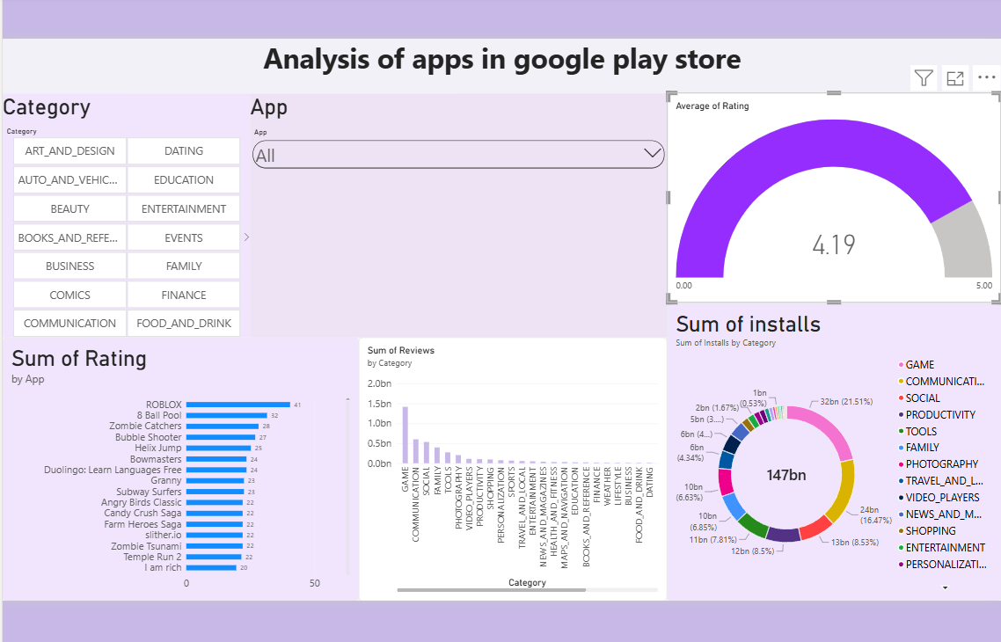



Dashboard:

Slide 6
Insights from the Dashboard:
1. High Average Rating: The average app rating is 4.19 out of 5, indicating generally positive user feedback across the apps.
2. Leading Apps by Rating: ROBLOX ranks first in the displayed chart with a rating of approximately 41, followed by 8 Ball Pool (32) and Zombie Catchers (28). These values appear to represent aggregated ratings rather than individual app star ratings.
3. Game Category Leads Reviews: The GAME category has the highest number of reviews, at approximately 1.4 billion, significantly exceeding most other categories. This suggests strong user engagement with gaming apps.
4. Installs Are Concentrated in Major Categories: The dashboard shows approximately 147 billion total installs. The largest displayed category shares are GAME (21.51%), COMMUNICATION (16.47%), and SOCIAL (8.53%), indicating their substantial contribution to total installs.
‹#›

Slide 7
Recommendation:
  Focus on High-Performing Categories: Prioritize opportunities in the GAME, COMMUNICATION, and SOCIAL categories, as they account for large shares of total installs.
  Learn from Successful Apps: Analyze popular apps such as ROBLOX and 8 Ball Pool to understand their user experience, features, engagement strategies, and retention techniques.
Confidential
‹#›

Slide 8


Thank you!
Confidential
‹#›

