Slide 1
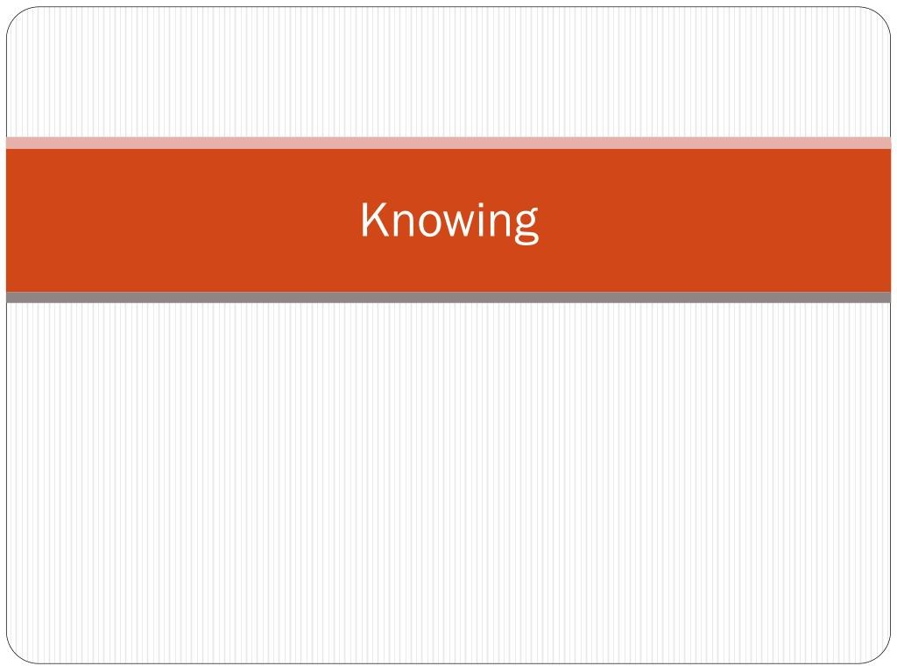

Slide 2
Being Critical.........................
Is sometimes interpreted as passing negative judgments
In TOK it is seen as being thoughtful and examining and
craluating information
Recognising unccrtaintics and diiiFring points o1 i icw
Whilst at the same time appreciating knowledge as an achievement
Examining and craluating allows u.s to .sitt thc irlcas w c harc been gi men in order to aI”firm the ones with the best claim on our f›elief, log consiclerin$ the reasons that support diffcrcnt claims

Slide 3



Over this TOK cour
Y‹›u mill be inc ited to apply critical
know an)•thin at all
Y‹iu will pay particular attentitin t‹i Nurtu^{r}ing through sense gerce/ti‹in, emotion, language and reas‹in WOKs
You will be asked to assess what we' consider knowledge to bc ancl how c c approach Ending truth
You mill be askcd to look at major areas Of knowledge AOKs to sec how thcy acquire knowlcrlgc ancl to cornparc them for a more holistic picture of knowing

Slide 4
Develop an awareness of yourself..
If you are tti Main tr›ols f‹ir the ffective critical rebectitin tin the clairris of others you will need to also dcx clop an awareness ot yourself
Your background affects how you do the sifting and evaluating
ancl you are tiften unau°are of its inhuence

Slide 5
The Knower (YOU!
What does it mean tr› be an International stuclent?
You each have a way o1 li ^{r}ing and a worldview that is familiar to you but possibly stranpc to someone clsc
You carry your own /crs/cctirc that you need to identify and understand in order to frame an an areness of other cultural possibilities

Slide 6

r personal profile as a ‘knower’
How old are you? How might your age affect what you know and your attitude towards gaining knowledge?
What is your mother tongue? What other languages do you speak? How might language affect your knowledge?
What sex are you? Does your gender affect how you see the world and the expectations you have about your knowledge and education?
Are you urban or rural? How might living in a city or countryside
affect how you have learnt and what you know?
What is you spiritual worldview? How do you think that your following a particular religion or not doing so, affects your knowledge?

Slide 7
The World as you know it....
° You have 7 minutes in which to draw as accurately and completely as }'ou can, a map of the world.
Drank is hat )°ou can, disci»°er o hat you carry° or d‹)n’t carry’ in
your mind as your picture of’ the world
Sharc j our tnap.s with your classmates
Are thcy different or the samc? Can you kuggest reasons for thcsc diffcrcnccs or similarities?
As an International .studcnt, you show in your draw ing sotnc of )•our ow n perspectires on the world
What part of the world is in the ccntrc or our map?
What parts have you Frau n in greatest detail? What parts have
^{ra}u eren drau°n in little cletail or left out?

Slide 8
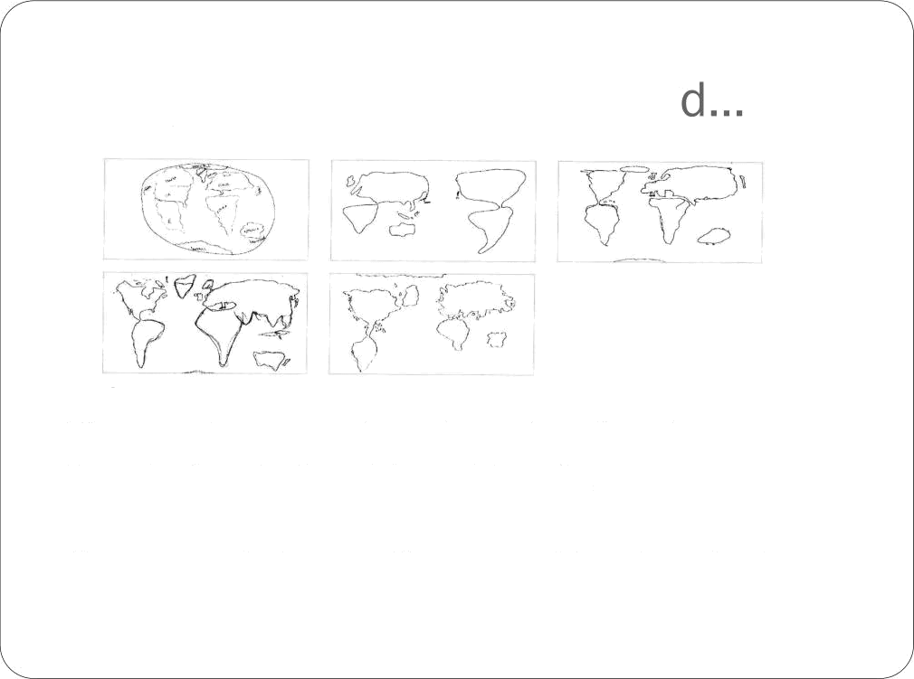
Maps from around the worl
The maps abet c were drawn by students from Japan,
Greenland, Italy, Costa Rica and Canada.
Can you match the most likelJ• map with each student?

Slide 9
Your picture of the world...
Is affected by what....
Differing drawing skills
Differing past attention to Geography
° Differing memories
* Differing home spots on the planet
Your picture of the world (your knowledge) is learned within your context and within your own cultural worldview
Knowledge is power. Map knowledge was once the power of rulers — colonising nations, concepts of ownership, droppping bombs on targets, current day conflicts Israel/ Palestine.
Maps may not represent only what you see but also what you believe
Maps can also be neutral and used for knowledge and appreciation

Slide 10
Your maps were not that good...mm
L‹›‹›ks like ii-e will have to lor)k at a map from a professit›nal CartOgraphcr to girc a corrcct version of thc worlds
Can you think Of some problems?
Scale —shrinking it so much (to just a page) surely 1ca›es a lot or“ detail out
Impossible to shosx^{e} u sphere (orange peel)and put it correctly
into a 2D form the Earth must be stretched an^{d @r} pe‹l
Uh oh and we just ttiok the ma_{r} thev t)rcw as true!!

Slide 11
Journal reflection time.....
Get a may tif thC ⁷⁽⁾rld and Waste it intti Stour journal
Annotate it: -
What is selected to be shown? Do human beings hare a pgreater interest in land or the sea? Do our maps show^{erb}ias to our species? Does }our map represent the physical qgeographv of the Earth or its hutnan political hit isions?
What is emphasized in ‹)ur may? What is in the centre — ‹ir the
top? What is artiliciall)^{r} enlarged?
Which map features are round in thc world and which ones arc humanly crcatcd? Do lincs of latitiudc ancl longitude really exist?

Slide 12
Journal reflection time.....
Do national borders really cxist? Do North, South, East and West? Does North have to lie at the top? How clo Ave separate West from East? What political and economical icleas are associated with north, south, east and west?
Him° is ) our may used?
In Chinese thc name for China is “middlc kingdom” . How clocs this fit into your map? Why do you think China is called the middle kingdom in Chinese?

