Slide 1

Predicting Bitcoin Price Movements and Volatility Using Transformer-Based Deep Learning Models
Rajgowthaman
rajendran

Slide 2
Objective
To build and evaluate deep learning models using Transformer-based architectures to predict:
Bitcoin's Close Price
Bitcoin's Volatility
Directional Accuracy (up/down movement)

Slide 3
Data Collection
The dataset used for this project is a comprehensive, minute-level Bitcoin (BTC) price and volume dataset covering the period from 2012 to 2025. The data was compiled from two sources:
Historical BTC Data (2012–March 2021)
Source: Kaggle Dataset by mczielinski
This dataset provided historical daily Bitcoin price data including Open, High, Low, Close, and Volume.
Post March 31, 2021)
To ensure up-to-date granularity, we implemented a custom Python scraper using the Binance API to collect minute-level candlestick data from April 1, 2021, to present. The script iteratively paginates through 1-minute intervals, fetches 1000 rows per API call, and merges the results into a single DataFrame.

Slide 4
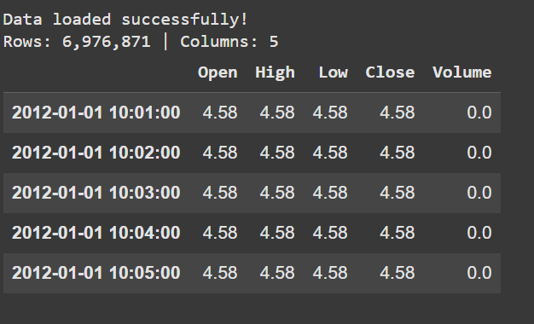
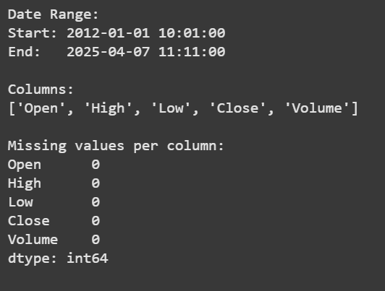
Dataset Overview

Slide 5

Common Preprocessing & Features
Log Return Calculation:
Feature Engineering:
RSI (Relative Strength Index)
Moving Averages (MA5, MA10, MA20)
Price difference
Lagged features
Direction label: 1 if price increases, else 0
Scaling:
Close and volatility values scaled using MinMaxScaler or StandardScaler

Slide 6
Common Preprocessing & Features
Bollinger Bands:
Upper Band = MA20 + 2 × rolling std
Lower Band = MA20 - 2 × rolling std
Helps model understand dynamic support/resistance zones.
Scaling
MinMaxScaler or StandardScaler applied to Close and Volatility for numerical stability during model training.

Slide 7
Transformers
In machine learning, a transformer is a neural network architecture that excels at processing sequential data, like text or audio, by using a mechanism called self-attention to understand relationships between different parts of the input.
The Time Series Transformer is a deep learning architecture adapted from the original Transformer (introduced for NLP tasks like machine translation) for handling sequential temporal data, such as stock prices, weather, or Bitcoin prices.
Transformers use self-attention mechanisms to weigh the importance of different time steps when making predictions. Unlike RNNs or LSTMs, they do not process data sequentially, which allows parallelization and better long-range dependency learning.

Slide 8
Key Components in Time Series Transformer
Component | Description
Input Embedding | Each timestamp's features are passed through a linear layer to become embeddings.
Positional Encoding | Since Transformers don’t inherently understand order, these encodings help inject time information.
Self-Attention Layers | Compute how much attention should be paid to each time step.
Feedforward Network | Fully connected layers applied after attention to refine representations.
Decoder (optional) | Used in forecasting tasks where future sequence generation is required.

Slide 9
Why Use It for Time Series?
Captures long-term patterns better than LSTM/RNN.
Naturally fits multivariate time series.
Works well for both regression (e.g., price forecasting) and classification (e.g., up/down trends).

Slide 10
Model
Minutely Time Series Transformer
Also a Time Series Transformer
Trained on 1-minute interval data from the last 1 month
No resampling is done — retains full raw temporal resolution
Designed for high-frequency trading signals and ultra-short-term volatility
Includes engineered features such as Bollinger Bands, lagged returns, and minute-level momentum indicators

Slide 11
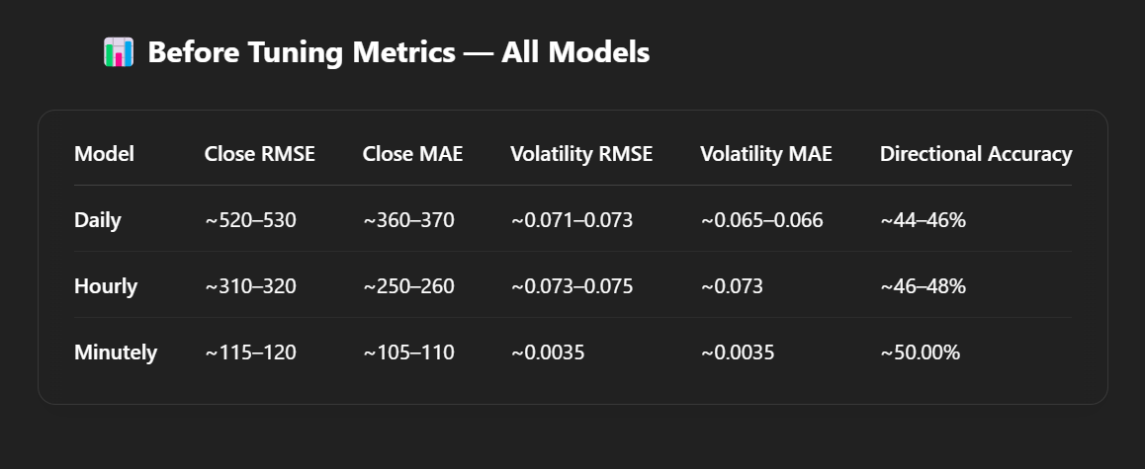
Training and Metrics

Slide 12
Minutely Model
Minutely Model
Already the most accurate among the three before tuning.
Close RMSE (~115–120) and MAE (~105–110) indicate it was able to closely track price movements.
Volatility metrics are very low (~0.0035), showing strong sensitivity to small changes.
Directional Accuracy (50%) suggests it was borderline usable even before tuning.

Slide 13
Parameter Tuning Overview
Daily Time Series Transformer
Tuning was performed
Epochs: Tuned up to 100
Learning Rate: Explored values like 1e-3, 5e-4, 1e-4
Dropout: Tuned between 0.1 and 0.3
Model Configs Tried:
d_model: 64 and 128
nhead: 4 and 8
num_layers: 2 and 3
Optimizer: AdamW
Batch Size: 32 and 64
Result: Post-tuning performance improved across all metrics, especially RMSE and Directional Accuracy

Slide 14
Minutely Time Series Transformer
Extensive tuning performed
Epochs: Trained up to 200, followed by 30 more for fine-tuning
Learning Rate: Tuned, final LR for fine-tuning was 1e-4
Weight Decay: Used 1e-5 for regularization
Dropout: Fixed at 0.1
Model Config:
d_model=64, nhead=4, num_layers=2
Batch Size: 64
Optimizer: AdamW
Result: Best performance across all metrics — lowest RMSE and highest directional accuracy

Slide 15
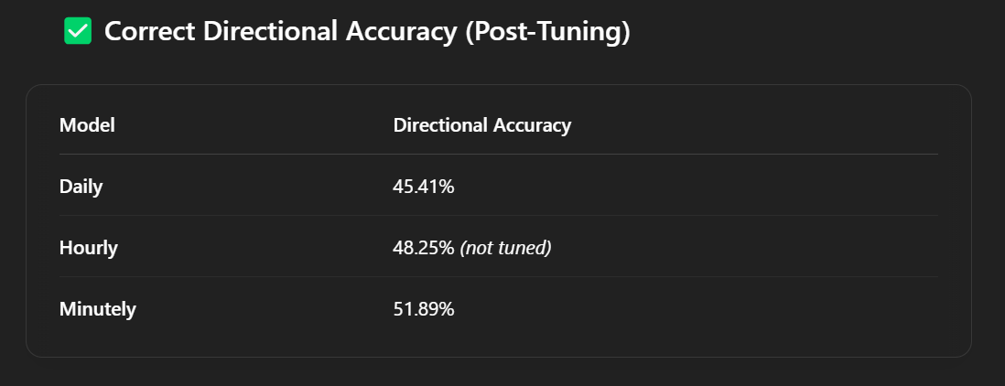
Post tuning metrics

Slide 16
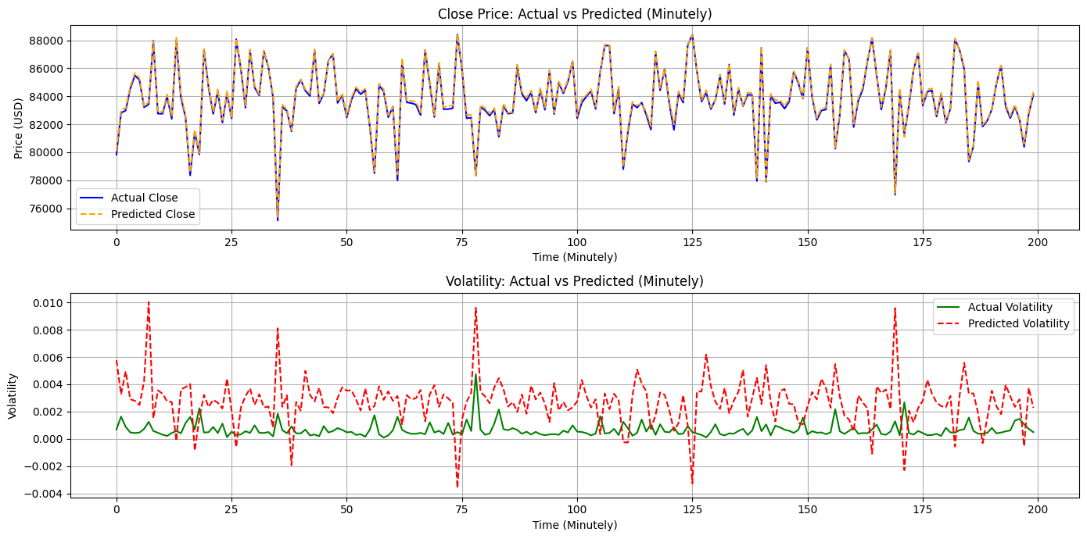
Minutely Model

Slide 17
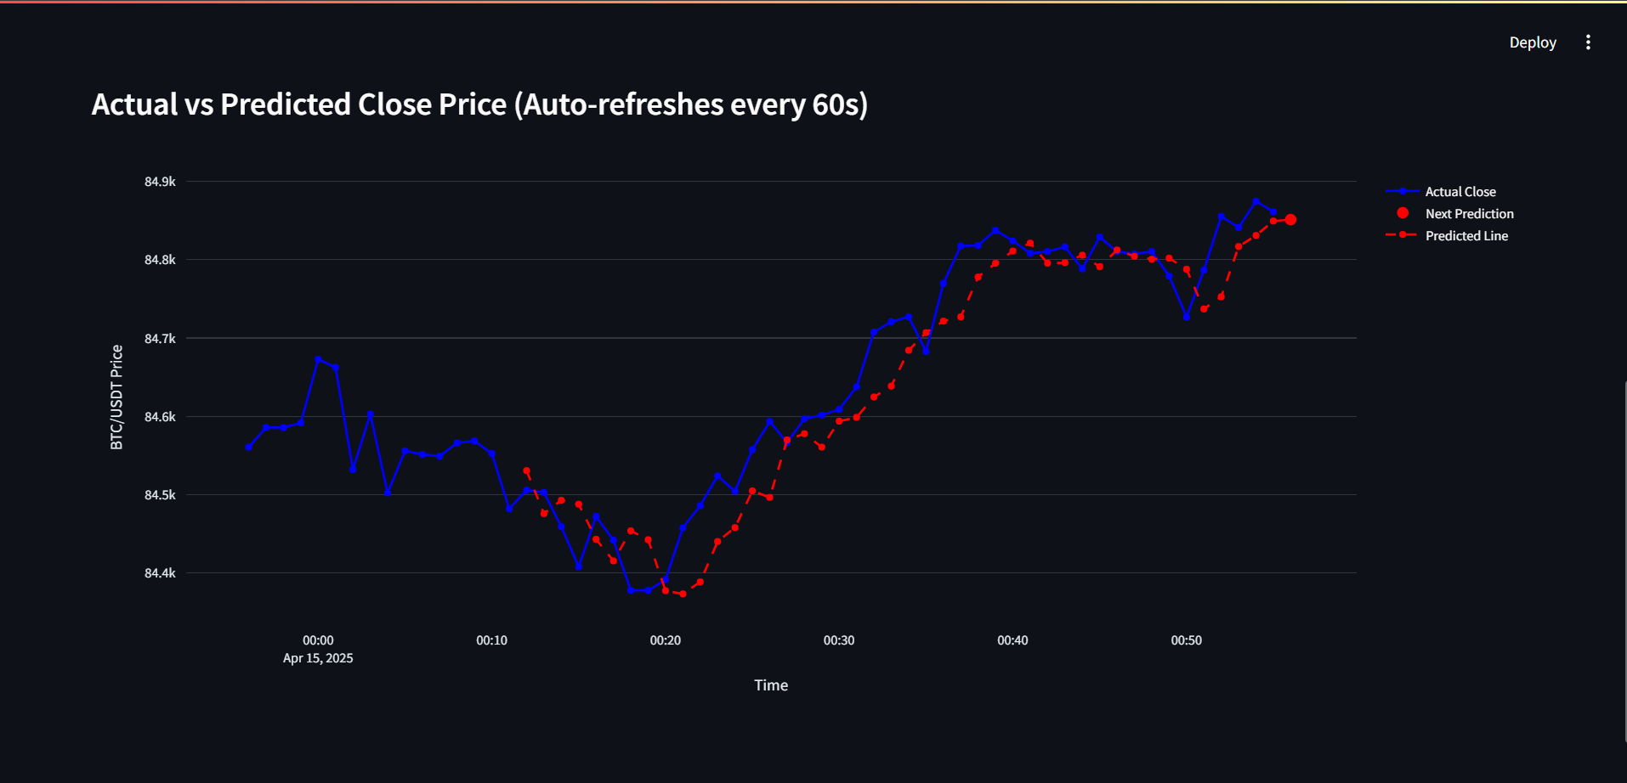
Dashboard based on Minutely Model

Slide 18
Interactive Minutely Crypto Trading Dashboard
Built with Streamlit + Binance Testnet API
Live prediction using Transformer-based models
Features:
Model-based buy/sell decisions
Visualized metrics: Sharpe Ratio, Win Rate
Auto-refreshing charts (1-min interval)
Notification integration (browser and Streamlit toast)
Online learning capability
Implements best configuration from Optuna tuning

Slide 19
Visual Analytics – Prediction vs Actual
Plotly-based interactive chart:
Blue: Actual Close
Red dot: Next predicted price
Dashed red line: Previous predictions
Prediction panel:
Close price
Volatility
Direction (+ confidence)

Slide 20
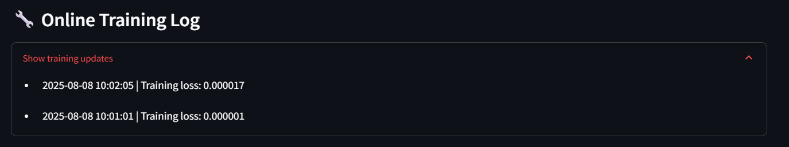
Online Learning
Trains on latest 60-min OHLCV + indicators
One-epoch backprop every minute (online_train())
Improves model adaptability to short-term trends
Lightweight training — safe for live use

Slide 21
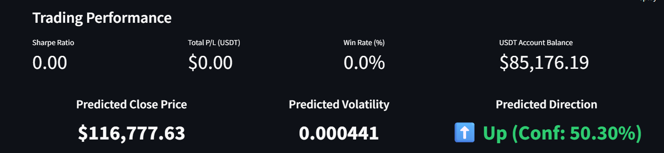
Seamless Binance Testnet Integration
Uses Binance Testnet API for:
Balance fetching
Market orders (Buy/Sell)
Symbol info (LOT_SIZE, MIN_NOTIONAL)
Example logic:
Sell All Coins button
Risk-based position sizing
Stop-loss / Take-profit logic

Slide 22
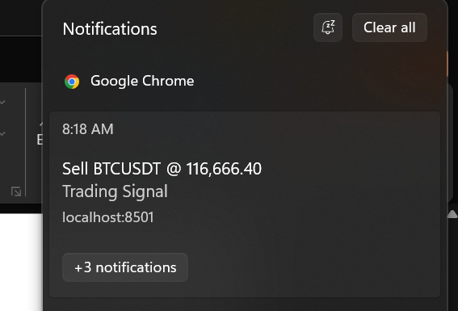
Alerts & Notifications - Multimodal Trading Alerts
Browser Push Notifications using JS injection
Streamlit Toasts:
Buy/Sell/SL/TP alerts
Balance and error feedback
Configurable confidence threshold for alert triggering

Slide 23
Future Work
Boost Directional Accuracy Target >60% using ensemble signals and attention on key features.
Smarter Tuning Optimize with Grid, Random, and Optuna + early stopping.
Better Architectures Try Informer, TFT, and N-BEATS for stronger forecasts.
Richer Features Add on-chain, macro, and sentiment signals.

Slide 24
Thank You

