Slide 1

Predicting Bitcoin Price Movements and Volatility Using Transformer-Based Deep Learning Models
Rajgowthaman
rajendran

Slide 2
Objective
To build and evaluate deep learning models using Transformer-based architectures to predict:
Bitcoin's Close Price
Bitcoin's Volatility
Directional Accuracy (up/down movement)
Across three time granularities:
Daily
Hourly
Minutely

Slide 3
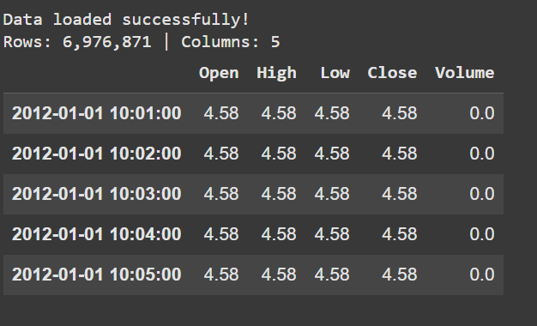
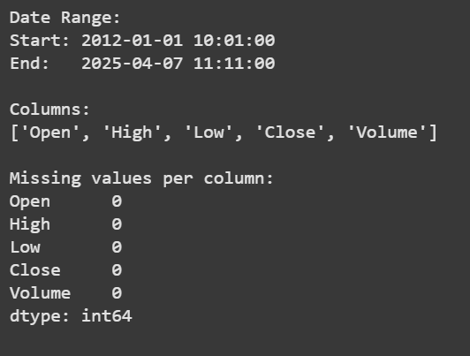
Dataset Overview

Slide 4

Common Preprocessing & Features
Log Return Calculation:
Rolling Volatility:
24-period rolling standard deviation (e.g., 24 minutes/hours/days)
Feature Engineering:
RSI (Relative Strength Index)
Moving Averages (MA5, MA10, MA20)
Price difference
Lagged features
Direction label: 1 if price increases, else 0
Scaling:
Close and volatility values scaled using MinMaxScaler or StandardScaler

Slide 5
Common Preprocessing & Features
Bollinger Bands:
Upper Band = MA20 + 2 × rolling std
Lower Band = MA20 - 2 × rolling std
Helps model understand dynamic support/resistance zones.
Scaling
MinMaxScaler or StandardScaler applied to Close and Volatility for numerical stability during model training.

Slide 6
Transformers
In machine learning, a transformer is a neural network architecture that excels at processing sequential data, like text or audio, by using a mechanism called self-attention to understand relationships between different parts of the input.
The Time Series Transformer is a deep learning architecture adapted from the original Transformer (introduced for NLP tasks like machine translation) for handling sequential temporal data, such as stock prices, weather, or Bitcoin prices.
Transformers use self-attention mechanisms to weigh the importance of different time steps when making predictions. Unlike RNNs or LSTMs, they do not process data sequentially, which allows parallelization and better long-range dependency learning.

Slide 7
Key Components in Time Series Transformer
Component | Description
Input Embedding | Each timestamp's features are passed through a linear layer to become embeddings.
Positional Encoding | Since Transformers don’t inherently understand order, these encodings help inject time information.
Self-Attention Layers | Compute how much attention should be paid to each time step.
Feedforward Network | Fully connected layers applied after attention to refine representations.
Decoder (optional) | Used in forecasting tasks where future sequence generation is required.

Slide 8
Why Use It for Time Series?
Captures long-term patterns better than LSTM/RNN.
Naturally fits multivariate time series.
Works well for both regression (e.g., price forecasting) and classification (e.g., up/down trends).

Slide 9
Our Models (Model 1)
Daily Time Series Transformer
Uses the entire available historical Bitcoin data
Data is resampled to daily frequency
Ideal for capturing long-term trends and seasonal patterns
Input features include moving averages, volatility, RSI, log returns, and directional labels
Trained using a Time Series Transformer with positional encoding and multi-head attention

Slide 10
Model 2
Hourly Time Series Transformer
Structurally identical to the Daily model, but trained on hourly-resolution data
Uses only the past 1 year of data
Offers better resolution for intra-day trends
Captures patterns that daily models might smooth out
Input features are tailored to hourly volatility, price differentials, and shorter moving windows

Slide 11
Model 3
Minutely Time Series Transformer
Also a Time Series Transformer
Trained on 1-minute interval data from the last 1 month
No resampling is done — retains full raw temporal resolution
Designed for high-frequency trading signals and ultra-short-term volatility
Includes engineered features such as Bollinger Bands, lagged returns, and minute-level momentum indicators

Slide 12
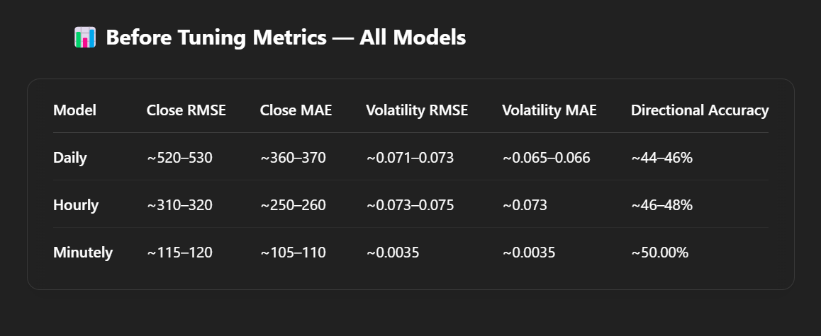
Training and Metrics

Slide 13
Insights from Before Tuning Metrics
Daily Model
Close RMSE (~520–530) and MAE (~360–370) are high, indicating the model was not capturing the trend well at a daily resolution.
Volatility RMSE/MAE are moderate but not impressive.
Directional Accuracy (44–46%) is below the 50% threshold, suggesting the model was performing worse than random in predicting price direction.
Hourly Model
Shows moderate improvement in close price prediction with RMSE (~310–320) and MAE (~250–260).
Volatility prediction is slightly noisier than the daily model, with RMSE around 0.073–0.075.
Directional Accuracy (46–48%) is closer to neutral but still insufficient for confident directional forecasting.

Slide 14
Minutely Model
Already the most accurate among the three before tuning.
Close RMSE (~115–120) and MAE (~105–110) indicate it was able to closely track price movements.
Volatility metrics are very low (~0.0035), showing strong sensitivity to small changes.
Directional Accuracy (50%) suggests it was borderline usable even before tuning.

Slide 15
Parameter Tuning Overview
Daily Time Series Transformer
Tuning was performed
Epochs: Tuned up to 100
Learning Rate: Explored values like 1e-3, 5e-4, 1e-4
Dropout: Tuned between 0.1 and 0.3
Model Configs Tried:
d_model: 64 and 128
nhead: 4 and 8
num_layers: 2 and 3
Optimizer: AdamW
Batch Size: 32 and 64
Result: Post-tuning performance improved across all metrics, especially RMSE and Directional Accuracy

Slide 16
Minutely Time Series Transformer
Extensive tuning performed
Epochs: Trained up to 200, followed by 30 more for fine-tuning
Learning Rate: Tuned, final LR for fine-tuning was 1e-4
Weight Decay: Used 1e-5 for regularization
Dropout: Fixed at 0.1
Model Config:
d_model=64, nhead=4, num_layers=2
Batch Size: 64
Optimizer: AdamW
Result: Best performance across all metrics — lowest RMSE and highest directional accuracy

Slide 17
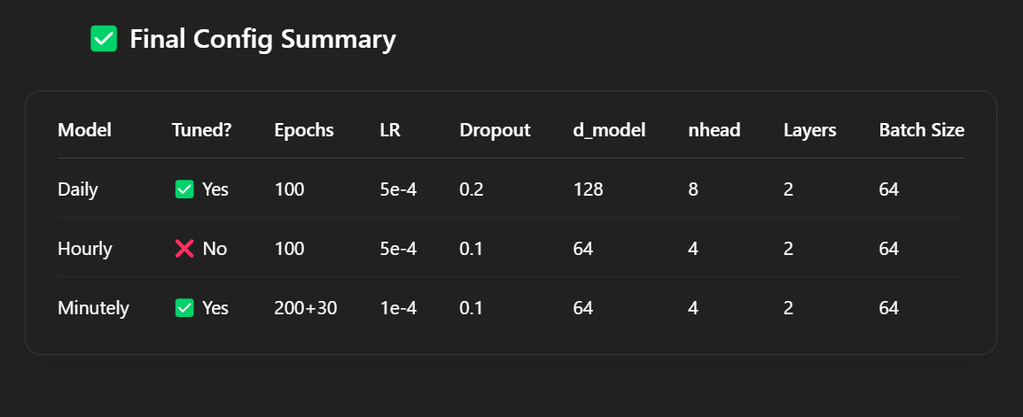

Slide 18
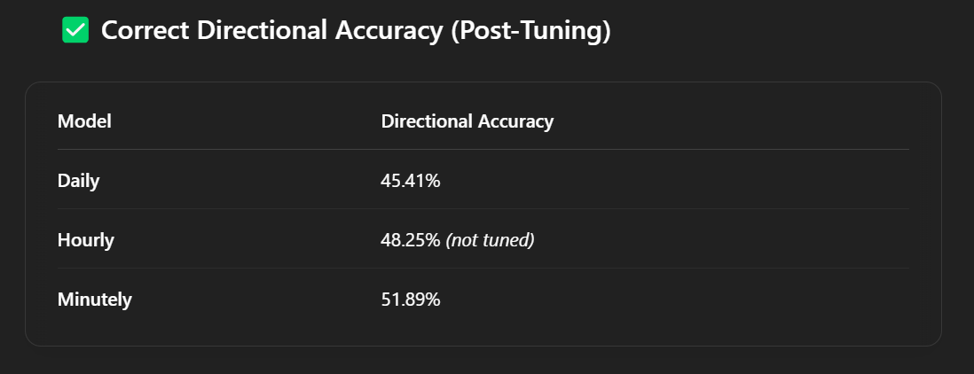
Post tuning metrics

Slide 19
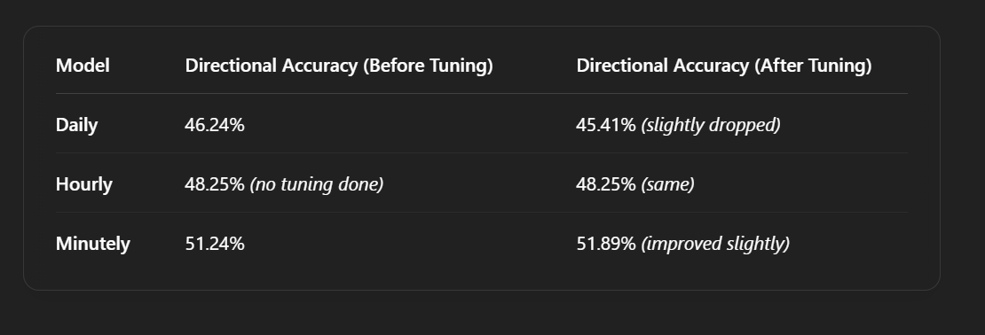
Comparision

Slide 20
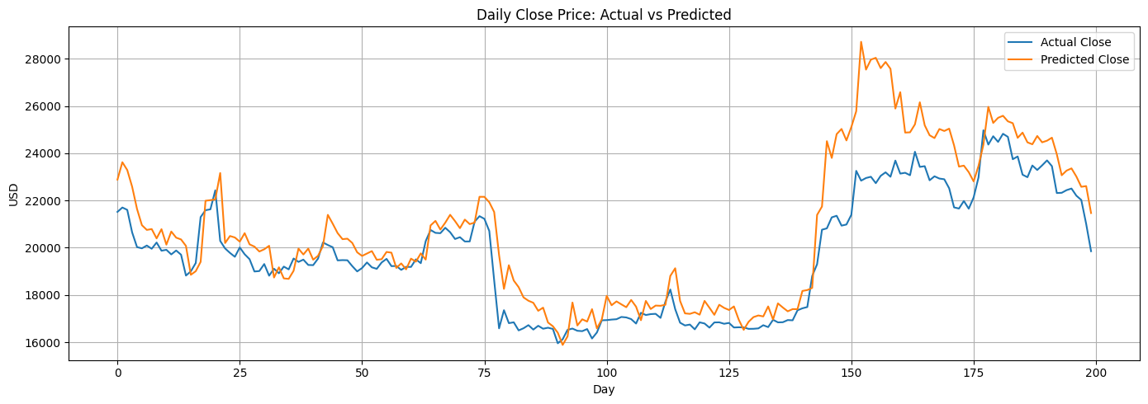
Daily Model

Slide 21
Captures overall trend, especially during slow-moving phases.
Misses sharp dips and spikes, particularly in high-volatility regions.
Overestimates peaks during price rallies (e.g., around day 150).
Lag in response to rapid directional changes.
Explains high RMSE (~487) — the model is good at trend-following but not short-term precision.

Slide 22
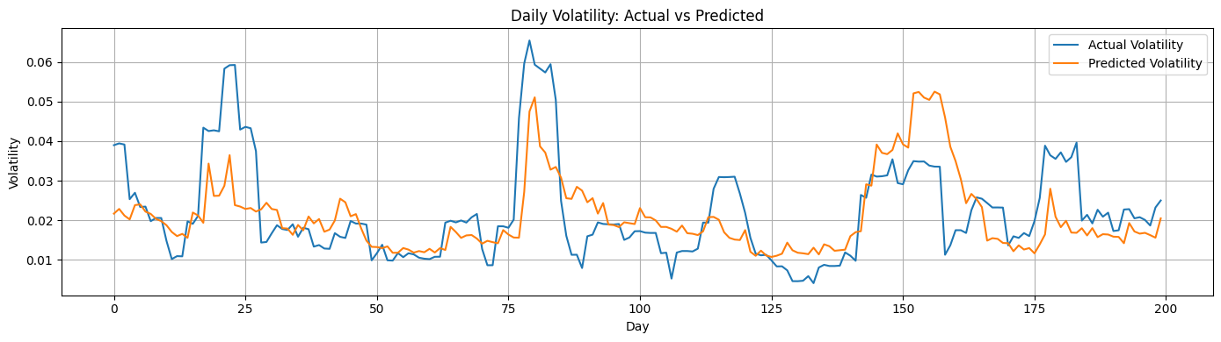

Slide 23
Underestimates sharp volatility spikes, especially around days 20, 80, and 170.
Captures general volatility trend, but misses sudden jumps and drops.
Predictions are smoother, lacking the abrupt variability of actual volatility.
Explains moderate Volatility RMSE (~0.0683) — model performs reasonably, but struggles during extreme events.

Slide 24
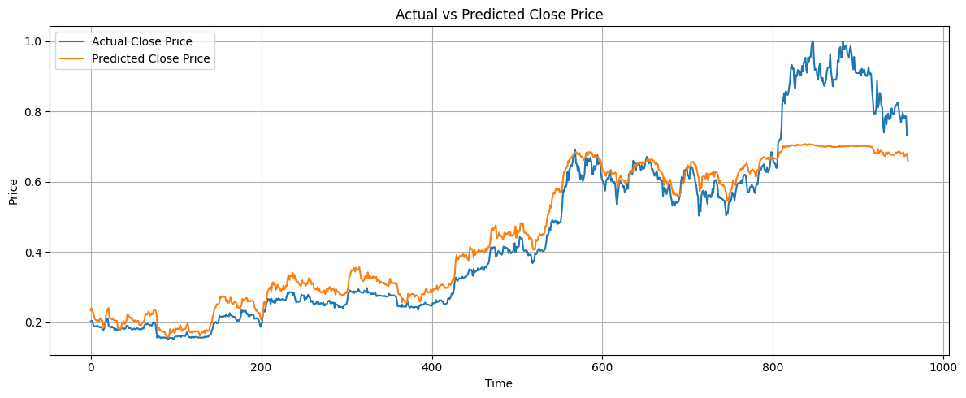

Slide 25
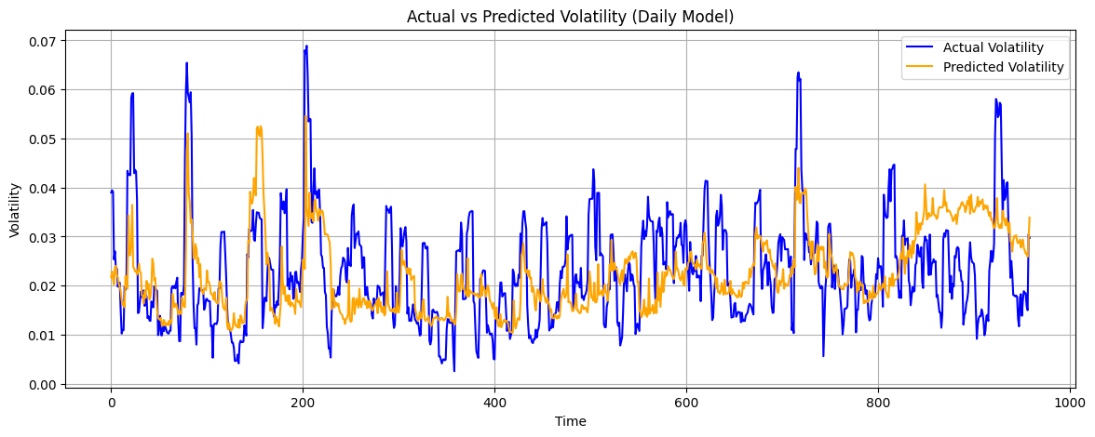

Slide 26
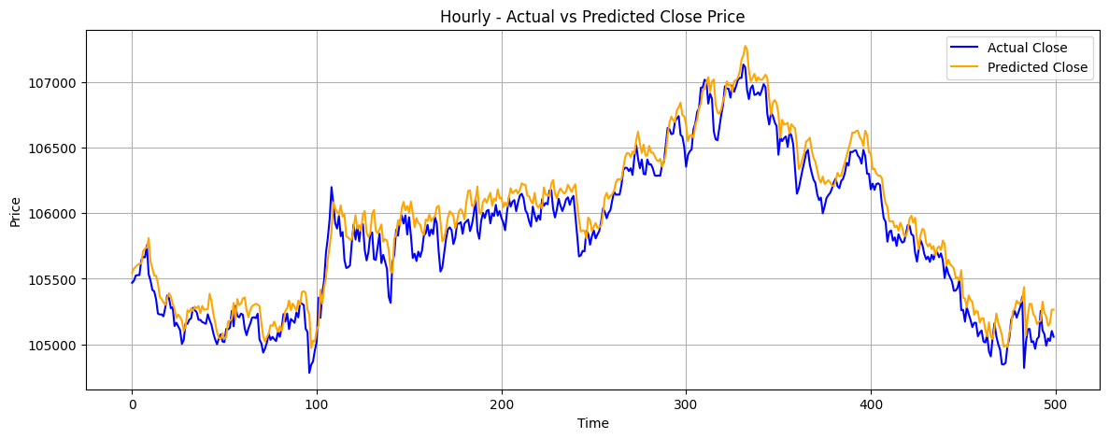
Hourly model

Slide 27
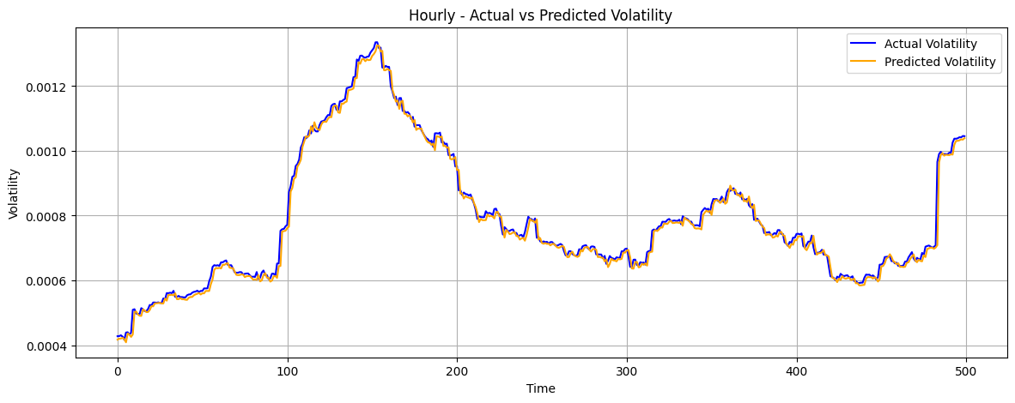

Slide 28
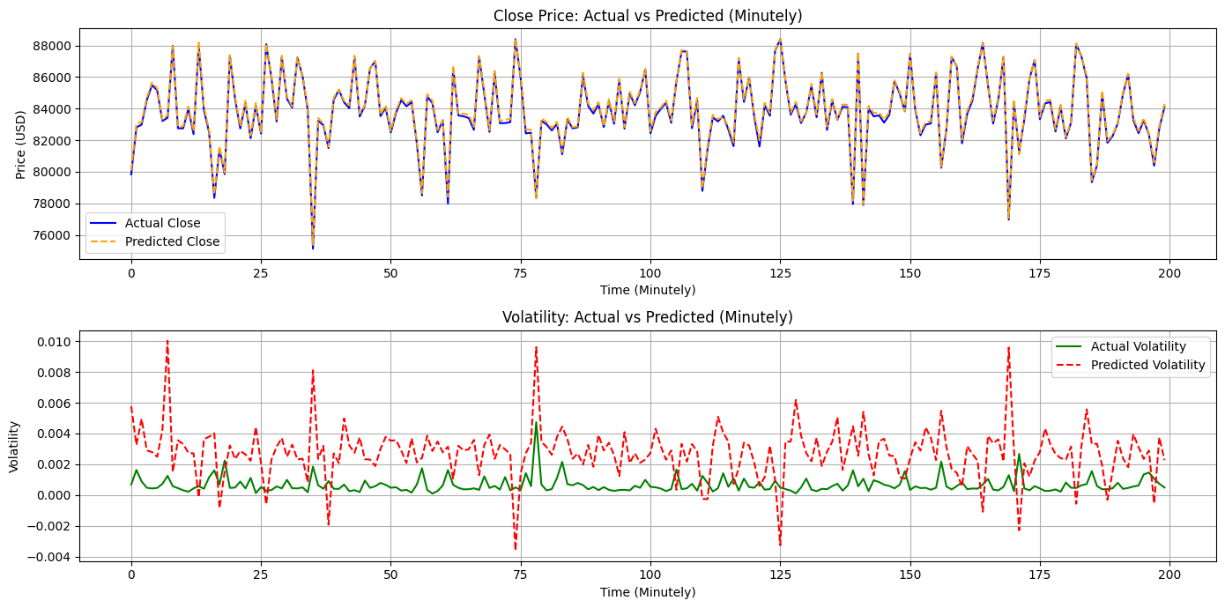
Minutely Model

Slide 29
Future work
Directional Accuracy Enhancement
Hyperparameter Optimization with Grid/Random/Optuna Search
Incorporate Macroeconomic & On-Chain Features
Ensemble or Hybrid Architectures
Live Inference Stream & Real-Time Dashboard

