Slide 1
Data607_Final_Project_Presentation
Mahmud Hasan Al Raji

Slide 2
Introduction on data
In this project, I used the unemployment rate data for the US states collected from The U.S. Bureau of Labor Statistics for the year between 2017 and 2021 by using web scrapping from their web page.
I also collected mass shooting casualty data as CSV files from the Gun Violence Archive and stored them on my github. The data is comprised of annual average unemployment rate for the US states

Slide 3
Research question :
“Does unemployment rate have an effect on mass shootings in US states?”

Slide 4
Work Flow
Data collection
Data Preparation: Data tidying, cleaning and transformation
Conducting exploratory and statistical analysis (linear regression analysis) to see if there is a correlation between the stated variables
Making decision

Slide 5
Libraries used: library(dplyr) library(rvest) library(ggplot2)

Slide 6
Unemployment rate data for 2021
# Uemployment rate data of 2021 annual averages
unemp2021_url<-read_html("https://www.bls.gov/lau/lastrk21.htm")
unemp_data_2021<-unemp2021_url %>% html_nodes(xpath='//*[@id="lastrk21"]/tbody') %>% html_table()
unemp2021_df<-as.data.frame(unemp_data_2021)
## List of 1 ## $ : tibble [53 × 3] (S3: tbl_df/tbl/data.frame) ## ..$ X1: chr [1:53] "United States" "" "Nebraska" "Utah" ... ## ..$ X2: num [1:53] 5.3 NA 2.5 2.7 3.1 3.2 3.4 3.4 3.4 3.4 ... ## ..$ X3: int [1:53] NA NA 1 2 3 4 5 5 5 5 ...
## X1 X2 X3 ## 1 United States 5.3 NA ## 2 NA NA ## 3 Nebraska 2.5 1 ## 4 Utah 2.7 2 ## 5 South Dakota 3.1 3 ## 6 Kansas 3.2 4

Slide 7
Unemployment fate data for 2020
# Unemployment rate data of 2020 annual averages
unemp2020_url<-read_html("https://www.bls.gov/lau/lastrk20.htm")
unemp_data_2020<-unemp2020_url %>% html_nodes(xpath='//*[@id="lastrk20"]/tbody') %>% html_table()
unemp2020_df<-as.data.frame(unemp_data_2020)
head(unemp2020_df)
## X1 X2 X3 ## 1 United States 8.1 NA ## 2 NA NA ## 3 Nebraska 4.1 1 ## 4 South Dakota 4.3 2 ## 5 Utah 4.7 3 ## 6 Maine 5.0 4

Slide 8
Unemployment rate data for 2019
# Unemployment rate data of 2019 annual averages
unemp2019_url<-read_html("https://www.bls.gov/lau/lastrk19.htm")
unemp_data_2019<-unemp2019_url %>% html_nodes(xpath='//*[@id="lastrk19"]/tbody') %>% html_table()
unemp2019_df<-as.data.frame(unemp_data_2019)
head(unemp2019_df)
## X1 X2 X3 ## 1 United States 3.7 NA ## 2 NA NA ## 3 North Dakota 2.1 1 ## 4 Vermont 2.3 2 ## 5 Hawaii 2.5 3 ## 6 Colorado 2.6 4

Slide 9
Unemployment rate data for 2018
# Unemployment rate data of 2018 annual averages
unemp2018_url<-read_html("https://www.bls.gov/lau/lastrk18.htm")
unemp_data_2018<-unemp2018_url %>% html_nodes(xpath='//*[@id="lastrk18"]/tbody') %>% html_table()
unemp2018_df<-as.data.frame(unemp_data_2018)
head(unemp2018_df)
## X1 X2 X3 ## 1 United States 3.9 NA ## 2 NA NA ## 3 Hawaii 2.4 1 ## 4 North Dakota 2.4 1 ## 5 Iowa 2.5 3 ## 6 New Hampshire 2.6 4

Slide 10
Unemployment rate data for 2017
# Unemployment rate data of 2017 annual average
unemp2017_url<-read_html("https://www.bls.gov/lau/lastrk17.htm")
unemp_data_2017<-unemp2017_url %>% html_nodes(xpath='//*[@id="lastrk17"]/tbody') %>% html_table()
unemp2017_df<-as.data.frame(unemp_data_2017)
head(unemp2017_df)
## X1 X2 X3 ## 1 United States 4.4 NA ## 2 NA NA ## 3 Hawaii 2.2 1 ## 4 Colorado 2.6 2 ## 5 North Dakota 2.6 2 ## 6 New Hampshire 2.8 4

Slide 11
Unemployment rate data tidying and transformation: #Remove irrelevant rows and columns from data frames unemp2021_df<-unemp2021_df %>% slice(-c(1,2)) unemp2021_df<-subset(unemp2021_df, select=-X3) unemp2020_df<-unemp2020_df %>% slice(-c(1,2)) unemp2020_df<-subset(unemp2020_df, select=-X3) unemp2019_df<-unemp2019_df %>% slice(-c(1,2)) unemp2019_df<-subset(unemp2019_df, select=-X3) unemp2018_df<-unemp2018_df %>% slice(-c(1,2)) unemp2018_df<-subset(unemp2018_df, select=-X3) unemp2017_df<-unemp2017_df %>% slice(-c(1,2)) unemp2017_df<-subset(unemp2017_df, select=-X3)

Slide 12
#Renaming columns
unemp2021_df<-unemp2021_df %>% rename(state=X1,unemployment_rate_2021=X2)
head(unemp2021_df)
## state unemployment_rate_2021 ## 1 Nebraska 2.5 ## 2 Utah 2.7 ## 3 South Dakota 3.1 ## 4 Kansas 3.2 ## 5 Alabama 3.4 ## 6 Minnesota 3.4
unemp2020_df<-unemp2020_df %>% rename(state=X1,unemployment_rate_2020=X2)
unemp2019_df<-unemp2019_df %>% rename(state=X1,unemployment_rate_2019=X2)
unemp2018_df<-unemp2018_df %>% rename(state=X1,unemployment_rate_2018=X2)
unemp2017_df<-unemp2017_df %>% rename(state=X1,unemployment_rate_2017=X2)

Slide 13
#Combining data frames with one column name in common
unemp_df<-full_join(unemp2021_df,unemp2020_df,by="state") %>%
full_join(unemp2019_df,by="state") %>%
full_join(unemp2018_df,by="state") %>%
full_join(unemp2017_df,by="state")
## state unemployment_rate_2021 unemployment_rate_2020 ## 1 Nebraska 2.5 4.1 ## 2 Utah 2.7 4.7 ## 3 South Dakota 3.1 4.3 ## 4 Kansas 3.2 5.7 ## 5 Alabama 3.4 6.5 ## 6 Minnesota 3.4 6.3 ## unemployment_rate_2019 unemployment_rate_2018 unemployment_rate_2017 ## 1 3.0 2.9 3.0 ## 2 2.6 2.9 3.1 ## 3 2.8 2.8 3.1 ## 4 3.1 3.3 3.6 ## 5 3.2 3.9 4.5 ## 6 3.4 3.1 3.5

Slide 14
#Convert to lowercase in data frames
unemp_df$state<-tolower(unemp_df$state)
head(unemp_df)
## state unemployment_rate_2021 unemployment_rate_2020 ## 1 nebraska 2.5 4.1 ## 2 utah 2.7 4.7 ## 3 south dakota 3.1 4.3 ## 4 kansas 3.2 5.7 ## 5 alabama 3.4 6.5 ## 6 minnesota 3.4 6.3 ## unemployment_rate_2019 unemployment_rate_2018 unemployment_rate_2017 ## 1 3.0 2.9 3.0 ## 2 2.6 2.9 3.1 ## 3 2.8 2.8 3.1 ## 4 3.1 3.3 3.6 ## 5 3.2 3.9 4.5 ## 6 3.4 3.1 3.5

Slide 15
#Sorting data frame by alphabetic order
unemp_df <- unemp_df[order(unemp_df$state),]
head(unemp_df)
## state unemployment_rate_2021 unemployment_rate_2020 ## 5 alabama 3.4 6.5 ## 46 alaska 6.4 8.2 ## 27 arizona 4.9 7.7 ## 17 arkansas 4.0 6.1 ## 51 california 7.3 10.2 ## 33 colorado 5.4 6.9 ## unemployment_rate_2019 unemployment_rate_2018 unemployment_rate_2017 ## 5 3.2 3.9 4.5 ## 46 5.5 6.0 6.5 ## 27 4.9 4.8 5.0 ## 17 3.5 3.6 3.7 ## 51 4.1 4.3 4.8 ## 33 2.6 3.0 2.6

Slide 16
#Adding average unemployment rate column
unemp_df<-unemp_df %>%
rowwise() %>%
mutate(avg_unemp_rate = mean(c_across(unemployment_rate_2021:unemployment_rate_2017))) %>% select(state,avg_unemp_rate)
glimpse(unemp_df)
head(unemp_df)
## Rows: 51 ## Columns: 2 ## Rowwise: ## $ state <chr> "alabama", "alaska", "arizona", "arkansas", "california… ## $ avg_unemp_rate <dbl> 4.30, 6.52, 5.46, 4.18, 6.14, 4.10, 5.18, 4.98, 6.34, 4…
## # A tibble: 6 × 2 ## # Rowwise: ## state avg_unemp_rate ## <chr> <dbl> ## 1 alabama 4.3 ## 2 alaska 6.52 ## 3 arizona 5.46 ## 4 arkansas 4.18 ## 5 california 6.14 ## 6 colorado 4.1

Slide 17
Getting mass shooting casualty data df_2017<-read.csv("https://raw.githubusercontent.com/Raji030/data607_mass_shooting/main/2017.csv") df_2018<-read.csv("https://raw.githubusercontent.com/Raji030/data607_mass_shooting/main/2018.csv") df_2019<-read.csv("https://raw.githubusercontent.com/Raji030/data607_mass_shooting/main/2019.csv") df4<-read.csv("https://raw.githubusercontent.com/Raji030/data607_mass_shooting/main/19-22.csv")

Slide 18
Mass shooting casualty data tidying and transformation
#Merging rows with the same name in state column
df_2017<-df_2017 %>% group_by(state) %>% summarise_each(funs(sum))
df_2018<-df_2018%>% group_by(state) %>% summarise_each(funs(sum))
df_2019<-df_2019 %>% group_by(state) %>% summarise_each(funs(sum))
df_2020<-df_2020 %>% group_by(state) %>% summarise_each(funs(sum))
df_2021<-df_2021 %>% group_by(state) %>% summarise_each(funs(sum))

Slide 19
Combine casualty dataframe
## # A tibble: 6 × 6 ## state total_casualty_2021 total_casualty_2020 total_cas…¹ total…² total…³ ## <chr> <int> <int> <int> <int> <int> ## 1 Alabama 107 53 67 67 44 ## 2 Alaska 5 13 NA NA NA ## 3 Arizona 37 20 33 9 20 ## 4 Arkansas 29 58 23 24 37 ## 5 California 224 190 258 186 186 ## 6 Colorado 74 58 22 36 12 ## # … with abbreviated variable names ¹​total_casualty_2019, ²​total_casualty_2018, ## # ³​total_casualty_2017

Slide 20
Convert state name to lower case # Convert state name to lower case casualty_df$state<-tolower(casualty_df$state)

Slide 21
order state name alphabetically
casualty_df <- casualty_df[order(casualty_df$state),]
casualty_df
## # A tibble: 48 × 6 ## state total_casualty_2021 total_casu…¹ total…² total…³ total…⁴ ## <chr> <int> <int> <int> <int> <int> ## 1 alabama 107 53 67 67 44 ## 2 alaska 5 13 NA NA NA ## 3 arizona 37 20 33 9 20 ## 4 arkansas 29 58 23 24 37 ## 5 california 224 190 258 186 186 ## 6 colorado 74 58 22 36 12 ## 7 connecticut 8 34 13 8 8 ## 8 delaware 29 14 10 5 4 ## 9 district of columbia 75 63 32 25 24 ## 10 florida 187 159 74 179 122 ## # … with 38 more rows, and abbreviated variable names ¹​total_casualty_2020, ## # ²​total_casualty_2019, ³​total_casualty_2018, ⁴​total_casualty_2017

Slide 22
Combine unemployment and casualty data and get final data frame
df_combined<-full_join(unemp_df,casualty_df,by="state")
head(df_combined)
df_combined[is.na(df_combined)] <- 0
Head(df_combined)
## # A tibble: 51 × 7 ## # Rowwise: ## state avg_unemp_rate total_c…¹ total…² total…³ total…⁴ total…⁵ ## <chr> <dbl> <int> <int> <int> <int> <int> ## 1 alabama 4.3 107 53 67 67 44 ## 2 alaska 6.52 5 13 NA NA NA ## 3 arizona 5.46 37 20 33 9 20 ## 4 arkansas 4.18 29 58 23 24 37 ## 5 california 6.14 224 190 258 186 186 ## 6 colorado 4.1 74 58 22 36 12
## # A tibble: 51 × 7 ## # Rowwise: ## state avg_unemp_rate total_c…¹ total…² total…³ total…⁴ total…⁵ ## <chr> <dbl> <int> <int> <int> <int> <int> ## 1 alabama 4.3 107 53 67 67 44 ## 2 alaska 6.52 5 13 0 0 0 ## 3 arizona 5.46 37 20 33 9 20 ## 4 arkansas 4.18 29 58 23 24 37 ## 5 california 6.14 224 190 258 186 186 ## 6 colorado 4.1 74 58 22 36 12

Slide 23
Adding average and total casualty column and get the final data set
df_final<-df_combined %>%
rowwise() %>%
mutate(avg_casualty = mean(c_across(total_casualty_2021:total_casualty_2017)),total_casualty=sum(c_across(total_casualty_2021:total_casualty_2017))) %>% select(state,avg_unemp_rate,avg_casualty,total_casualty)
df_final<-data.frame(df_final)
glimpse(df_final)
head(df_final)
## Rows: 51 ## Columns: 4 ## $ state <chr> "alabama", "alaska", "arizona", "arkansas", "california… ## $ avg_unemp_rate <dbl> 4.30, 6.52, 5.46, 4.18, 6.14, 4.10, 5.18, 4.98, 6.34, 4… ## $ avg_casualty <dbl> 67.6, 3.6, 23.8, 34.2, 208.8, 40.4, 14.2, 12.4, 43.8, 1… ## $ total_casualty <int> 338, 18, 119, 171, 1044, 202, 71, 62, 219, 721, 378, 0,…
## state avg_unemp_rate avg_casualty total_casualty ## 1 alabama 4.30 67.6 338 ## 2 alaska 6.52 3.6 18 ## 3 arizona 5.46 23.8 119 ## 4 arkansas 4.18 34.2 171 ## 5 california 6.14 208.8 1044 ## 6 colorado 4.10 40.4 202

Slide 24
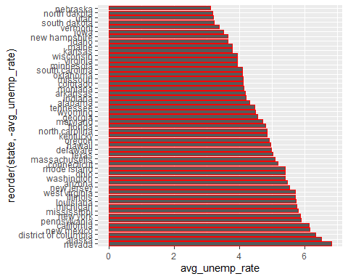
Visualize average unemployment rate in states ggplot(unemp_df,aes(x=reorder(state,-avg_unemp_rate), avg_unemp_rate))+geom_bar(stat='identity',width = 0.8,color='red')+coord_flip()

Slide 25
Check state names with highest and lowest average unemployement rate
## [1] "nevada"
## [1] 6.82
## [1] "nebraska"
## [1] 3.1

Slide 26
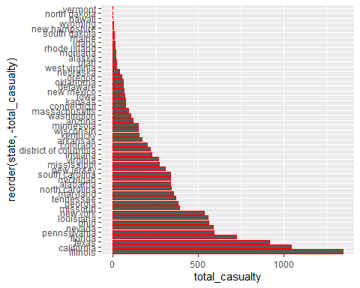
Visualize total casualty in states ggplot(df_final,aes(x=reorder(state,-total_casualty), total_casualty))+geom_bar(stat='identity',width = 0.8,color='red')+coord_flip()

Slide 27
Check state names with highest and lowest mass shooting casualty
## [1] "illinois"
## [1] 1345
## [1] "hawaii"
## [1] 0

Slide 28
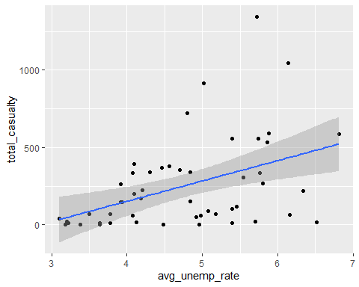
Linear regression analysis
Plotting the relationship between the average unemployment rate and total casualty in US states for the year between 2017 and 2021 considering average unemployment rate as the predictor (independent variable ).
ggplot(df_final,aes(x=avg_unemp_rate,y=total_casualty))+geom_point(stat="identity")+geom_smooth(method = "lm")

Slide 29
Find correlation coefficient
## cor(avg_unemp_rate, total_casualty) ## 1 0.4384533
The coefficient value above indicates a moderate relationship between the variables.

Slide 30
Find the linear model
By using the lm function to fit the linear model ( a.k.a regression line):
## ## Call: ## lm(formula = total_casualty ~ avg_unemp_rate, data = df_final) ## ## Residuals: ## Min 1Q Median 3Q Max ## -464.97 -179.17 -40.33 129.22 967.15 ## ## Coefficients: ## Estimate Std. Error t value Pr(>|t|) ## (Intercept) -373.81 186.17 -2.008 0.05019 . ## avg_unemp_rate 131.41 38.48 3.415 0.00129 ** ## --- ## Signif. codes: 0 '***' 0.001 '**' 0.01 '*' 0.05 '.' 0.1 ' ' 1 ## ## Residual standard error: 264.2 on 49 degrees of freedom ## Multiple R-squared: 0.1922, Adjusted R-squared: 0.1758 ## F-statistic: 11.66 on 1 and 49 DF, p-value: 0.00129

Slide 31
Model Summary:
With the summary above,the least squares regression line for the linear model: yˆ= 131.41 × (avg_unemp_rate)-373.81
The positive slope line indicates that it’s trend is upward. The slope of the line also indicates that if change in average unemployment rate happens by 1, the change in total casualty value will go up by 131.41.
The R-squared value above is very low (0.19) which indicating that the correlation between the two variables is not strong. It is also reflecting that 19% of the variability in the predicting variables can be explained by this model.
The p-value,0.00129 is lower than the usual significance level (0.05) which indicating that the average unemployment rate is statistically significant.

Slide 32
Set up and examine hypothesis test conditions:
Null Hypothesis: There is no relationship between average unemployment rate and mass shooting casualty
Alternate Hypothesis: There is a relationship between average unemployment rate and mass shooting casualty
Based on summary the above, it is seen a slight trend but a weak correlation. The P_value is less than the usual significance level 0.05 indicating that the null hypothesis will be rejected . But this does not mean that the alternative hypothesis is true here.

Slide 33
Model diagnostic
To assess whether the linear model is reliable, I will check for linearity, nearly normal residual and constant variability of the residuals.

Slide 34
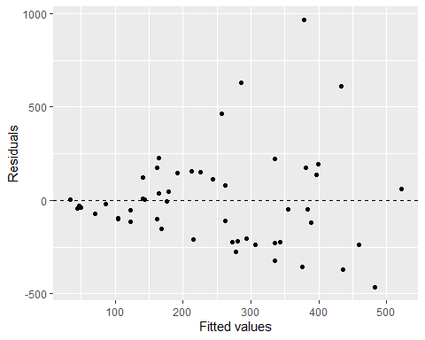
Linearity check by the residuals vs. fitted (predicted) plot: ggplot(data = linear_model, aes(x = .fitted, y = .resid)) + geom_point() + geom_hline(yintercept = 0, linetype = "dashed") + xlab("Fitted values") + ylab("Residuals")

Slide 35
From the plot above, it is seen that the residuals are not distributed around 0 with a consistent pattern, which indicating a linear trend. So, I can not assume a linear regression model for fitting the data set here.

Slide 36
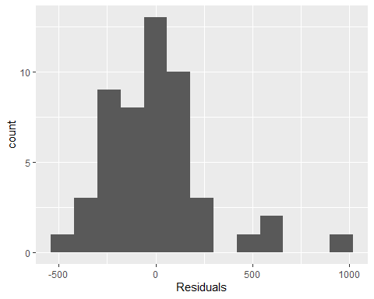
Nearly normal residuals check by plotting histogram: ggplot(data = linear_model, aes(x = .resid)) + geom_histogram(binwidth = 120) + xlab("Residuals")

Slide 37
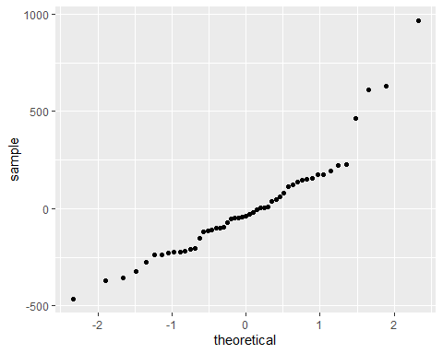
Normal probability plot of the residuals: ggplot(data = linear_model, aes(sample = .resid)) + stat_qq()

Slide 38
It is seen that the histogram is not nearly normally distributed (right skewed). Also, the qq plot is not reflecting a straight line. It has zig-zag and curvature in its shape and errant points. So, the residuals condition for being nearly normal is not met here.
** Constant variability check: From the residuals vs. fitted plot above, it is seen that the spread of the residuals is not roughly equal at each level of the fitted values.So, the constant variance condition or assumption is not properly met here.

Slide 39
Conclusion
The correlation coefficient value (0.44) is suggesting a moderate correlation between the unemployment rate and mass shooting casualty and the p-value (0.00129) is lower than the usual significance level (0.05) is indicating that the unemployment rate is statistically significant.
From the linear model diagnostics above, it is seen that the linear regression model was unable to satisfy all the conditions for a strong correlation between the two variables. So, the model will not work properly to predict the relationship between the variables i chose here. Hence, from this analysis it can be said that the unemployment rate in states is not the proper predictor of the mass shooting casualty in US. Rather, it is a relatively a weak predictor of the mass shooting casualties and it is practical.
Since, other factors like far-right radicalization, community’s change in employment or economic well-being over time have much impact on mass shooting casualties. Therefore, it can be said that the effect of unemployment rate alone is less on mass shooting casualty in USA.

Slide 40
Challenges:
Data selection and data collection
Data tidying and cleaning
Finding appropriate analysis method and codes

Slide 41
References:
Unemployment rate data source: https://www.bls.gov/ US mass shooting casualty data source: https://www.gunviolencearchive.org/ Introduction to linear regression: https://fall2022.data606.net/chapters/chapter8/ https://github.com/Raji030/data606_lab8

