Slide 1

FLOOD MONITORING SYSTEM
PHASE-2: INNOVATION
TEAM MEMBERS: PRIYADHARSHINI
KADHAMBARI
RAJESHWARI
KAVIYA
ARCHANA
SHALINI

Slide 2

1. Data Collection and Preparation:
Historical Data: Gather detailed historical flood data, including information on water levels, rainfall, river discharge, and impact on affected areas. This data serves as the foundation for understanding past events.
Additional Data: Include data on terrain, land use, soil types, vegetation, and climate patterns. These variables can influence how floods occur and their impact on communities.

Slide 3

2. Data Preprocessing and Cleaning:
Data Integration: Combine historical flood data with other relevant datasets to create a comprehensive database for analysis.
Handling Missing Data: Address any missing or incomplete data points using techniques like interpolation or data imputation.
Outlier Detection: Identify and handle outliers in the dataset, ensuring that they do not skew the predictive model.

Slide 4

3. Feature Selection and Engineering:
Feature Importance: Use techniques like correlation analysis and feature importance scores from machine learning algorithms to identify the most relevant variables.
Create New Features: Generate new features based on domain knowledge, such as historical flood frequency, seasonal patterns, or long-term climate trends.

Slide 5

4. Predictive Modeling:
Choose Suitable Models: Select appropriate predictive modeling techniques such as Random Forest, Gradient Boosting, or Neural Networks based on the nature of the problem and the dataset.
Time-Series Analysis: If dealing with time-dependent data, consider time-series models like ARIMA (AutoRegressive Integrated Moving Average) or SARIMA (Seasonal ARIMA) for accurate predictions.
Cross-Validation: Implement cross-validation techniques to assess the model's performance and generalizability to new data.

Slide 6

5. Model Training and Validation:
Training the Model: Train the selected predictive model using the prepared dataset, ensuring that it captures the underlying patterns in the historical flood data.
Validation and Testing: Validate the model using a separate subset of the historical data (not used during training) to evaluate its accuracy and reliability.

Slide 7

6. Continuous Improvement and Updating:
Real-Time Data Integration: Integrate real-time data from sensors and other sources to continuously update the predictive model, ensuring it reflects the latest conditions.
Model Calibration: Regularly calibrate the model using the most recent data to adapt to changing environmental factors and improve accuracy over time.

Slide 8

7. Early Warning System Integration:
Thresholds and Triggers: Set specific thresholds based on the predictive model's output. When the predicted risk surpasses these thresholds, trigger early warnings.
Alert Dissemination: Develop a robust alert system to disseminate warnings through various channels such as SMS, mobile apps, sirens, and social media platforms.

Slide 9

8. Feedback Loop and Evaluation:
Community Feedback: Encourage feedback from communities regarding the accuracy of warnings and their effectiveness. Use this feedback to make necessary adjustments and improvements.
Periodic Evaluation: Regularly evaluate the predictive model's performance against actual flood events, making adjustments as needed to enhance accuracy.

Slide 10


9.Machine Learning and Predictive Analytics:
Anomaly Detection: Machine learning algorithms can identify anomalies in sensor data, helping detect unusual patterns that might indicate an imminent flood.
Predictive Modeling: Advanced predictive models using machine learning can forecast flood events based on historical data, weather patterns, and real-time sensor inputs.
This Photo by Unknown author is licensed under CC BY.

Slide 11


10.Sensors:
Water Level Sensors: Deploy water level sensors in rivers, streams, and flood-prone areas to measure water levels continuously.
Rainfall Sensors: Install rainfall sensors to measure precipitation in real-time.
Soil Moisture Sensors: Monitor soil moisture levels to assess the ground's saturation point.
Weather Stations: Gather data on temperature, humidity, wind speed, and direction to understand weather patterns.

Slide 12

11.IoT Devices:
Microcontrollers (e.g., Arduino, Raspberry Pi): Connect sensors to microcontrollers to process data locally.
Communication Modules (e.g., GSM, LoRa, NB-IoT): Transmit sensor data to a central server or cloud platform securely.

Slide 13

12.Remote Sensing and Satellite Technology:
Satellite Data Integration: Incorporating satellite imagery for real-time monitoring of large-scale weather patterns and early detection of potential flooding areas.
Remote Sensing Devices: Using remote sensing devices on satellites for detailed mapping and monitoring of flood-prone regions.

Slide 14
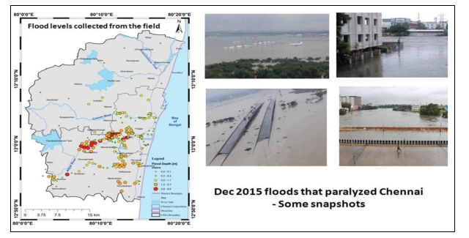
Chennai Flood, December 2015
The 2015 Chennai floods which paralysed the city was due to three consecutive weather systems that brought in unprecedented rain to the city. Chennai came to a standstill, in spite of its extensive drainage connectivity, comprising three major rivers namely Kosasthalaiyar, Cooum, Adyar , the mammoth Buckingham canal, ennore creek, pallikaranai marsh and man-made drainage systems.

Slide 15
Program :
Python
from sklearn.model_selection import
train_test_split
from sklearn.ensemble import RandomForestClassifier
from sklearn.metrics import accuracy_score
X = data.drop('label_column', axis=1) y = data['label_column’]
X_train, X_test, y_train, y_test = train_test_split(X, y, test_size=0.2, random_state=42)
clf = RandomForestClassifier()
clf.fit(X_train, y_train)
y_pred = clf.predict(X_test)
accuracy = accuracy_score(y_test, y_pred)
print("Accuracy:", accuracy)

Slide 16
Output :
The code I provided calculates the accuracy of a flood monitoring model. After running the code, you will get an output that includes the accuracy score. Here's what the output might look like in the console:
Accuracy: 0.85
In this example, the accuracy is 0.85, which means the model correctly predicted the flood occurrence in 85% of the test data. The specific accuracy value may vary based on your dataset and the model's performance.

Slide 17
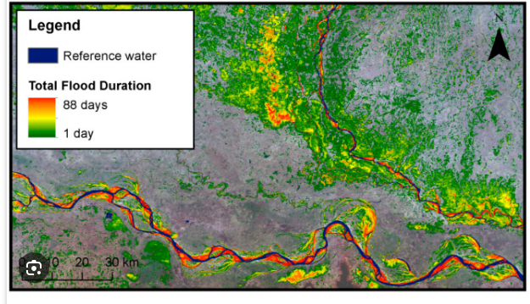
Automatic flood duration estimation based on Multi-Sensor Satellite Data

