Slide 1
Employee Gender analysis using Excel
Student Name-A.Rajeshwari
Register no-312215059
Department –Commerce
College – Soka ikeda college

Slide 2
Project Title
Employee Gender analysis using Excel

Slide 3
Agenda
Problem statement
Project overview
End users
Our solution proposition
Data set description
Modeling approach
Results and discussion
Conclusion

Slide 4
Problem statement
The employee Gender analysis project aims to examine gender distribution, representation, potential disparities within an organization.By analysing data on employee demographic, position, promotion,and salaries,the project seeks to identify trends and patterns they may indicate gender biases or imbalances.
The findings will inform recommendations fostering a more equitable workplace, ensuring derverity,and promoting inclusive policies.

Slide 5
Project overview
The employee Gender analysis project aims to access gender distribution and disparities with an organisation.
It involves collecting and analysing employee data , including gender ,job role , promotion, salaries,and performance rating.
The goal is to identify trends, ensure equitable treatment,and inform polcies to promote diversity and inclusion.
The project will provide actionable insights to address gender imbalances and enhance organisation fairness

Slide 6
Who aretheendusers?
The end users for the employee Gender analysis datasets:
Diversity and llusion officers.
Company executives.
Hr manager.

Slide 7
Our solution and it’s value proposition
Our solution for the employee Gender analysis project is an comprehensive data analytics tools that visualise Gender distribution across various roles and departments
The value proposition lies in its ability to provide actionable insights for promoting gender equality, identifying disparities,and ensuring compliance with diversity policies
This tool empower hr and leadership and teams to make how informed decisions.
Potering the more inclusive balanced work place environment.

Slide 8
Data set description
The data which I used for this analysis,which I download from kaggle
There are 8 features in their data
Example
Emp ID
Name
Gender
Department
Salary
Employee type
Work location

Slide 9
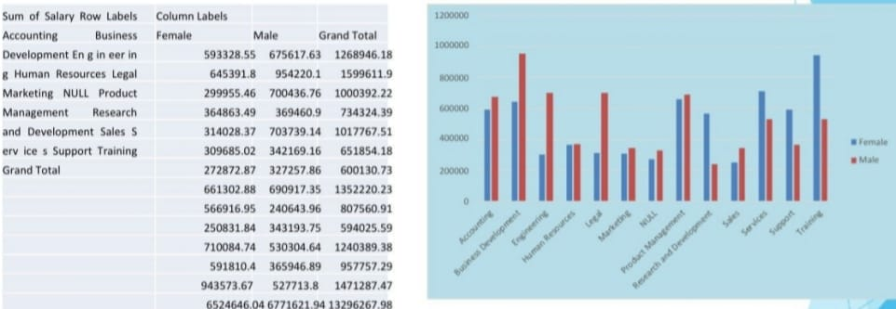
Results

Slide 10
Conclusion
In conclusion,the employee Gender analysis project offers vital insights into gender representation,enabling stakeholders to identify disparities and drive positive change.
Bye leveraging data company can promote a more inclusive workplace,align with diversity goal,and enhance employee sratification.

