Slide 1
AIRLINE RESERVATION SYSTEM
Submitted by: Ms.Raji M, Mr.Srikanth , Ms.NandhaKumar.
Batch No. 7457
Under the Guidance of
Trainer Mrs. Yogesh Gopal Jangle

Slide 2
Introduction
The project “Airline Reservation System” is developed using spring boot framework, which mainly focuses on basic operations of passenger, flight and Ticket information system. Like Inserting, Deleting, Updating and getting all records of flight, passenger and Ticket information’s.

Slide 3
Module
Passenger Module
Flight Module
Ticket Info Module

Slide 4
Passenger Module
In the Passenger module we can perform:
We can add new Passenger records.
We can update Passenger records using Passenger id.
Fetch all Passenger’s records.
Fetch Passenger record by using Passenger id.
Fetch Passenger List record by Passenger name.
Fetch Passenger List record by Passenger Gender.
Fetch Passenger List record by Passenger email.
Fetch Passenger List record by Passenger mobile number.
Fetch Passenger List record by Passenger address.
Many Passenger can travel in single flight.
We can delete the passenger records by using Passenger id.

Slide 5
Flight Module
In the Flight module we can perform:
We can add new Flight records.
We can update the Flight records by using Flight id.
Fetch all Flight records.
Fetch Flight record by using Flight id.
Fetch Flight record by using name.
Fetch Flight record by using departure location.
Fetch Flight record by using destination location.
Fetch Flight record by using departure time.
Fetch Flight record by using arrival time.
Fetch Flight record by using seat capacity.
We can delete the Flight records by using Flight id.

Slide 6
Ticket Info Module
In the Ticket info module we can perform:
We can book new Tickets.
We can update Passenger details to Ticket Info.
We can update flight details to Ticket Info.
Fetch ticket record by using ticket cost.
Fetch ticket record by using ticket reservation class.
Fetch ticket record by using ticket reservation status.
We can delete the Ticket records by using Ticket id.

Slide 7
System Requirement
Software Requirement:
Database: MySQL
Dependencies: API- Spring Data JPA
Spring web, Spring Boot Dev Tools, Validation, MySQL Driver
Tools: Postman, IDE-Spring Tool Suit4 Coding language-Java 1.8

Slide 8
System Requirements
Hardware Requirements:
RAM: 2GB
Processor: 64bit Memory: 512 MB Disk Space: 100GB

Slide 9
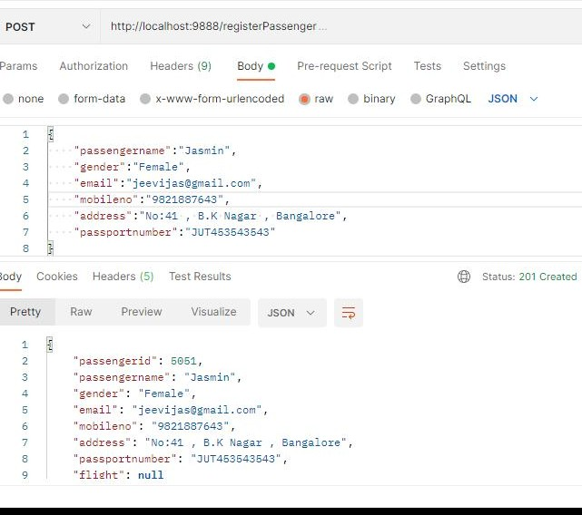
Screenshot
Step 1: We can add new Passenger records.
URL: http://localhost:9888/registerPassenger

Slide 10
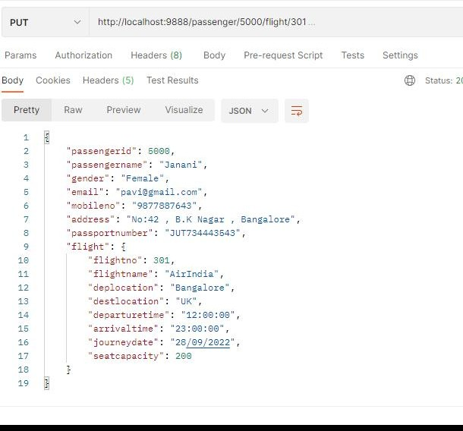
Step 2: We can add new Passenger records. URL: http://localhost:9888/registerPassenger

Slide 11
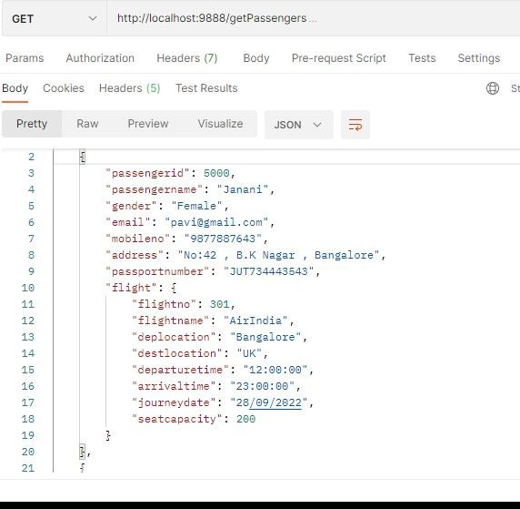
Step 3: Fetch all Passenger records
URL: http://localhost:9888/getPassengers

Slide 12
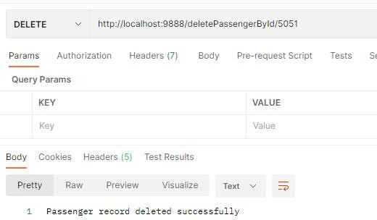
Step 4: We can delete the Passenger records by using Passenger id. URL: http://localhost:9888/deletePassengerById/5051

Slide 13
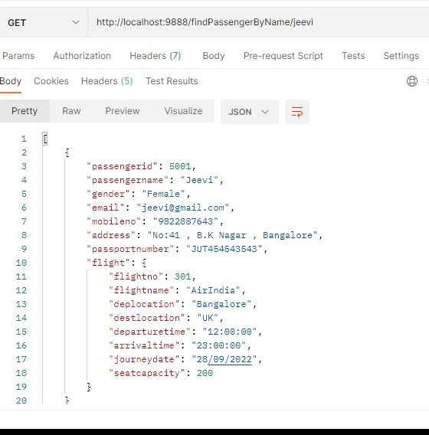
Step 5: We can fetch the list of passenger based on name. URL: http://localhost:9888/findPassengerByName/Jeevi

Slide 14
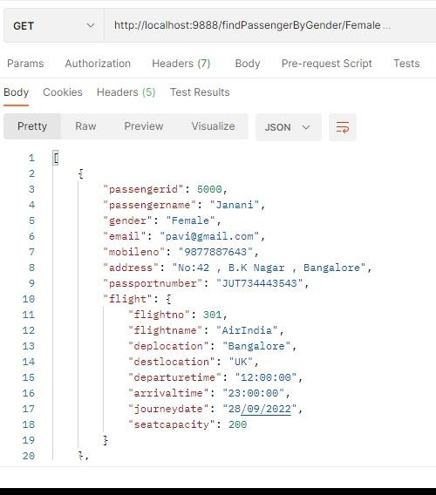
Step 6: We can fetch the passenger gender based on gender. URL: http://localhost:9888/findPassengerByGender/female

Slide 15
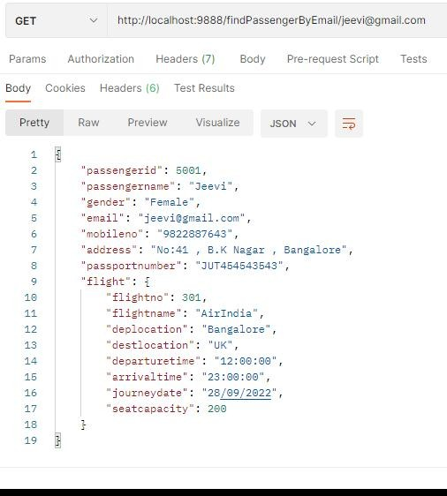
Step 7: We can fetch the passenger email based on email. URL: http://localhost:9888/findPassengerByEmail/email

Slide 16
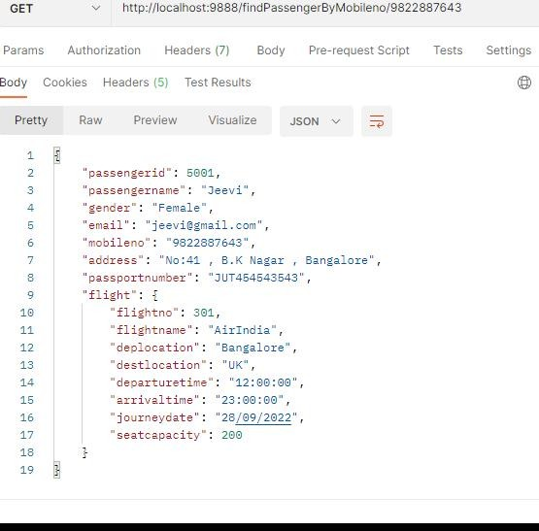
Step 8: We can fetch the passenger mobileno based on mobileno. URL: http://localhost:9888/findPassengerByMobileno/ 9822887643

Slide 17
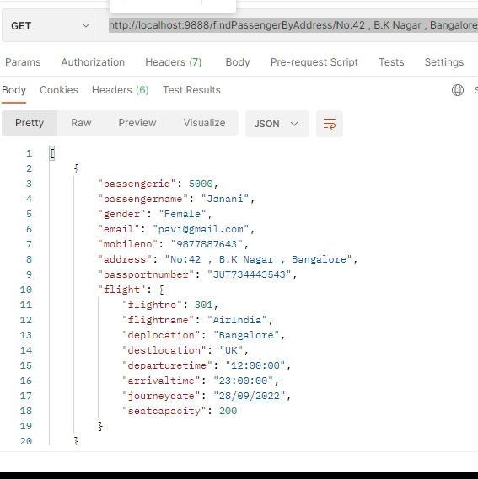
Step 9:Fetch the passenger based on address URL :http://localhost:9888/findPassengerByAddress/No:42 , B.K Nagar , Bangalore

Slide 18
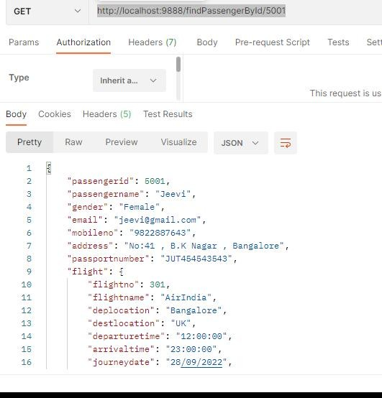
Step 10:Fetch Passenger based on Id URL:http://localhost:9888/findPassengerById/5001

Slide 19
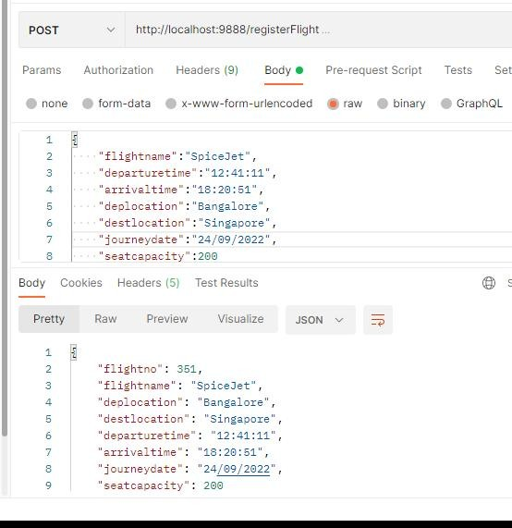
Step 11: We can add new Flight records. URL: http://localhost:9888/registerFlight

Slide 20
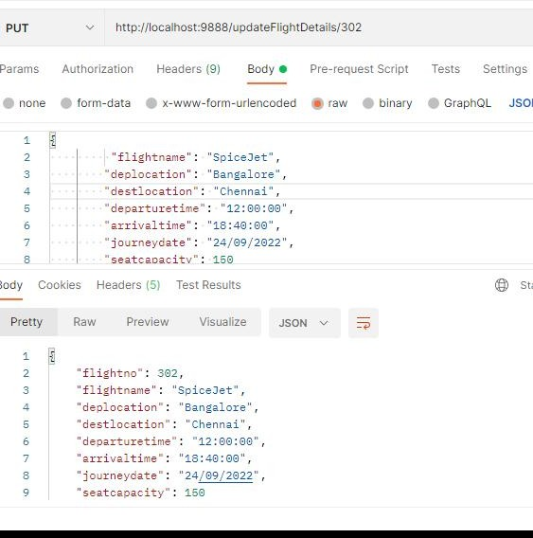
Step 12: We can update Flight records using Flight id. URL : http://localhost:9888/updateFlightDetails/302

Slide 21
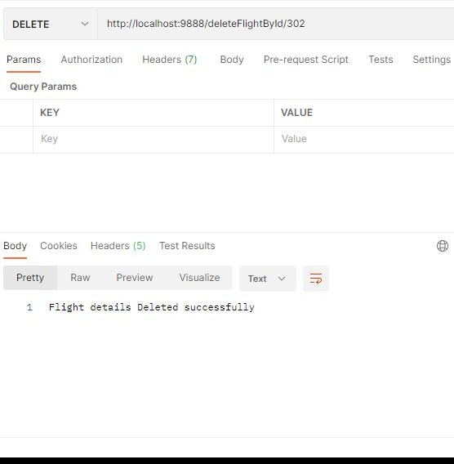
Step 13: We can delete Flight records using Flight id. URL : http://localhost:9888/deleteFlightDetailsById/302

Slide 22
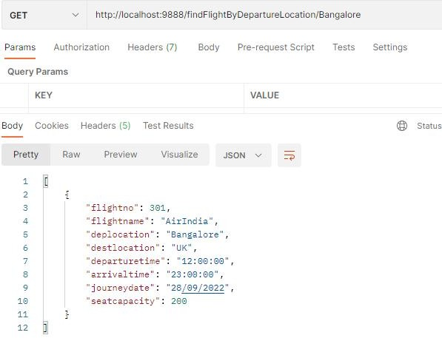
Step 14: Fetch all Flight based on departurelocation URL: http://localhost:9888/findFlightByDepartureLocation/Bangalore

Slide 23
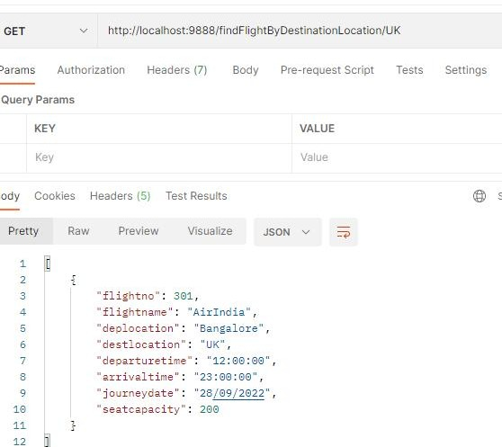
Step 15:Fetch all flight based on destination location URL: http://localhost:9888/findFlightByDestinationLocation/UK

Slide 24
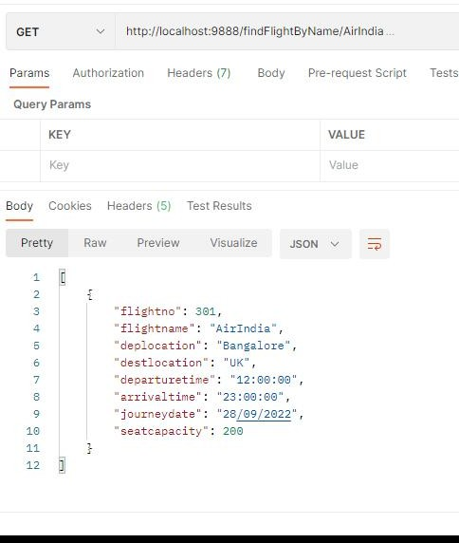
Step 16: Fetch Flight List by its Name URL: http://localhost:9888/findFlightByName/AirIndia.

Slide 25
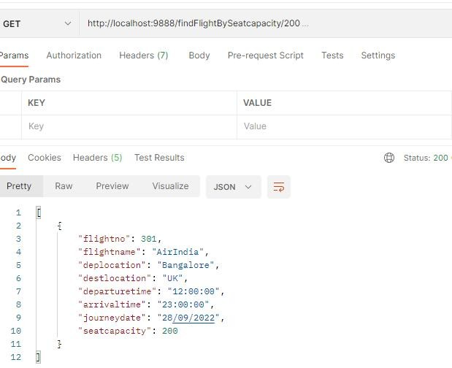
Step 17 : We can GET the Flight seat Capacity records. URL : http://localhost:9888/findFlightBySeatcapacity/200

Slide 26
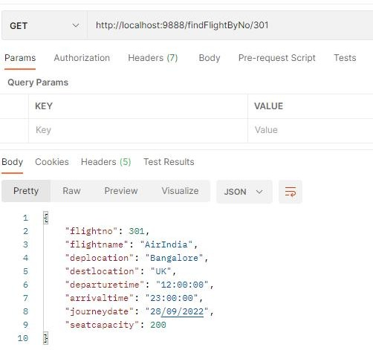
Step 18: Fetch Flight based on Id URL: http://localhost:9888/findFlightByNo/301

Slide 27
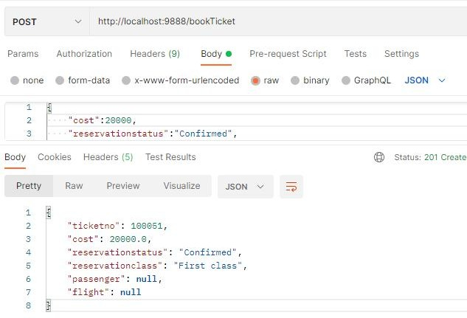
Step 19 : We can Book Ticket. URL: http://localhost:9888/bookTicket.

Slide 28
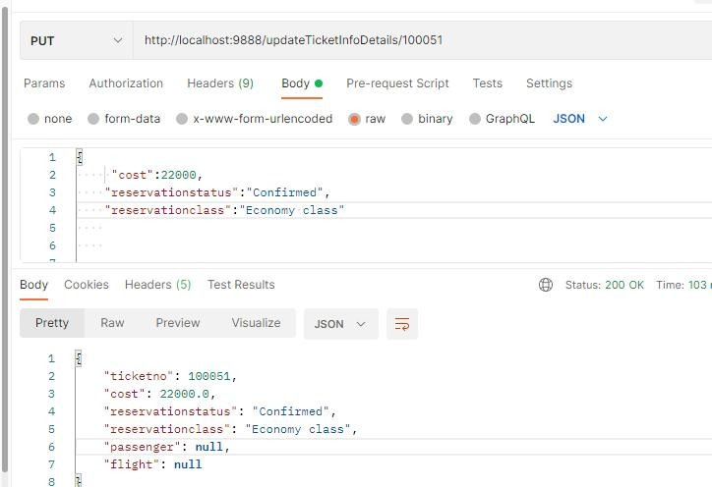
Step 20 : We can update Ticket records. URL : http://localhost:9888/updateTicketInfoDetails/100051

Slide 29
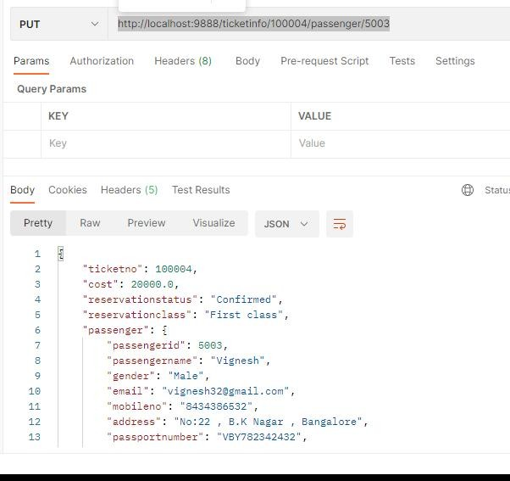
Step 21 : Update Passenger record using passenger id in Ticket Info entity. URL : http://localhost:9888/ticketinfo/100004/passenger/5003

Slide 30
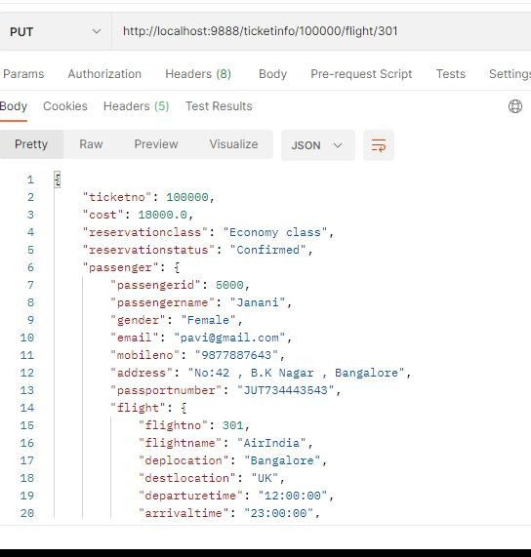
Step 22 : Update Flight record using flight id in Ticket Info entity URL : http://localhost:9888/ticketinfo/100000/flight/300

Slide 31
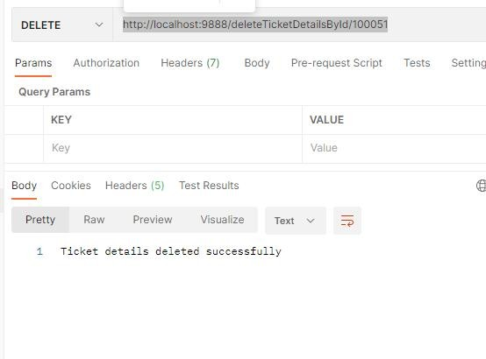
Step 23 : Delete Ticketinfo details by ticket no. URL : http://localhost:9888/deleteTicketDetailsById/100051

Slide 32
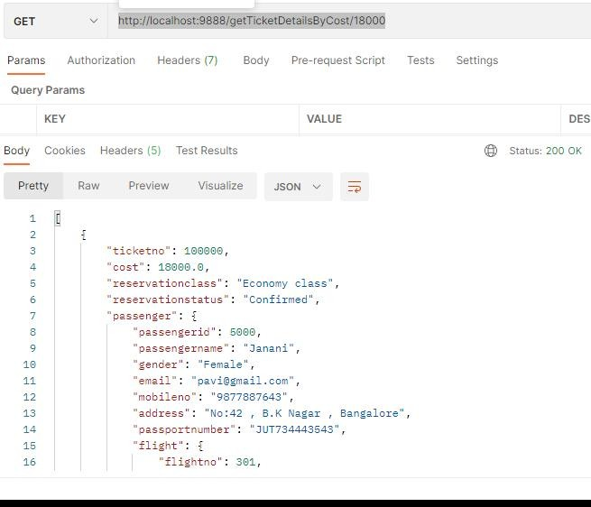
Step 24:Fetch ticket details based on cost. URL: http://localhost:9888/getTicketDetailsByCost/18000

Slide 33
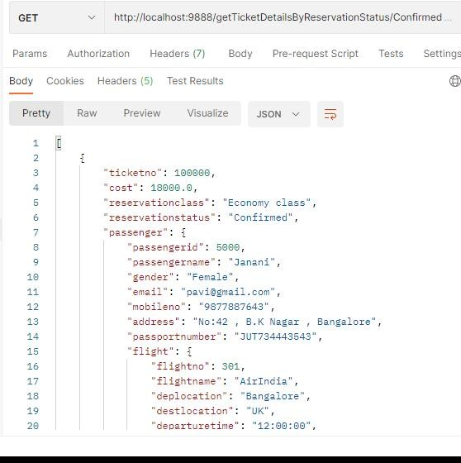
Step 25: Fetch ticket details based on reservation status URL: http://localhost:9888/getTicketDetailsByReservationStaus/Confirmed

Slide 34
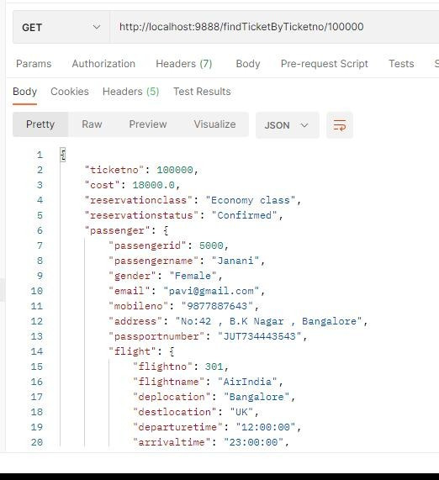
Step 26: Fetch ticket details based on reservation class URL:http://localhost:9888/getTicketDetailsByReservationClass/Economy class

Slide 35
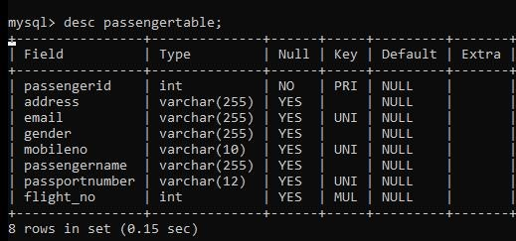
Database Table Design
Passenger Table

Slide 36
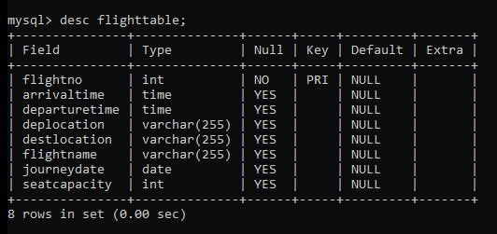
Flight Table

Slide 37
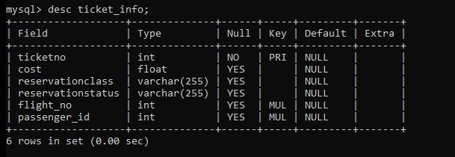
Ticket info Table

Slide 38
Conclusion
Airline Reservation System make flight attendant jobs more accessible by giving them an easy place to find and sort information.

Slide 39
THANK YOU

