Slide 1

Java

Slide 2
Introduction to Java

Slide 3
Program Outline
History - Java
Object Oriented Programming concepts
Primitive Data Types
Wrapper Classes
Inheritance
String Handling
Exception Handling
Collections, Regular Expressions
JDBC

Slide 4
Applications
Desktop Applications such as acrobat reader, media player, antivirus, etc.
Web Applications such as irctc.co.in, javatpoint.com, etc.
Enterprise Applications such as banking applications.
Mobile
Embedded System
Smart Card
Robotics
Games, etc.

Slide 5
History
James Gosling, Mike Sheridan, and Patrick Naughton initiated the Java language project in June 1991. The small team of sun engineers called Green Team.
Initially it was designed for small, embedded systems in electronic appliances like set-top boxes.
"Greentalk" with .gt. later Oak developed as a Green project.
In 1995, Oak was renamed as "Java"
Notes:
Oak-Symbol of strength,
Java – After Discussion with various options silk, dynamic,jolt,DNA..

Slide 6
Versions
JDK Alpha and Beta (1995)
JDK 1.0 (23rd Jan 1996)
JDK 1.1 (19th Feb 1997)
J2SE 1.2 (8th Dec 1998)
J2SE 1.3 (8th May 2000)
J2SE 1.4 (6th Feb 2002)
J2SE 5.0 (30th Sep 2004)
Java SE 6 (11th Dec 2006)
Java SE 7 (28th July 2011)
Java SE 8 (18th Mar2014)
Java SE 9 (21st Sep 2017)
Java SE 10 (20th Mar 2018)
Java SE 11 (September 2018)
Java SE 12 (March 2019)
Java SE 13 (September 2019)
Java SE 14 (Mar 2020)
Java SE 15 (September 2020)
Java SE 16 (Mar 2021)
Java SE 17 (September 2021)
Java SE 18 (to be released by March 2022)

Slide 7
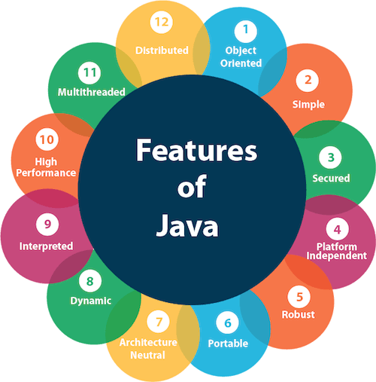
Features

Slide 8
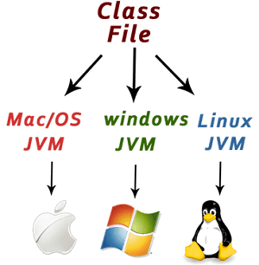
Platform Independent

Slide 9
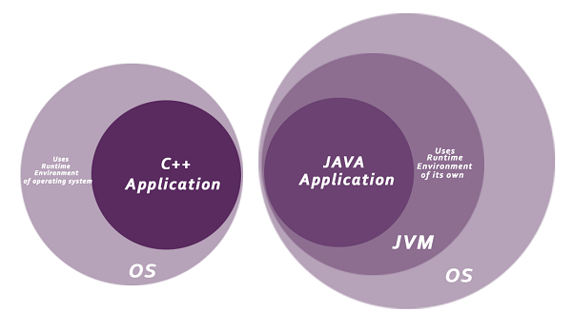
Secured

Slide 10
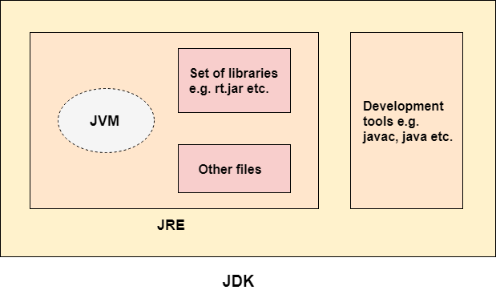
Difference between JDK, JRE, and JVM

Slide 11
Simple Java Program
class Simple
{
public static void main(String args[])
{
System.out.println("Hello Java");
}
}

Slide 12
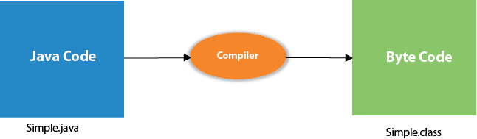
Compile Time

Slide 13
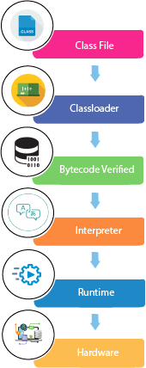
Run Time

Slide 14
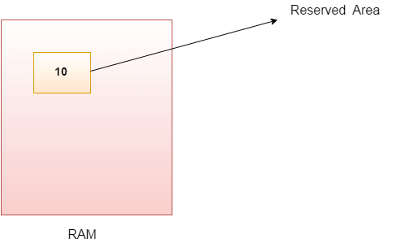
Variables

Slide 15
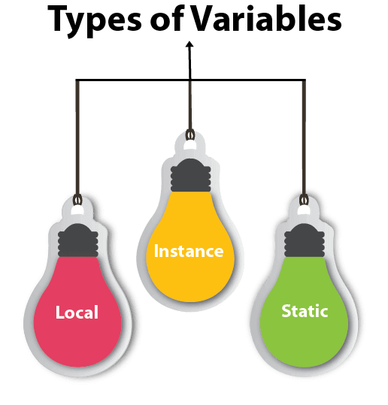

Slide 16
public class A
{
static int m=100;//static variable
void method()
{
int n=90;//local variable
}
public static void main(String args[])
{
int data=50;//instance variable
}
}

Slide 17
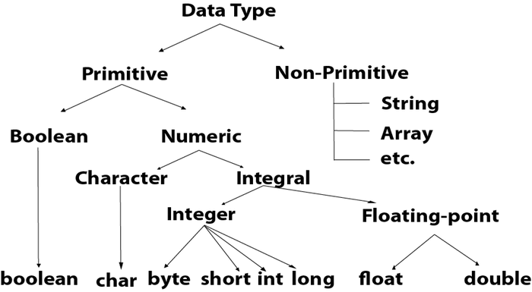

Slide 18
Operators
Unary Operator,
Arithmetic Operator,
Shift Operator,
Relational Operator,
Bitwise Operator,
Logical Operator,
Ternary Operator and
Assignment Operator.

Slide 19
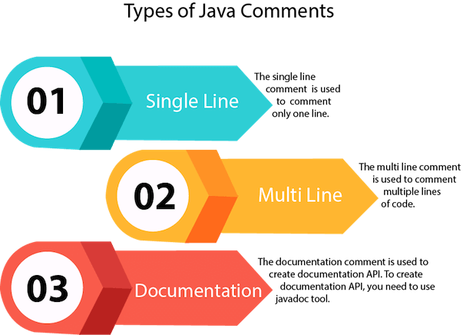

Slide 20
Control Statements
Decision Making Statements
Looping Statements
Jumping Statements
Break
Continue

Slide 21
Decision Making Statements
Simple if statement
if-else statement
if-else-if ladder
Nested if-statement
Switch statement

Slide 22
Looping Statements
for loop
while loop
do-while loop

Slide 23
Object Oriented Concepts
Object
Class
Inheritance
Polymorphism
Abstraction
Encapsulation

Slide 24
Object
An Object can be defined as an instance of a class. An object contains an address and takes up some space in memory.

Slide 25
Class
Collection of objects is called class. It is a logical entity.
A class can also be defined as a blueprint from which you can create an individual object. Class doesn't consume any space.

Slide 26
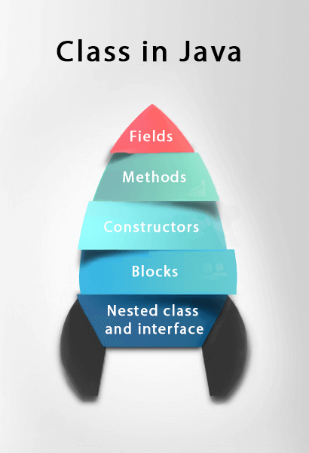

Slide 27
Sample Program
//Defining a Student class.
class Student{
//defining fields
int id;//field or data member or instance variable
String name;
public static void main(String args[]){
//Creating an object or instance
Student s1=new Student();//creating an object of Student
System.out.println(s1.id);//accessing member through reference variable
System.out.println(s1.name);
}
}

Slide 28
Inheritance
When one object acquires all the properties and behaviors of a parent object, it is known as inheritance.
It provides code reusability.
It is used to achieve runtime polymorphism.

Slide 29
Polymorphism
one task is performed in different ways
method overloading and method overriding to achieve polymorphism.
For example: to convince the customer differently, to draw something, for example, shape, triangle, rectangle, etc.

Slide 30
Abstraction
Hiding internal details and showing functionality is known as abstraction.

Slide 31
Encapsulation
Binding (or wrapping) code and data together into a single unit are known as encapsulation.

Slide 32
Naming Convention
Java naming convention is a rule to follow as you decide what to name your identifiers such as class, package, variable, constant, method, etc.
But, it is not forced to follow. So, it is known as convention not rule.
All the classes, interfaces, packages, methods and fields of Java programming language are given according to the Java naming convention. If you fail to follow these conventions, it may generate confusion or erroneous code.

Slide 33
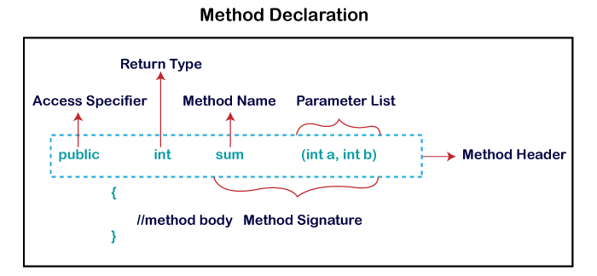
Methods

Slide 34
Access Specifiers
Public: The method is accessible by all classes when we use public specifier in our application.
Private: When we use a private access specifier, the method is accessible only in the classes in which it is defined.
Protected: When we use protected access specifier, the method is accessible within the same package or subclasses in a different package.
Default: When we do not use any access specifier in the method declaration, Java uses default access specifier by default. It is visible only from the same package only.

Slide 35
Types of Methods
Predefined Method
User-defined Method

Slide 36
Static Method
public class Display
{
public static void main(String[] args)
{
show();
}
static void show()
{
System.out.println("It is an example of static method.");
}
}

Slide 37
Instance Method
public int getRoll() //accessor method
{
return roll;
}
public void setRoll(int roll) //mutator
{
this.roll = roll;
}
Accessor
Get the values
Also called as getters
Mutator
Read and modify the values
Also called setters or modifiers

Slide 38
Abstract Method
abstract void method_name();
The method that does not has method body is known as abstract method.
It always declares in the abstract class.

Slide 39
Inheritance (is-a)
A mechanism in which one object acquires all the properties and behaviors of a parent object.
class Subclass-name extends Superclass-name
{
//methods and fields
}

Slide 40
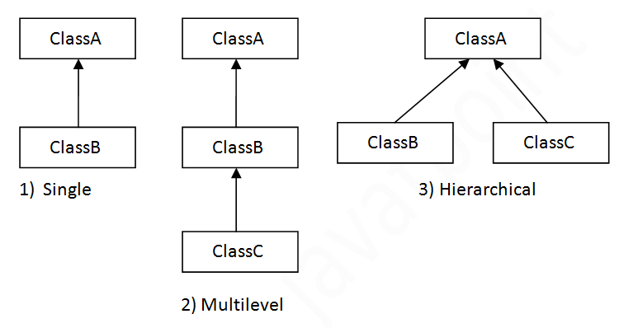
Types of Inheritance

Slide 41
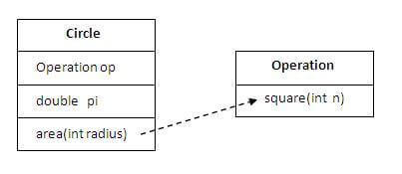
Aggregation (has-a)

Slide 42
Polymorphism

Slide 43
Method Overloading
If a class has multiple methods having same name but different in parameters, it is known as Method Overloading.
There are two ways to overload the method in java
By changing number of arguments
By changing the data type

Slide 44
Method Overriding
If subclass (child class) has the same method as declared in the parent class, it is known as method overriding.
Rules for Method Overriding
The method must have the same name as in the parent class
The method must have the same parameter as in the parent class.
There must be an IS-A relationship (inheritance).

Slide 45
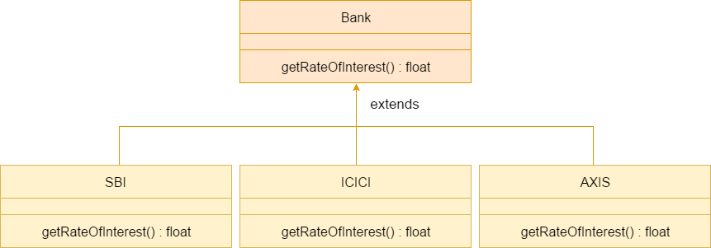

Slide 46
Difference between overloading & overriding
No. | Method Overloading | Method Overriding
1) | Increase the readability of the program. | Provide the specific implementation of the method that is already provided by its super class.
2) | Performed within class. | Occurs in two classes that have IS-A (inheritance) relationship.
3) | Parameter must be different. | Parameter must be same.
4) | Compile time polymorphism. | Run time polymorphism.

Slide 47
Super Keyword
Refer immediate parent class object.
super can be used to refer immediate parent class instance variable.
super can be used to invoke immediate parent class method.
super() can be used to invoke immediate parent class constructor.

Slide 48
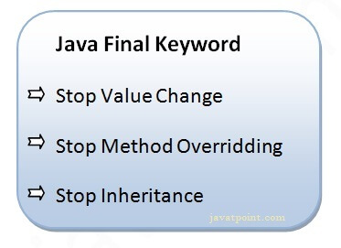
Final Keyword

Slide 49
Abstraction
Process of hiding the implementation details and showing only functionality to the user.
Ways to achieve Abstraction
Abstract class
Interface

Slide 50
Encapsulation

Slide 51
Definition
Encapsulation in Java is a process of wrapping code and data together into a single unit

Slide 52
Packages
A java package is a group of similar types of classes, interfaces and sub-packages.
Package in java can be categorized in two form, built-in package and user-defined package.
There are many built-in packages such as java, lang, awt, javax, swing, net, io, util, sql etc.

Slide 53
Access Modifiers
There are two types of modifiers in Java: access modifiers and non-access modifiers.
There are many non-access modifiers, such as static, abstract, synchronized, native, volatile, transient, etc

Slide 54
Access Modifier | within class | within package | outside package by subclass only | outside package
Private | Y | N | N | N
Default | Y | Y | N | N
Protected | Y | Y | Y | N
Public | Y | Y | Y | Y

Slide 55
String
An object that represents sequence of char values.
char[] ch={'j','a','v','a'};
String s=new String(ch);
is same as:
String s="java";

Slide 56
Creating String object
There are two ways to create String object:
By string literal
String s="welcome";
By new keyword
String s3=new String("example");

Slide 57
Example
String s1="java";//creating string by Java string literal
char ch[]={'s','t','r','i','n','g','s'};
String s2=new String(ch);//converting char array to string
String s3=new String("example");//creating Java string by new keyword

Slide 58
String Functions
compare()
concat()
equals()
split()
length()
replace()
compareTo()
intern()
substring() etc.

Slide 59
Collections
The Collection in Java is a framework that provides an architecture to store and manipulate the group of objects.
Achieve all the operations that you perform on a data such as searching, sorting, insertion, manipulation, and deletion.
Provides many interfaces (Set, List, Queue, Deque) and classes (ArrayList, Vector, LinkedList, PriorityQueue, HashSet, LinkedHashSet, TreeSet).

Slide 60
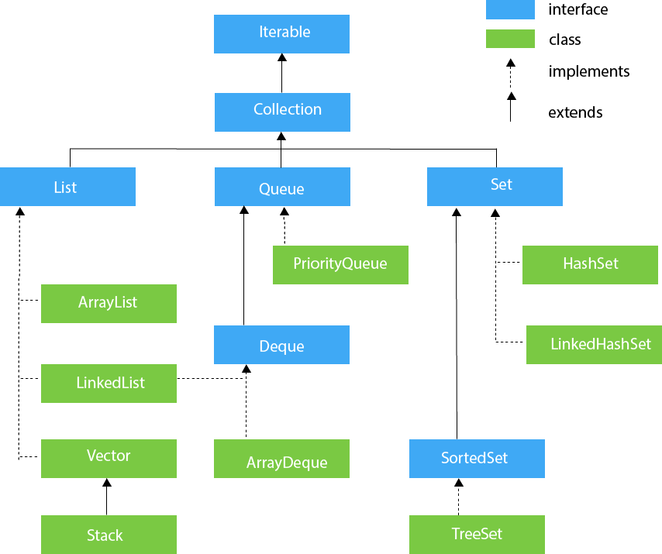

Slide 61
Framework
A Collection represents a single unit of objects, i.e., a group
The Collection framework represents a unified architecture for storing and manipulating a group of objects. It has:
Interfaces and its implementations, i.e., classes
Algorithm

Slide 62
JDBC
JDBC stands for Java Database Connectivity. JDBC is a Java API to connect and execute the query with the database

