Slide 1
Women safety application
A collaborative effort by:Priyanshu Bhatt ,Vibhanshu Dhadwal,Rajibul Islam,Raju Chaudhary,Shiva Raman,Muskan

Slide 2
ABOUT PROJECT
An android app which can INSTANTLY alert the Guardians(along with user location) whenever the user is in an emergency situation. It can be triggered just by shaking the android device in which the app is installed.
It is based on Android Technology in which we use various objects to create the application.
It incorporates all the essential features such as GPS tracking, emergency contact numbers, directions to safe locations etc

Slide 3
Why women safety application
Women’s safety is a big concern which has been the most important topic till date. Women safety matters a lot whether at home, outside the home or working place. Few crimes against ladies particularly rape cases were terribly dread and fearful. Most of the women of various ages, till this day are being subjected to violence, domestic abuse, and rape. As ladies ought to travel late night generally, it’s necessary to remain alert and safe. Although the government is taking necessary measures for their safety, still, there are free safety apps for women that can help them to stay safe. Most of the females these days carry their smartphone with them, so it is necessary to have at least one the personal safety apps installed. Such a security app for ladies will definitely facilitate in a way or the opposite. This is user-friendly application that can be accessed by anyone who has installed it in their smart phones. Our intention is to provide you with fastest and simplest way to contact your nearest help. In this system user needs to feed three contact numbers, in case of emergency on moving the phone up and down thrice, the system sends SMS and calls on one of the numbers feeded into the system with the location. The phone starts vibrating and siren starts ringing. This features for both everyday safety and real emergencies, making it an ultimate tool for all.

Slide 4
Design Goals
Elegant yet simple enough for any user to understand at a glance.
This is user-friendly application that can be accessed by anyone who has installed it in their smart phones
It is fast and simple to use.

Slide 5
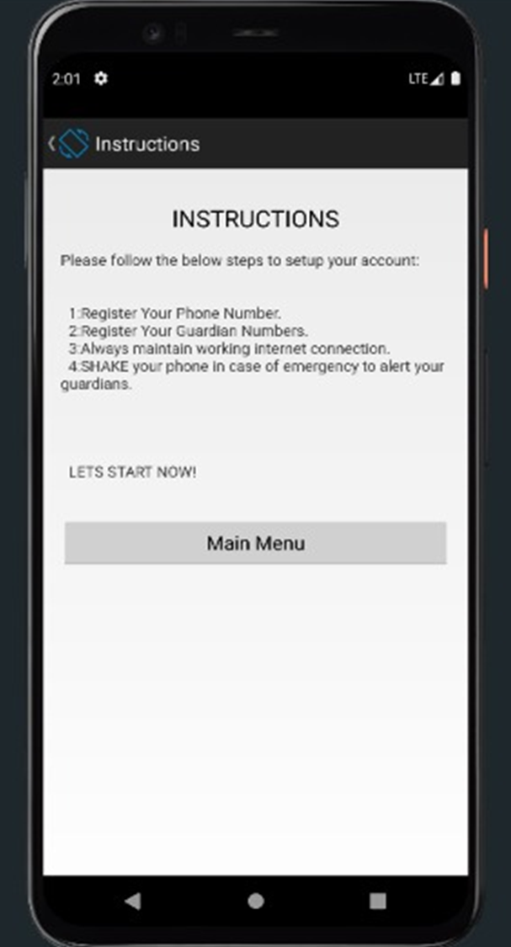
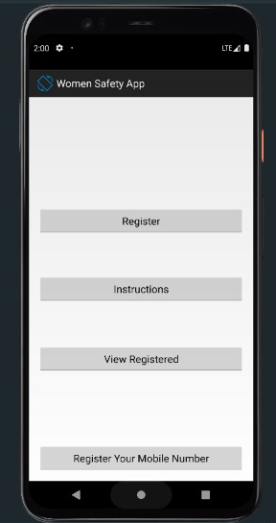

Slide 6
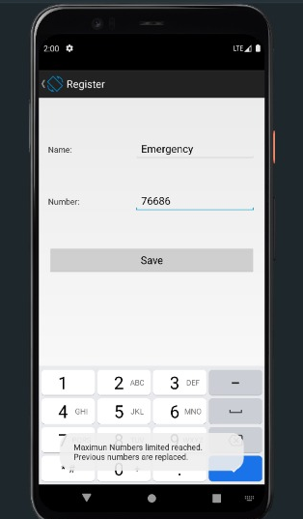
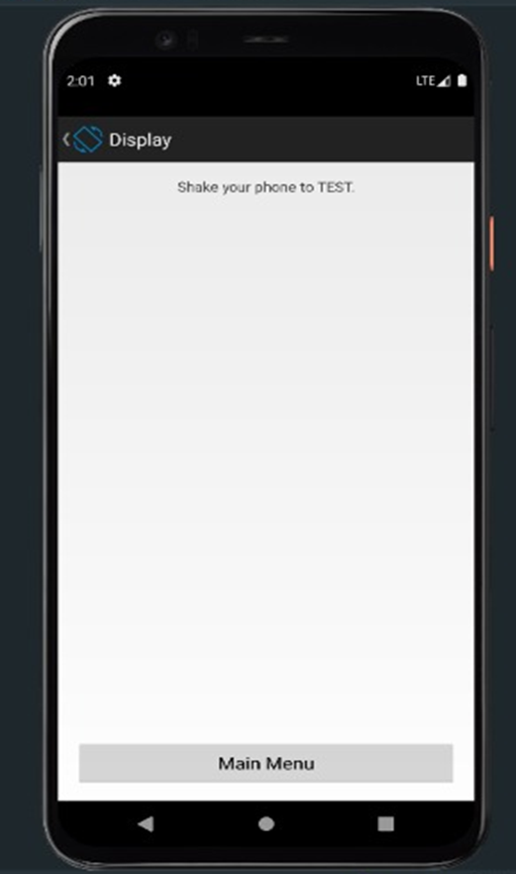

Slide 7
APP System Requirement
Minimum android version | Android 7 (API 24)
Target android version | Android 12 (API 31)
Arch | Arm64-8a and x86
Ram | 2GB

Slide 8
App Features
Multi-window support
Foldable smartphone support
Responsive user interface
Readable-first design
By just shaking smartphone SMS will be shared with location in case of emergency.
This application sends the live location of the user

Slide 9
Drawback of project
This application requires active internet connection.
User needs to put correct data or else it behaves abnormally.
It always need your location active hence which consumes much battery .

Slide 10
Thank you

