Slide 1
CSE 4/55 Introduction to Pattern Recognition
Rajib das
Final Presentation
Visual Question-Answering

Slide 2
Agenda
Problem definition and motivation
Past related work
Proposed approach
Data and experiments
Milestones

Slide 3
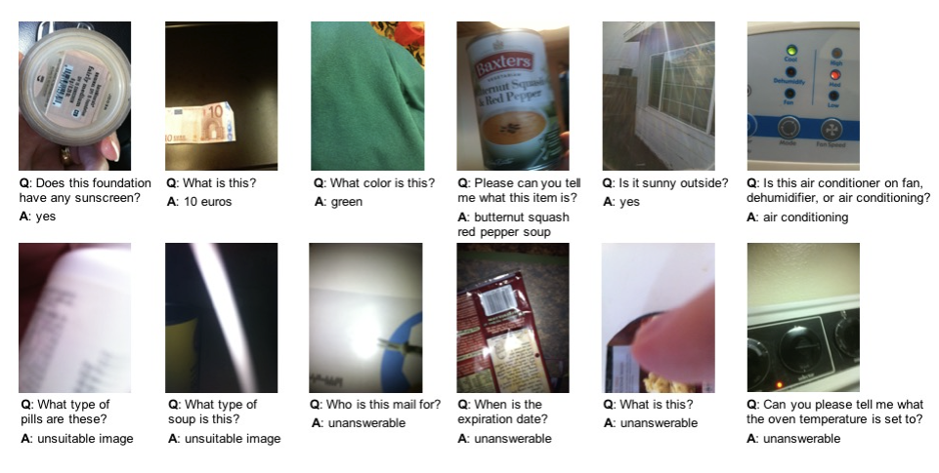
Problem definition and motivation
Goal: The VizWiz Visual Question Answering (VQA) aims to develop AI models that can answer questions about images captured by visually impaired individuals using smartphones.
Motivation: Mimic human cognition in understanding visual information, with applications in aiding the visually impaired, improving image retrieval systems, and enhancing human-computer interactions.

Slide 4
Past related work
ViT + BERT: used to process images and questions in the VizWiz dataset, allowing the model to understand both visual and textual inputs for tasks like Visual Question Answering.
CNN-LSTM: extract visual features from images and process textual inputs (questions) to predict answers in VQA tasks for the VizWiz Challenge.

Slide 5
Past related work
ResNet+Attention: used to extract visual features from images and attend to specific regions while processing questions, improving performance in VQA tasks.
CLIP + FNN: CLIP embeddings can be used in conjunction with a FeedForward Network to process images and questions, enabling the model to perform VQA.
CLIP+FNN is known to have the best performance and our baseline model.

Slide 6
Proposed approach
Objective: Solve the VizWiz Visual Question Answering (VQA) task using BEiT (BERT for Image Understanding with Transformer).
Model Description: BEiT jointly handles image and text input, eliminating the need for separate text and image encoders as in ViT (Vision Transformer).
Implementation Steps:
1. Fine-tune BEiT on the VizWiz dataset.
2. Perform hyperparameter tuning to improve model accuracy.
Expected Outcome: A VQA model based on BEiT that achieves improved accuracy on the VizWiz dataset than the baseline CLIP + FNN model.

Slide 7
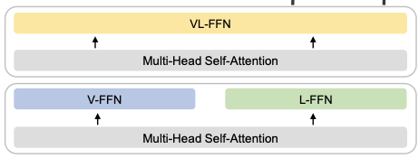
Proposed approach
Answer
Classification layer
Positional Encoding
Patch embedding
word embedding
Image
Question

Slide 8
Data and experiments
Dataset : VizWiz Dataset
Train Split: 20523 image and questions, 205230 answers
Valid Split: 4319 image and questions, 43190 answers
Test split: 8000 images
Evaluation Metric: The model's performance is measured based on its accuracy on the test dataset.
Exploratory Data Analysis (EDA): Basic EDA is conducted to analyze the distribution of question patterns (represented as a word cloud) and answers (including categories like yes/no, number, unanswerable, and others).
Baseline Model: A baseline model consisting of CLIP (Contrastive Language-Image Pre-training) and FNN (Feedforward Neural Network) is trained and evaluated, achieving an accuracy of 54%.

Slide 9
Milestones
Literature Review and Feasibility Study: Complete
Data Acquisition and Preprocessing: Complete
Prepare baseline model: Complete
Model Development (3 days): Develop the BEiT model
Initial Testing and Refinement (2 days): Test the model on a validation set and refine based on performance metrics.
Final Evaluation and Documentation (3 days): Perform extensive testing, document the project, and prepare the final report.

Slide 10

Questions

