Slide 1
Diabetic Retinopathy Prediction using Convolutional Neural Networks
Rajib Das Bhagat (CS17M034)
Guide: Prof. Balaraman Ravindran
IIT Madras

Slide 2
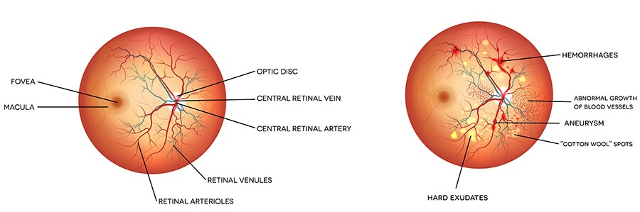
What is DR?
Diabetic Retinopathy can be termed as any damage caused to the retina of an eye due to abnormal blood flow.
Fig. 1: Normal Eye
Fig. 2: Abnormal Eye

Slide 3
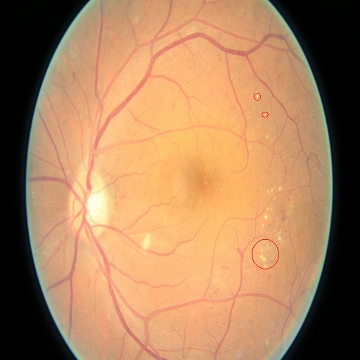
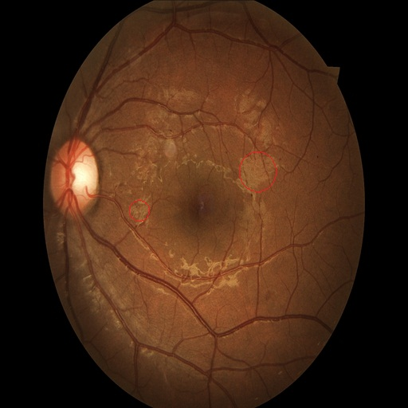
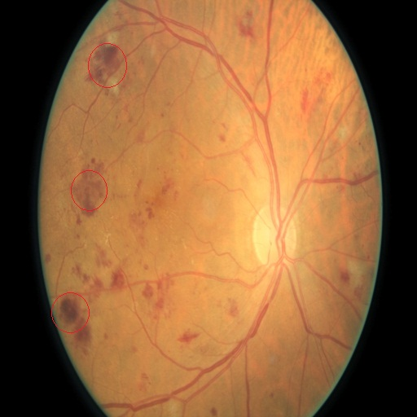
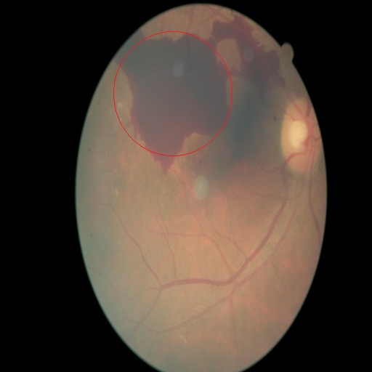
a. Mild DR
b. Moderate DR
c. Severe DR
a. Proliferative DR
Fig. 1: DR abnormalities
(related abnormalities are circled)

Slide 4
Literature Survey:
Table 1: Literature Survey
No. | Published Paper | Year | Classification Type | Techniques Used | Accuracy
1 | Automatic detection of diabetic retinopathy using an artificial neural network: A screening Tool. [Authors: G G Gardner, D Keating, T H Williamson, A T Elliott] | 1996 | Binary | Neural Network | 88.4%
2 | Automated identification of diabetic retinopathy stages using digital fundus images. [Authors: Nayak J, Bhat PS, Acharya R, Lim CM, Kagathi M] | 2008 | Three-class | Neural Network | 93.0%
3 | Application of higher order spectra for the identification of diabetes retinopathy stages. [Authors: Acharya UR, Chua CK, Ng EY, Yu W, Chee C] | 2008 | Five-class | SVM | 82.0%
4 | Computer-based detection of diabetes retinopathy stages using digital fundus images. [Authors: Acharya UR, Lim CM, Ng EY, Chee C, Tamura T] | 2009 | Five-class | SVM | 85.9%
5 | Multiclass SVM-based automated diagnosis of diabetic retinopathy. [Authors: P. Adarsh, D. Jeyakumari] | 2013 | Five-class | SVM | 96.0%

Slide 5
Problem Statement:
“The aim of this study is to explore how we can automate the process of correctly classifying and predicting an eye image as abnormal or normal”.

Slide 6
Methodology:
Steps for building CNN
Convolution
Pooling
Flattening
Full connection
Fig. 1: DR abnormalities
(related abnormalities are circled)

Slide 7
Table 2: Hyper-parameters & other settings
No. | Attributes Used | Values
1 | training_batch | 32
2 | test_batch | 32
3 | learning_rate | 0.0001
4 | epochs | 50
5 | drop_out | 0.5
6 | class_mode | category
7 | input_size | 512 x 512
8 | kernel_size | 3 x 3
9 | pool_size | 3 x 3
10 | strides | 2 x 2
11 | padding | same
12 | color_mode | Grayscale
Fig. 4: Network Architecture

Slide 8
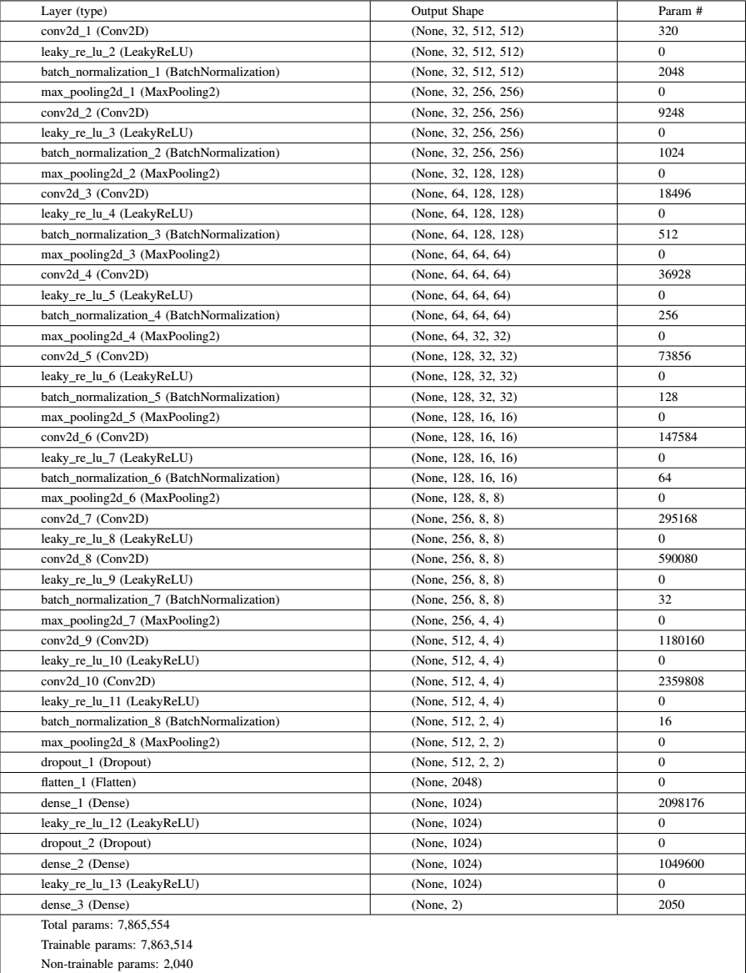
Table 3: CNN architecture

Slide 9
Dataset:
Source: https://kaggle.com/c/diabetic retinopathy detection/data
Table 4: Training dataset
Table 5: Testing dataset
Cat. | DR TYPE | COUNT
0 | Normal | 25810
1 | Mild DR | 2443
2 | Moderate DR | 5292
3 | Severe DR | 873
4 | Proliferative DR | 708
 | Total | 35126
Cat. | DR TYPE | COUNT
0 | Normal | 39533
1 | Mild DR | 3762
2 | Moderate DR | 7861
3 | Severe DR | 1214
4 | Proliferative DR | 1206
 | Total | 53576
Normal
4000
Train:3600
Test:400
Abnormal
4000
Train:3600
Test:400

Slide 10
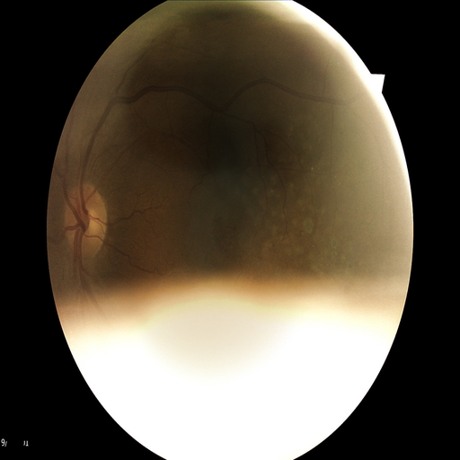
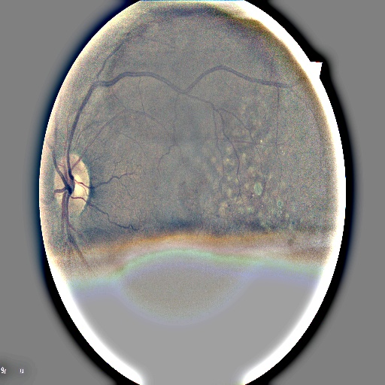
Pre-processing:
Noise
Corrupted image
Blurred image
Poorly focused
Lighting variation
Fig. 4: Example of noisy image
Remedy
Cropping
Resizing 512 x 512
Normalization (GaussianBlur)
Fig. 5: Preprocessed image

Slide 11
Augmentation:
Done when batches are formed.
Randomly rescaled by ±10%.
Randomly rotated 0-90 degree.
Random horizontal and vertical flip.
Performed on training data only (except rescaling).

Slide 12
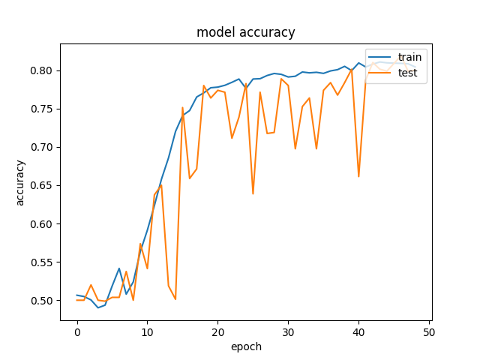
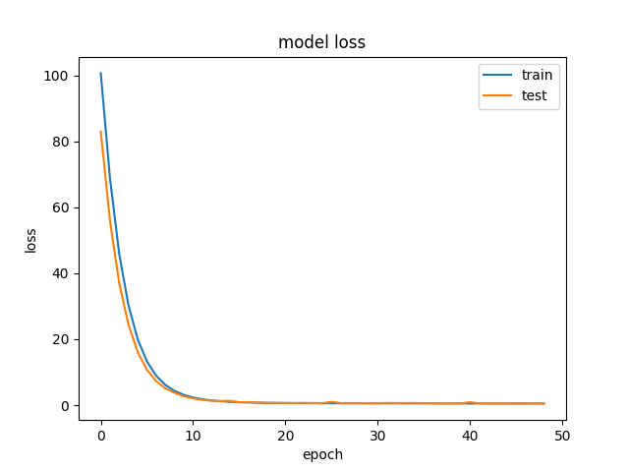
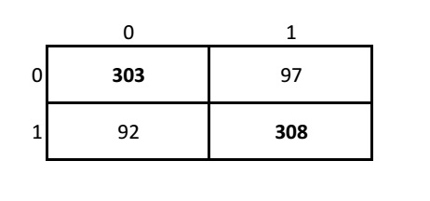
Experiment 1:
Fig 6: Accuracy graph
Fig 7: Loss graph
batch_size | learning_rate | epochs | drop-out
32 | 0.0001 | 50 | 0.5
 | Precision | Recall | F1-score | Support
0(abnormal) | 0.74 | 0.87 | 0.80 | 400
1(normal) | 0.84 | 0.69 | 0.76 | 400
Total/Avg | 0.79 | 0.78 | 0.78 | 800
Fig 8: Confusion Matrix
Table 6: Classification Report

Slide 13
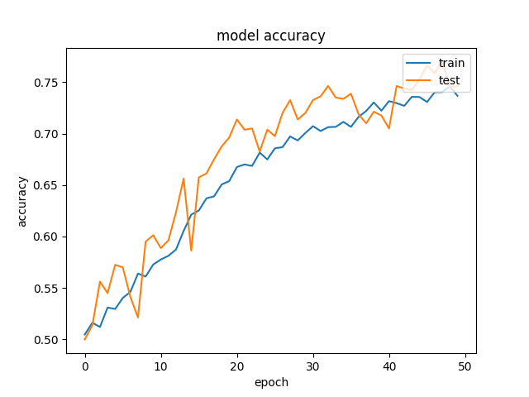
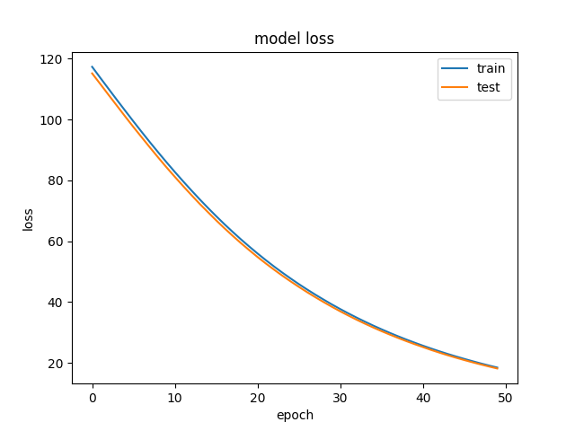
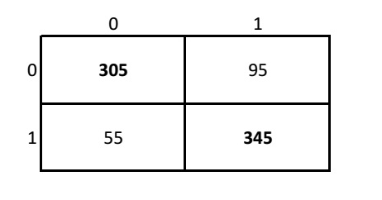
Experiment 2:
Fig 9: Accuracy graph
Fig 10: Loss graph
batch_size | learning_rate | epochs | drop-out
32 | 0.00001 | 50 | 0.5
 | Precision | Recall | F1-score | Support
0(abnormal) | 0.77 | 0.76 | 0.76 | 400
1(normal) | 0.76 | 0.77 | 0.77 | 400
Total/Avg | 0.76 | 0.76 | 0.76 | 800
Fig 11: Confusion Matrix
Table 7: Classification Report

Slide 14
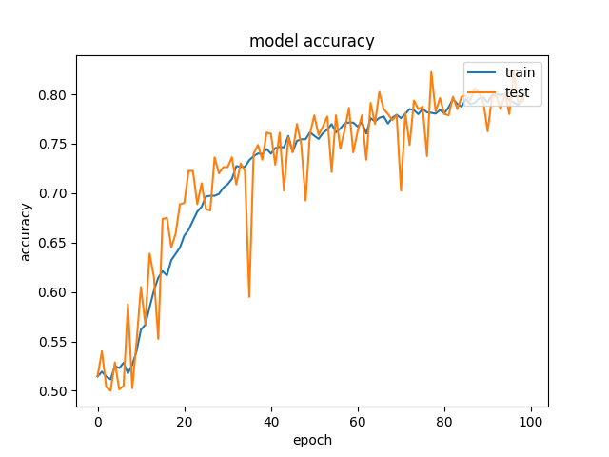
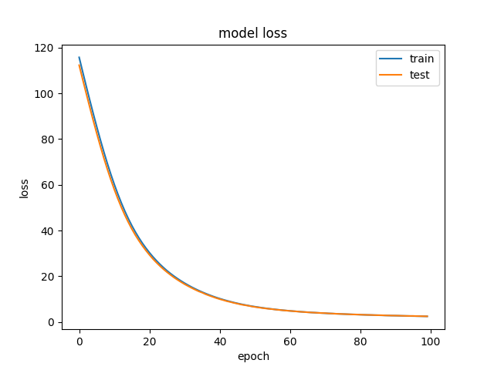
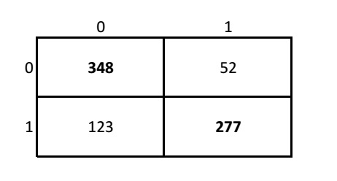
Experiment 3:
Fig 12: Accuracy graph
Fig 13: Loss graph
batch_size | learning_rate | epochs | drop-out
16 | 0.00001 | 100 | 0.5
 | Precision | Recall | F1-score | Support
0(abnormal) | 0.85 | 0.76 | 0.80 | 400
1(normal) | 0.78 | 0.86 | 0.82 | 400
Total/Avg | 0.82 | 0.81 | 0.81 | 800
Fig 14: Confusion Matrix
Table 8: Classification Report

Slide 15
Future Work:
add more training images
use adversarialization process
more complex architecture such as Inception, VGGNet, ResNet, and other architectures
five-class classification

Slide 16
References:
[1] G. G. Gardner, D. Keating, T. H. Williamson, A. T. Elliott.. Automatic detection of diabetic retinopathy using an artificial neural network: a screening tool. British Journel Ophthalmology 1996;80(11):940-944. [2] Markku Kuivalainen. Retinal Image Analysis Using Machine Vision. Thesis report Lappeenranta Univ of Tech, Dept of IT 2005. [3] Nayak J, Bhat PS, Acharya R, Lim CM, Kagathi M.. Automated identification of diabetic retinopathy stages using digital fundus images. J Med Sys 2008;32(2):107-115. [4] Acharya UR, Chua CK, Ng EY, Yu W, Chee C..Application of higher order spectra for the identification of diabetes retinopathy stages. J Med Sys 2008;32(6):481-488. [5] Acharya UR, Lim CM, Ng EY, Chee C, Tamura T.. Computer-based detection of diabetes retinopathy stages using digital fundus images. P I Mech Eng H 2009; 223(5): 545-553. [6] P.Adarsh, D.Jeyakumari.. Multiclass SVM-based automated diagnosis of diabetic retinopathy. In: Communications and Signal Processing (ICCSP),2013 International Conference on. IEEE; 2013,p. 206-210. [7] Ben Graham. Kaggle Diabetic Retinopathy Detection competition report. 2015. [8] Harry Pratt, Frans Coenen, Deborah M Broadbent, Simon P Harding, Yalin Zheng.. Convolutional Neural Network for Diabetic Retinopathy. Procedia Computer Science 90 2016:200-205. [9] Linda Roach. Artificial Intelligence, The Next Step in Diagnostics. In: EyeNet November 2017. [10] Pascanu, Razvan et al. Understanding the exploding gradient problem. In: CoRR 2012. [11] Wikipedia. https://en.wikipedia.org/wiki/Diabetic retinopathy

Slide 17
Thank You
Special thanks
Karthik Thiagarajan [Ms Scholar]
Saurabh Desai [Project Associate, RBCDSAI LAB]

