Slide 1

Automation Testing
RLL PROJECT

Slide 2
Demo Web Shop
Team Lead :Rajib Kumar Maity

Slide 3
Group 3:
Group Member: Emp ID
Prajwal B S 2569067
Kiran Kumar Rout 2568277
Rajib Kumar Maity 2567329
Botha Sai Kiran 2569197
Mansi Nitin Borse 2567979
Gottipati Akhila 2567326
Srijit Chakraboty 2569298
Meghana G P 2568973

Slide 4
AGENDA
Introduction​
​Test Scenarios
Feature File
Gherkin Key Words
Technologies
Screenshot
Outcome
Conclusion
​

Slide 5
Introduction
E-commerce testing is crucial for ensuring a seamless user experience. Streamline your testing process with Cucumber, Selenium, TestNG, and Listener. This presentation will cover the benefits of automation and how to implement it in your testing strategy.

Slide 6
Test Scenario:
1)Navigate to the URL, Click on the Register. Fill in the Personal Details to register. Validate the successful registration.
2)Navigate to the URL, enter the search keyword, and click search button. Read the Search keyword from the Excel Sheet.
3)Navigate to the URL, Validate the Community poll, with login, without login, poll for more than one time.
4)Navigate to the URL, click on the book, confirm all the books having “Add To Cart” button.
5)Navigate to the URL, click on the book, Add the third book into the cart. Validate the book is successfully added to the Cart.
6)Navigate to the URL, click on the book, Add the third book into the cart. Complete the checkout process and validate the same.
7)Navigate to the URL, add the any 3 products into cart, then delete the any two products from cart and validate the cart after deleting the product.
8)Navigate to the URL, click on the “Digital Downloads", and add all the product into the Wishlist. Then, go to Wishlist and remove the product and validate the Wishlist after deleting the product

Slide 7
Technologies:
Maven & pom.xml
Selenium WebDriver
Page Object Model
TestNG
Data Driven Frame Work (DDF)
Cucumber
Listeners
Assertions
Logs
Extent & Cucumber Reports

Slide 8
Maven
Maven is a tool which is used for building and managing Java Based Projects
Providing quality project information
Easy Documentation
Best practices development

Slide 9
Pom.xml
A Project Object Model or POM is the fundamental unit of work in Maven.
It is an XML file that contains information about the project and configuration details used by Maven to build the project.
One of the most critical functions of the pom.xml file is specifying project dependencies.
Maven uses this information to download and manage external libraries and dependencies automatically

Slide 10
Selenium WebDriver
Selenium WebDriver is a popular open-source automation tool used for automating web browser interactions.
It provides a programming interface to interact with web elements, such as clicking buttons, filling forms, and navigating between pages, using various programming languages like Java, Python, C#, etc.
Selenium WebDriver is widely used for web testing, web scraping, and automating repetitive web tasks.
It enables testers and developers to create scripts to interact with web applications and verify their functionality, making it an essential tool for web application testing and automation.

Slide 11
Page Object Model
The Page Object Model is a design pattern used in test automation to create an abstraction layer between test scripts and the user interface of a web application. In simpler terms
it organizes and structures your automation code in a way that makes it more maintainable and readable.

Slide 12
TestNG
TestNG is a popular testing framework for Java applications. It simplifies test case management, parallel execution, and reporting.
It supports various annotations to define test methods and their execution order.
TestNG is widely used for unit, functional, and integration testing in both manual and automated testing scenarios.
Its features include test parameterization, test grouping, and fine-grained control over test execution.

Slide 13
Data Driven Frame Work (DDF)
A data-driven framework is an automation testing approach where test data is separated from test scripts.
It allows for testing the same functionality with multiple sets of data.
Test data is typically stored in external sources like spreadsheets or databases, and the testing logic remains constant.
This framework enhances test coverage and maintainability by easily accommodating new data sets without code changes.
It's particularly valuable for repetitive tests with varying input values and expected outcomes.

Slide 14
Cucumber
Cucumber is a behavior-driven development (BDD) tool used for automated acceptance testing.
It enables collaboration between non-technical stakeholders and developers by expressing test scenarios in plain-text, human-readable language.
Cucumber scenarios are written in Gherkin syntax and linked to executable code, allowing teams to define test cases with clear, descriptive steps.
Cucumber integrates with automation frameworks like Selenium or Appium to execute these tests.
It's a valuable tool for ensuring that software features align with user expectations and business requirements.

Slide 15
Feature File:
A feature file is usually a common file which stores feature, scenarios, and feature description to be tested.
The feature file is an entry point, to write the cucumber tests and used as a live document at the time of testing. The extension of the feature file is ". feature"

Slide 16
Gherkin Key Words
Gherkin is a domain-specific language used in Cucumber for writing feature files in a human-readable format.
Gherkin uses a set of keywords to structure and describe the behavior of software features. These keywords help define the scenarios and steps that are part of a feature

Slide 17
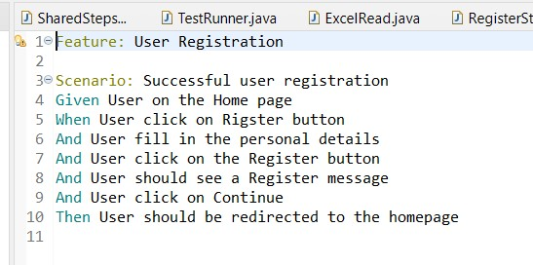
Gherkin Key Words

Slide 18
Listeners
TestNG listeners are Java classes used in the TestNG testing framework to customize and control test execution behavior.
They provide hooks to intercept and perform actions before and after test methods, suites, and other testing phases.
TestNG offers several built-in listeners, such as ITestListener and ISuiteListener, which can be implemented to handle events like test pass/failure, suite start/end, and more.
Custom listeners can also be created to extend TestNG's functionality, enabling detailed reporting, logging, and dynamic test orchestration based on specific events during test execution.
These listeners are a powerful tool for fine-tuning test automation workflows.

Slide 19
Assertions
Assertions in software testing are statements used to verify expected outcomes and actual results in code.
They are crucial for ensuring the correctness of software.
If the condition is true, the code continues to execute; if false, it triggers an error or failure, indicating a problem.
Assertions are used extensively in unit testing to validate that functions and methods produce the expected results, aiding in debugging and quality assurance.

Slide 20
Logs
Logs are chronological records generated by software applications to capture and store information about their operation.
They include details like error messages, warnings, status updates, and diagnostic data.
Logs are essential for troubleshooting, debugging, and monitoring software systems, as they provide insights into system behavior and performance.
They can be stored locally or remotely, and various logging levels, such as INFO, ERROR, and DEBUG, help filter and prioritize information.

Slide 21
Extent Reports
Extent Reports is a popular reporting library in the Java ecosystem, often used in conjunction with TestNG and Selenium for test automation.
It provides detailed HTML reports that help testers and developers understand test execution results.

Slide 22
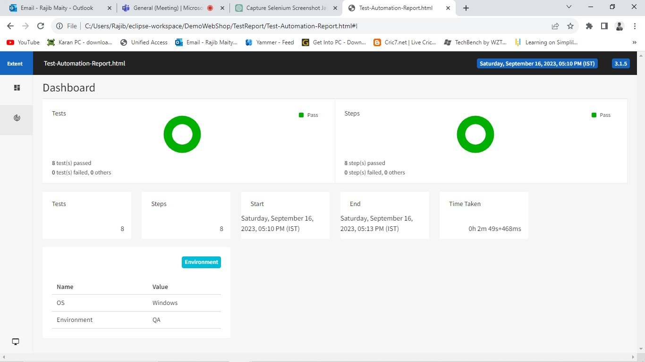

Slide 23
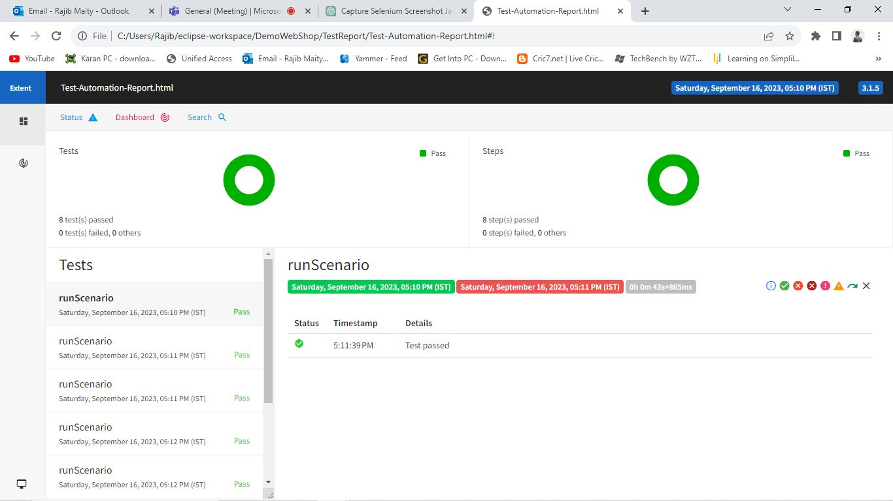

Slide 24
Cucumber reports
Cucumber Reports: Cucumber produces reports that highlight the execution of Gherkin-based scenarios, including step definitions, pass/fail outcomes, and scenario statuses.
It typically generates reports in formats like JSON, HTML, or JSON files, offering insights into feature file execution.
Cucumber reports facilitate collaboration between technical and non-technical team members, ensuring that behavior-driven tests align with business requirements and are easy to understand

Slide 25
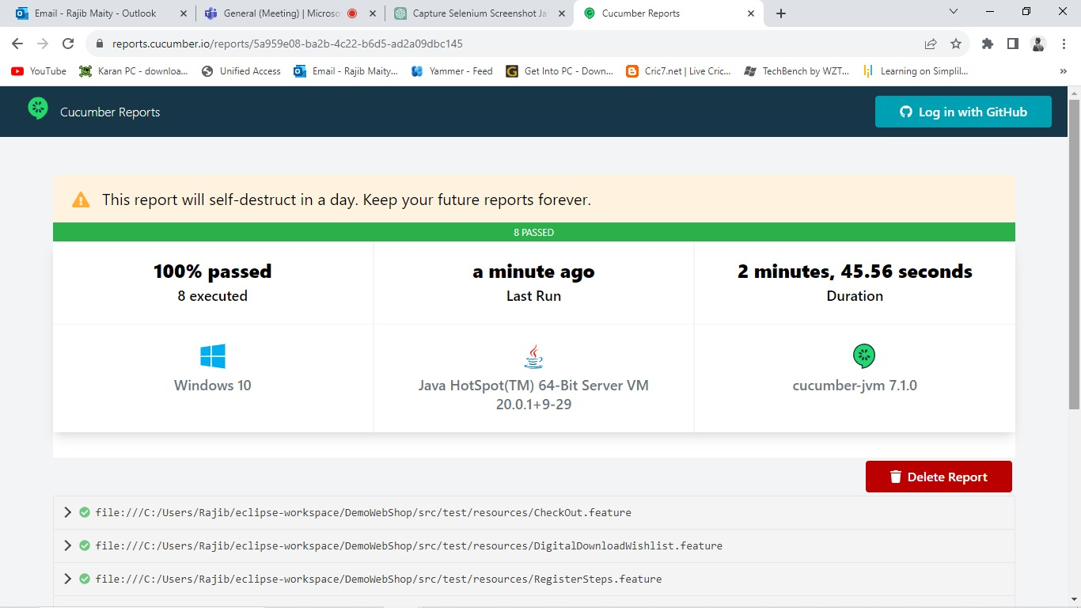

Slide 26
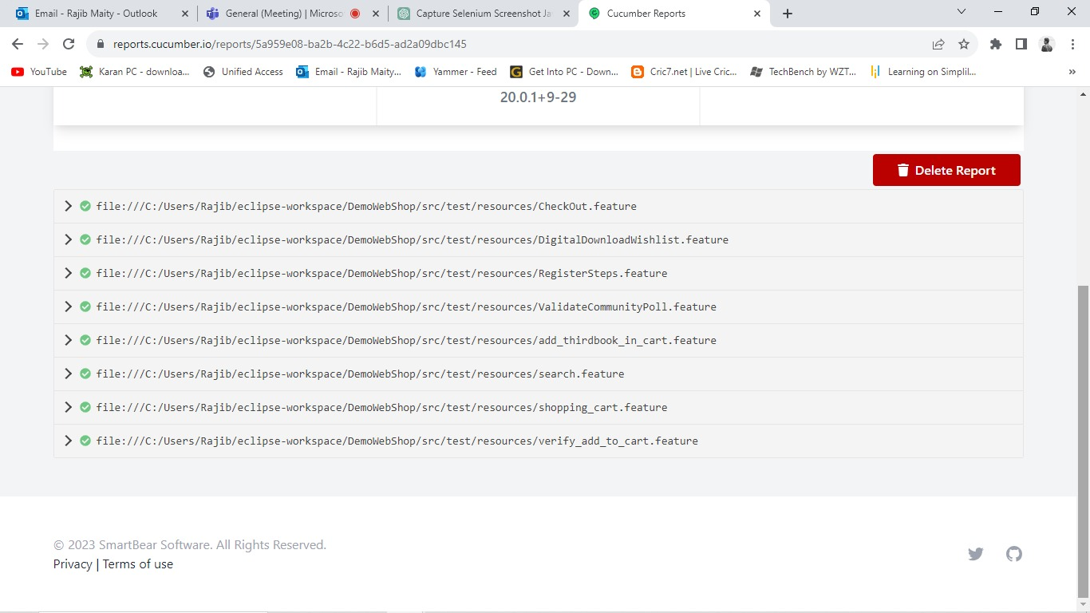

Slide 27
Test Runner Class
Parallel Execution: In modern test automation, parallel execution of test cases is essential to save time and resources.
Test runner classes often provide options for running tests in parallel, whether it's at the class level, method level, or suite level.
We can run all the feature file together in test runner class.

Slide 28
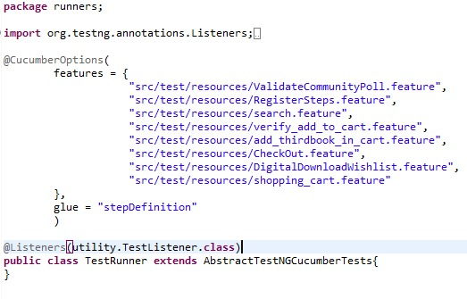
Test Runner Class

Slide 29
Conclusion
Automating your e-commerce testing with Cucumber, Selenium, TestNG, and Listener can provide reliable and efficient testing. This can help you catch defects early and improve the overall user experience.

Slide 30
THANK YOU

