Slide 1
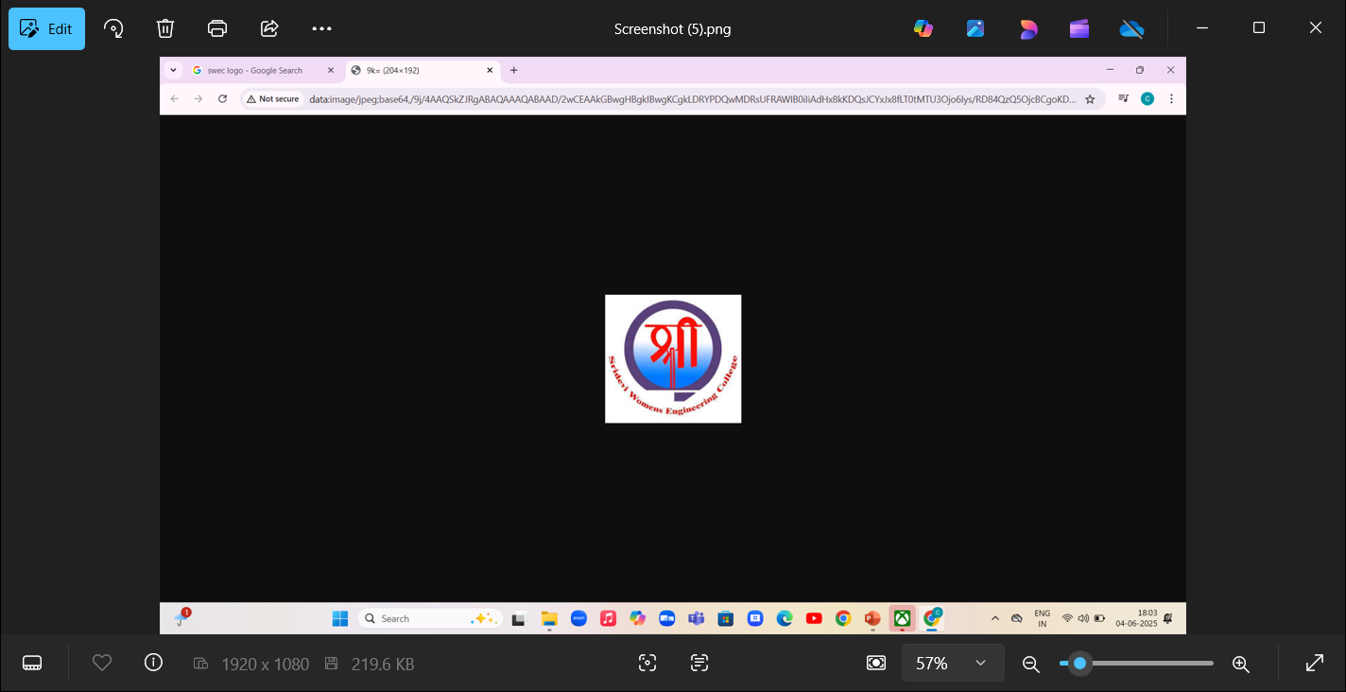
Sri devi women’s engineering college
GUIDE NAME :-Mrs.A.Aruna mam
TEAM NUMBER:-3
TEAM MEMBERS NAMES:-B.RAMYA(23D21A05C7)
b.Sushma(23d21a05c8)
ch.rajini(23d21a05d1)

Slide 2


Slide 3
Table of content
Abstract
Introduction
System architecture
Software & hardware requirements
Output
Conclusion
Future enhancement

Slide 4
Abstract
The Gaming Galaxy is a dynamic and interactive entertainment space designed to provide immersive gaming experiences for all age groups. Equipped with state-of-the-art technology, the zone features a wide range of games including virtual reality (VR), augmented reality (AR), console gaming, PC setups, and classic arcade machines. Whether for casual players or competitive gamers, the Gaming Galaxy fosters a social and engaging environment where fun, skill development, and digital exploration intersect. With dedicated areas for tournaments, multiplayer sessions, and individual gameplay, it serves as a hub for community engagement, innovation, and recreation in the rapidly evolving world of gaming.

Slide 5
Introduction
Welcome to Gaming Galaxy, Gaming Galaxy is your go-to place for fun, safe, and super cool online games made just for kids under 15. Whether you love puzzles, adventure, memory games, coloring challenges, or action-packed fun – we’ve got it all right here!
Our games are easy to play, full of color, and totally safe – with no downloads, no ads, and no worries. Just click, play, and enjoy endless hours of entertainment designed for curious and creative minds.

Slide 6
System architecture
REGISTER
NO
ADMIN
YES
LOGIN
GAMEING HOME PAGE
LOGOUT

Slide 7
Software & hardware requirements
SOFTWARE REQUIREMENTS:-
Operating System: window 11
Frontend: HTML, CSS, JavaScript
Backend: JavaScript
Database: MySQL
HARDWARE REQUIREMENTS:-
Processor: Intel Core 7
RAM: 16GB

Slide 8
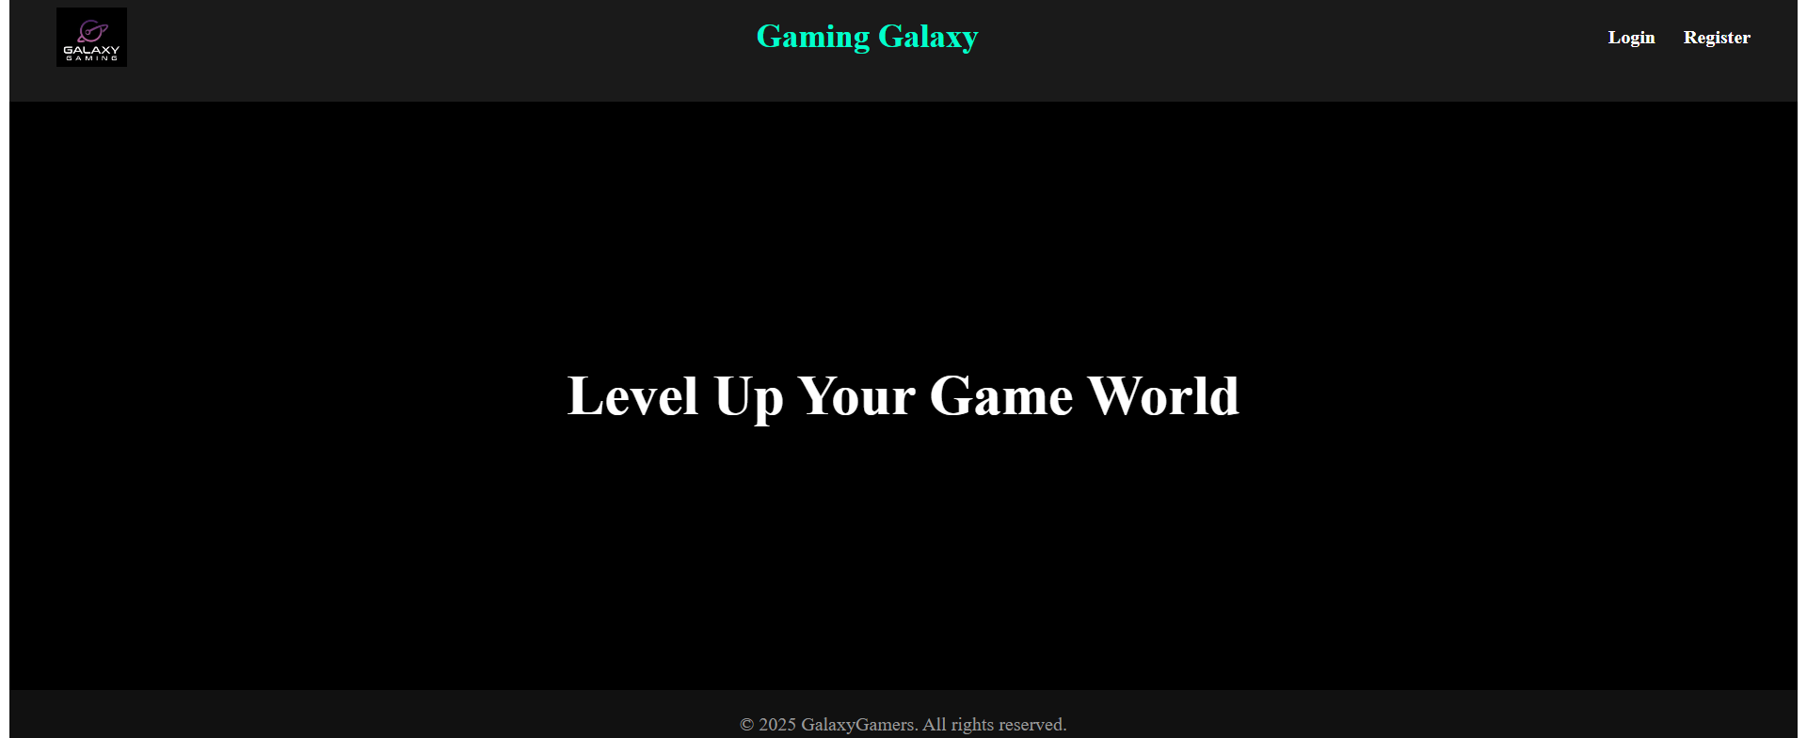
OUTPUT
INDEX PAGE

Slide 9
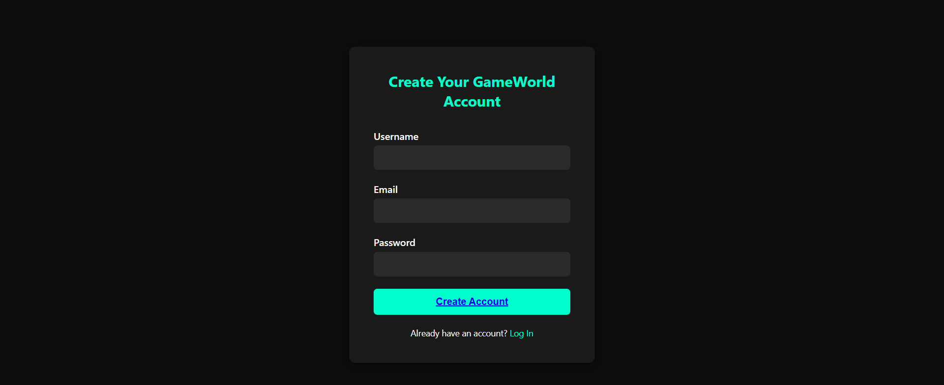
REGISRATION PAGE

Slide 10
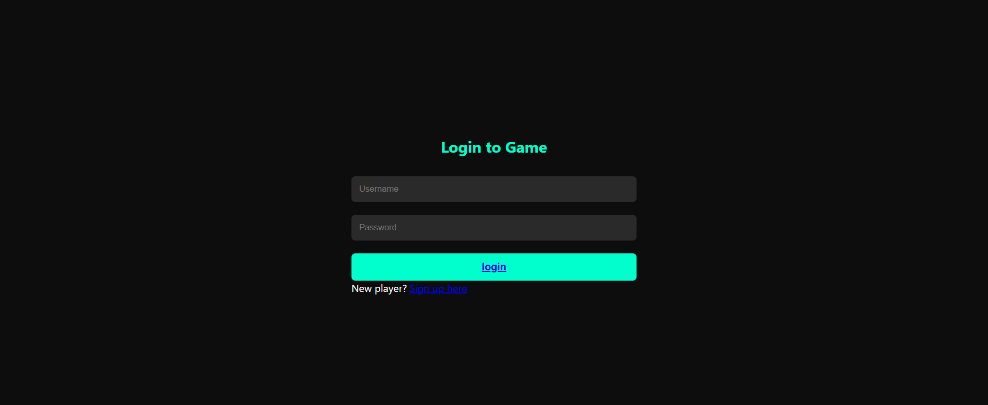
LOGIN PAGE

Slide 11
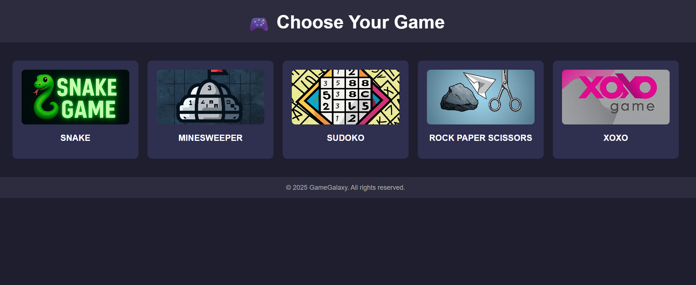
FINAL GAMING PAGE

Slide 12
Future enhancement
1. AI Game Assistants add intelligent assistants that offer hints, tutorials, or real-time tips while playing. Use voice or chat-based interaction to guide new players.
2. Dynamic News & Event Feed Integrate a personalized dashboard showing news, game updates, patch notes, and trending topics. Include developer blogs, trailers, and upcoming releases.
3. Game Streaming & Content Creation Tools Allow users to stream gameplay directly to platforms like Twitch, YouTube, or within the app. Include overlays, recording, and editing tools for content creators.

Slide 13
Conclusion
Gaming Galaxy offers a fun, user-friendly platform for casual gamers to enjoy a variety of simple games anytime, anywhere. With its clean design and easy navigation, it's perfect for quick entertainment and stress relief. Whether you're looking to kill time or challenge your high score, Gaming Galaxy is the go-to destination for simple, enjoyable gaming.

Slide 14
Thank you

