Slide 1
Statistics for SNU_AO class Summary review
5yㅛㅐㅐㅜㄴ ㅛㅐdfasdfasdfㅁㄴㅇㄹㅁㄴㅇㄹㅁㄴㅇㄹ df
Yoonsoo P. Bach

Slide 2
Note
For all the basics, see the Book file in our class repo.

Slide 3
AO1 – Basics
Frequentist view

Slide 4
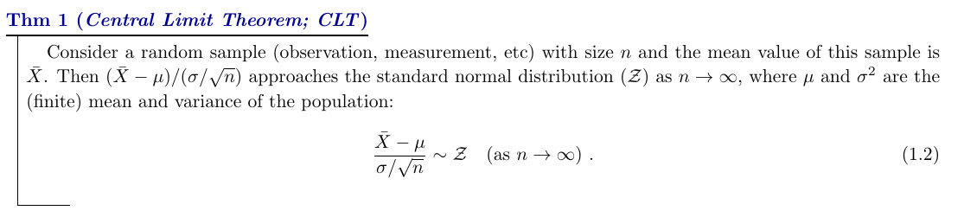
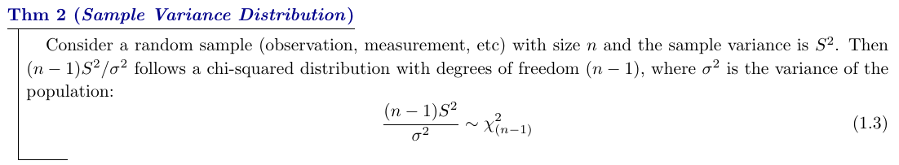
CLT

Slide 5
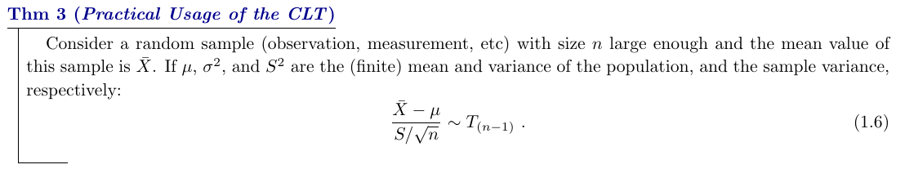
CLT
CLT tells us about mean, not individual outcome.
Mean of coin-tossing experiment can have estimation 0.001 ± 0.00001, but none of the data is within this range.
Similarly in astronomy, mean magnitude, for instance, may not be reproduced all the time (but as it's rather a continuous variable, it is highly likely that new measurements will be contained in the 1-sigma range).
Coin-toissing experiment
#
Proba. of true mean(x)
x
x = -1
(T)
x = +1
(H)

Slide 6
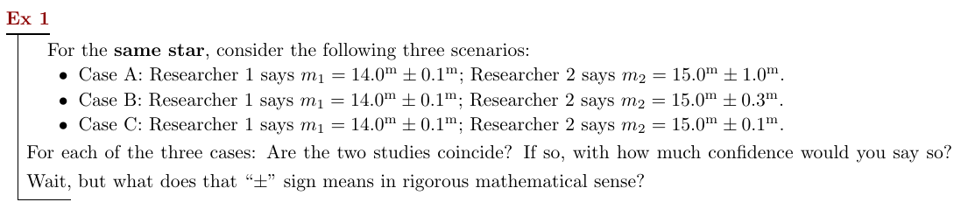
Researcher 1 VS 2
Answer
Can we reject the null hypothesis (H₀: true m₁ = true m₂) when n_{obs} were 5 for both researchers? :
 | at 90% CI | at 95% CI | at 99% CI
Case A | X | X | X
Case B | O | O | X
Case C | O | O | O

Slide 7
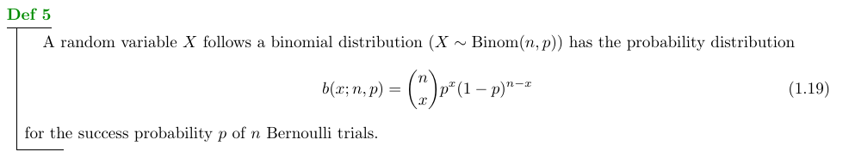
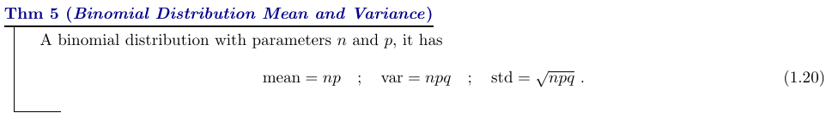
Binomial distribution

Slide 8
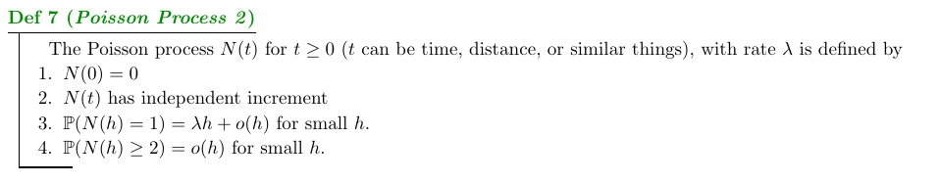
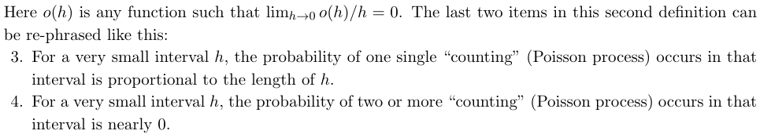
Poisson process/distribution

Slide 9
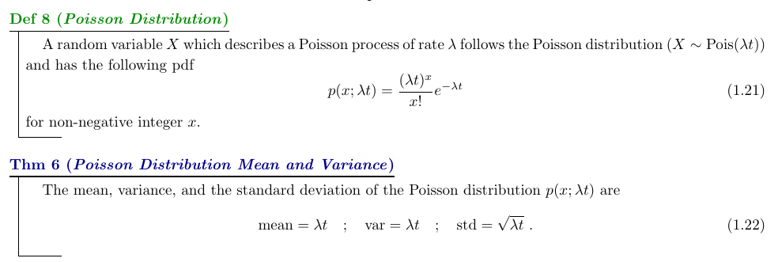
Poisson process/distribution

Slide 10
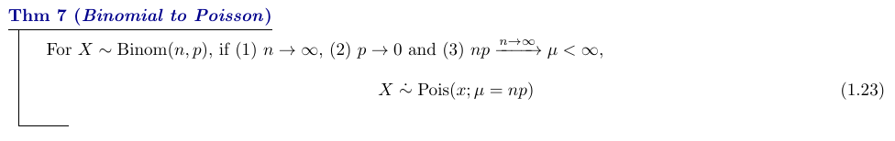
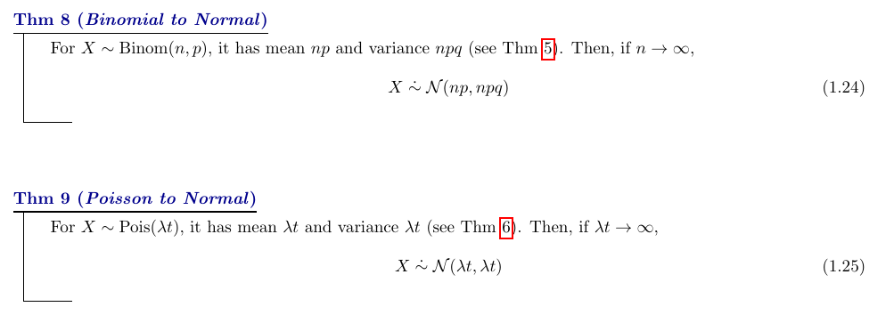
Relationships

Slide 11
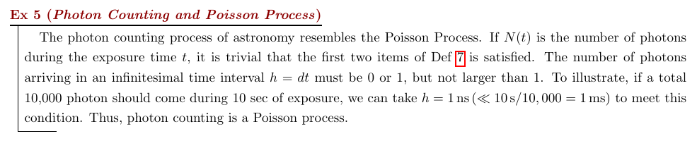
Photon counting in astronomy

Slide 12
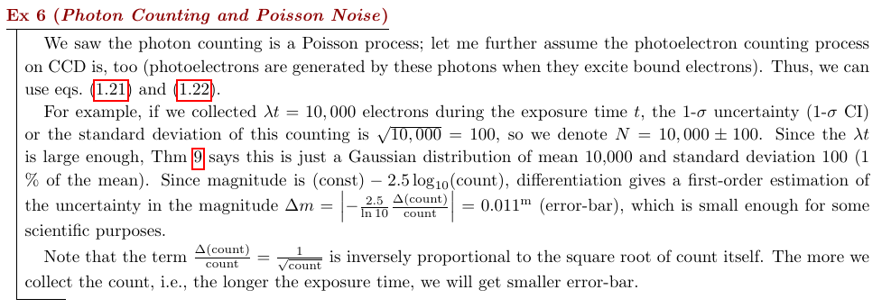
Photon counting in astronomy

Slide 13
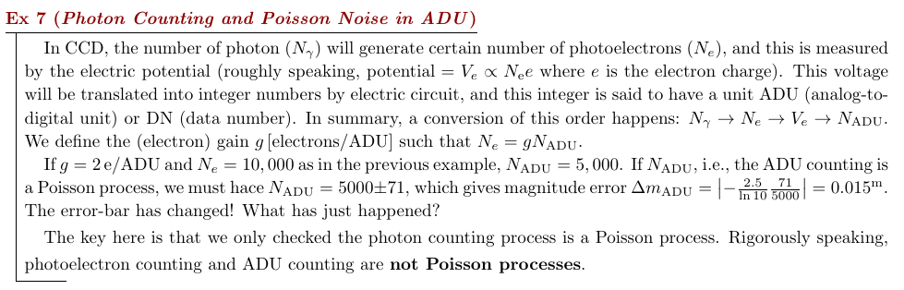
Photon counting in astronomy

Slide 14
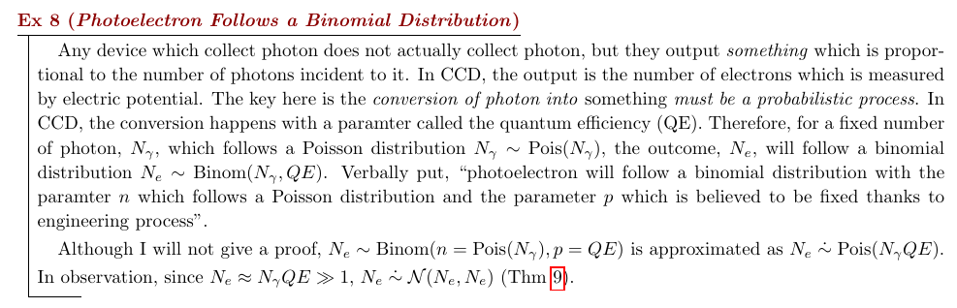
Photon counting in astronomy

Slide 15
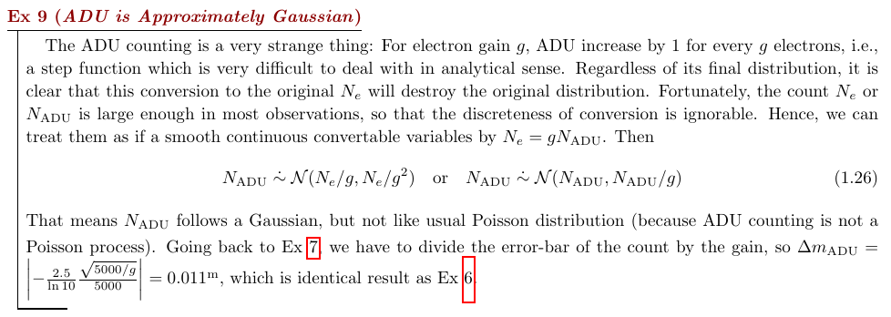
Photon counting in astronomy

Slide 16
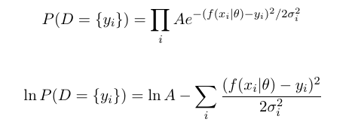
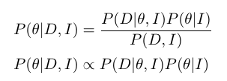

Chi-square minimization
taking natural log
maximize
P(D|θ, I)
minimize
χ²

Slide 17
AO2 – Some more
Basic Bayesian

