Slide 1
AO Class Prep Course for TA Final Exam Questions
Yoonsoo P. Bach

Slide 2
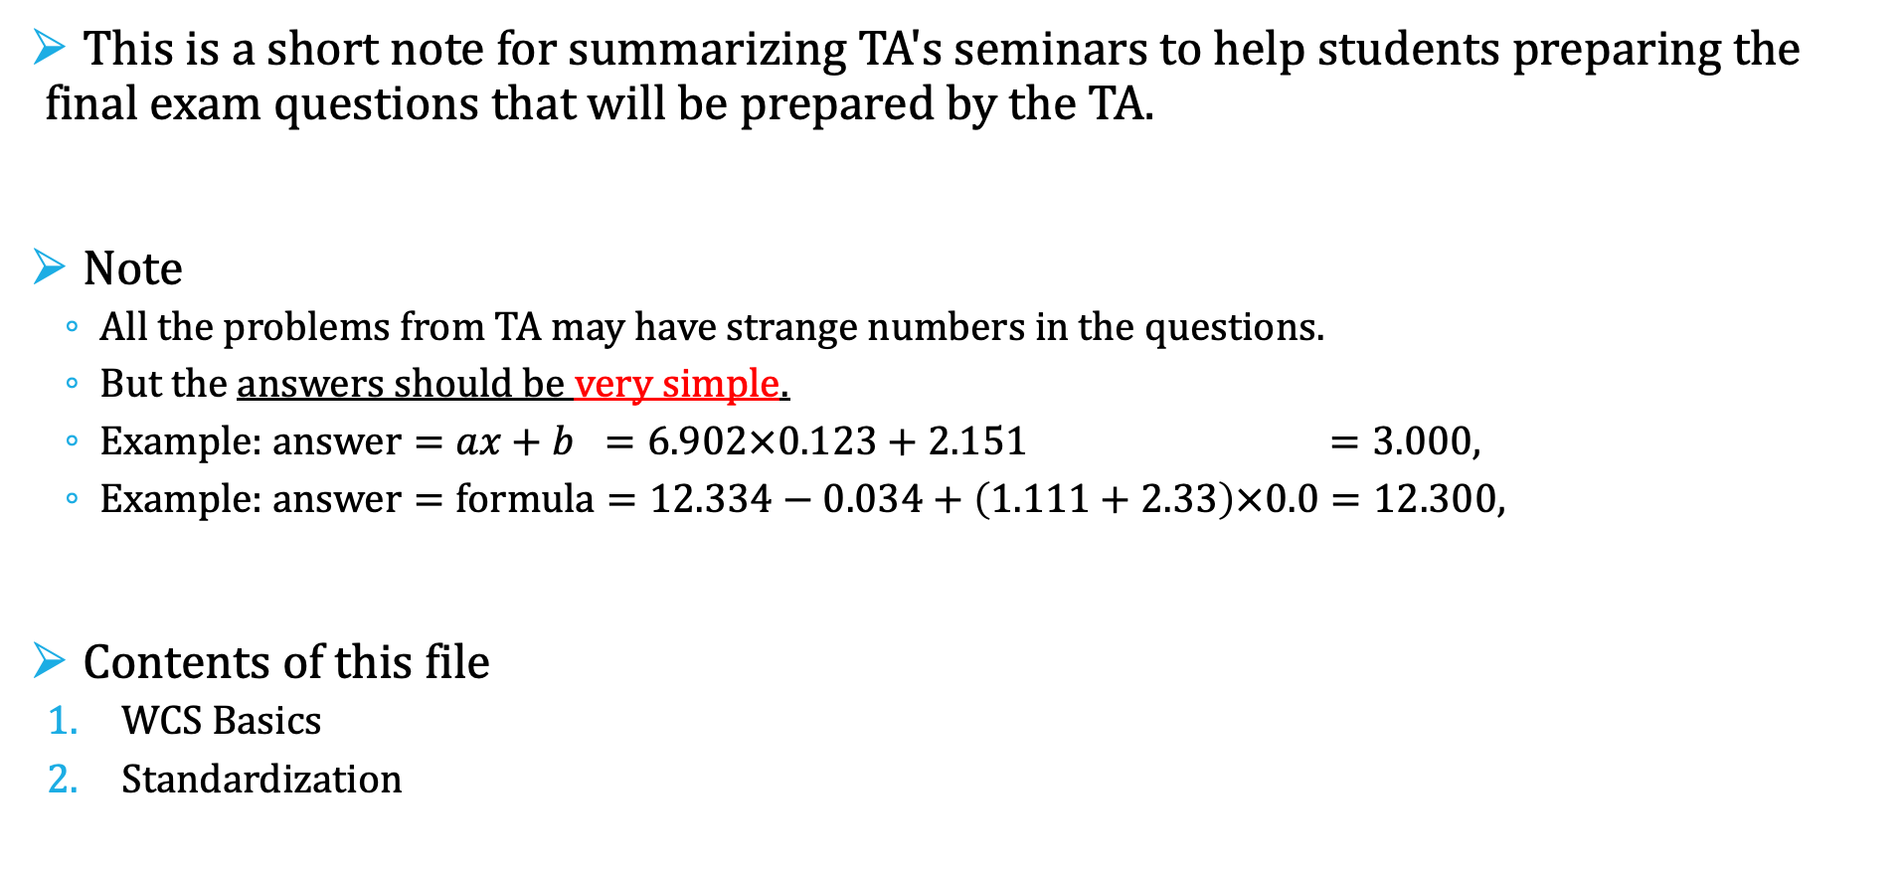
Introduction
This is a short note for summarizing TA's seminars to help students preparing the final exam questions that will be prepared by the TA.
Note
All the problems from TA may have strange numbers in the questions.
But the answers should be very simple.
Example: $answer=ax+b =6.902×0.123+2.151 =3.000$,
Example: $answer=formula=12.334−0.034+\left(1.111+2.33\right)×0.0=12.300$,
Contents of this file
WCS Basics
Standardization
crazy numbers
neat answer

Slide 3
WCS Basics
WCS = World Coordinate System

Slide 4
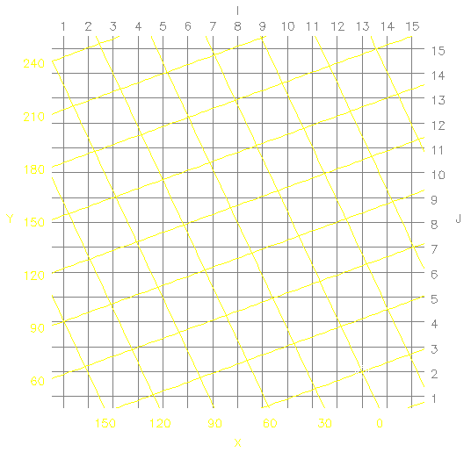
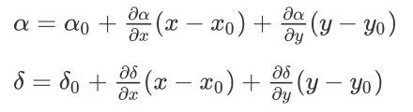
WCS basics
Header contains information.
RA [deg]
e.g.,
(α, δ)
(x, y)
DEC [deg]
(α₀, δ₀)
(x₀, y₀)
https://www.atnf.csiro.au/people/mcalabre/WCS/Intro/WCS02.html

Slide 5
WCS basics
CRPIX1 CRPIX2
(coordinate reference pixel)
Header contains information.
RA [deg]
e.g.,
CRVAL1 CRVAL2
(coordinate reference value)
CDi_j
Coordinate Description matrix component
i (RA/DEC), j (x/y)
(α, δ)
(x, y)
DEC [deg]
(see left figure and fill)
CTYPE1 = '?'
CTYPE2 = '?'
CUNIT1 = '?'
CUNIT2 = '?'
EQUINOX= 2000.0
CRVAL1 = ?
CRVAL2 = ?
CRPIX1 = ?
CRPIX2 = ?
(α₀, δ₀)
(x₀, y₀)

Slide 6
WCS basics
CRPIX1 CRPIX2
(coordinate reference pixel)
Header contains information.
RA [deg]
e.g.,
CRVAL1 CRVAL2
(coordinate reference value)
CDi_j
Coordinate Description matrix component
i (RA/DEC), j (x/y)
(α, δ)
(x, y)
DEC [deg]
(see left figure and fill)
CTYPE1 = 'RA'
CTYPE2 = 'DEC'
CUNIT1 = 'deg'
CUNIT2 = 'deg'
EQUINOX= 2000.0
CRVAL1 = 13.00
CRVAL2 = 2.00
CRPIX1 = 0.00
CRPIX2 = 0.00
(α₀, δ₀)
(x₀, y₀)
Note: normally we put the "projection" algorithm in CTYPE, such as "RA--TAN": see https://fits.gsfc.nasa.gov/fits_wcs.html

Slide 7


WCS basics
CRPIX1 CRPIX2
(coordinate reference pixel)
Header contains information.
RA [deg]
e.g.,
CRVAL1 CRVAL2
(coordinate reference value)
CDi_j
Coordinate Description matrix component
i (RA/DEC), j (x/y)
(α, δ)
(x, y)
DEC [deg]
$$y−y_{0}=+60$$
(see left figure and fill)
CTYPE1 = 'RA'
CTYPE2 = 'DEC'
CUNIT1 = 'deg'
CUNIT2 = 'deg'
EQUINOX= 2000.0
CRVAL1 = 13.00
CRVAL2 = 2.00
CRPIX1 = 0.00
CRPIX2 = 0.00
(α₀, δ₀)
(x₀, y₀)
$$x−x_{0}=−60$$
Note: normally we put the "projection" algorithm in CTYPE, such as "RA--TAN": see https://fits.gsfc.nasa.gov/fits_wcs.html

Slide 8
WCS basics
Header contains information.
RA [deg]
$$\left[\begin{matrix}CTYPE1 \\ CTYPE2\end{matrix}\right]=\left[\begin{matrix}CRVAL1 \\ CRVAL2\end{matrix}\right]+\left[\begin{matrix}CD1_1 & CD1_2 \\ CD2_1 & CD2_2\end{matrix}\right]\left[\begin{matrix}X−CRPIX1 \\ Y−CRPIX2\end{matrix}\right]$$
In the units of CUNIT1 and CUNIT2
at the equinox position of J EQUINOX (i.e., J 2000.0 in this case)
(α, δ)
(x, y)
DEC [deg]
$$y−y_{0}=+60$$
(see left figure and fill)
CTYPE1 = 'RA'
CTYPE2 = 'DEC'
CUNIT1 = 'deg'
CUNIT2 = 'deg'
EQUINOX= 2000.0
CRVAL1 = 13.00
CRVAL2 = 2.00
CRPIX1 = 0.00
CRPIX2 = 0.00
(α₀, δ₀)
(x₀, y₀)
$$x−x_{0}=−60$$
Note: normally we put the "projection" algorithm in CTYPE, such as "RA--TAN": see https://fits.gsfc.nasa.gov/fits_wcs.html

Slide 9
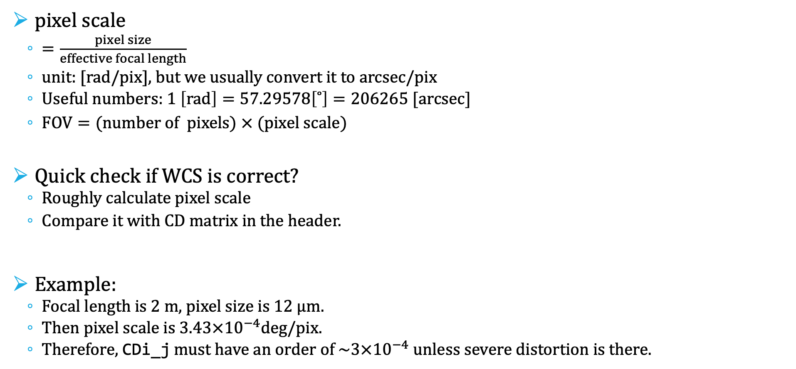
WCS basics
pixel scale
$=\frac{pixel size}{effective focal length}$
unit: [rad/pix], but we usually convert it to arcsec/pix
Useful numbers: $1 \left[rad\right]=57.29578\left[˚\right]=206265 [arcsec]⁡$
$FOV=(number of pixels) × (pixel scale)$
Quick check if WCS is correct?
Roughly calculate pixel scale
Compare it with CD matrix in the header.
Example:
Focal length is 2 m, pixel size is 12 µm.
Then pixel scale is $3.43×{10}^{−4}$deg/pix.
Therefore, CDi_j must have an order of $\sim 3×{10}^{−4}$ unless severe distortion is there.

Slide 10
Standardization

Slide 11

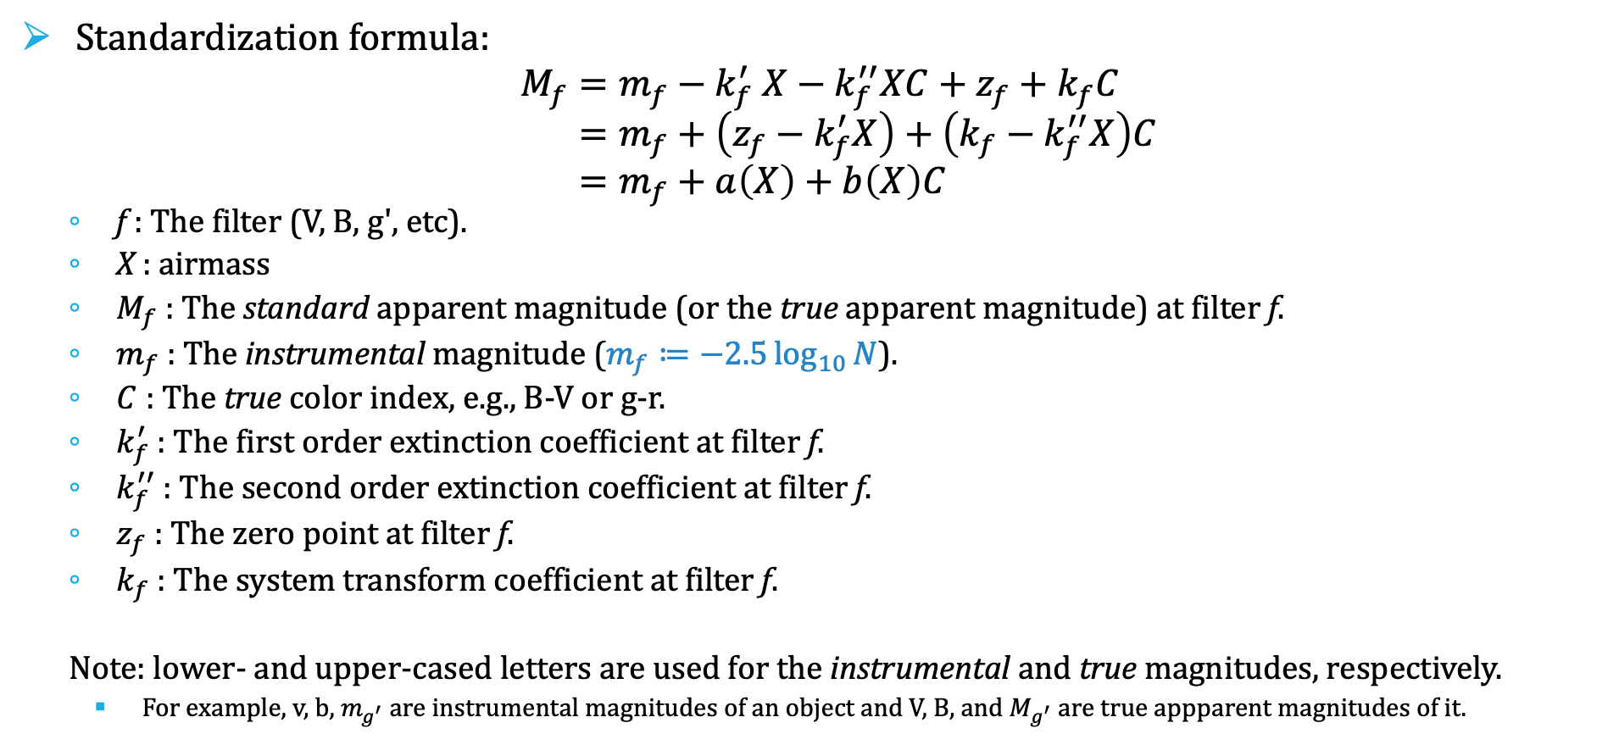
Standardization
Standardization formula:
$$M_{f}=m_{f}−k_{f}^{′} X−k_{f}^{′′}XC+z_{f}+k_{f}C \\ =m_{f}+\left(z_{f}−k_{f}^{′}X\right)+\left(k_{f}−k_{f}^{′′}X\right)C \\ =m_{f}+a\left(X\right)+b\left(X\right)C$$
f : The filter (V, B, g', etc).
X : airmass
$M_{f}$ : The standard apparent magnitude (or the true apparent magnitude) at filter f.
$m_{f}$ : The instrumental magnitude ($m_{f}≔−2.5\log_{10}{N}$).
$C$ : The true color index, e.g., B-V or g-r.
$k_{f}^{′}$ : The first order extinction coefficient at filter f.
$k_{f}^{′′}$ : The second order extinction coefficient at filter f.
$z_{f}$ : The zero point at filter f.
$k_{f}$ : The system transform coefficient at filter f.
Note: lower- and upper-cased letters are used for the instrumental and true magnitudes, respectively.
For example, v, b, $m_{g^{′}}$ are instrumental magnitudes of an object and V, B, and $M_{g^{′}}$ are true appparent magnitudes of it.
$$m_{f}≔−2.5\log_{10}{count}$$
To the 1st order Taylor series:
$$\left|dm_{f}\right|=\frac{2.5}{\ln{10}}\frac{Δcount}{count}$$

Slide 12
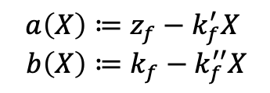

Standardization
at least two with different colors: called blue-red pair
If you observed standard stars in many airmasses (X), you know $M_{f}$ and $C$ from catalog and $m_{f}$ from CCD image.
$$M_{f}−m_{f}=a\left(X\right)+b\left(X\right)C$$
$$a\left(X\right)≔z_{f}−k_{f}^{′}X \\ b\left(X\right)≔k_{f}−k_{f}^{′′}X$$
Known

Slide 13


Standardization
If you observed standard stars in many airmasses (X), you know $M_{f}$ and $C$ from catalog and $m_{f}$ from CCD image.
$$M_{f}−m_{f}=a\left(X\right)+b\left(X\right)C$$
$$a\left(X\right)≔z_{f}−k_{f}^{′}X \\ b\left(X\right)≔k_{f}−k_{f}^{′′}X$$
$$M_{f}−m_{f}$$
$$X=X_{1}$$
4
5
3
2
1
Color C

Slide 14
Standardization
If you observed standard stars in many airmasses (X), you know $M_{f}$ and $C$ from catalog and $m_{f}$ from CCD image.
$$M_{f}−m_{f}=a\left(X\right)+b\left(X\right)C$$
$$a\left(X\right)≔z_{f}−k_{f}^{′}X \\ b\left(X\right)≔k_{f}−k_{f}^{′′}X$$
$$M_{f}−m_{f}$$
$$X=X_{1}$$
4
5
3
2
1
Color C

Slide 15

Standardization
If you observed standard stars in many airmasses (X), you know $M_{f}$ and $C$ from catalog and $m_{f}$ from CCD image.
$$M_{f}−m_{f}=a\left(X\right)+b\left(X\right)C$$
$$a\left(X\right)≔z_{f}−k_{f}^{′}X \\ b\left(X\right)≔k_{f}−k_{f}^{′′}X$$
$$M_{f}−m_{f}$$
$$a\left(X_{1}\right)=a_{1}$$
$$b\left(X_{1}\right)=b_{1}$$
$$X=X_{1}$$
4
5
3
2
1
Color C

Slide 16


Standardization
If you observed standard stars in many airmasses (X), you know $M_{f}$ and $C$ from catalog and $m_{f}$ from CCD image.
$$M_{f}−m_{f}=a\left(X\right)+b\left(X\right)C$$
$$a\left(X\right)≔z_{f}−k_{f}^{′}X \\ b\left(X\right)≔k_{f}−k_{f}^{′′}X$$
$$M_{f}−m_{f}$$
$$a\left(X_{1}\right)=a_{1}$$
$$b\left(X_{1}\right)=b_{1}$$
$$X=X_{1}$$
4
5
3
2
4
5
1
$$a\left(X_{2}\right)=a_{2}$$
$$b\left(X_{2}\right)=b_{2}$$
2
3
1
$$X=X_{2}$$
Color C

Slide 17
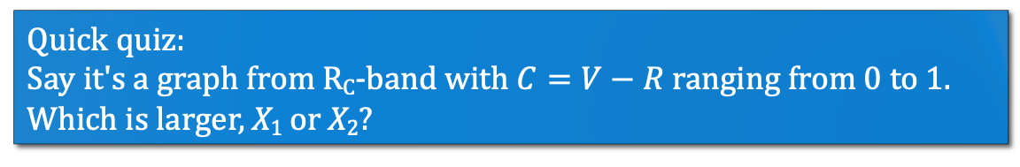
Standardization
If you observed standard stars in many airmasses (X), you know $M_{f}$ and $C$ from catalog and $m_{f}$ from CCD image.
$$M_{f}−m_{f}=a\left(X\right)+b\left(X\right)C$$
$$a\left(X\right)≔z_{f}−k_{f}^{′}X \\ b\left(X\right)≔k_{f}−k_{f}^{′′}X$$
$$M_{f}−m_{f}$$
$$a\left(X_{1}\right)=a_{1}$$
$$b\left(X_{1}\right)=b_{1}$$
$$X=X_{1}$$
4
5
3
2
4
5
1
$$a\left(X_{2}\right)=a_{2}$$
$$b\left(X_{2}\right)=b_{2}$$
2
3
1
$$X=X_{2}$$
Color C
Quick quiz:
Say it's a graph from R_{C}-band with $C=V−R$ ranging from 0 to 1.
Which is larger, X₁ or X₂?

Slide 18
Standardization
If you observed standard stars in many airmasses (X), you know $M_{f}$ and $C$ from catalog and $m_{f}$ from CCD image.
$$M_{f}−m_{f}=a\left(X\right)+b\left(X\right)C$$
$$a\left(X\right)≔z_{f}−k_{f}^{′}X \\ b\left(X\right)≔k_{f}−k_{f}^{′′}X$$
$$M_{f}−m_{f}$$
$$a\left(X_{1}\right)=a_{1}$$
$$b\left(X_{1}\right)=b_{1}$$
$$X=X_{1}$$
Repeat for all X values
4
5
3
2
4
5
1
$$a\left(X_{2}\right)=a_{2}$$
$$b\left(X_{2}\right)=b_{2}$$
2
3
1
$$X=X_{2}$$
Color C

Slide 19




Standardization
If you observed standard stars in many airmasses (X), you know $M_{f}$ and $C$ from catalog and $m_{f}$ from CCD image.
$$M_{f}−m_{f}=a\left(X\right)+b\left(X\right)C$$
$$a\left(X\right)≔z_{f}−k_{f}^{′}X \\ b\left(X\right)≔k_{f}−k_{f}^{′′}X$$
$$M_{f}−m_{f}$$
$$a(X)$$
$$a\left(X_{1}\right)=a_{1}$$
$$b\left(X_{1}\right)=b_{1}$$
$$X=X_{1}$$
Repeat for all X values
4
5
3
$$X$$
2
4
5
1
$$a\left(X_{2}\right)=a_{2}$$
$$b\left(X_{2}\right)=b_{2}$$
$$b(X)$$
2
3
1
$$X=X_{2}$$
Color C
$$X$$

Slide 20

Standardization
If you observed standard stars in many airmasses (X), you know $M_{f}$ and $C$ from catalog and $m_{f}$ from CCD image.
$$M_{f}−m_{f}=a\left(X\right)+b\left(X\right)C$$
$$a\left(X\right)≔z_{f}−k_{f}^{′}X \\ b\left(X\right)≔k_{f}−k_{f}^{′′}X$$
$$M_{f}−m_{f}$$
$$a(X)$$
$$a\left(X_{1}\right)=a_{1}$$
$$b\left(X_{1}\right)=b_{1}$$
$$X=X_{1}$$
Repeat for all X values
4
5
3
$$X$$
2
4
5
1
$$a\left(X_{2}\right)=a_{2}$$
$$b\left(X_{2}\right)=b_{2}$$
$$b(X)$$
2
3
1
$$X=X_{2}$$
Color C
$$X$$

Slide 21
Standardization
If you observed standard stars in many airmasses (X), you know $M_{f}$ and $C$ from catalog and $m_{f}$ from CCD image.
$$M_{f}−m_{f}=a\left(X\right)+b\left(X\right)C$$
$$a\left(X\right)≔z_{f}−k_{f}^{′}X \\ b\left(X\right)≔k_{f}−k_{f}^{′′}X$$
$$M_{f}−m_{f}$$
$$a(X)$$
$$a\left(X_{1}\right)=a_{1}$$
$$b\left(X_{1}\right)=b_{1}$$
$$X=X_{1}$$
Repeat for all X values
4
5
3
slopes and intercepts give all unknowns
$$X$$
2
4
5
1
$$a\left(X_{2}\right)=a_{2}$$
$$b\left(X_{2}\right)=b_{2}$$
$$b(X)$$
2
3
1
$$X=X_{2}$$
Color C
$$X$$

Slide 22

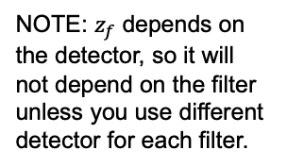
Standardization
If you observed standard stars in many airmasses (X), you know $M_{f}$ and $C$ from catalog and $m_{f}$ from CCD image.
$$M_{f}−m_{f}=a\left(X\right)+b\left(X\right)C$$
$$a\left(X\right)≔z_{f}−k_{f}^{′}X \\ b\left(X\right)≔k_{f}−k_{f}^{′′}X$$
$$M_{f}−m_{f}$$
$$a(X)$$
$$a\left(X_{1}\right)=a_{1}$$
$$b\left(X_{1}\right)=b_{1}$$
$$X=X_{1}$$
Repeat for all X values
4
5
3
slopes and intercepts give all unknowns
$$X$$
2
4
5
1
$$a\left(X_{2}\right)=a_{2}$$
$$b\left(X_{2}\right)=b_{2}$$
$$b(X)$$
2
3
1
$$X=X_{2}$$
Color C
NOTE: $z_{f}$ depends on the detector, so it will not depend on the filter unless you use different detector for each filter.
Do the identical thing for many filters to get coefficients for all filters. Get $M_{f}$for all filters. Then you will get the standardized color, too.
$$X$$

Slide 23
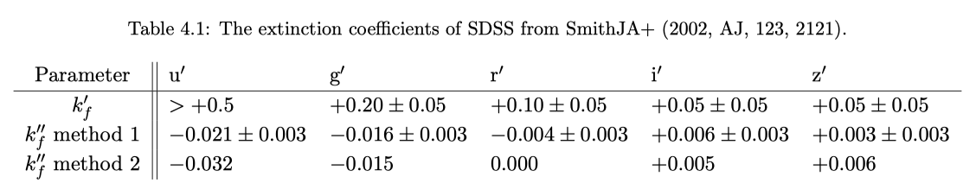
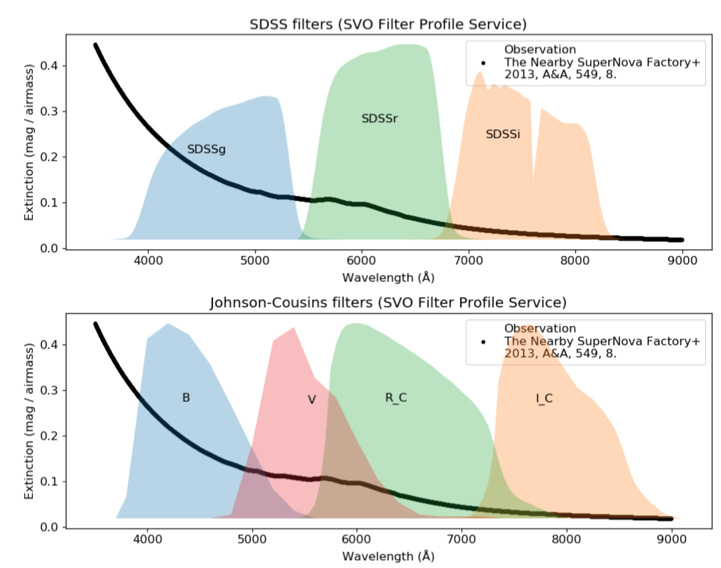

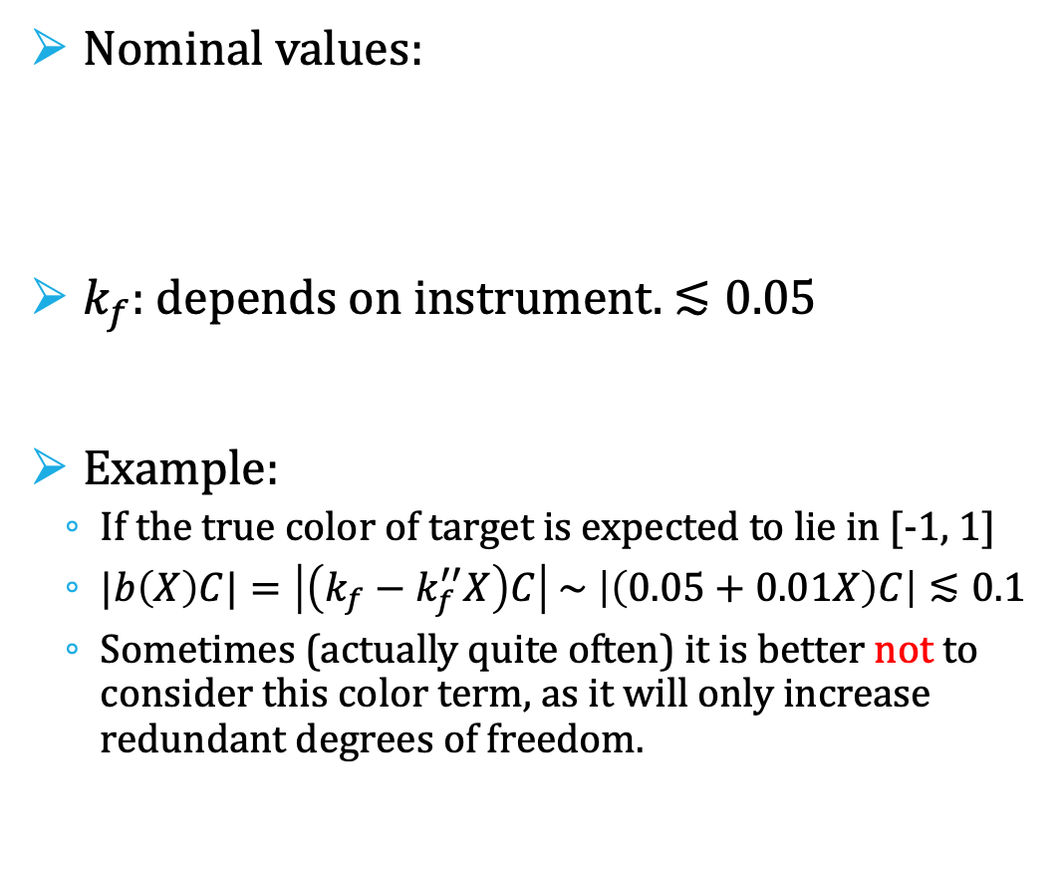


Standardization
$$a\left(X\right)≔z_{f}−k_{f}^{′}X \\ b\left(X\right)≔k_{f}−k_{f}^{′′}X$$
Nominal values:
$k_{f}$: depends on instrument. $≲0.05$
Example:
If the true color of target is expected to lie in [-1, 1]
$|b\left(X\right)C|=\left|\left(k_{f}−k_{f}^{′′}X\right)C\right| \sim \left|\left(0.05+0.01X\right)C\right|≲0.1$
Sometimes (actually quite often) it is better not to consider this color term, as it will only increase redundant degrees of freedom.
$$b$$
현시창
$$X$$

