Slide 1
Who Am I
Yoonsoo P. Bach

Slide 2
Intro
박윤수 Yoonsoo Bach (GitHub @ysBach)
2009 IOAA 3rd
Not from science high school
KAIST (2011-2016), BS Physics
SNU since 2016 Mar
ROKA Expert Research Personnel (2019 Mar -)
@Ishiguro's lab
Asteroids – polarimetry, thermal modeling, reflectance, experiments
Statistics, data analysis, coding, …
010-2259-3199 // dbstn95@gmail.com

Slide 3
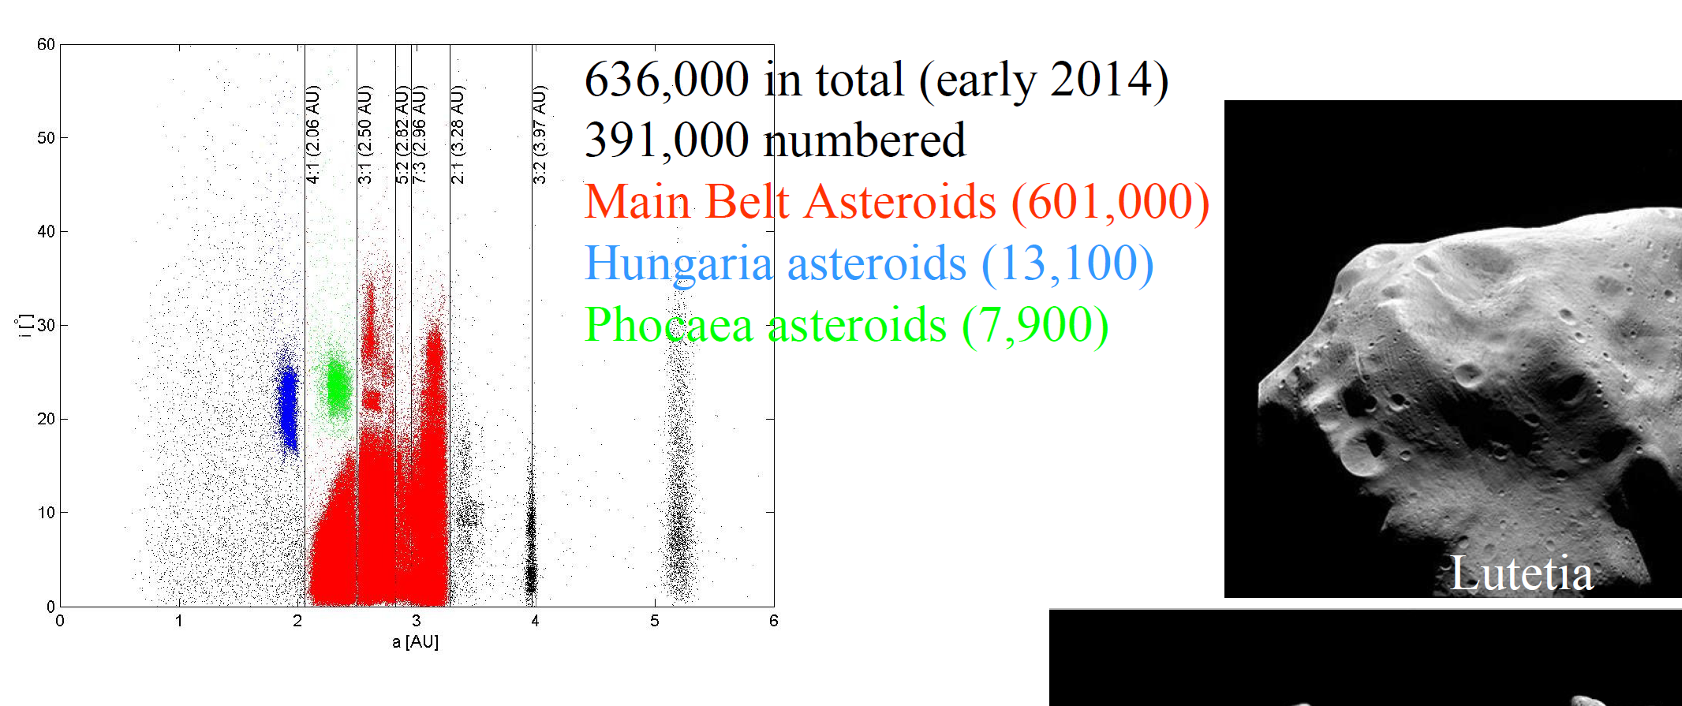
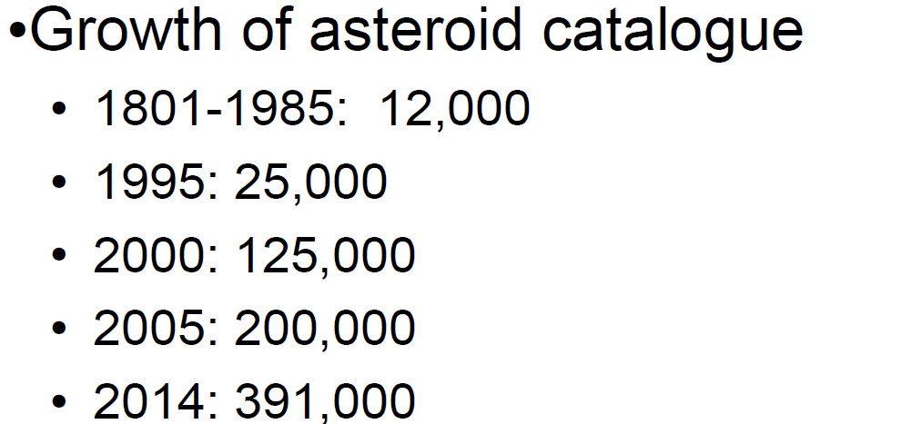
Intro
B. Davidsson+ 2014, Lecture notes on Physics of Planetary Systems, Uppsala University, lecture 01

Slide 4
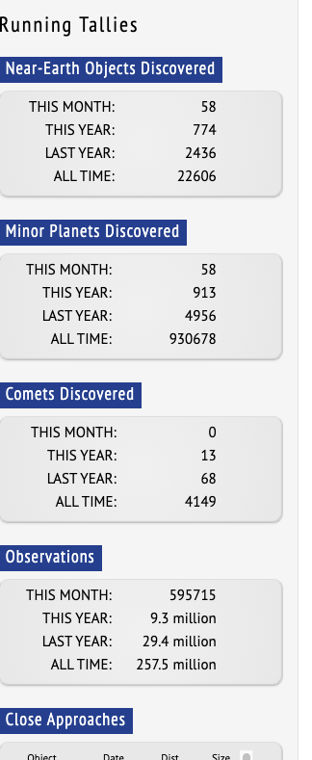
https://www.minorplanetcenter.net/
2020-04-13

Slide 5
Intro
How should you call me?
윤수 Yoonsoo
형/오빠
I don't care which gender you specify yourself; choose whatever you want.
TA (조교님)
여어 조교
선배 (님)
존댓말 (honorifics / polite words)
Either (1) we both should use or (2) we both do not use.
This is because I believe we do have social 'rank' if only one of us use 존댓말, while the opponent use 반말.
Since 2017, I never used 반말 to whoever has taken AO class.
I speak 반말 only if students, i.e., those who have lower social rank than me, used it to me first.

Slide 6
조교 (TA)
助敎
(To) Help Teaching
(the professor)
The person who helps the professor of the course
(I am not a professor or THE teacher of the course!)

Slide 7
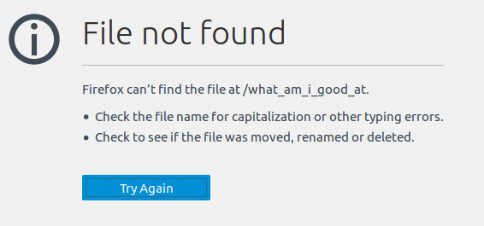
Intro
What am I good at?

Slide 8
Intro
But I am a TA… What are we going to do?
# | Contents | HW
1 | Intro // Intro of IRAF, SAO DS9, Python, Git(Hub), Slack | #1 make GitHub account #2 join our Slack workspace #3 install Anaconda, DS9
2 | Basic statistics | #4 basic python #5 basic numpy
3
4
5
6
7

