Slide 1
OOPs

Slide 2
What is OOPs?
Object Oriented Programming is a way of computer programming using the idea of “objects” to represents data and methods.
It is also, an approach used for creating neat and reusable code instead of a redundant one. the program is divided into self-contained objects or several mini-programs.

Slide 3
Class:
Model or Plan or Blue print, which is nothing but class.
ex: House..
We can write a class to represent properties (attributes) and actions (behavior) of object.
ex: pen, House..
In Python every thing is an object.
ex: int,string..etc

Slide 4
Creating Class:
class className:
''' documenttation string '‘’
variables:
methods:
Functions

Slide 5
What is Object
Physical existence of a class is nothing but object.
An instance of Class is nothing but Object.
We can create any number of objects for a class.
Syntax:
reference_variable = classname()

Slide 6
Method
Action /Functionality/Business Logic
Name of method can be any name
Syntax:
ObjectName.Method_Name()
Self Variable:
self is the default variable which is always pointing to current object.
By using self we can access instance variables and instance methods of object.
self should be first parameter inside constructor
def __init__(self):
self should be first parameter inside instance methods
def talk(self):

Slide 7
Inheritance:
We can use members (variables, methods and constructors ) of one class inside another class is called Inheritance.
the main advantage of inheritance is Code Reusability and we can extend existing functionality with some more extra functionality.
Types of Inheritance:
Single Inheritance
Multi Level Inheritance
Hierarchical Inheritance
Multiple Inheritance
Hybrid Inheritance
Cyclic Inheritance

Slide 8
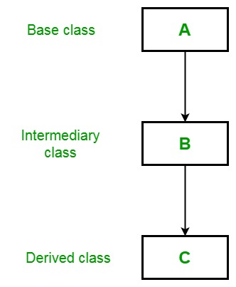
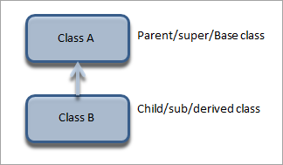
Single Inheritance
Inheriting the properties from one class to another class
Multi Level Inheritance:
inheriting the properties from multiple classes to single class

Slide 9
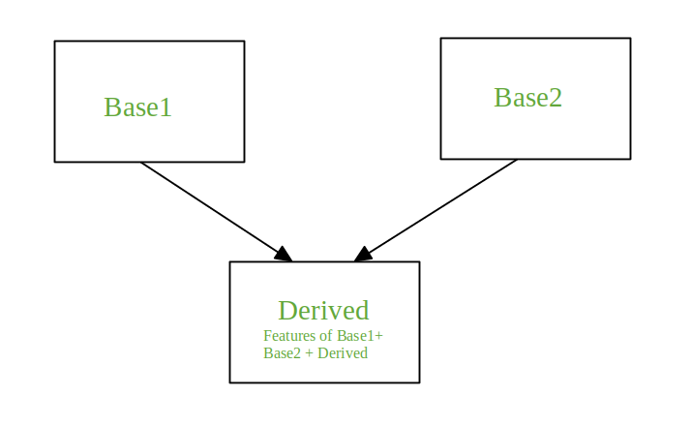
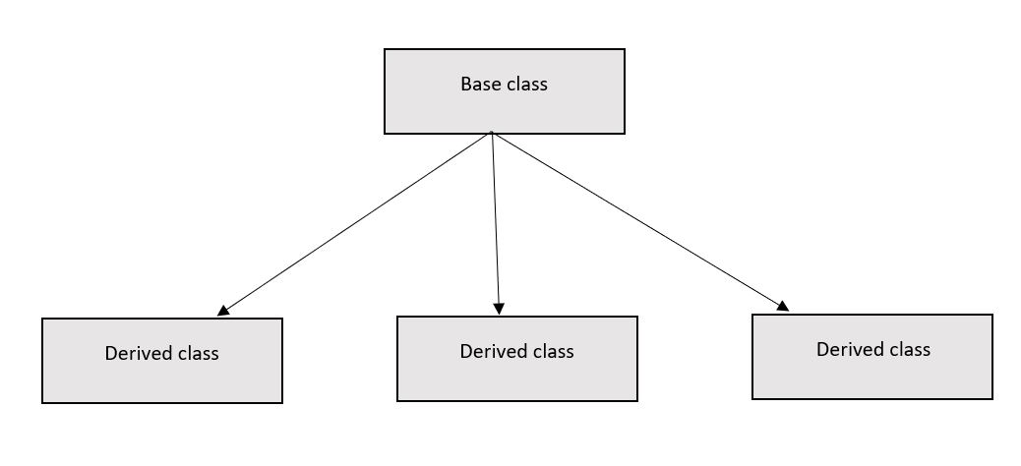
Hierarchical Inheritance
inheriting properties from one class into multiple classes which are present at same level
Multiple Inheritance:
inheriting the properties from multiple classes to single class

Slide 10
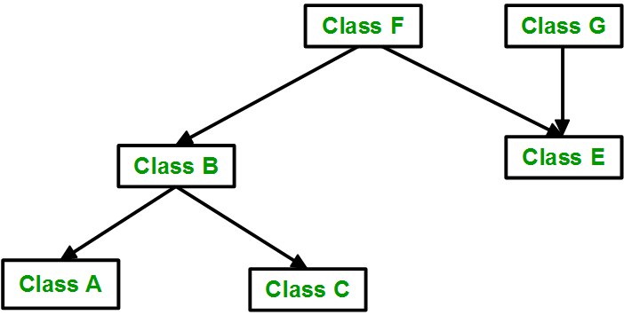
Hybrid Inheritance
Combination of Single, Multi level, multiple and Hierarchical inheritance is known as Hybrid Inheritance
Multiple Inheritance:
inheriting the properties from multiple classes to single class

Slide 11
POLYMORPHISM
poly means many. Morphs means forms. Polymorphism means 'Many Forms’.
* operator
one name, many forms
Polymorphism allows for more flexible and reusable code. By treating different objects uniformly, we can write generic code that can work with various object types, making our programs more modular and adaptable.

Slide 12
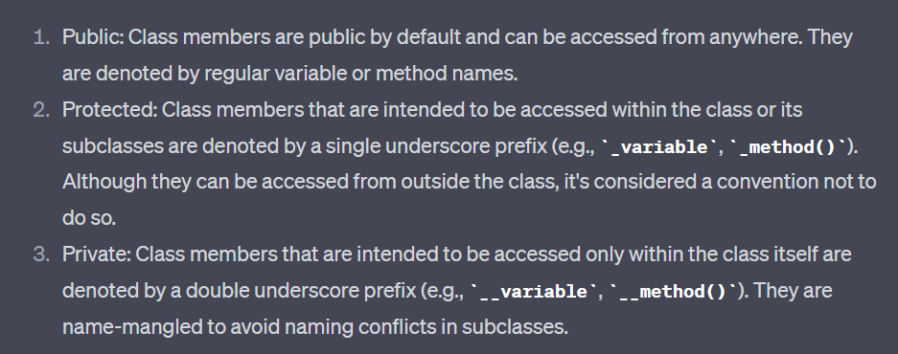
Encapsulation
Encapsulation focuses on bundling data and methods together within a class, hiding the internal details and providing a public interface to interact with the object.
It promotes the concept of data hiding and information hiding.
.

Slide 13
ABSTRACTION
Sometimes we don't know about implementation, still we can declare a method. Such types of methods are called abstract methods abstract method has only declaration but not implementation.
In python we can declare abstract method by using @abstractmethod decorator as follows.
@abstractmethod decorator present in abc module. Hence compulsory we should import abc module, otherwise we will get error.

