Slide 1
EXCEPTION HANDLING

Slide 2
In any programming language there are 2 types of errors are possible.
1) Syntax Errors
2) Runtime Errors
Syntax Errors: The errors which occur because of invalid syntax are called
syntax errors
x = 10
if x == 10
print("Hello")
SyntaxError: invalid syntax
print "Hello"
SyntaxError: Missing parentheses in call to 'print'

Slide 3
Runtime Errors(Exception)
While executing the program if something goes wrong because of end user input or programming logic or memory problems etc then we will get Runtime Errors.
print(10/0) → ZeroDivisionError: division by zero
print(10/"ten") → TypeError: unsupported operand type(s) for /: 'int' and 'str’
Note: Exception Handling concept applicable for Runtime Errors but not for syntax errors

Slide 4
Exceptions:
An unwanted and unexpected event that disturbs normal flow of program is called exception.
Eg:
ZeroDivisionError
TypeError
ValueError
FileNotFoundError
EOFError
SleepingError • TyrePuncturedError
main objective of exception handling is Graceful Termination of the program (i.e we should not block our resources and we should not miss anything)

Slide 5
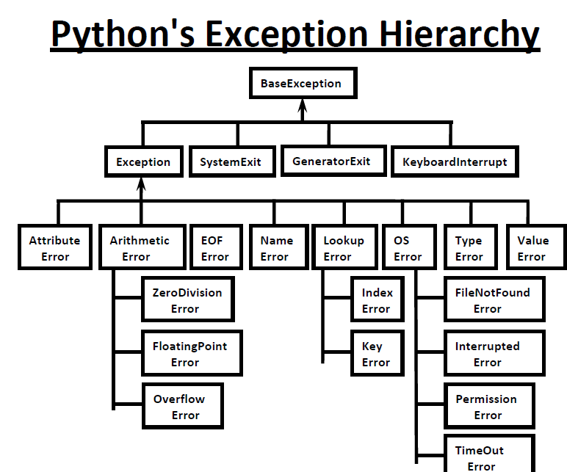

Slide 6
It is highly recommended to handle exceptions.
The code which may raise exception is called risky code and we have to take risky code inside try block. The corresponding handling code we have to take inside except block.
Syntax:
try:
Risky Code
except XXX:
Handling code/Alternative Code
We can use multiple except blocks if there are multiple exceptions

Slide 7
Note: The following are various possible combinations of except blocks
1) except ZeroDivisionError:
2) except ZeroDivisionError as msg:
3) except (ZeroDivisionError,ValueError) :
4) except (ZeroDivisionError,ValueError) as msg:
5) except :

Slide 8
Else:
It provides a way to specify a block of code that should be executed if no exceptions are raised in the try block.
try:
# Code that may raise an exception
except SomeException:
# Code to handle the exception
else:
# Code to be executed if no exceptions are raised

Slide 9
finally Block:
It is not recommended to maintain clean up code(Resource Deallocating Code or Resource Releasing code) inside try block because there is no guarantee for the execution of every statement inside try block always.
It is not recommended to maintain clean up code inside except block, because if there is no exception then except block won't be executed.
Hence we required some place to maintain clean up code which should be executed always irrespective of whether exception raised or not raised and whether exception handled or not handled. Such type of best place is nothing but finally block.
Hence the main purpose of finally block is to maintain clean up code

Slide 10
finally:
try:
Risky Code
except:
Handling Code
else:
code
finally:
Cleanup code
The specialty of finally block is it will be executed always whether exception raised or not raised and whether exception handled or not handled.
Note: There is only one situation where finally block won't be executed ie whenever we are using os._exit(0) function.

Slide 11
raise
The raise statement is used to manually raise exceptions or errors in our code.
raise ExceptionType("Optional error message")
Custome Exceptions:
class MyCustomException(Exception):
def __init__(self, message, code=None):
super().__init__(message)
self.code = code
def __str__(self):
return f"{self.__class__.__name__}: {self.args[0]} (Error Code: {self.code})"

