Slide 1



sales_insights
View in Power BI
Last data refresh:
7/23/2024 8:37:55 AM UTC
Downloaded at:
7/23/2024 8:42:51 AM UTC

Slide 2
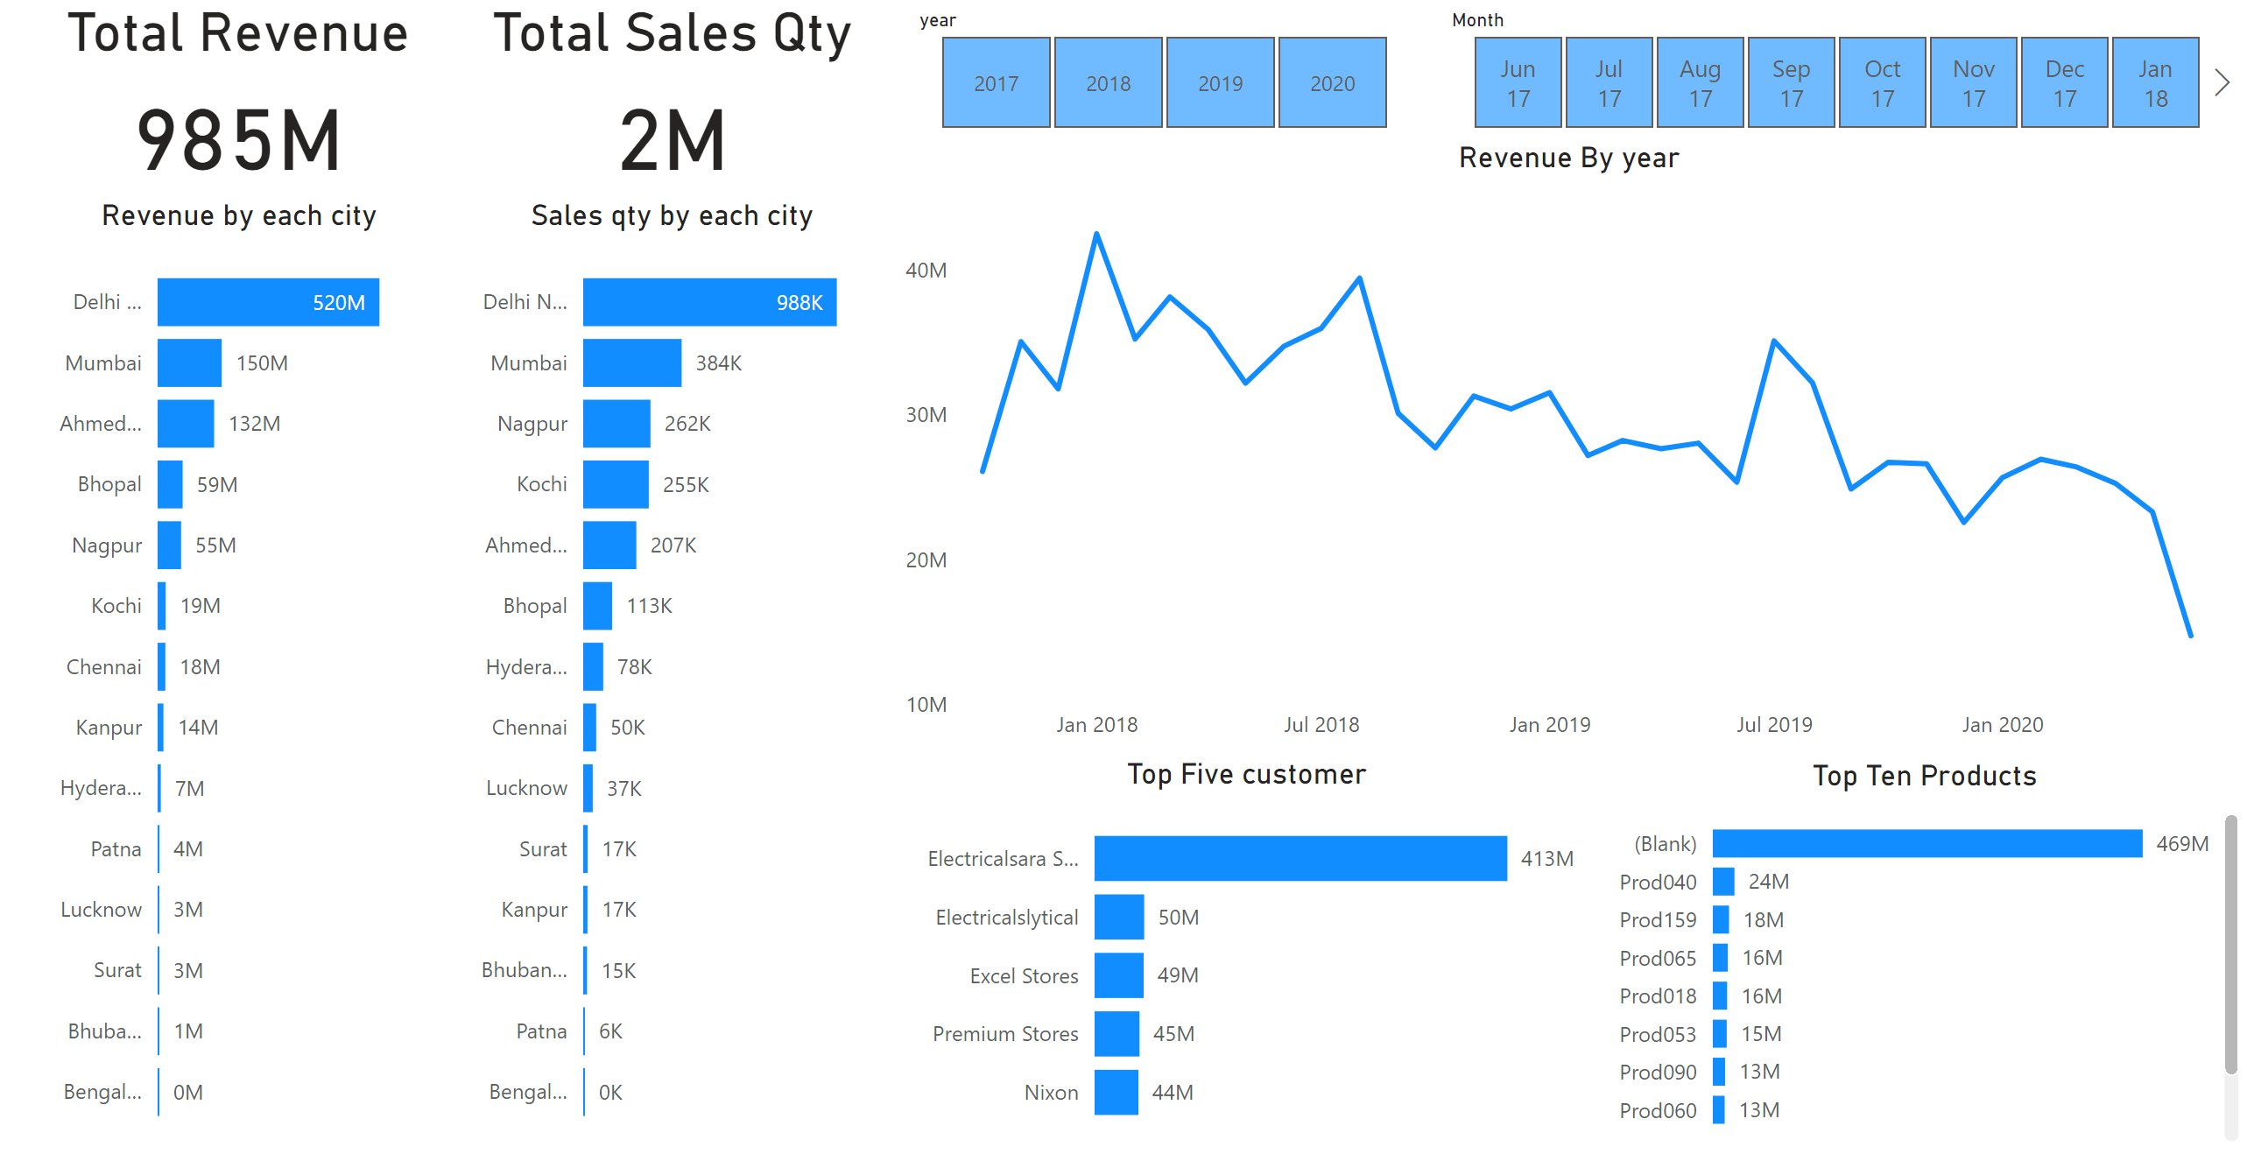
Page 1
Notes:
Total Revenue
No alt text provided
Total Sales Qty
No alt text provided
Revenue by each city
No alt text provided
Sales qty by each city
No alt text provided
slicer
No alt text provided
slicer
No alt text provided
Top Five customer
No alt text provided
Top Ten Products
No alt text provided
Revenue By year
No alt text provided

