Slide 1
Diffusion-based Graph Generative Methods
Generative AI Project
Students
Rajiv (B21216)
Prem Shankar (B21115)
Somit Gond (B21138)
Shubham Kumar (B21136)

Slide 2
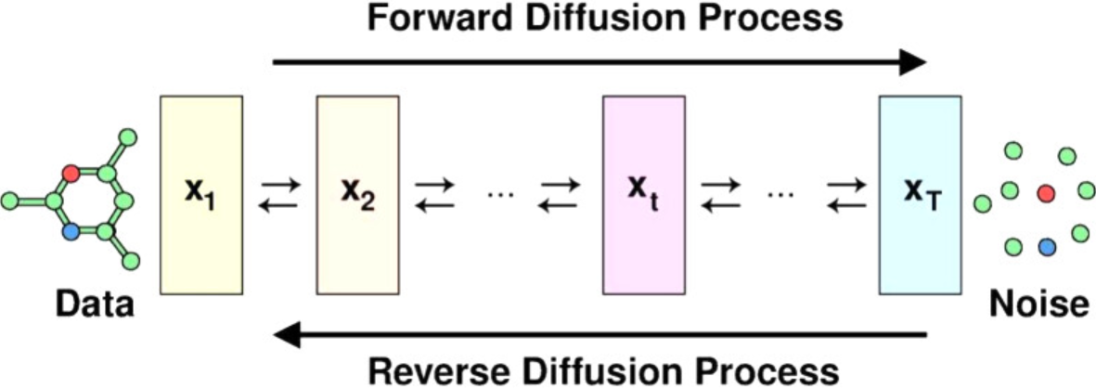
Introduction
Diffusion-based graph generative methods leverage the principles of diffusion processes to create synthetic graphs that mirror real-world structures. By modeling how information and influence spread across networks, these methods capture the dynamic interactions between nodes and edges. This approach addresses the challenge of generating realistic graph data, which is crucial for applications in social networks, biological systems, and recommendation systems. In this presentation, we'll explore the key concepts behind these methods and their potential impact on various domains.
Generative AI Project
2
2

Slide 3

Objective
Generative AI Project
The objective of this presentation on diffusion-based graph generative methods is to provide a comprehensive overview of how these innovative approaches leverage diffusion processes to create realistic and complex graph structures. We aim to explore the underlying mechanisms of various models, such as Denoising Diffusion Probabilistic Models (DDPM) and Graph Neural Networks (GNNs), and to highlight their applications in diverse fields like social network analysis and biological systems. Ultimately, this presentation seeks to enhance understanding of the significance and potential of diffusion-based methods in advancing graph generation techniques.
3
2

Slide 4
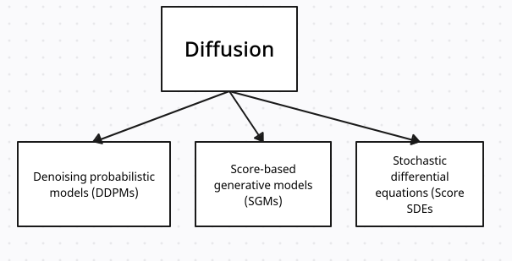
I
Types of Diffusion Models
Generative AI Project
4
2

Slide 5
Denoising Diffusion Probabilistic Model (DDPM)
Generative AI Project
Denoising Diffusion Probabilistic Models (DDPM) are a class of generative models that create data by simulating a diffusion process. The core idea involves adding Gaussian noise to data in a series of steps, gradually corrupting it until it becomes nearly indistinguishable from random noise. The model is then trained to reverse this process, learning to denoise the data step by step.
Forward Process: Noise is progressively added to the data, making it more random at each step.
Reverse Process: The model learns to reverse the noising process, effectively denoising the data step by step.
5
2

Slide 6
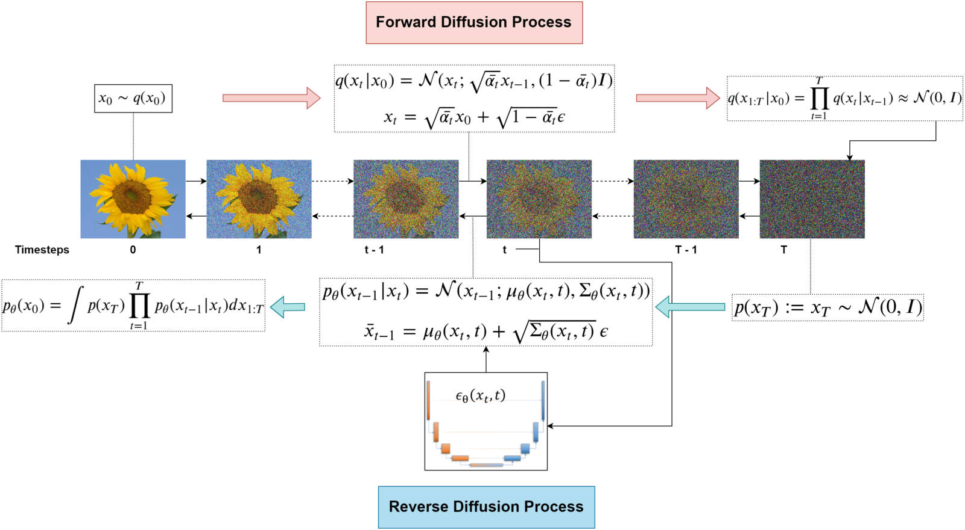
Generative AI Project
6
2

Slide 7
Uses of Denoising Diffusion Probabilistic Models (DDPM)
Image Generation: DDPMs have shown impressive results in generating high-resolution images, making them popular in creative applications like art and design.
Video Generation: The models can also be extended to generate video frames, leading to applications in animation and simulation.
Audio Synthesis: DDPMs can be used for generating realistic audio samples, applicable in music production and sound design.
Graph Generation: In graph-related tasks, DDPMs can create synthetic graphs that maintain structural properties, useful in network analysis and simulations.
Text-to-Image Synthesis: By conditioning on textual descriptions, DDPMs can generate images that correspond to specific prompts, enhancing applications in AI-driven design tools.
In summary, DDPMs offer a powerful approach to generative modeling with distinct advantages, particularly in generating high-quality samples. However, their computational demands and complexity pose challenges that may limit their practical use in certain scenarios.
Generative AI Prooject
7
2

Slide 8
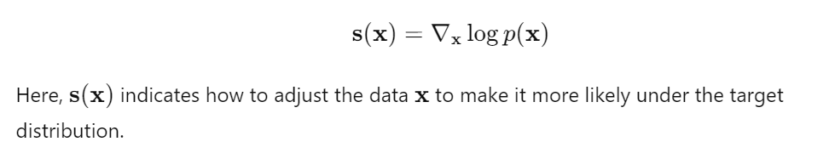
Score Generative Models (SGMs) are a class of generative models that leverage the score function of data distributions to generate new samples. The central idea is to learn the gradient of the log probability density function (the score) and use it to guide the generation process.
Score-based Generative Models (SGMs)
Generaive AI Project
Key Concepts
Score Function Estimation: The score function is defined as the gradient of the log probability density function of the data distribution p(x):
8
2

Slide 9
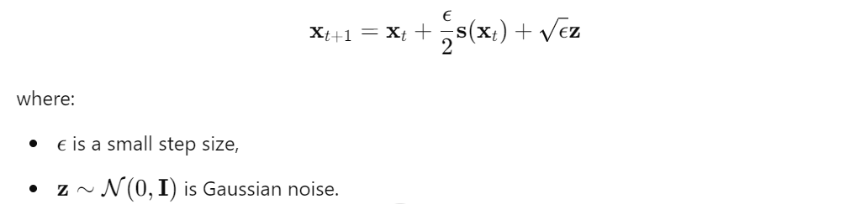
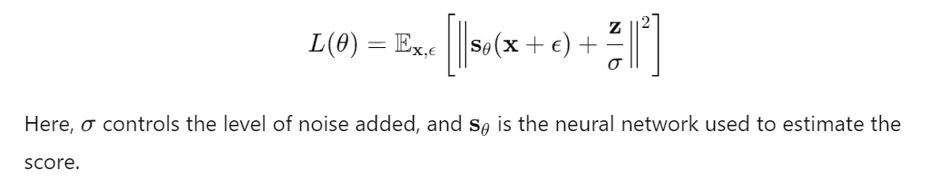
2.Generative Process: SGMs typically use iterative methods, such as Langevin dynamics, to refine random noise into realistic samples. The update rule can be expressed as:
3.Training Objective: The score function can be estimated using denoising score matching, where the objective is to minimize the following loss:
Generative AI Project
9
2

Slide 10
Uses of Score Generative Models (SGMs)
Image Generation: SGMs are widely used for generating realistic images from random noise, making them popular in art, design, and visual effects.
Text-to-Image Synthesis: They can generate images based on textual descriptions, enhancing applications in creative fields and advertising.
Audio Synthesis: SGMs can produce high-quality audio samples, useful in music production, sound design, and speech synthesis.
Video Generation: Extending their capabilities to generate coherent video frames, SGMs can be applied in animation and video content creation.
Scientific Simulation: SGMs can model complex phenomena in scientific research, generating synthetic data for simulations in fields like physics and biology.
Score Generative Models offer a powerful framework for generating high-quality data across various domains. Their advantages in output quality and flexibility are balanced by challenges related to computational requirements and complexity. Despite these drawbacks, SGMs are increasingly utilized in diverse applications, reflecting their growing importance in the field of generative modeling.
Generative AI Project
10
2

Slide 11
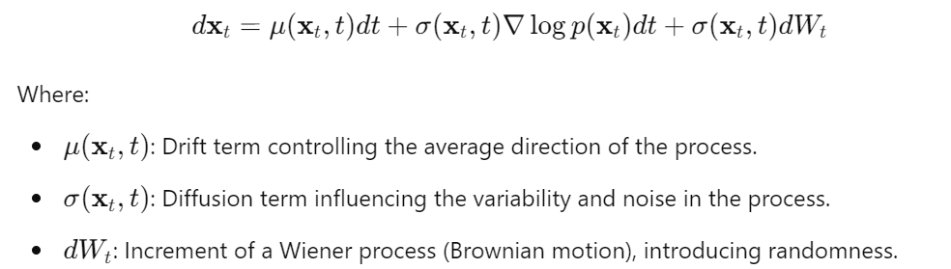
Score stochastic Differenntial Equation (SDEs)
Score Stochastic Differential Equations (Score SDEs) are a powerful framework in generative modeling that combines the concepts of score-based generative modeling with stochastic differential equations. This approach leverages the score function, which is the gradient of the log probability density function, to guide the generation of new samples through stochastic processes.
Key Concepts
Score Function: The score function, denoted as ∇log⁡p(x), represents the gradient of the log probability density function of the target distribution. It indicates how to adjust a sample x to increase its likelihood.
Score SDE Formulation: A Score SDE can be expressed as:
Generative AI Project
11
2

Slide 12
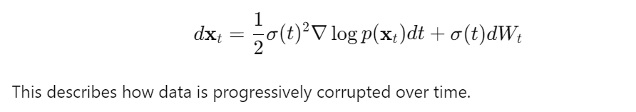
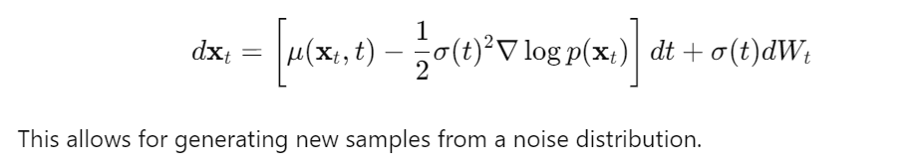
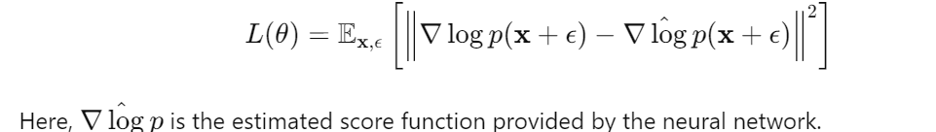
3.Forward and Reverse Processes:
Forward Process (Adding Noise): The forward process can be modeled as:
Reverse Process (Denoising): The reverse process is formulated to remove noise:
Training Objective
To train the model, the objective is typically to minimize the denoising score matching loss, which can be expressed as:
Generative AI Project
12
2

Slide 13
Uses of Score-SDEs
Image Generation: Widely used in generating high-resolution and realistic images, achieving state-of-the-art performance in various benchmarks.
Text-to-Image Synthesis: Models can generate images based on textual descriptions, facilitating applications in advertising and content creation.
Audio Generation: Applied in creating high-quality audio samples, useful in music production, sound design, and speech synthesis.
Graph Generation: Score SDEs can model and generate complex graph structures, enabling synthetic graph generation for social networks and molecular structures.
Scientific Simulation: Used in simulating physical phenomena or biological processes, generating synthetic data for research and analysis.
Score SDEs offer a powerful and flexible framework for generative modeling, producing high-quality samples across various domains. While they have distinct advantages, such as stability and theoretical grounding, they also come with challenges related to computational intensity and implementation complexity. Their applications span diverse fields, highlighting their versatility and effectiveness in tackling generative tasks.
Generative AI Project
13
2

Slide 14
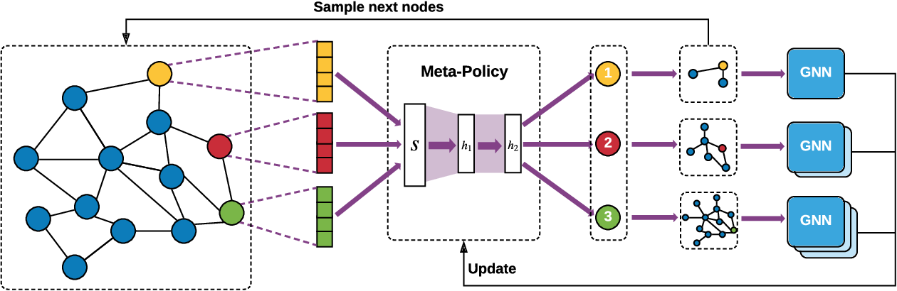
Graph neural network
A Graph Neural Network (GNN) is a type of neural network specifically designed to operate on graph-structured data. In a graph, data points (called nodes) are connected by edges that represent relationships or interactions between them. GNNs learn by aggregating information from a node's neighbors in the graph, updating each node’s feature representation based on the features of its neighbors. This process, often called message passing, helps the model capture both local and global patterns in the graph
Generative AI Project
14
2

Slide 15
How to combine GNN with Diffusion model
Combining Graph Neural Networks (GNNs) with Diffusion Models leverages the strengths of both: GNNs for learning graph-structured data and diffusion models for generative processes.
Generative AI Project
Key Steps to combine:
1.Graph Encoding: Use GNNs to learn graph structure or node/edge embeddings.
2.Conditioning: Use the learned graph representations to condition the diffusion model.
3.Generation/Refinement: The diffusion model generates new graph structures or refines existing ones, guided by GNN representations.
This combination is useful in tasks like graph generation, link prediction, graph completion, and anomaly detection, where both the structural integrity of the graph and the generative capabilities of diffusion models are essential
15
2

Slide 16
References
Generative AI Project
Tools Used: https://app.creately.com
Research Paper: https://arxiv.org/abs/2401.15617
Tools used : Google colab, Google slides,
16
2

