Slide 1

PHYS 375 Final Project Gravity Group
Presented by: R. Chattopadhyay, E. M. Elkhalifa, F. S. T. Ibrahim, A. Katil, E. Long, R. T. Pappur, C. Tang

Slide 2

Equations of Stellar Structure
Modification on Gravity : $g=\frac{GM}{r^{2}}\left(1+\frac{λ}{r}\right)$ with $λ[r^{−3}]$
$\frac{dP}{dr}=−\frac{GM}{r^{2}}$
$\frac{dρ}{dr}=−\left[\frac{GMρ}{r^{2}}\left(1+\frac{λ}{r}\right)+\frac{∂P}{∂T}\frac{dT}{dr}\right]$ / $\frac{∂P}{∂ρ}$
$\frac{dT}{dr}=−\min\left[\frac{3κpL}{16πacT^{3}r^{2}}, \left(1−\frac{1}{γ}\right)\left(1+\frac{λ}{r}\right)\left(\frac{T}{p}\frac{GMρ}{r^{2}}\right)\right]$
$\frac{dM}{dr}=4πr^{2}ρ \frac{dL}{ dr}=$ $4πr^{2}ρε \frac{dτ}{dr}=κρ$

Slide 3

Equations of Stellar Structure

Slide 4

Algorithmic Choice
Adaptive RK45:
Uses O(h5) order to calculate error, then change the step size accordingly.
Solve the sets of differential equations, until the surface boundary condition is reached
$τ(∞)−τ≈δτ=κρ^2/|dρ/dr|$
$τ\left(∞\right)−τ\left(R_{∗}\right)=2/3$
Bisection:
$f\left(ρ_{c}\right)=\frac{L_{∗}−4πσR_{∗}^{2}T_{∗}^{4}}{\sqrt{4πσR_{∗}^{2}T_{∗}^{4}L_{∗}}}$
Increase precision as $ρ_{c}$ converges
Given T_{c} , the star’s other parameters can be computed

Slide 5
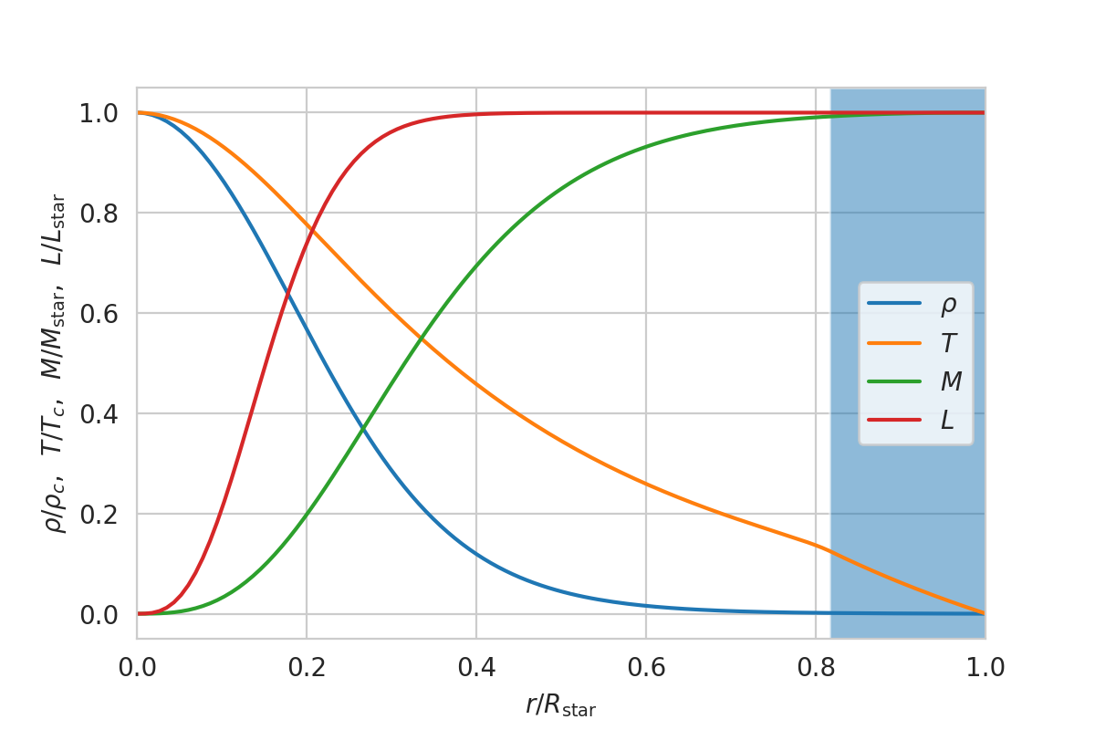
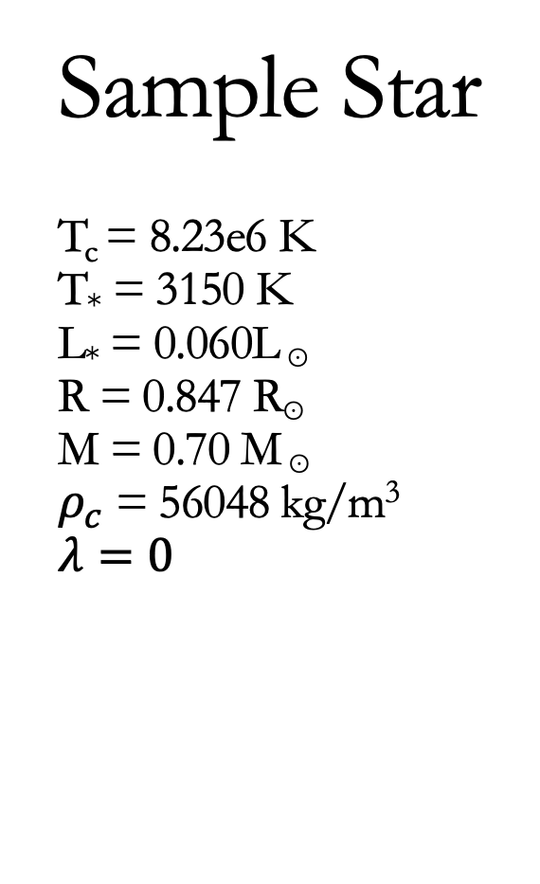
Sample Star T_{c} = 8.23e6 K T* = 3150 K L* = 0.060L ⊙ R = 0.847 R⊙ M = 0.70 M ⊙ $ρ_{c}$ = 56048 kg/m³ $$λ=0$$

Slide 6
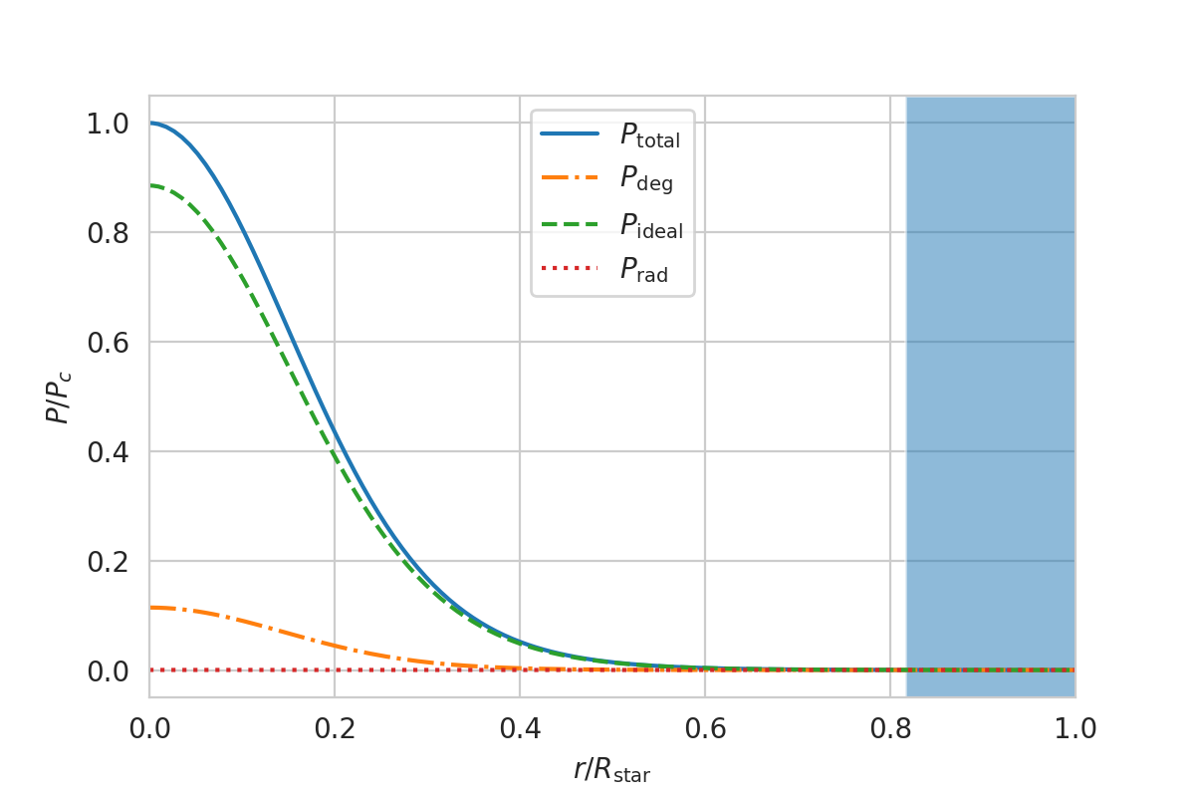
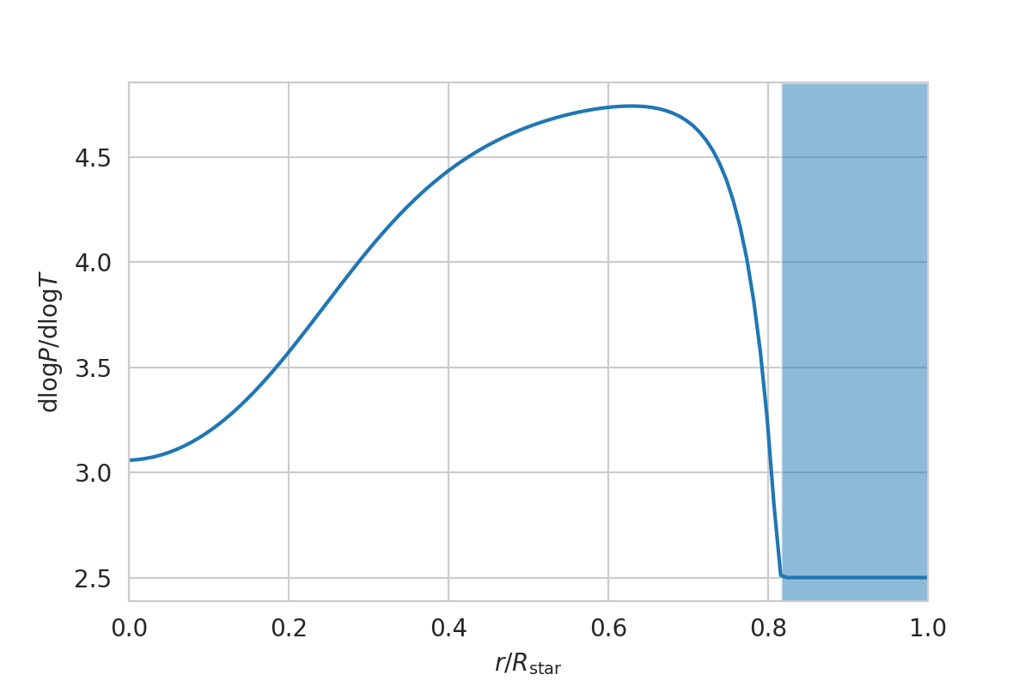
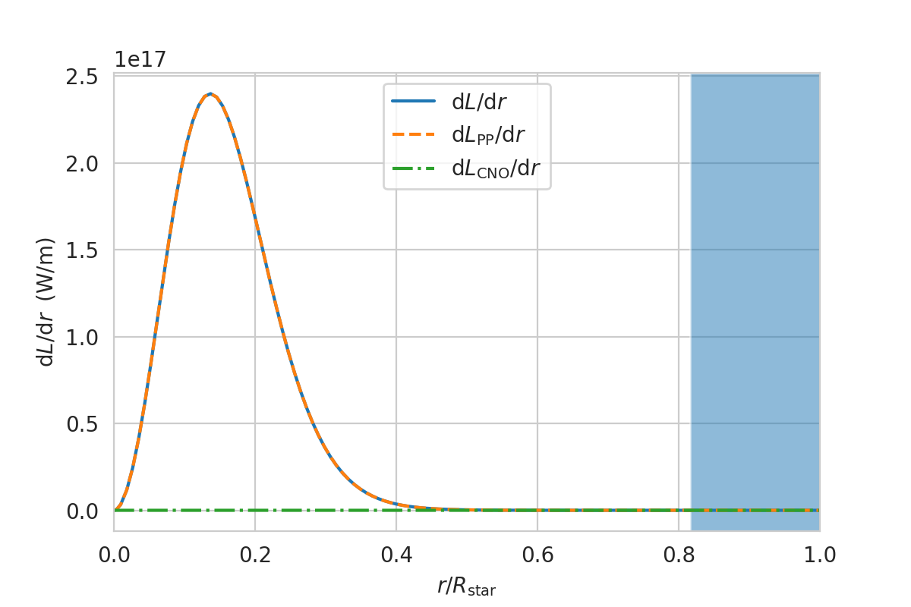
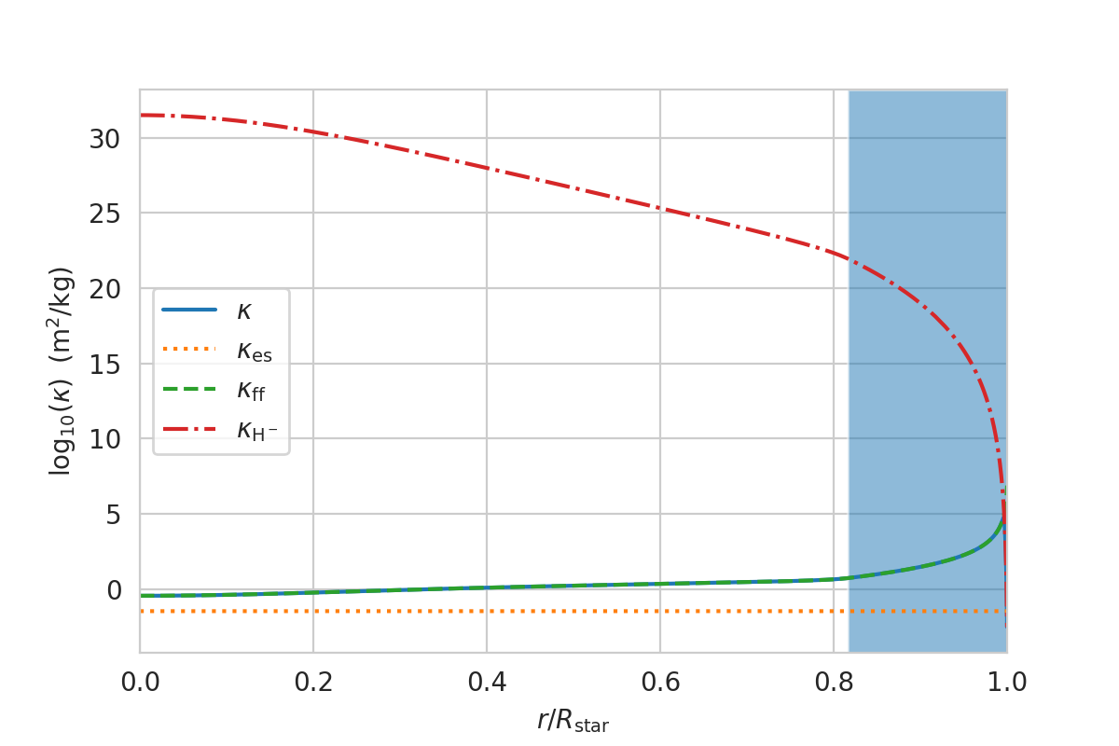

Slide 7
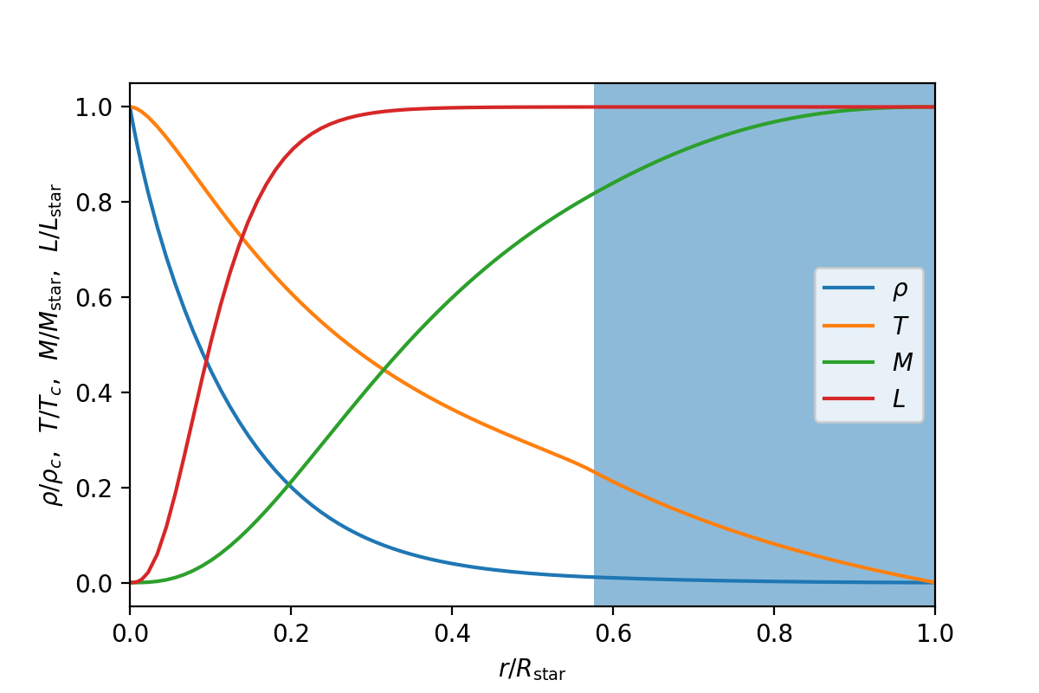
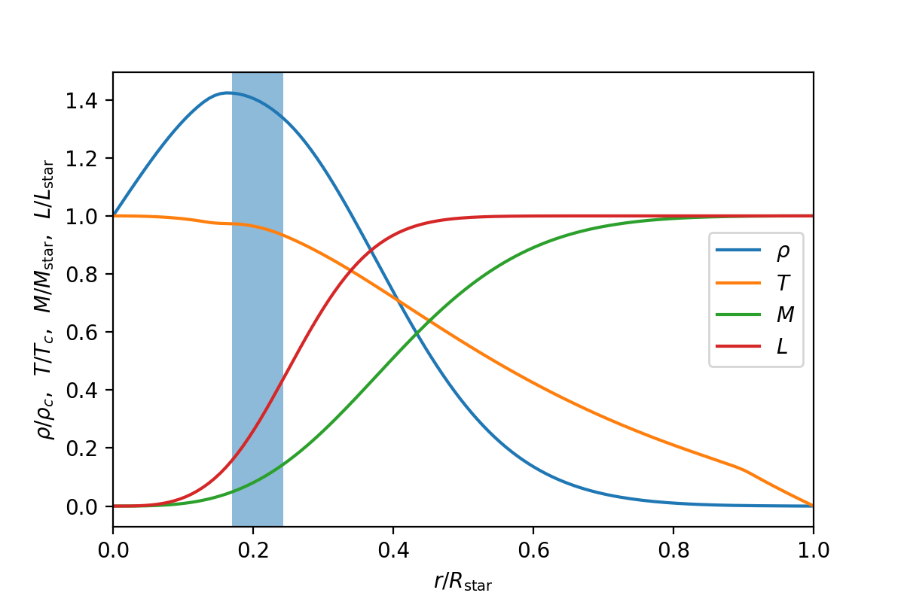

Modified Gravity T_{c} = 8.23e6 K T* = 3150 K L* = 0.060L ⊙ R = 0.847 R⊙ M = 0.70 M ⊙ $ρ_{c}$ = 56048 kg/m³ $$λ=0$$
𝜆 = 1e8
𝜆 = -1e8
Positive 𝜆 compresses the core, negative 𝜆 stretches the core, creating a cusp around the centre
For positive 𝜆, radiative region decreases, and convective region shows earlier. Pressure decreases rapidly from cntre to surface. Temperature at the core is higher
For negative zone, convective zone moves around the core. Pressure increases form centre to cusp. Temperature at the core is lower, small variation inside the cusp. Surface temperature and total mass is smaller.

Slide 8
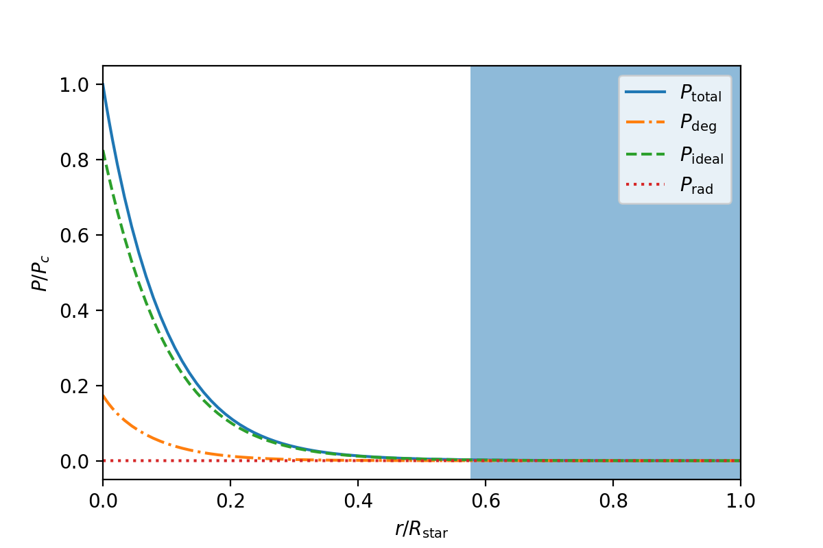
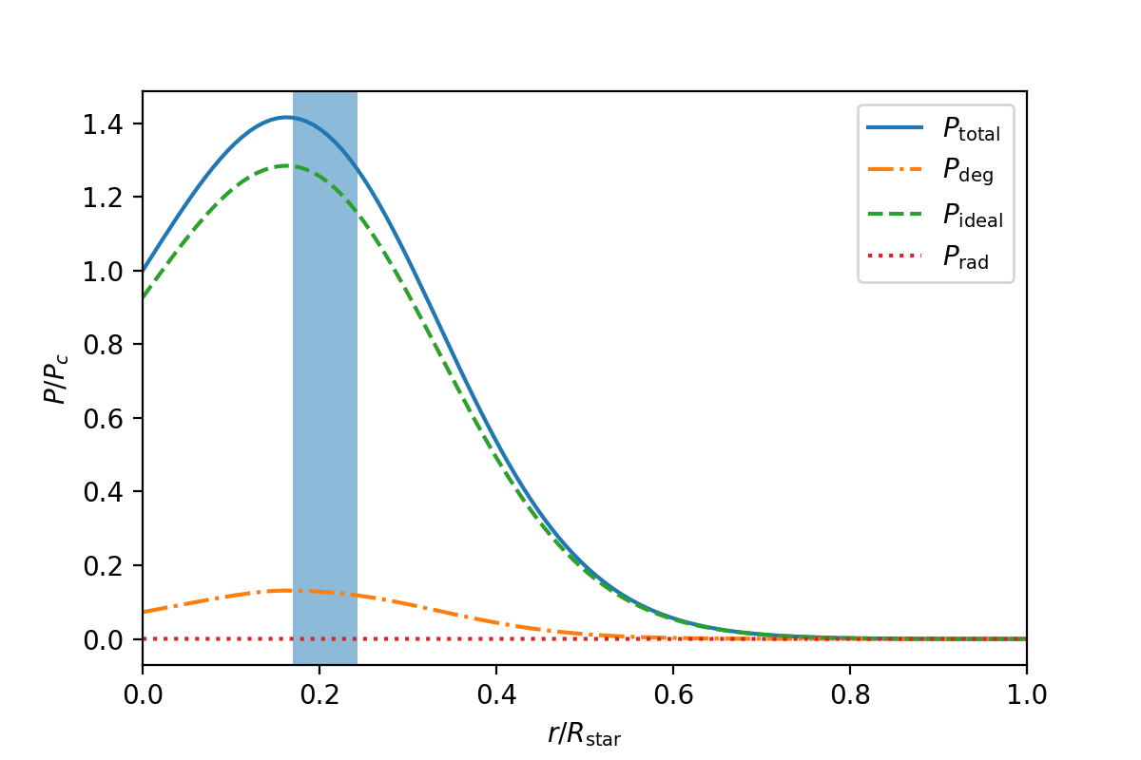
Effect of 𝜆 on Pressure
Pressure due to ideal gas dominates
For positive 𝜆, core is compressed, pressure decreases rapidly
For negative 𝜆, pressure increases from the centre to the cusp
𝜆 = 1e8
𝜆 = -1e8

Slide 9
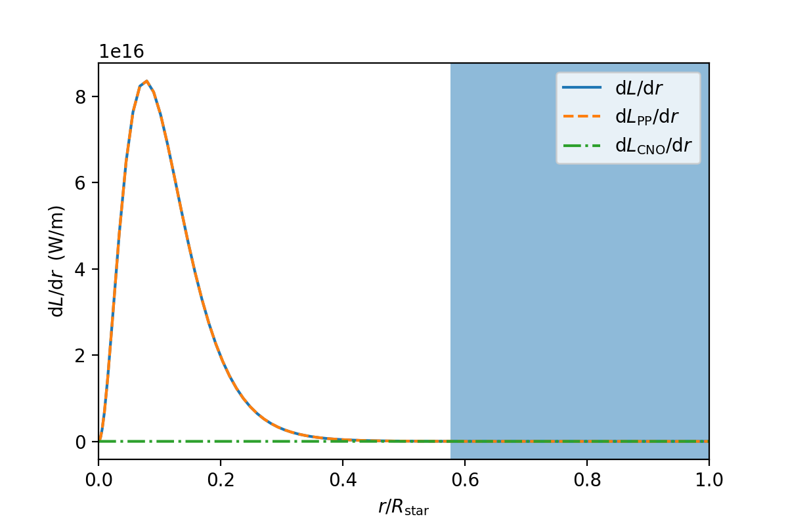
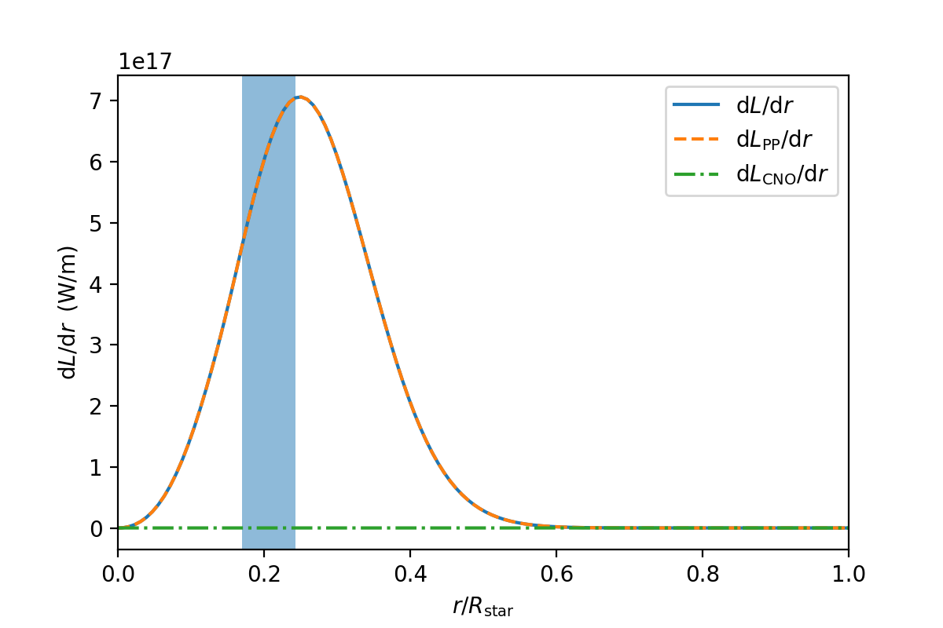
Effect of 𝜆 on Luminosity
𝜆 = 1e8
𝜆 = -1e8
Luminosity due pp chain dominates
Peak for positive 𝜆 is closer to the centre

Slide 10
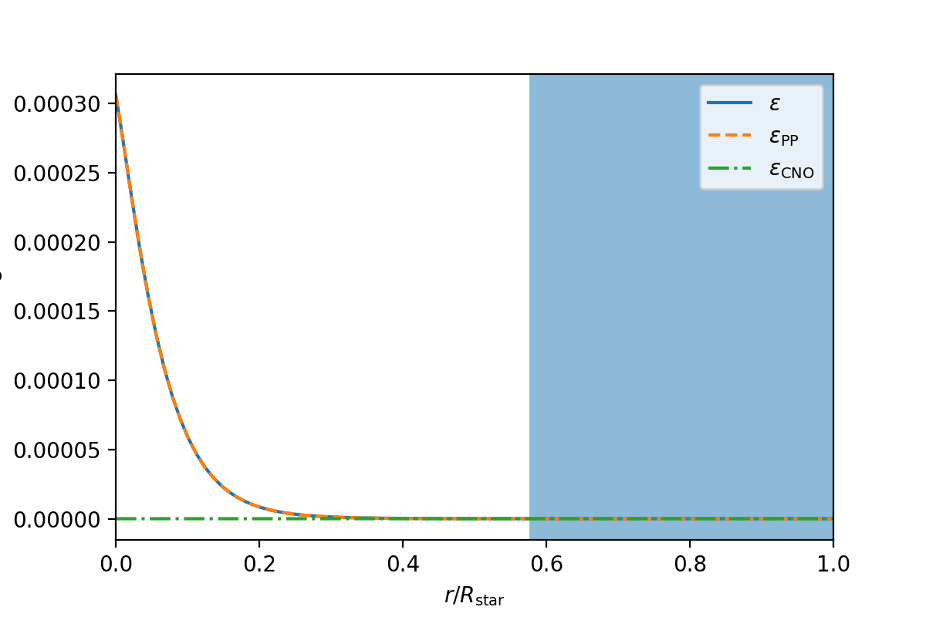
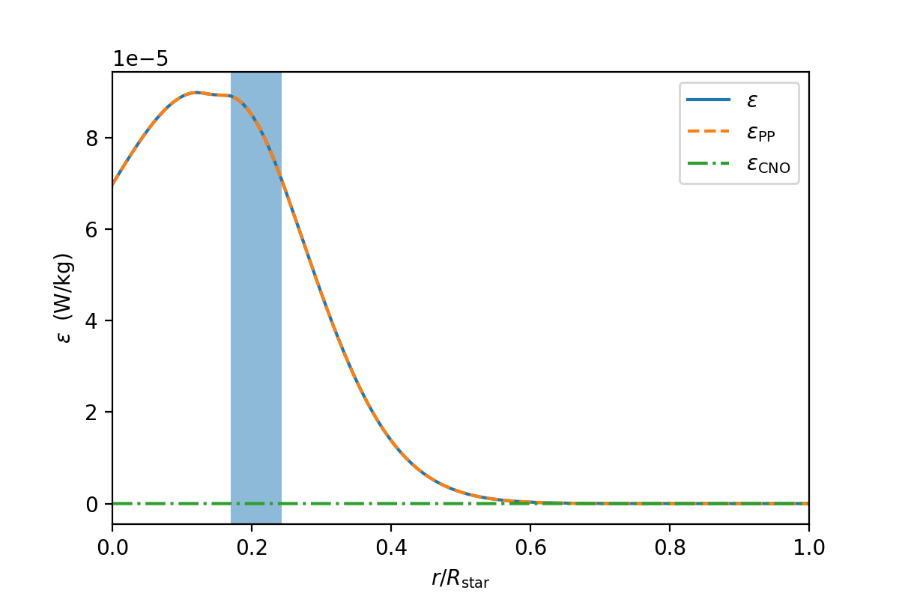
Effect of 𝜆 on Energy Production
𝜆 = 1e8
𝜆 = -1e8
For 𝜆 positive, energy production rate is the highest at the centre
For 𝜆 negative, the rate increases from centre to the cusp

Slide 11
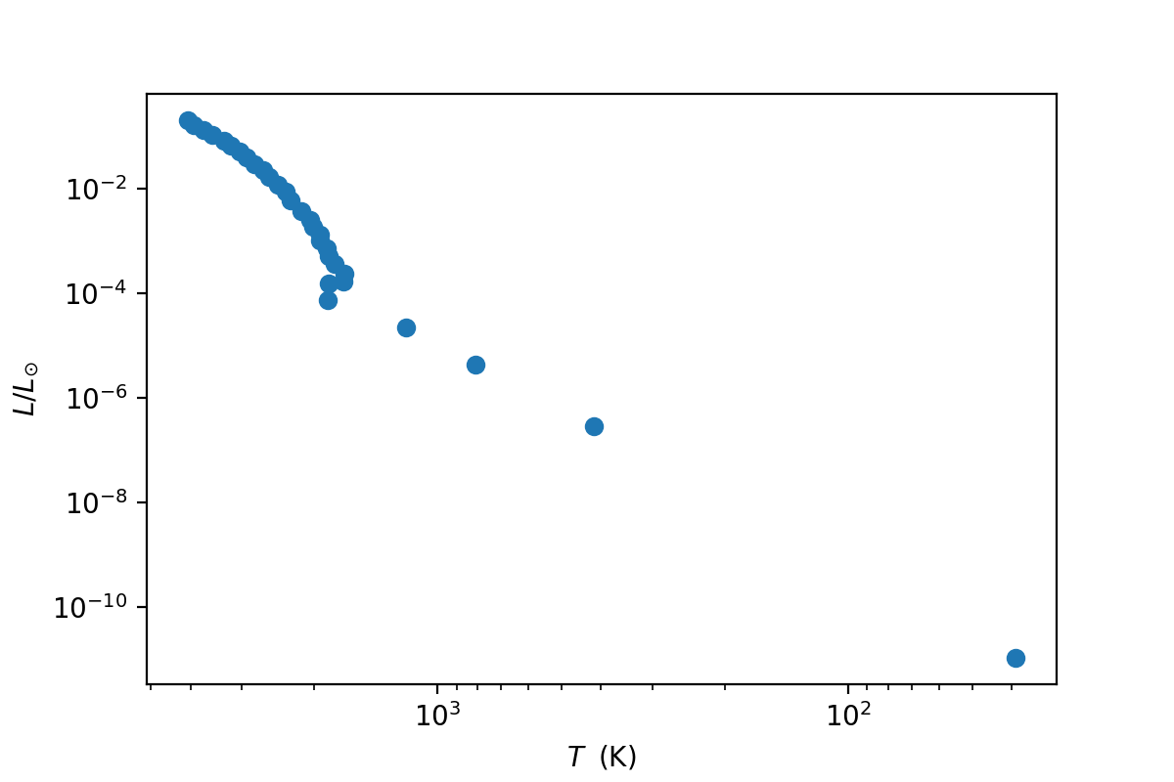
Main sequence stars
HR Diagram

Slide 12
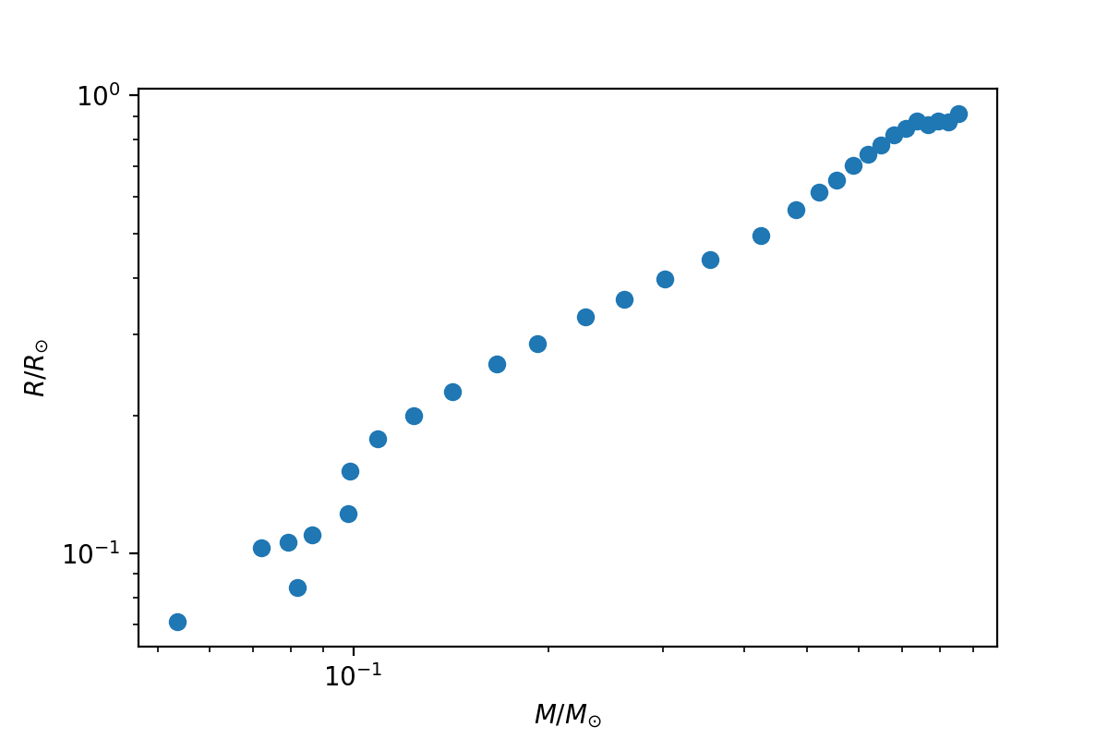
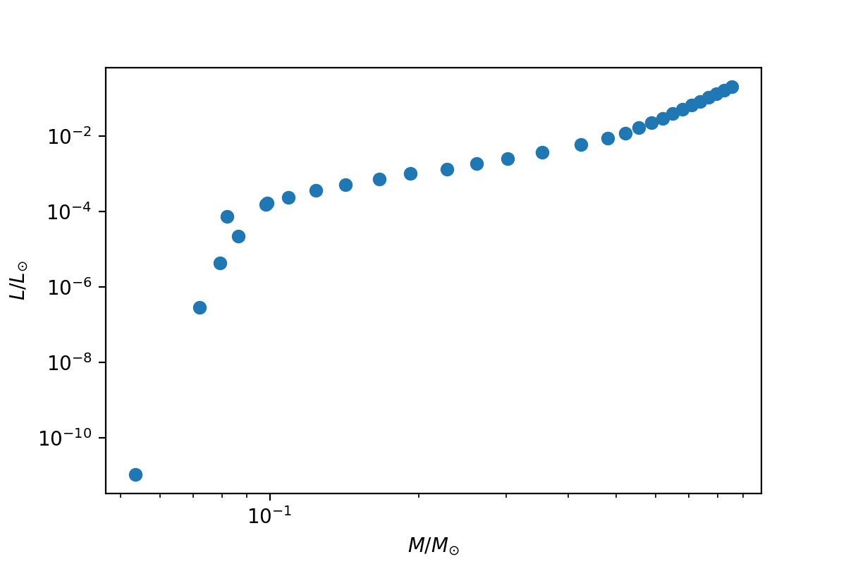
LM and RM Relationship
Radius vs Mass
Luminosity vs Mass

Slide 13
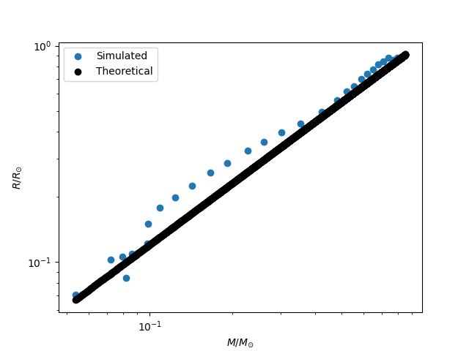
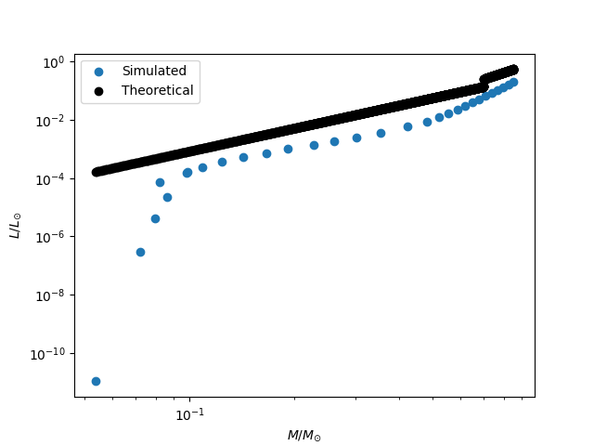
Validations with Theory

Slide 14
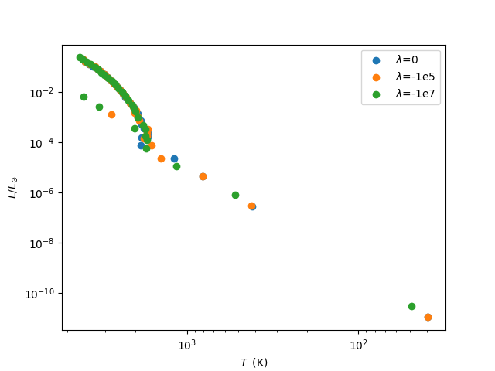
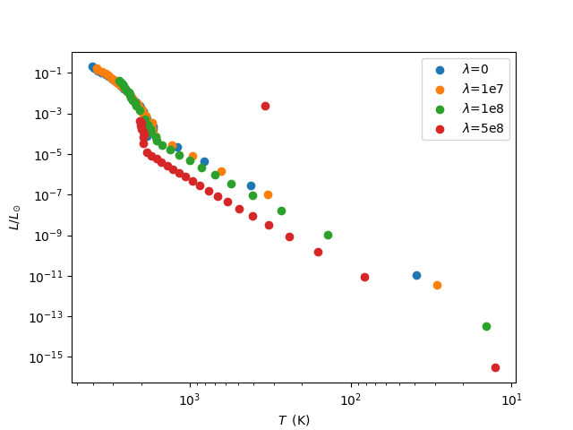
Effect of 𝜆 on HR Diagrams
As 𝜆 increases, the temperature needed to generate a certain luminosity is lower

Slide 15
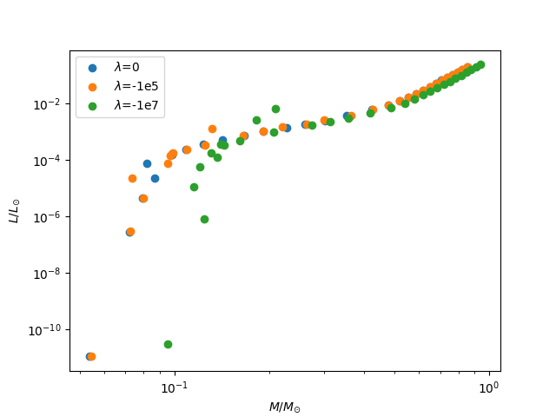
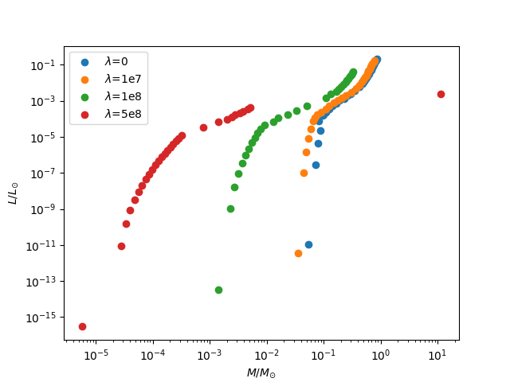
Effect of 𝜆 on LM Diagrams
As 𝜆 is increasingly positive, stars with same mass are more luminous
As 𝜆 is increasingly negative, same mass stars have less luminosity

Slide 16
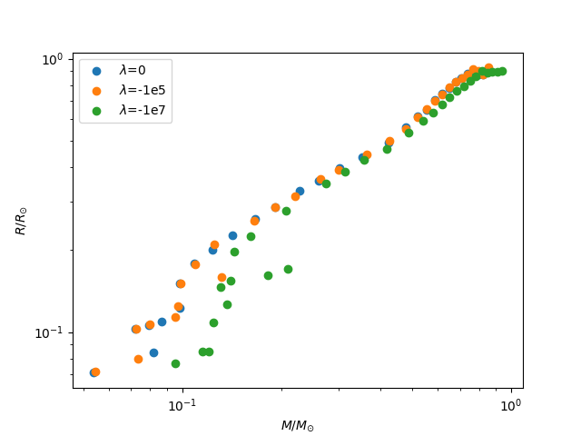
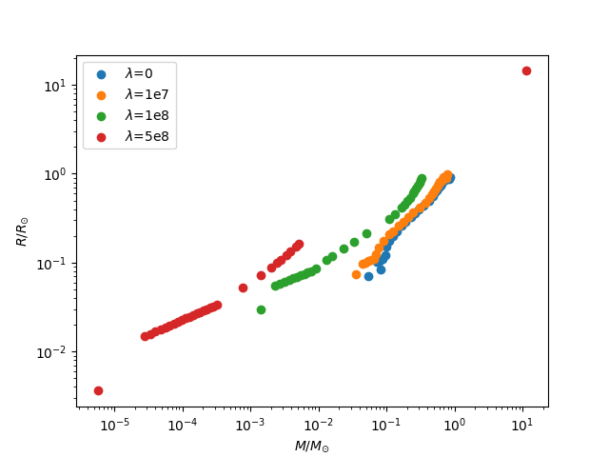
Effect of 𝜆 on RM Diagrams
As 𝜆 is increasingly positive, stars with same mass have smaller radius

Slide 17
Summery
Positive 𝜆 compresses the core of the star, making it denser at the centre. Energy production rate, luminosity and temperature becomes higher at the core.
Negative 𝜆 stretches the core of the star, creating a denser region (cusp)around the core.
> 1e7 (R_{sun} ~7e8 m)

Slide 18
Thank you for listening!

