Slide 1

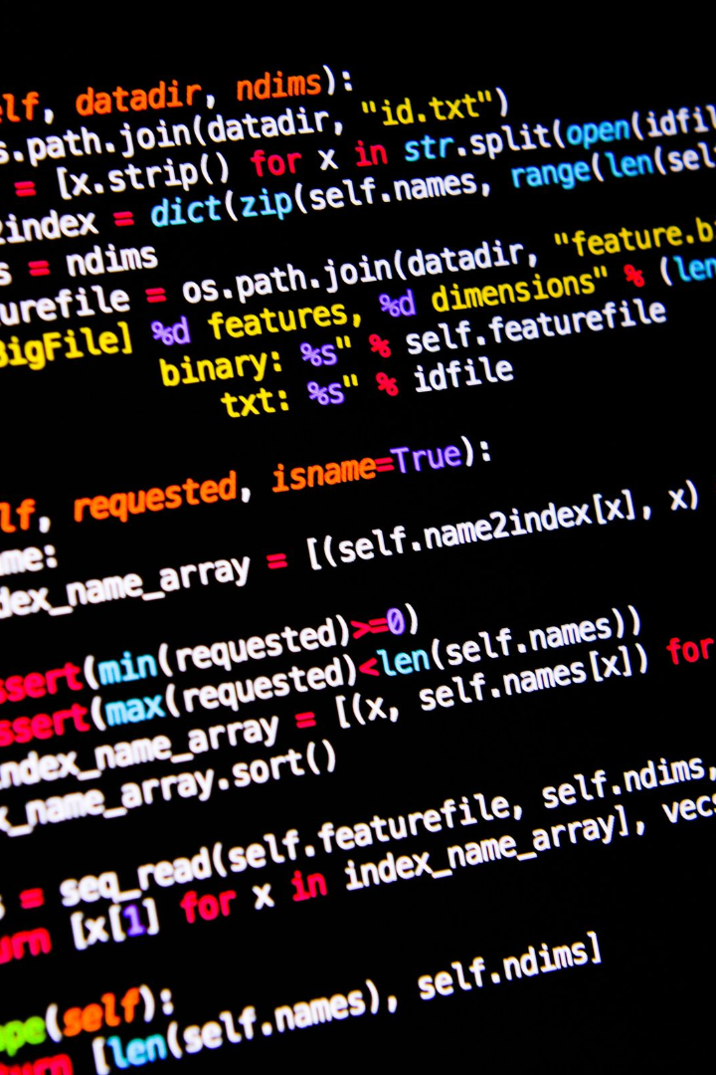

Python Code for Spam Detection: A Comprehensive Guide
Spam, be gone! This presentation delves deep into the documentation for Python code that effectively detects spam. Let's explore!
Rajiv Ranjan Kumar

Slide 2
What is Spam Detection?
Purpose
Overview
Discover the importance of spam detection and how it safeguards users from unwanted and harmful messages.
Get an overview of the Python code for spam detection and understand its role in filtering out spam emails.

Slide 3
Input and Output
Explore the input requirements and generated output produced by the spam detector code.
Input
Output
Analyze the data fed into the spam detector, including email content, metadata, and potential keywords.
Dive into the results provided by the code, determining whether an email is classified as spam or not.

Slide 4
How the Code Detects Spam
Uncover the inner workings of the Python code, and learn how it accurately identifies and filters out spam messages.
1
Data Preprocessing
Discover the steps involved in cleaning and preparing the data for analysis.
Feature Extraction
2
Explore the techniques used to extract relevant features from the email data.
3
Machine Learning
Gain insights into the machine learning algorithms employed to train the spam detector model.

Slide 5

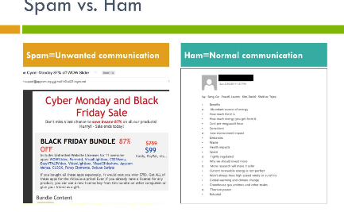
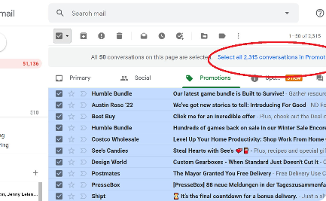
Examples in Action
Spam Email
Ham Email
Clean Inbox
Visualize an example of a spam email caught by the Python code, highlighting the key indicators.
Contrast the spam email example with a legitimate email, demonstrating how the code distinguishes between them.
Witness the beauty of a perfectly filtered inbox, free from clutter and unwanted spam messages.

Slide 6

Limitations of the Code
Explore the boundaries and constraints of the Python code for spam detection, understanding its limitations.
1
Learn how imbalanced data may impact the accuracy of the spam detector's performance.
2
Discover how the ever-changing tactics of spammers pose challenges for the code.

Slide 7
Resources for Further Learning
Online Tutorials
Research Papers
Access a curated list of online tutorials and courses to enhance your understanding of spam detection and Python programming.
Delve into scholarly articles and research papers that explore the intricacies of spam detection algorithms.

Slide 8
# Importing necessary libraries
from sklearn.feature_extraction.text import CountVectorizer
from sklearn.model_selection import train_test_split
from sklearn.naive_bayes import MultinomialNB
from sklearn.metrics import accuracy_score, confusion_matrix
from sklearn.pipeline import make_pipeline
# Sample data (replace with your own dataset)
messages = [
("This is a legitimate message.", 0),
("Congratulations! You've won a prize.", 1),
("Click the link to claim your reward.", 1),
("Meeting at 2 PM in the conference room.", 0),
# Add more examples...
]
# Splitting the data into training and testing sets
text, labels = zip(*messages)
X_train, X_test, y_train, y_test = train_test_split(text, labels, test_size=0.2, random_state=42)
# Creating a pipeline with CountVectorizer and Multinomial Naive Bayes classifier
model = make_pipeline(CountVectorizer(), MultinomialNB())
# Training the model
model.fit(X_train, y_train)
# Making predictions
predictions = model.predict(X_test)
# Evaluating the model
accuracy = accuracy_score(y_test, predictions)
conf_matrix = confusion_matrix(y_test, predictions)
print(f"Accuracy: {accuracy}")
print("Confusion Matrix:")
print(conf_matrix)

