Slide 1
Car Loan Claim Prediction
PGP-DSE-FT-BLR-JAN-2024
Group 2
Team Members
Sudarshan Venkatesh
Akhil T Nandini MK
Alishanandini Basa
Vishnu EM
Aditya Singh
Mentor:
Mr. Jatinder Bedi

Slide 2
Problem Statement
Business Problem
The overview of the project is to find the consumer behavior from the annual car loan data. Taking Third Party Liability (TPL) car loan coverage is mandatory in India. The TPL policy covers you against the legal ramifications of an accident caused by you.
The primary objective is predicting whether the customer has claimed the loan based on various input features.

Slide 3
Life Cycle
Data Collection
Data Cleaning
Exploratory Data Analysis (EDA)
Data Preprocessing
Model Building
Model Evaluation
Business Insights

Slide 4
Data Collection
Description of the dataset :
The company has shared its annual car loan data. Now, you have to find out the real customer behaviors over the data
The columns are resembling practical world features.
The outcome column indicates 1 if a customer has claimed his/her loan else 0. The data has 19 features from there 18 of them are corresponding logs which were taken by the company.
Data Size: Approximately 10000 rows and 19 columns
Source: https://www.kaggle.com/datasets/sagnik1511/car-loan-data

Slide 5
Data Cleaning
Handling Missing values : Approx 18% of missing values from columns credit_score, annual mileage.
Checking Special characters: In our dataset age and driving_experience column has special characters ‘65+’, we have sequence of strings also in vehicle year and driving experience columns.

Slide 6
Exploratory Data Analysis
Univariate Analysis : We did univariate analysis for every categorical and numerical variables separately.
Numeric variables:
Key findings:
Credit score is slightly left skewed and platy kurtic
Vehicle ownership is left skewed and platy kurtic
Married is slightly right skewed and platy kurtic
Children is left skewed and platy kurtic
Postal_code is right skewed and lepto kurtic
Annual_mileage is slightly left skewed and platy kurtic
Speeding_ violations is right skewed and platy kurtic
Past_accidents is right skewed and meso kurtic
Outcome is right skewed and platy kurtic

Slide 7
Categorical Variables:
Key findings:
In the dataset, we have people of age group 26 to 39 more, majority of people are from the age 26 to 64
In dataset has approximately equal number of male and female
In race feature, majority class is higher than minority,
In driving experience, we have more people whose driving experience between 0-9 years, after 19year of driving experience the frequency of people is going down
We have majority of people whose education background is high school
Income: Majority people are from upper class background
Majority vehicles are manufactured before 2015
Majority of vehicles are of type sedan

Slide 8
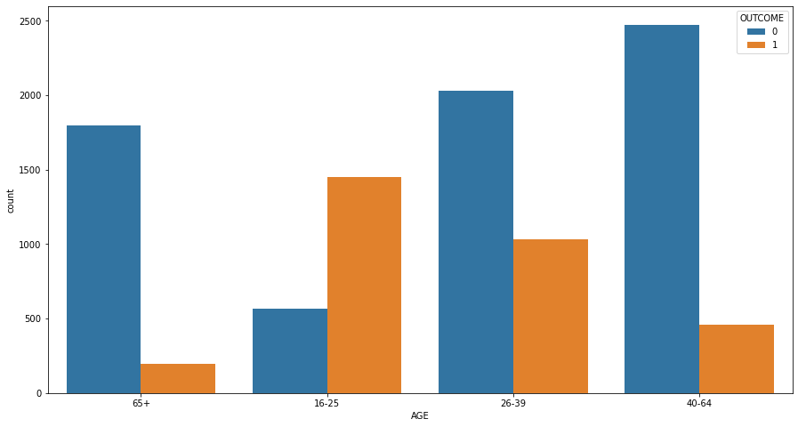
Bivariate analysis In bivariate analysis we did analysis for num vs num, cat vs cat and num vs
Key findings:
Age vs Outcome:
for age (16-25y) comparatively
the changes of getting loan is high
People of age between (40-64) the changes of getting loan is very less

Slide 9
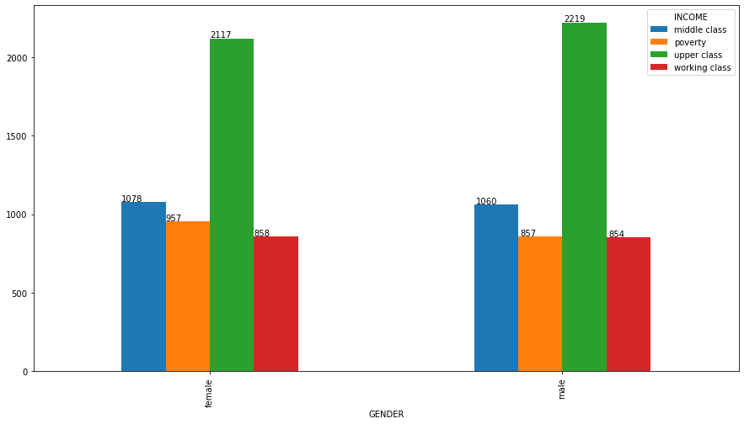
Key findings:
Gender vs Income:
The upper class (green bars) is the largest income group for both genders
There are slightly more upper-class individuals in the second gender category compared to the first
The middle class (blue bars) is the second-largest group, with similar numbers across genders
The poverty class (orange bars) has the lowest representation for both genders
The working class (red bars) shows slightly higher numbers in the second gender category
Overall, the distribution patterns are similar between the two gender categories, with the most notable difference in the upper class

Slide 10
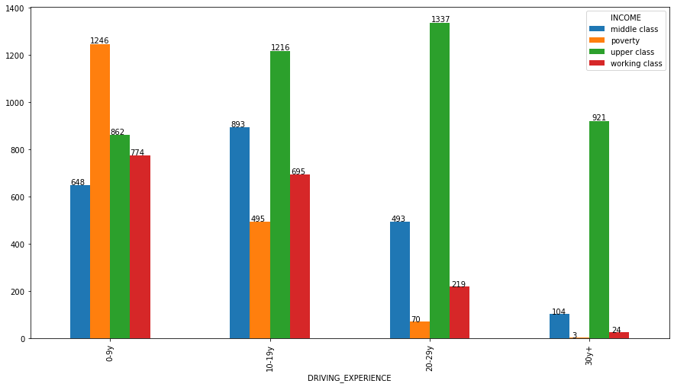
Key inferences:
Driving Experience vs Income:
Income distribution varies significantly across different driving experience levels.
The upper class consistently has the highest income across all driving experience categories.
Middle class income is highest for those with 0-5 years of driving experience.
The working class shows a declining income trend as driving experience increases.
Poverty levels are generally lower for those with more driving experience.
The 16-25 years driving experience category shows the most pronounced income inequality between classes.
The 26+ years category has the smallest income gap between different classes, excluding the upper class.
These observations suggest a complex relationship between driving experience, income, and social class, with different patterns emerging for each income group across the experience spectrum.

Slide 11
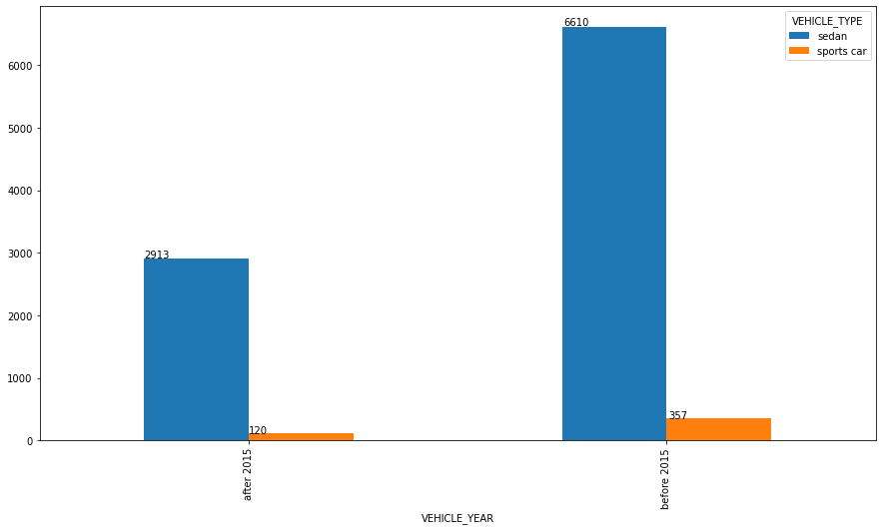
Key inferences:
Vehicle Year vs Vehicle Type:
Sedans are more popular than sports cars in both years shown
There was a significant increase in the number of sedans from the earlier year to 2015
The number of sports cars increased slightly from the earlier year to 2015, but not as dramatically as sedans
In 2015, there were 6610 sedans, which is much higher than the 357 sports cars for the same year.
The earlier year (likely 2014) had 2913 sedans and 120 sports cars, showing a clear preference for sedans even then
The automotive market represented in this data strongly favors sedans over sports cars, with the gap widening in 2015

Slide 12
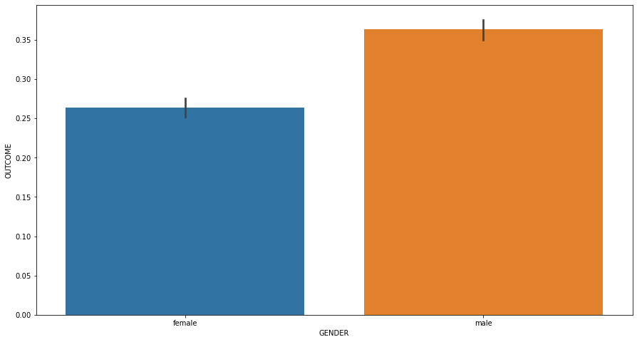
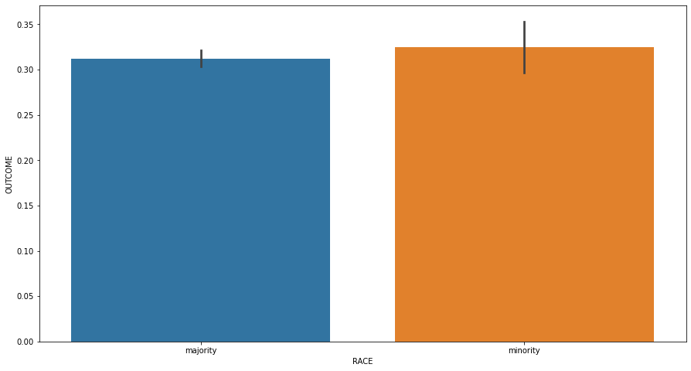
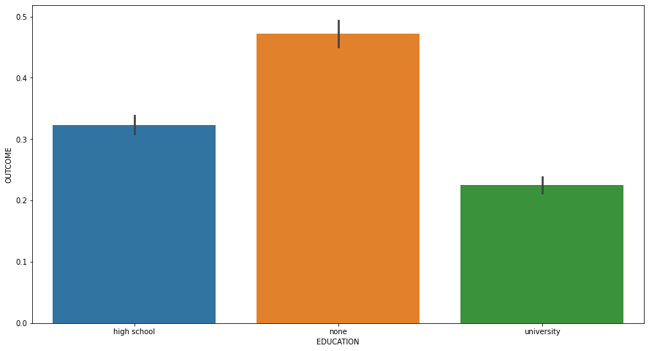
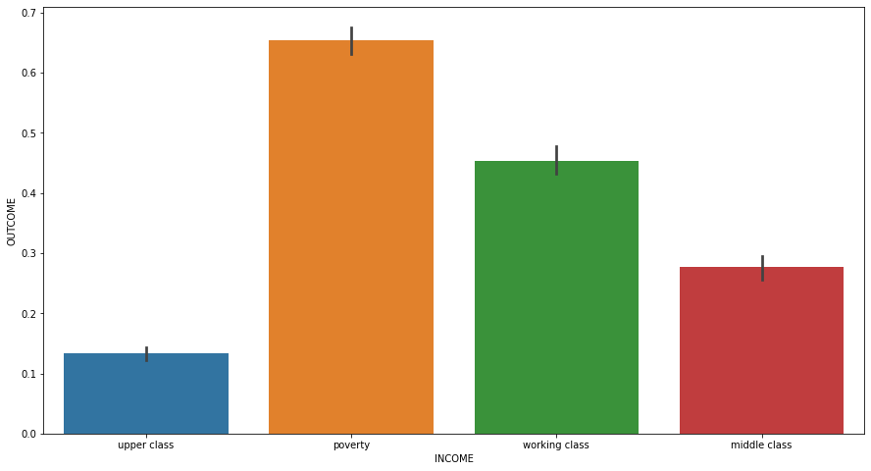
Num vs Cat:
Key findings:
Gender vs Outcome:
According to the dataset Males are having higher chance of getting car loans
Race vs outcome:
Minority race people are comparatively getting more car loans
Education vs outcome:
People with none education background are having higher chance of getting car loan
Income vs outcome:
People with low income(poverty) background are having higher chance of getting car loan

Slide 13
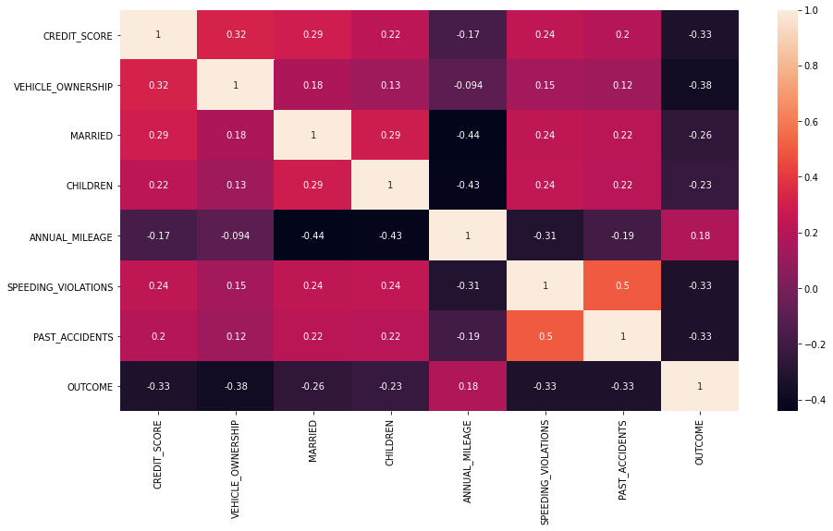
Multivariate Analysis
Identification of Multicollinearity:
Past_accidents and Speeding_violations have weak positive correlation
Other features are not correlated to each other

Slide 14
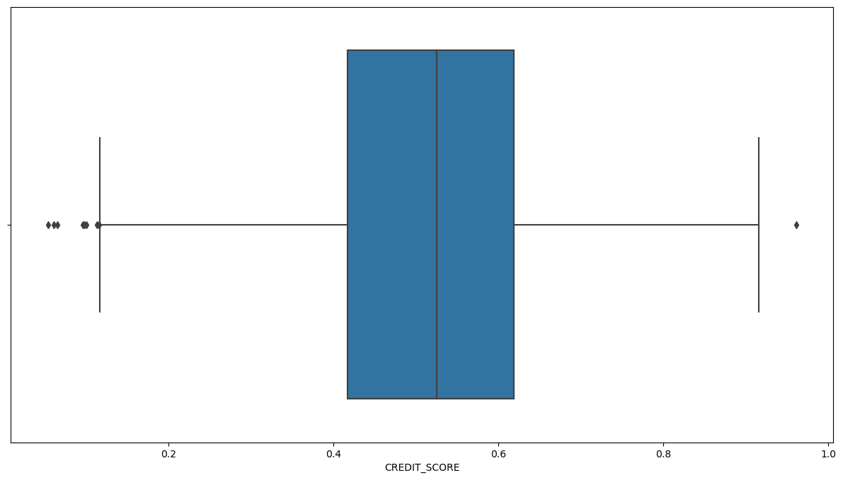
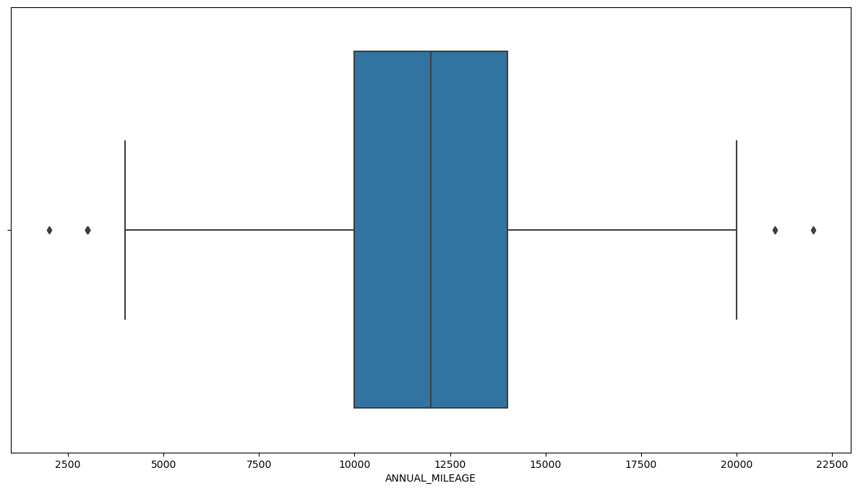
Data Preprocessing
Missing Values Treatment:
Approx 18% of missing values from columns credit_score, annual mileage.
As we observed that credit score and annual mileage columns has outliers, we filled the null values in credit score column by using the mean credit score of groups defined by the combination of education and income
In annual mileage column, we treated missing values with the average annual mileage for each group of vehicle type and vehicle year

Slide 15
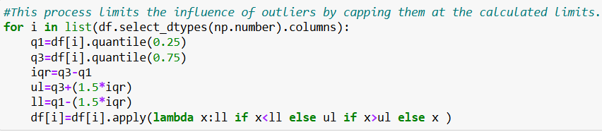
Outliers Treatment:
Identification of outliers:
Annual mileage has 3% outliers
Speeding violations has 6% outliers
Duis has 19% outliers are present
Past Accidents has 3% outliers
Treatment:
We have used capping method for handling the outliers

Slide 16
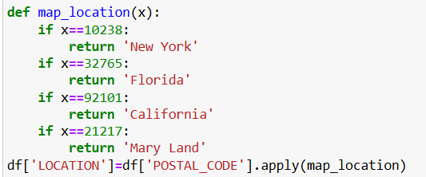
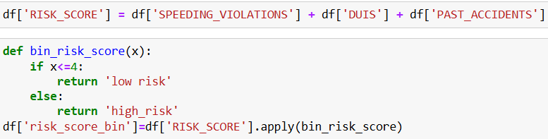
Feature Engineering
We have done feature engineering for column Postal code
As it has only 4 unique codes
We made that four codes into 4 cities:
New York, Florida, California, Mary Land
Risk score is the combination of speeding
violation, DUIS, past accidents
We have binned those risk scores as high risk and low risk accordingly

Slide 17
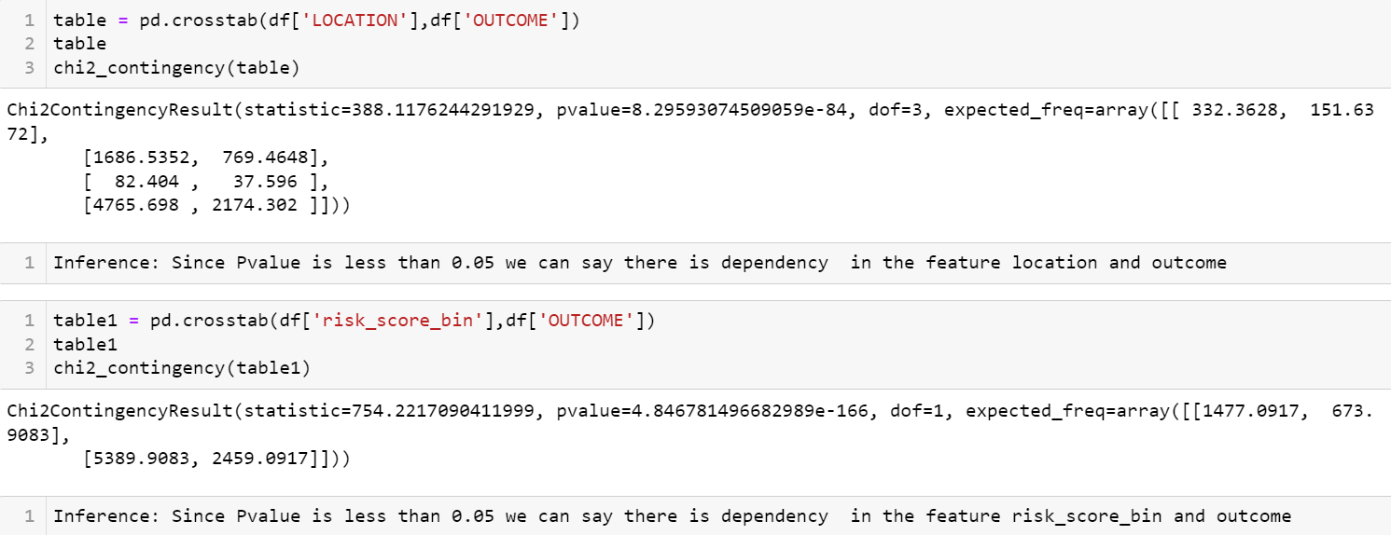
Statistical Test for Feature Engineered Column

Slide 18
Encoding
Encoding is one of the pre- processing steps which we convert categorical columns to numerical columns
Model will perform good on numerical values. So that we used encoding techniques
There are several encoding techniques available. Based on our dataset
We used N-1 encoding and ordinal encoding

Slide 19
Base model Building
Splitting of Data: We have split the data into 70% training and 30% testing.
Base Model :
We have used Logistic Regression algorithm as our base model as it is a classification problem
Class 1 contains the customers who claimed the loan and Class 0 contains the customers who did not claim the loan

Slide 20
Model Tuning
Grid search is a technique used in hyperparameter tuning to find the optimal combination of hyperparameters for a machine learning model
The process involves:
Defining a set of hyperparameters
Creating a parameter grid
Training and evaluating the model
Selecting the best hyperparameters

Slide 21
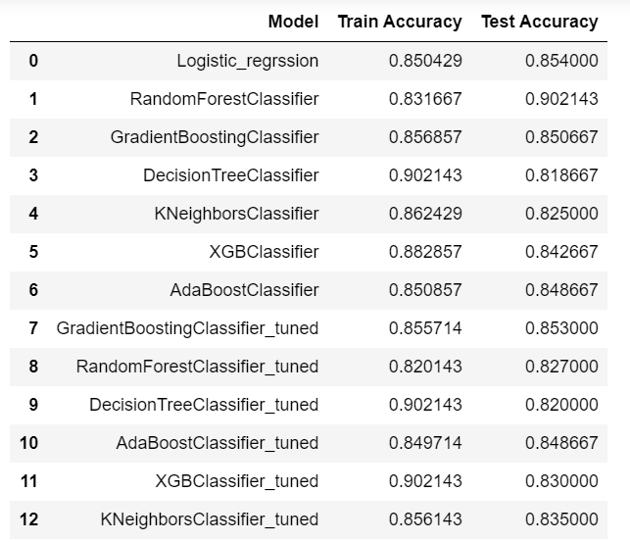
Evaluation
We used Classification Report for both training and testing data
We built model with different algorthims and got the training and testing accuracy

Slide 22
Thank
You!

