Slide 1
Quantum Innovation Challenge - 2025
Phase 1 Project Report
Team Entanglemental

Slide 2
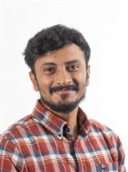

Team Entanglemental
Rajiv Kailasanathan
PhD in Chemical Engineering, Technical University of Denmark
Research areas: AI/ML in bioprocess engineering and systems biology, quantum algorithms
https://orcid.org/0009-0009-8915-7111
Shawn Gibford
PhD in Chemical Engineering, Technical University of Denmark
Research areas: Generative AI for engineering research, quantum algorithms
https://orcid.org/0009-0008-5168-658X

Slide 3
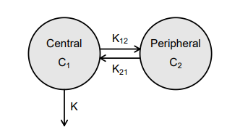

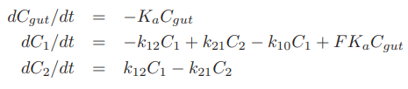
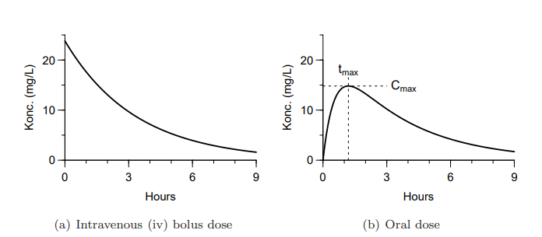

Problem Definition – PK-PD models
Pharmacokinetics and Pharmacodynamics is a systems approach to understand the life and effect of a drug in the human body.
System of differential equations embodying the conservation of mass of the drug in each compartment
Compartmentalize the human body to model the flow of the drug
Joint Pk-PD model
Parameter Estimation from Phase 1 clinical data
Effect of the drug on the biomarker modelled using mechanistic equations
Identify the mechanism of absorption, elimination and drug effect from pre-clinical studies / literature

Slide 4



Problem Definition –AI/ML in PK/PD models
All mathematical models lie in a spectra
Purely Mechanistic
Hybrid approaches
Purely Data-driven
Trade-off between data and mechanistic knowledge:
How much data is available to develop data-intensive models?
How much mechanistic knowledge is known to supplement with mechanistic models?
How are they combined?
Provides detailed mechanism of action
Difficult to construct these models
Provides explainability – great for regulatory compliance
Provides no insight into the mechanism
Models are relatively easy to setup – but often data intensive
Provides zero explainability – fails during regulatory compliance

Slide 5
Our approach – classical baseline
Development of joint PKPD model using a Neural ODE
Identify optimal dosing using virtual populations
Individual covariates
(Body weight, COMED status, dose)
Feed forward Neural network
Montecarlo simulation to generate a virtual patient
Use the trained NN to estimate the patient specific model parameters
Simulate the mechanistic model with the predicted parameters
Estimate individual parameters for the compartment model
Dose success if 90% of samples have biomarker level lesser than the threshold
Simulate the ODEs to predict the biomarker level till steady state
Backpropagation for training the NN
Estimate loss against observed data

Slide 6
Advantages of this hybrid approach
Neural Network can capture the complex relationships between the covariates and the model parameters
The mechanistic part is modular – the architecture can work with any mechanistic model for both PK and PD
The mechanistic part allows for interpretability of results – essential for regulatory compliances

Slide 7
Quantum enhancement to the classical approach : strategy 1
A variational quantum circuit as a replacement for the neural network
Expected advantage:
Expressivity in capturing the complex relationships between the covariates and the model parameters.
In futuristic clinical trials, with patient specific genomic data leading to very high dimensional covariates – QNN are expected to be much more efficient than classical NNs.
Expected disadvantages:
For the current dataset, the QNN is not expected to be better than the classical NN (only 3 covariates)
From our analyses, the time taken for training the neural ODE is not better with a quantum circuit than a classical NN ( 16 GB RAM, intel i5)

Slide 8
Quantum enhancement to the classical approach: strategy 2
Koopman von Neumann linearization
Since the integration of the systems of ODEs is the computational bottleneck in dose optimization, we explore a strategy to enhance the speed of the ODEs through Koopman von Neumann linearization.
The biggest challenge in this strategy will be to evaluate the Hermitian operator, but there is existing literature which deal with problems of this sort. They promise a speedup of O(log(N)) from O(poly(N)) that is achieved by classical systems – leading to atleast an exponential speed up.

Slide 9
Our plan of work
Strategy 2 is the most scientifically cutting edge, and has the potential to rethink the way we solve non-linear differential equations. Hence, strategy 2 (the Koopman von Neumann) linearization method will be our most important target.
Strategy 1 (QNNs) is a slightly lower hanging fruit, and it will be our fallback option.
October | November | December | January
1.Establishment of kvn linearization for toy problems 2.Development of method to estimate the Hermitian operator from PKPD data |  | Development of method to train the hybrid quantum classical algorithm Comparision against classical baseline | 3. Documentation, fine tuning, and submission

Slide 10
Team skills
Our PhD projects are in the domain of hybrid AI-quantum systems in the domain of biochemical engineering.
You can check out some of our works here: Quantum enhanced ensemble GANs for anomaly detection in continuous biomanufacturing
Exploring Hybrid Quantum-Classical Algorithms for Multiscale Bioprocess Optimization | Industrial & Engineering Chemistry Research

Slide 11
Prototype
We have developed a prototype for the NeuralODE, which will act as the classical baseline and the starting point of the quantum implementation. You can find the prototype at: RajivKailasanathan/QIC2025: Team Entanglemental solution for the Quantum Innovation Challenge 2025

