Slide 1
JAVA
--Punna Srija--

Slide 2
agenda
1. Introduction to Java
2. Java Development Environment
3. Data Types and Variables
4. Operators and Expressions
5. Control Flow
6. Classes and Objects
7. Object-Oriented Programming (OOP) in Java
8. Exception Handling
9. File Handling
10. Java Collections Framework
11. Multi Threading

Slide 3

introduction
Welcome to "A Brief History of Java“
Java: A versatile and influential programming language
Developed by James Gosling and his team at Sun Microsystems
Initial project: Green Project (Interactive television)
Inspired by C++ and other languages
Goal: Create a platform-independent language
Java 1.0 was released to the public
Key features: "Write Once, Run Anywhere" (WORA)
Applets: Small programs for web browsers

Slide 4
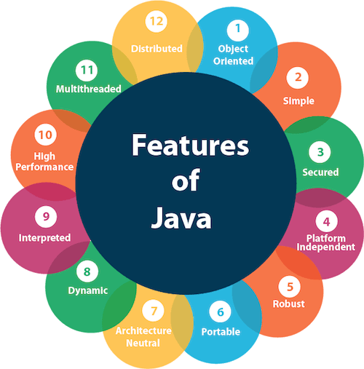
Features:-
Object Oriented
Simple
Secured
Platform Independent
Robust
Portable
Architectural Neutral
Dynamic
Interpreted
High Performance
Multithreaded
Distributed

Slide 5
Popularity and Use cases:-
Web Development
Enterprise Software
Mobile App Development
Finance and Banking
Game Development
Embedded Systems
Cloud Computing
Desktop Applications
E-commerce
Government and Public Sector
Healthcare

Slide 6
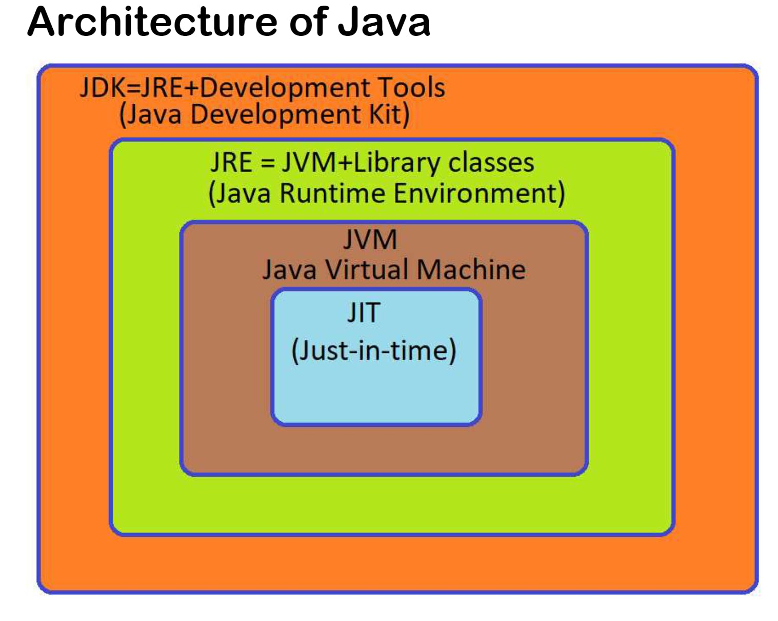
Architecture of Java:-
1. JDK (Java Development Kit) is a Kit that provides the environment to develop and execute(run) the Java program. JDK is a kit(or package) that includes two things
Development Tools(to provide an environment to develop your java programs)
JRE (to execute your java program).
2. JRE (Java Runtime Environment) is an installation package that provides an environment to only run(not develop) the java program(or application)onto your machine. JRE is only used by those who only want to run Java programs that are end-users of your system.
JVM (Java Virtual Machine):
JVM is a crucial component of the Java platform.
It is responsible for executing Java bytecode, which is the compiled output of Java source code.
JVM interprets or compiles bytecode into machine code (using the Just-In-Time Compiler) and manages memory, threads, and other runtime tasks.
JVMs are available for various platforms, allowing Java's "write once, run anywhere" capability.
JIT (Just-In-Time Compiler):
JIT is a component of the JVM responsible for improving the runtime performance of Java applications

Slide 7
Example : Java Program
public class MyFirstJavaProgram {
/* This is my first java program.
This will print 'Hello World' as the output
*/
public static void main(String[] args) {
System.out.println("Hello World"); // prints Hello World
}
}
Output:-- Hello World

Slide 8
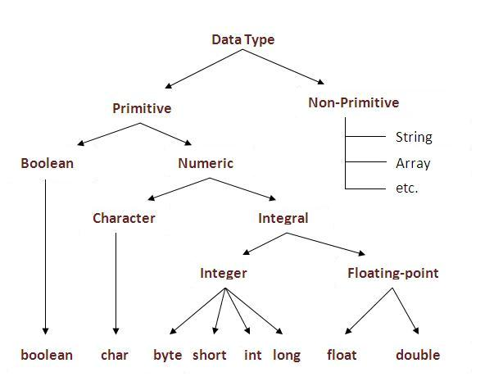
DataTypes and Variables:-
public class DataTypesExample {
public static void main(String[] args) {
// Primitive data types
byte age = 25;
short temperature = -10;
int population = 1000000;
long distance = 1500000000L;
float pi = 3.14f;
double circleArea = 7.07;
char grade = 'A';
boolean isJavaFun = true;
System.out.println("Age: " + age);
System.out.println("Temperature: " + temperature);
System.out.println("Population: " + population);
System.out.println("Distance: " + distance);
System.out.println("Pi: " + pi);
System.out.println("Circle Area: " + circleArea);
System.out.println("Grade: " + grade);
System.out.println("Is Java Fun? " + isJavaFun);
}
}

Slide 9

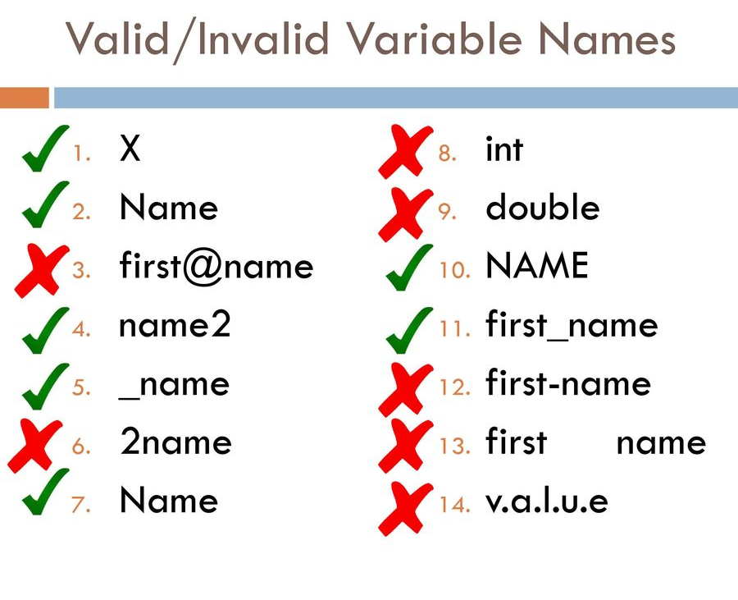
Variables:-
Example:
Int a=10;

Slide 10
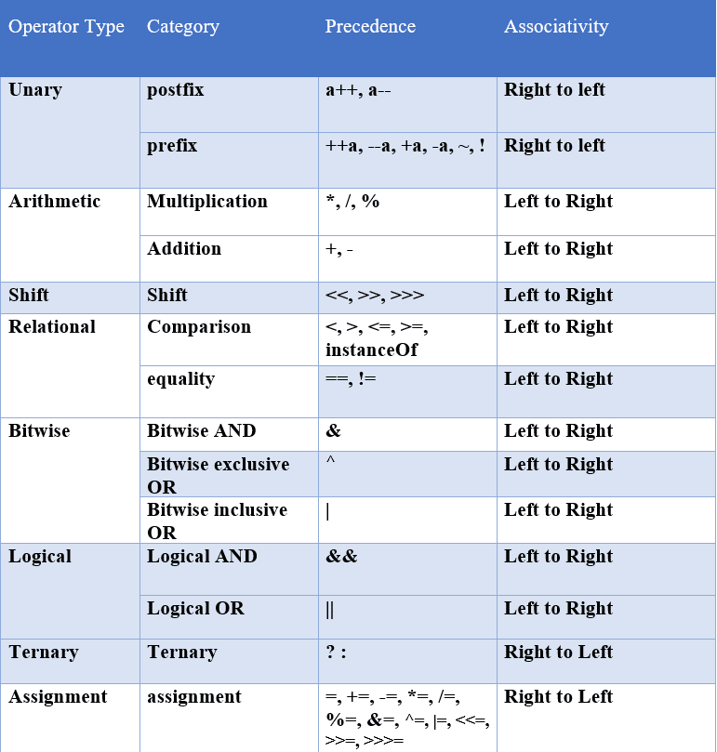
Operators:-
Unary Operator
Arithmetic Operator
Relational Operator
Bitwise Operator
Logical Operator
Ternary Operator
Assignment Operator

Slide 11
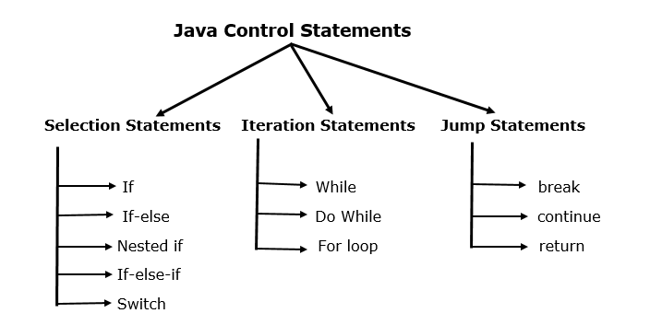
Java Control Statements:-
Selection Statements:-
If
If-else
Nested if
If-else-if
Switch
Iteration Statements:-
While
Do While
For loop
Jump Statements:-
Break
Continue
return

Slide 12
Control Statements programming examples:- 1. If Statement:
public class IfExample {
public static void main(String[] args) {
int number = 10;
if (number > 0) {
System.out.println("The number is positive.");
}
}
}

Slide 13
2. If-Else Statement:
public class IfElseExample {
public static void main(String[] args) {
int number = 7;
if (number % 2 == 0) {
System.out.println("The number is even.");
} else {
System.out.println("The number is odd.");
}
}
}

Slide 14
3. Nested If Statement:
public class NestedIfExample {
public static void main(String[] args) {
int mathScore = 85;
int scienceScore = 75;
if (mathScore >= 50) {
if (scienceScore >= 50) {
System.out.println("The student passed both math and science.");
} else {
System.out.println("The student passed math but failed in science.");
}
} else {
System.out.println("The student failed in math.");
}
}
}

Slide 15
4. If-Else If Statement:
public class ElseIfExample {
public static void main(String[] args) {
int score = 75;
if (score >= 90) {
System.out.println("Grade: A");
} else if (score >= 80) {
System.out.println("Grade: B");
} else if (score >= 70) {
System.out.println("Grade: C");
} else if (score >= 60) {
System.out.println("Grade: D");
} else {
System.out.println("Grade: F");
}
}
}

Slide 16
5. Switch Statement:
public class SwitchExample {
public static void main(String[] args) {
int dayOfWeek = 3;
switch (dayOfWeek) {
case 1:
System.out.println("It's Monday");
break;
case 2:
System.out.println("It's Tuesday");
break;
case 3:
System.out.println("It's Wednesday");
break;
case 4:
System.out.println("It's Thursday");
break;
case 5:
System.out.println("It's Friday");
break;
case 6:
System.out.println("It's Saturday");
break;
case 7:
System.out.println("It's Sunday");
break;
default:
System.out.println("Invalid day of the week");
break;
}
}
}

Slide 17
1. While Loop:
This program prints numbers from 1 to 5 using a while loop
public class WhileLoopExample {
public static void main(String[] args) {
int i = 1;
while (i <= 5) {
System.out.println(i);
i++;
}
}
}

Slide 18
2. Do-While Loop:
This program prints numbers from 1 to 5 using a do-while loop:
public class DoWhileLoopExample {
public static void main(String[] args) {
int i = 1;
do {
System.out.println(i);
i++;
} while (i <= 5);
}
}

Slide 19
3. For Loop:
This program prints numbers from 1 to 5 using a for loop:
public class ForLoopExample {
public static void main(String[] args) {
for (int i = 1; i <= 5; i++) {
System.out.println(i);
}
}
}

Slide 20
1. Break Statement:
public class BreakExample {
public static void main(String[] args) {
for (int i = 1; i <= 5; i++) {
if (i == 3) {
break; // Exit the loop when i is 3
}
System.out.println(i);
}
}
}

Slide 21
2. Continue Statement:
public class ContinueExample {
public static void main(String[] args) {
for (int i = 1; i <= 5; i++) {
if (i == 3) {
continue; // Skip the iteration when i is 3
}
System.out.println(i);
}
}
}

Slide 22
3. Return Statement:
public class ReturnExample {
public static void main(String[] args) {
int result = addNumbers(5, 3);
System.out.println("Sum: " + result);
}
static int addNumbers(int a, int b) {
int sum = a + b;
return sum; // Return the sum
}
}

Slide 23
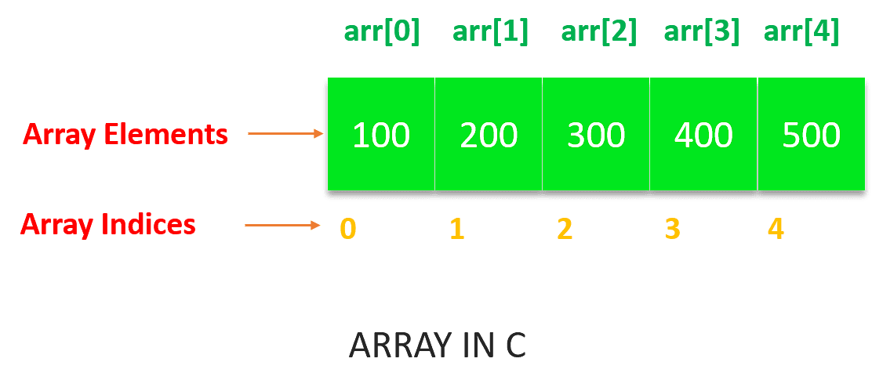
Arrays:
In Java, an array is a data structure that allows you to store a collection of elements of the same data type under a single variable name. Arrays are used to store and manipulate multiple values of the same type.
Declaration of Array:-
Single-Dimensional Array Declaration and Initialization:
Syntax: data_type[] array_name = new data_type[size];
int[] numbers = new int[5]; // Declares an integer array of size 5

Slide 24
Single-Dimensional Array Declaration and Initialization (Shorter Syntax):
Syntax: data_type[] array_name = {value1, value2, ...};
int[] numbers = {1, 2, 3, 4, 5}; // Declares and initializes an integer array
Multi-Dimensional Array Declaration and Initialization:
Syntax: data_type[][] array_name = new data_type[rows][columns];
int[][] matrix = new int[3][4]; // Declares a 2D integer array with 3 rows and 4 columns

Slide 25
public class ArrayExample {
public static void main(String[] args) {
// Declare an integer array to store 5 numbers
int[] numbers = new int[5];
// Store elements in the array
numbers[0] = 10;
numbers[1] = 20;
numbers[2] = 30;
numbers[3] = 40;
numbers[4] = 50;
// Access and print elements from the array
System.out.println("Element at index 0: " + numbers[0]);
System.out.println("Element at index 1: " + numbers[1]);
System.out.println("Element at index 2: " + numbers[2]);
System.out.println("Element at index 3: " + numbers[3]);
System.out.println("Element at index 4: " + numbers[4]);
}
}
Output:=
Element at index 0: 10
Element at index 1: 20
Element at index 2: 30
Element at index 3: 40
Element at index 4: 50

Slide 26
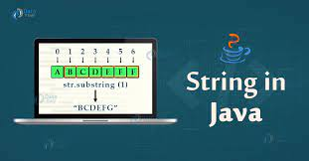
Strings:-
Definition of a String:
A string is a sequence of characters.
In Java, strings are objects of the String class.
Importance of Strings in Programming:
Strings are fundamental for working with textual data.
They are used for various tasks like data processing, user interaction, and more.

Slide 27
Declaring and Initializing Strings
How to Declare a String:
Syntax: String variableName;
Example: String name;
Initializing Strings:
Initializing with a value: String greeting = "Hello, World!";
Initializing as an empty string: String emptyString = "";
Initializing as null: String nullString = null;
String Literals:
A string literal is a sequence of characters enclosed in double quotes.
Example: "Java" is a string literal.

Slide 28
public class StringMemoryDemo {
public static void main(String[] args) {
// String literal stored in the string pool (heap)
String str1 = "Hello, World!";
// String object created in heap memory
String str2 = new String("Hello, World!");
// String reference in stack memory
String str3 = str1;
System.out.println("str1 == str2: " + (str1 == str2)); // false
System.out.println("str1 == str3: " + (str1 == str3)); // true
// Modifying str2 (heap memory) will not affect str1
str2 = str2.concat(" How are you?");
System.out.println("str1: " + str1); // "Hello, World!"
System.out.println("str2: " + str2); // "Hello, World! How are you?"
System.out.println("str3: " + str3); // "Hello, World!"
// Explanation of the code
// - String literals (str1) are stored in the string pool (heap).
// - Creating a new String object (str2) with new keyword stores it in heap memory.
// - String references (str1, str3) are stored in stack memory.
// - String objects are immutable; modifying str2 creates a new object.
}
}

Slide 29
some common methods in strings:-
length() Method:
Returns the length (number of characters) of the string.
String str = "Hello, World!";
int length = str.length();
System.out.println("Length of str: " + length); // Output: 13
charAt(int index) Method:
Returns the character at the specified index.
String str = "Java";
char character = str.charAt(1);
System.out.println("Character at index 1: " + character); // Output: 'a'

Slide 30
substring(int startIndex, int endIndex) Method:
Returns a substring between the specified start and end indices.
String str = "Java Programming";
String substring = str.substring(5, 13);
System.out.println("Substring from index 5 to 12: " + substring); // Output: "Programm"
concat(String str) Method:
Concatenates the specified string to the end of the current string.
String str1 = "Hello, ";
String str2 = "World!";
String result = str1.concat(str2);
System.out.println("Concatenated String: " + result); // Output: "Hello, World!"
toLowerCase() and toUpperCase() Methods:
Converts the string to lowercase or uppercase.

Slide 31
Importance of Strings:-
Importance of Strings in Programming:
Strings are fundamental in programming for tasks involving textual data, such as:
Storing and displaying messages to users.
Reading and writing data to files and databases.
Parsing and manipulating text, e.g., searching, replacing, and splitting.
Strings are essential in user interfaces, data processing, web development, and many other areas.
Java provides a robust and versatile String class, making it easy to work with text data efficiently and reliably.

Slide 32
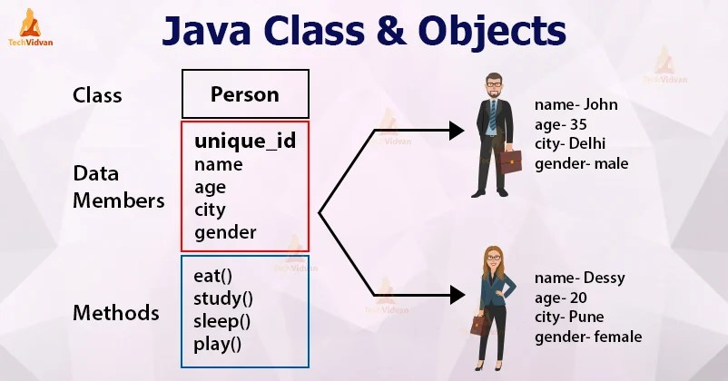
Classes and Objects:
In Java, a class is a blueprint for creating objects. Here's a simple example of defining a class named Person:
public class Person {
// Fields (instance variables)
String name;
int age;
// Methods
void sayHello() {
System.out.println("Hello, my name is " + name + " and I am " + age + " years old.");
}
}
Defining Classes:

Slide 33
You create objects (instances) of a class using the new keyword. Here's how you can create instances of the Person class:
2. Creating Objects:
public class Main {
public static void main(String[] args) {
// Create two Person objects
Person person1 = new Person();
Person person2 = new Person();
// Set values for the fields
person1.name = "Alice";
person1.age = 25;
person2.name = "Bob";
person2.age = 30;
person1.sayHello(); // Output: Hello, my name is Alice and I am 25 years old.
person2.sayHello(); // Output: Hello, my name is Bob and I am 30 years old.
}
}

Slide 34
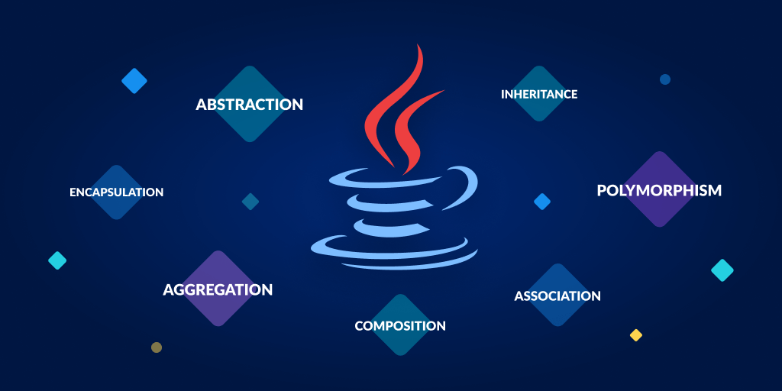
Object-Oriented Programming (OOP) Concepts:
Encapsulation
Abstraction
Inheritance
Polymorphism

Slide 35
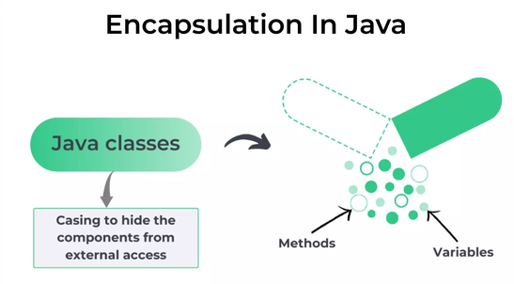
1. Encapsulation:
Encapsulation is the concept of bundling data (attributes) and methods (functions) that operate on that data into a single unit, known as a class. Access modifiers like private, public, and protected are used to control access to class members.

Slide 36
Encapsulation Example:
class Student {
private String name;
private int age;
public void setName(String name) {
this.name = name;
}
public String getName() {
return name;
}
}
public class Main {
public static void main(String[] args) {
Student student1 = new Student();
student1.setName("Alice");
// Accessing the name using a getter method
String studentName = student1.getName();
System.out.println("Student name: " + studentName); // Output: Student name: Alice
}
}

Slide 37
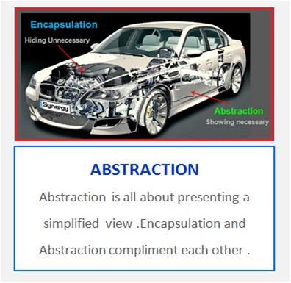
2. Abstraction:
Abstraction is one of the fundamental principles of object-oriented programming (OOP). It refers to the concept of hiding the complex implementation details of an object and showing only the necessary features of that object. In Java, abstraction is achieved through the use of abstract classes and interfaces.

Slide 38
Abstraction Example:
// Abstract class
abstract class Shape {
// Abstract method (no implementation)
abstract void draw();
void resize() {
System.out.println("Resizing the shape");
}
}
// Concrete subclass
class Circle extends Shape {
// Implementing the abstract method
void draw() {
System.out.println("Drawing a circle");
}
}
public class Main {
public static void main(String[] args) {
Circle circle = new Circle();
circle.draw(); // Output: Drawing a circle
circle.resize(); // Output: Resizing the shape
}
}

Slide 39

3. Inheritance:
Inheritance is a mechanism that allows one class (subclass or derived class) to inherit properties and methods from another class (superclass or base class).

Slide 40
Inheritance Example:
class Animal {
void eat() {
System.out.println("The animal eats.");
}
}
class Dog extends Animal {
void bark() {
System.out.println("The dog barks.");
}
}
public class Main {
public static void main(String[] args) {
Dog myDog = new Dog();
myDog.eat(); // Output: The animal eats.
myDog.bark(); // Output: The dog barks.
}
}

Slide 41
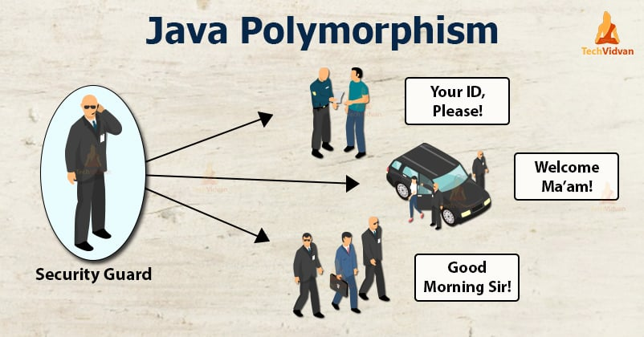
4. Polymorphism:
Polymorphism means "many forms", and it occurs when we have many classes that are related to each other by inheritance.
Two types:
Method Overloading
Method Overriding

Slide 42
Polymorphism Examples:
1. Method Overloading
public class Calculator {
// Method to add two integers
public int add(int a, int b) {
return a + b;
}
public int add(int a, int b, int c) {
return a + b + c;
}
public double add(double a, double b) {
return a + b;
}
public static void main(String[] args) {
Calculator calculator = new Calculator();
int sum1 = calculator.add(5, 10); // Calls the first add method
int sum2 = calculator.add(2, 3, 4); // Calls the second add method
double sum3 = calculator.add(2.5, 3.5); // Calls the third add method
System.out.println("Sum1: " + sum1); // Output: Sum1: 15
System.out.println("Sum2: " + sum2); // Output: Sum2: 9
System.out.println("Sum3: " + sum3); // Output: Sum3: 6.0
}
}

Slide 43
2. Method Overriding
class Shape {
void draw() {
System.out.println("Drawing a shape.");
}
}
class Circle extends Shape {
@Override
void draw() {
System.out.println("Drawing a circle.");
}
}
class Rectangle extends Shape {
@Override
void draw() {
System.out.println("Drawing a rectangle.");
}
}
public class Main {
public static void main(String[] args) {
Shape shape1 = new Circle();
Shape shape2 = new Rectangle();
shape1.draw(); // Output: Drawing a circle.
shape2.draw(); // Output: Drawing a rectangle.
}
}

Slide 44
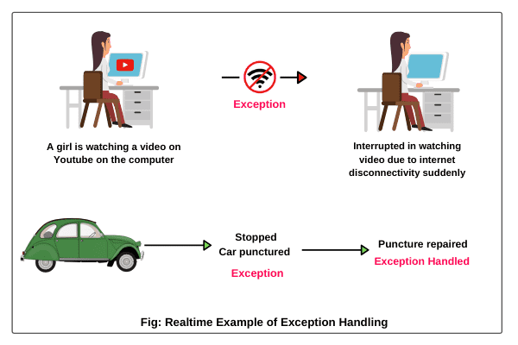
Exception Handling:
Exception Handling is a mechanism in Java that allows you to handle runtime errors (exceptions) gracefully, preventing your program from crashing. It involves using try, catch, finally, and throw blocks to manage exceptions that may occur during program execution.

Slide 45
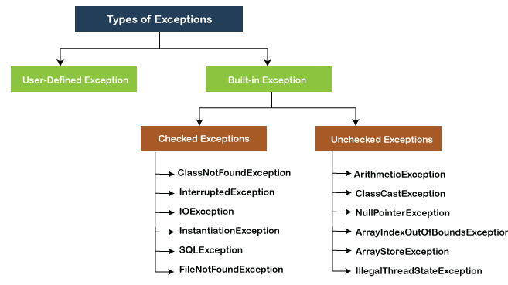
Different type of Exceptions Examples:
1. ArithmeticException:
Occurs when an arithmetic operation results in an error, such as dividing by zero.
try {
int result = 10 / 0; // This will throw an ArithmeticException
} catch (ArithmeticException e) {
System.out.println("ArithmeticException: " + e.getMessage());
}

Slide 46
2. NullPointerException:
Occurs when you try to access or call methods on a null object.
try {
String text = null;
int length = text.length(); // This will throw a NullPointerException
} catch (NullPointerException e) {
System.out.println("NullPointerException: " + e.getMessage());
}

Slide 47
3. ArrayIndexOutOfBoundsException:
Occurs when you try to access an array element with an invalid index.
try {
int[] numbers = {1, 2, 3};
int value = numbers[4]; // This will throw an ArrayIndexOutOfBoundsException
} catch (ArrayIndexOutOfBoundsException e) {
System.out.println("ArrayIndexOutOfBoundsException: " + e.getMessage());
}

Slide 48
4. NumberFormatException:
Occurs when you attempt to convert a string to a numeric type, but the string is not a valid number.
try {
String text = "abc";
int number = Integer.parseInt(text); // This will throw a NumberFormatException
} catch (NumberFormatException e) {
System.out.println("NumberFormatException: " + e.getMessage());
}

Slide 49
5. FileNotFoundException (IO Exception):
Occurs when attempting to access a file that doesn't exist.
import java.io.*;
try {
FileReader fileReader = new FileReader("non_existent_file.txt"); // This will throw a FileNotFoundException
} catch (FileNotFoundException e) {
System.out.println("FileNotFoundException: " + e.getMessage());
}

Slide 50
Throwing Custom Exceptions:
Sometimes, you may want to create your own custom exceptions to handle specific scenarios in your code.
Definition of throw and throws:
throw: It is used to explicitly throw an exception within your code. You can create a custom exception and throw it when a certain condition is met.
throws: It is used in method signatures to declare that a method might throw a specific exception. This is necessary when a method can potentially generate an exception, and it allows the caller to handle it.

Slide 51
class CustomException extends Exception {
public CustomException(String message) {
super(message);
}
}
public class CustomExceptionExample {
public static void main(String[] args) {
try {
validateAge(15);
} catch (CustomException e) {
System.err.println("Custom Exception caught: " + e.getMessage());
}
}
public static void validateAge(int age) throws CustomException {
if (age < 18) {
throw new CustomException("Age must be at least 18 years.");
} else {
System.out.println("Age is valid.");
}
}
}
Example of Custom Exception:

Slide 52
File Handling in Java:-
Reading and Writing Files in Java:
Definition: File handling in Java allows you to work with files on the local file system, including reading data from files and writing data to files. The primary classes for file handling are File, FileInputStream, FileOutputStream, BufferedReader, and BufferedWriter.

Slide 53
File Creation:-
package filesPractice;
import java.io.*;
public class FileCreation {
public static void main(String[] args) {
try {
File fr=new File("kimi no nawa.txt");
if(fr.createNewFile()) {
System.out.println("the file created successfully: "+fr.getName());
}else {
System.out.println("file already exists.");
}
}
catch(IOException e) {
System.out.println("an error occured");
e.printStackTrace();
/*The printStackTrace() method in Java is a tool used to handle exceptions and errors. It is a method of Java's throwable class which prints the throwable along with other details like the line number and class name where the exception occurred. printStackTrace() is very useful in diagnosing exceptions.*/
}
}
}

Slide 54
File Reading:-
package filesPractice;
import java.util.*;
import java.io.*;
public class FileReading {
public static void main(String[] args) {
try {
FileReader fr=new FileReader("data.txt");
int i;
while((i=fr.read())!=-1) {
System.out.print((char)i);
}
}
catch(Exception e){
System.out.println(e);
e.printStackTrace();
}
}
}

Slide 55
File Writing:-
package filesPractice;
import java.io.*;
public class FileWiriting {
public static void main(String[] args) {
try {
FileWriter fr=new FileWriter("data.txt");
fr.write("i want to practice more to become java backend developer ");
fr.close();
System.out.println("successfully written in file");
}
catch(java.io.IOException p) {
System.out.println(p);
p.printStackTrace();
}
}
}

Slide 56

BufferedReader:
package filesPractice;
import java.io.*;
public class FileBufferedReading2 {
public static void main(String[] args) {
try {
BufferedReader br=new BufferedReader(new FileReader("data.txt"));
String line=null;
while((line=br.readLine())!=null) {
System.out.println(line);
}
}
catch(Exception e) {
System.out.println(e);
e.printStackTrace();
}
}
}

Slide 57
BufferedWriter:-
package filesPractice;
import java.io.*;
public class FileBufferedWriting2 {
public static void main(String[] args) {
try {
BufferedWriter bw=new BufferedWriter(new FileWriter("data.txt"));
bw.append("what should i do!..");
}
catch(IOException e){
System.out.println(e);
e.printStackTrace();
}
}
}

Slide 58
Differences between BufferedReader and FileReader:
Basis | BufferedReader | FileReader
Use | It is used to read characters from any type of character input stream (String, Files, etc.) | It can be used only for reading files
Buffer | Uses Buffer internally to read characters from | Doesn’t use Buffer. Directly reads from the file by accessing the hard drive.
Speed | Faster | Slower
Efficiency | Much more efficient for reading files | Less efficient
Reading Lines | BufferedReader can be used to read a single character at a time as well as a line at a time. | It can read only one character at a time, can not read lines

Slide 59
Difference between BufferedWriter and FileWriter:
Aspect | FileWriter | BufferedWriter
Purpose | Writes characters to a file directly, one at a time. | Writes characters to a file with buffering, improving efficiency.
Buffering | No built-in buffering. Writes characters directly to the file. | Uses an internal buffer to accumulate data before writing to the file, reducing the number of I/O operations.
Efficiency | Less efficient, especially for large files or when writing substantial data. | More efficient, especially for large files or when writing substantial data, due to buffering.
Ease of Use | Simple to use, as it writes characters directly. | Slightly more complex, as you need to manage buffer flushing manually.
Writing Data | Writes data one character at a time. | Can write data in larger chunks (e.g., strings or character arrays), improving performance.
Performance | Performs better for small files or minimal data. | Performs better for large files or substantial data, thanks to buffering.
I/O Operations | Generates more I/O operations. | Reduces the number of I/O operations due to buffering.
Example | java FileWriter fileWriter = new FileWriter("output.txt"); fileWriter.write("Hello, World!"); | java BufferedWriter bufferedWriter = new BufferedWriter(new FileWriter("output.txt")); bufferedWriter.write("Hello, World!"); bufferedWriter.flush();

Slide 60
Threads in java:
Importance of Understanding Threads in Java:-
Multithreading is a fundamental concept in Java programming.
Understanding threads is crucial for building efficient and responsive Java applications.
Threads enable concurrent execution, allowing tasks to run simultaneously.
They play a pivotal role in enhancing application performance and responsiveness.
What is a Thread?
Definition: A thread is the smallest unit of execution in a Java program.
Threads are lightweight, independent paths of execution within a process.
Threads allow multiple tasks to run concurrently, achieving parallelism.
Threads can execute different code segments simultaneously, enhancing efficiency.

Slide 61
Thread Lifecycle:-
Threads in Java go through various states during their lifecycle.
Understanding these states is essential for effective thread management.
The thread lifecycle consists of several states, each with its significance.
Thread States:-
Thread states represent different phases of a thread's execution.
Common thread states in Java include:
New
Runnable
Blocked
Waiting
Timed Waiting
Terminated
The common thread states are:
New: A thread that has been created but hasn't started yet.
Runnable: A thread that's ready to run and may be executing or waiting for its turn.
Blocked: A thread that's waiting for a monitor lock to enter a synchronized block/method.
Waiting: A thread that's waiting indefinitely for another thread to perform a specific action.
Timed Waiting: A thread that's waiting for a specific duration before resuming its execution.
Terminated: A thread that has completed its execution and has either exited or been terminated.

Slide 62
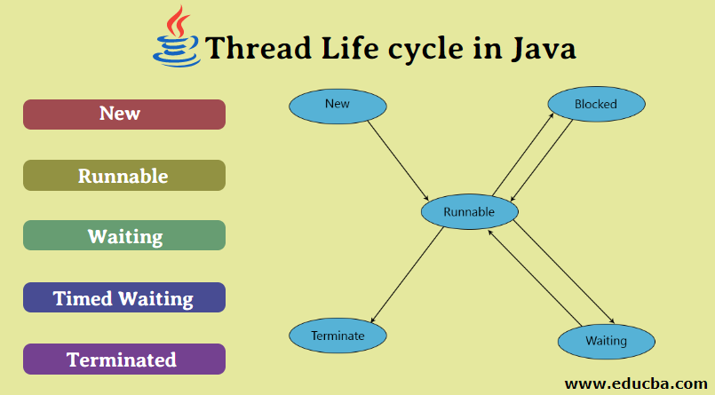

Slide 63
Thread Creation:-
package threads;
import java.io.*;
public class ThreadCreation extends Thread {
public void run() {
System.out.println("multi threading example");
}
public static void main(String[] args) {
ThreadCreation tc=new ThreadCreation();
tc.start();
}
}

Slide 64
public class ThreadStatesExample {
public static void main(String[] args) {
// Create a thread in the "New" state
Thread newThread = new Thread(() -> {
// This is the thread's task
System.out.println("New Thread is running!");
});
// Start the thread to transition it to the "Runnable" state
newThread.start();
// Create a thread in the "Runnable" state
Thread runnableThread = new Thread(() -> {
// This is the thread's task
System.out.println("Runnable Thread is running!");
});
// Start the runnableThread to keep it in the "Runnable" state
runnableThread.start();
// Create a thread in the "Blocked" state
Thread blockedThread = new Thread(() -> {
// Attempt to enter a synchronized block (causes "Blocked" state)
synchronized (ThreadStatesExample.class) {

Slide 65
try {
Thread.sleep(2000); // Sleep for 2 seconds to stay in "Blocked" state
} catch (InterruptedException e) { e.printStackTrace();
}
} System.out.println("Blocked Thread is running!");
}); // Start the blockedThread blockedThread.start();
// Create a thread in the "Waiting" state
Thread waitingThread = new Thread(() -> { synchronized (ThreadStatesExample.class) {
try {
Thread.sleep(2000); // Wait indefinitely (causes "Waiting" state)
ThreadStatesExample.class.wait();
} catch (InterruptedException e) {
e.printStackTrace();
}
} System.out.println("Waiting Thread is running!");
});
// Start the waitingThread waiting
Thread.start(); // Create a thread in the "Timed Waiting" state
Thread timedWaitingThread = new Thread(() -> { synchronized (ThreadStatesExample.class) {
try {
Thread.sleep(2000); // Wait for a specific duration (causes "Timed Waiting" state)
ThreadStatesExample.class.wait(1000); } catch (InterruptedException e) {
e.printStackTrace();
}
} System.out.println("Timed Waiting Thread is running!");
});

Slide 66
// Start the timedWaitingThread timedWaitingThread.start(); // Create a thread in the "Terminated" state Thread terminatedThread = new Thread(() -> {
// This thread completes its task immediately System.out.println("Terminated Thread is running!");
}); // Start and immediately join the terminatedThread to ensure it completes terminatedThread.start();
try {
terminatedThread.join();
} catch (InterruptedException e) { e.printStackTrace();
}
System.out.println("Main Thread is running!");
}
}
Output:-
New Thread is running!
Runnable Thread is running!
Blocked Thread is running!
Waiting Thread is running!
Timed Waiting Thread is running!
Terminated Thread is running!
Main Thread is running!

Slide 67
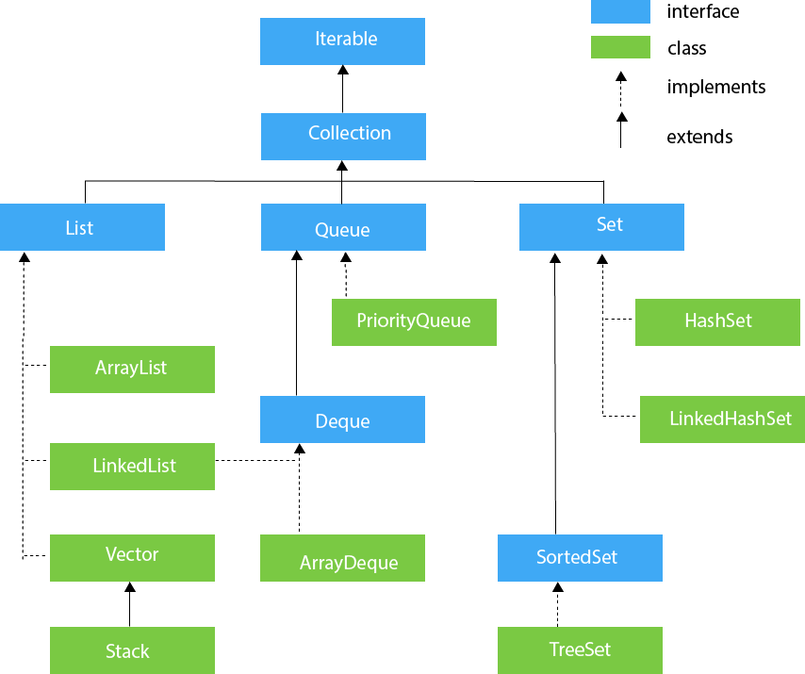
Collections:-
Introduction to Collections Framework
Definition of Collection:
A "collection" in Java refers to a group of objects that are stored and manipulated as a single unit.
Collections allow you to manage, store, and process multiple objects efficiently.

Slide 68
Definition of Framework:
A "framework" in software development is a pre-designed set of classes and interfaces that provide a reusable and structured way to solve common programming problems.
The Java Collections Framework is a standardized framework that provides interfaces and classes to work with collections efficiently.

Slide 69
List Interface:-
Definition:
The List interface in Java is part of the Java Collections Framework.
It represents an ordered collection of elements where duplicates are allowed.
Lists allow elements to be inserted or accessed based on their positional index.
List Interface - Key Methods
Common Methods:
add(E element): Adds an element to the end of the list.
get(int index): Retrieves an element at the specified index.
remove(int index): Removes and returns an element at the specified index.
size(): Returns the number of elements in the list.

Slide 70
Array List
import java.util.ArrayList;
import java.util.List;
public class ArrayListExample {
public static void main(String[] args) {
// Create an ArrayList of strings
List<String> names = new ArrayList<>();
// Add elements to the list
names.add("Alice");
names.add("Bob");
names.add("Charlie");
// Display the list
System.out.println("ArrayList: " + names);
// Access elements by index
String secondElement = names.get(1);
System.out.println("Second element: " + secondElement);
// Modify an element by index
names.set(0, "Alicia");
System.out.println("After modifying the first element: " + names);
// Remove an element by index
names.remove(2);
System.out.println("After removing the third element: " + names);
// Get the size of the list
int size = names.size();
System.out.println("Size of the list: " + size);
}
}
Output:-
ArrayList: [Alice, Bob, Charlie]
Second element: Bob
After modifying the first element: [Alicia, Bob, Charlie]
After removing the third element: [Alicia, Bob]
Size of the list: 2

Slide 71
Advantages of Array List:-
Pros
Dynamic Sizing: Automatically resizes as needed to accommodate elements.
Random Access: Provides quick access to elements by their index.
Simple to Use: Easy to understand and use, especially for beginners.
Generics Support: Ensures type safety by specifying the data type.
Integration with Collections Framework: Part of Java's standard library for collections.
Efficient Iteration: Supports efficient traversal of elements.
Backed by an Array: Provides memory-efficient storage.
Advantages of ArrayList:

Slide 72
import java.util.LinkedList;
import java.util.List;
public class LinkedListExample {
public static void main(String[] args) {
// Create a LinkedList of integers
List<Integer> numbers = new LinkedList<>();
// Add elements to the list
numbers.add(1);
numbers.add(2);
numbers.add(3);
// Display the list
System.out.println("LinkedList: " + numbers);
// Access elements by index
int thirdElement = numbers.get(2);
System.out.println("Third element: " + thirdElement);
// Modify an element by index
numbers.set(1, 22);
System.out.println("After modifying the second element: " + numbers);
// Remove an element by index
numbers.remove(0);
System.out.println("After removing the first element: " + numbers);
// Get the size of the list
int size = numbers.size();
System.out.println("Size of the list: " + size);
}
}
Linked List
Output:-
LinkedList: [1, 2, 3]
Third element: 3
After modifying the second element: [1, 22, 3]
After removing the first element: [22, 3]
Size of the list: 2

Slide 73
Advantages of Linked List:-
Pros
Efficient Insertions/Deletions: Allows for quick insertions and deletions anywhere in the list.
Dynamic Sizing: Automatically adjusts its size as needed.
No Wasted Memory: Consumes memory only for elements and their links.
Well-suited for Implementing Queues and Stacks: Provides efficient operations for these data structures.
No Need for Reallocation: No need to copy elements when resizing.
Can Be More Memory Efficient: In certain scenarios, LinkedLists can be more memory-efficient than ArrayLists for small data structures.

Slide 74
Queue Interface:-
Queue Definition:
A queue is a linear data structure that follows the "First-In-First-Out" (FIFO) principle, meaning the element added first will be the one to be removed first.
Queues are often used to manage tasks or elements in a sequential order, like in task scheduling, printing tasks, or order processing.
Queue Classes in Java:
Java provides several classes and interfaces to work with queues, primarily in the java.util package. Here are some of the key classes and interfaces related to queues:
Queue Interface: This is the root interface for all queue types in Java. It defines common methods such as add, remove, and peek.
LinkedList: java.util.LinkedList implements the Queue interface and is commonly used as a basic queue implementation.
PriorityQueue: java.util.PriorityQueue is an implementation of a priority queue, which allows elements with higher priority to be processed first.

Slide 75
import java.util.LinkedList;
import java.util.Queue;
public class QueueExample {
public static void main(String[] args) {
// Create a Queue using LinkedList
Queue<String> taskQueue = new LinkedList<>();
// Adding elements to the queue
taskQueue.add("Task 1");
taskQueue.add("Task 2");
taskQueue.add("Task 3");
// Removing and processing elements in FIFO order
while (!taskQueue.isEmpty()) {
String task = taskQueue.poll(); // Retrieves and removes the head of the queue
System.out.println("Processing: " + task);
}
}
}
Output:-
Processing: Task 1
Processing: Task 2
Processing: Task 3

Slide 76
Advantages of Queue:-
Order Preservation: Queues maintain the order of elements, ensuring that the first element added is the first to be processed.
FIFO Principle: The FIFO principle ensures that tasks or elements are processed in a fair and predictable manner.
Synchronization: In multi-threaded applications, queues can be used for safe data sharing and task scheduling.
Task Prioritization: Priority queues allow for the processing of high-priority tasks first, useful in scenarios where tasks have different levels of urgency.
Efficient Enqueue and Dequeue: Queues provide efficient insertion and removal of elements, making them suitable for scenarios requiring quick task management.
Data Buffering: Queues can be used as buffers for data flow control in applications like data streaming and message processing.
Well-Defined APIs: Java's Queue interface offers a well-defined set of methods for working with queues, making them easy to use.

Slide 77
Set Interface:-
The Set interface in Java is a part of the Java Collections Framework.
It represents an unordered collection of unique elements, which means no duplicate elements are allowed.
Sets are used when you need to store a collection of elements with no duplicates.
The Set interface extends the Collection interface and does not allow duplicate elements.
Set Classes in Java:
Java provides several classes and interfaces to work with sets. Here are some of the key classes and interfaces related to sets:
HashSet: java.util.HashSet is one of the most commonly used implementations of the Set interface. It uses a hash table for efficient storage and retrieval of elements.
LinkedHashSet: java.util.LinkedHashSet is similar to HashSet but maintains the insertion order of elements.
TreeSet: java.util.TreeSet is an implementation of a Set that maintains elements in a sorted order. It uses a Red-Black tree data structure for storage.

Slide 78
import java.util.HashSet;
import java.util.Set;
public class SetExample {
public static void main(String[] args) {
// Create a Set using HashSet
Set<String> fruits = new HashSet<>();
// Adding elements to the set
fruits.add("Apple");
fruits.add("Banana");
fruits.add("Cherry");
fruits.add("Banana"); // Duplicate element, will not be added
// Display the set
System.out.println("Fruits Set: " + fruits);
}
}
Output:-
Fruits Set: [Apple, Banana, Cherry]

Slide 79
Advantages of set:-
Uniqueness: Sets enforce uniqueness, ensuring that duplicate elements are automatically eliminated.
Fast Lookup: Sets provide efficient methods for element lookup, making them suitable for scenarios where you need to quickly check for element existence.
No Defined Order: Sets do not maintain the order of elements, which can be advantageous in some situations where order is not important.
Well-Defined APIs: Java's Set interface offers a well-defined set of methods for working with sets, making them easy to use.
Efficient Storage: Different set implementations (e.g., HashSet, TreeSet) provide efficient storage and retrieval mechanisms, allowing you to choose the best fit for your needs.
Set Operations: Sets support common set operations like union, intersection, and difference, making them useful in various applications.

Slide 80
thank you

