Slide 1
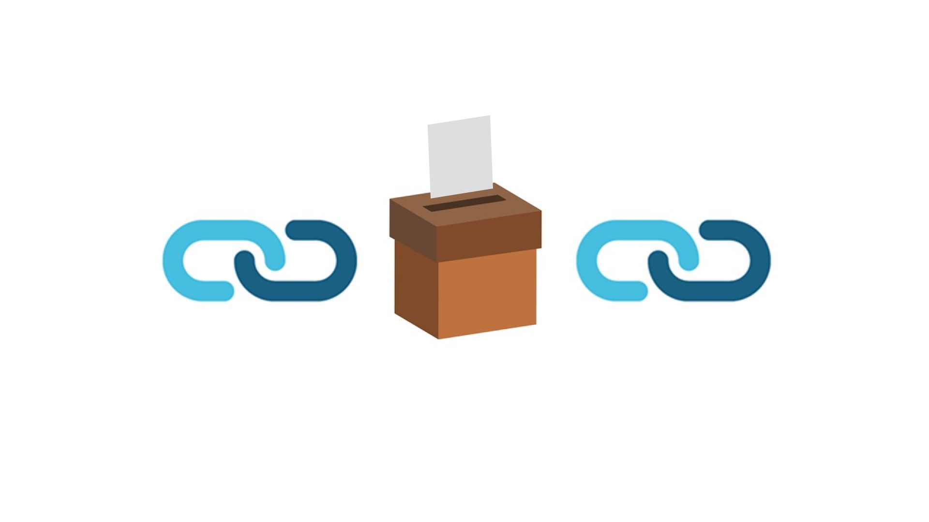
Votechain
CryptoBallot
By-
Rajiv ramchandani
Akhil singh
Vaibhav jaiswal
Mohhamad noor
By-
Rajiv Ramchandani
Akhil Singh
Vaibhav Jaiswal
Mohammad Noor

Slide 2
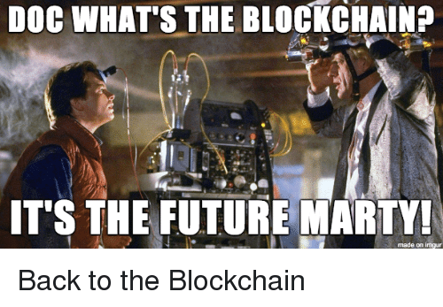

Slide 3
What is blockchain ?
A blockchain is, in the simplest of terms, a time-stamped series of immutable record of data that is managed by cluster of computers not owned by any single entity. Each of these blocks of data (i.e. block) are secured and bound to each other using cryptographic principles (i.e. chain).
The blockchain is an incorruptible digital ledger of economic transactions that can be programmed to record not just financial transactions but virtually everything of value.
By allowing digital information to be distributed but not copied, blockchain technology created the backbone of a new type of internet. Originally devised for the digital currency, the tech community has now found other potential uses for the technology.

Slide 4
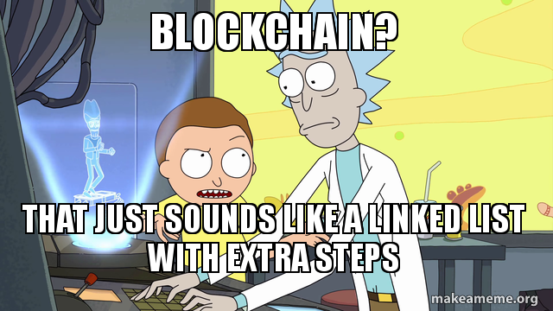

Slide 5
So why blockchain?
The Three Pillars of Blockchain Technology
The three main properties of the Blockchain Technology which has helped it gain widespread acclaim are as follows:
Decentralization
Transparency
Immutability
The blockchain network has no central authority — it is the very definition of a democratized system. Since it is a shared and immutable ledger, the information in it is open for anyone and everyone to see. Hence, anything that is built on the blockchain is by its very nature transparent and everyone involved is accountable for their actions.

Slide 6
Security of digital voting is always the biggest concern when considering to implement a digital voting system. With such monumental decisions at stake, there can be no doubt about the system’s ability to secure data and defend against potential attacks. One way the security issues can be potentially solved is through the technology of blockchains.

Slide 7
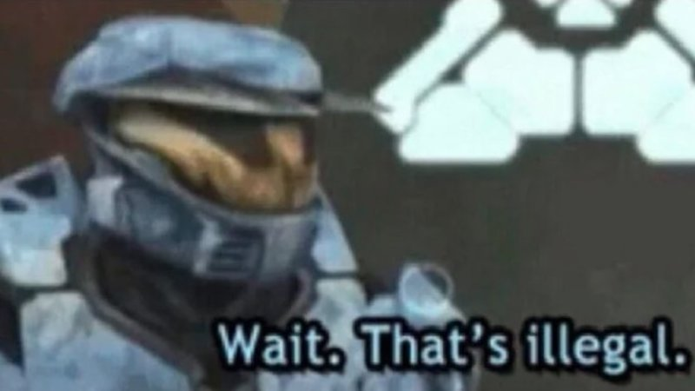
But can you tamper with it?

Slide 8
How we incorporated blockchain in voting?
As you know blockchain has blocks which has transactional data stored in it. In the case of voting this data is in the form of votes casted by voters
Each block has fixed numbers of vote casting data which is in the form of “who gave whom 1 vote”
Initially , credential verification of the voter is done i.e. name, DOB, voter ID as well as their private keys are verified only after which they are allowed to cast a vote and it is recorded in a vote list.
As soon as the voter is done voting , his entry from the voter database is deleted so as to prevent multi-voting by same person

Slide 9
The number of votes data stored in a block is set to 2
So after every 2 successful votes, a block is mined i.e. its hash is computed according to the difficulty level set to 4 (in our implementation)
After mining, it is added to the blockchain list
After the voting session has been completed, all the blocks are first verified and then votes are tallied and results are displayed

Slide 10
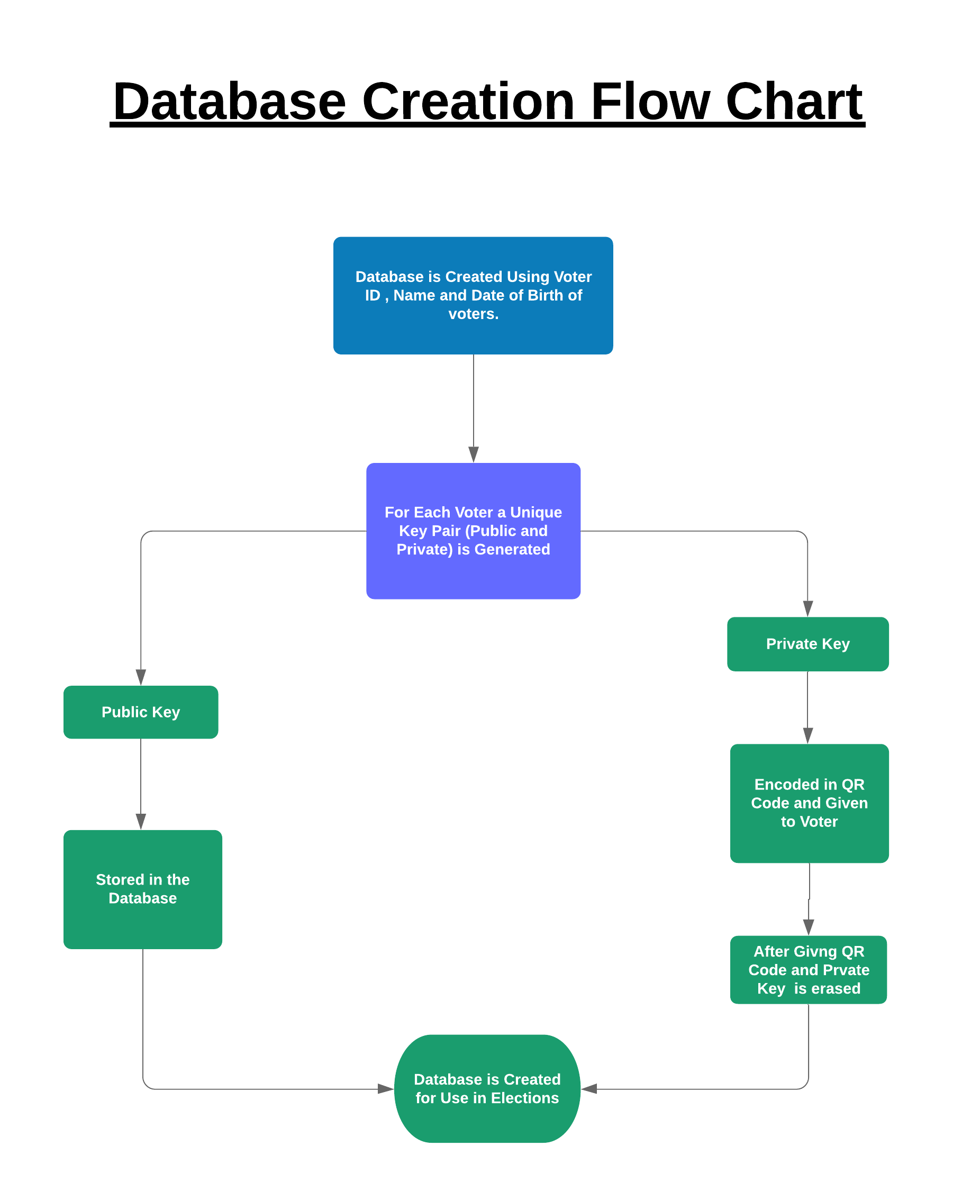

Slide 11
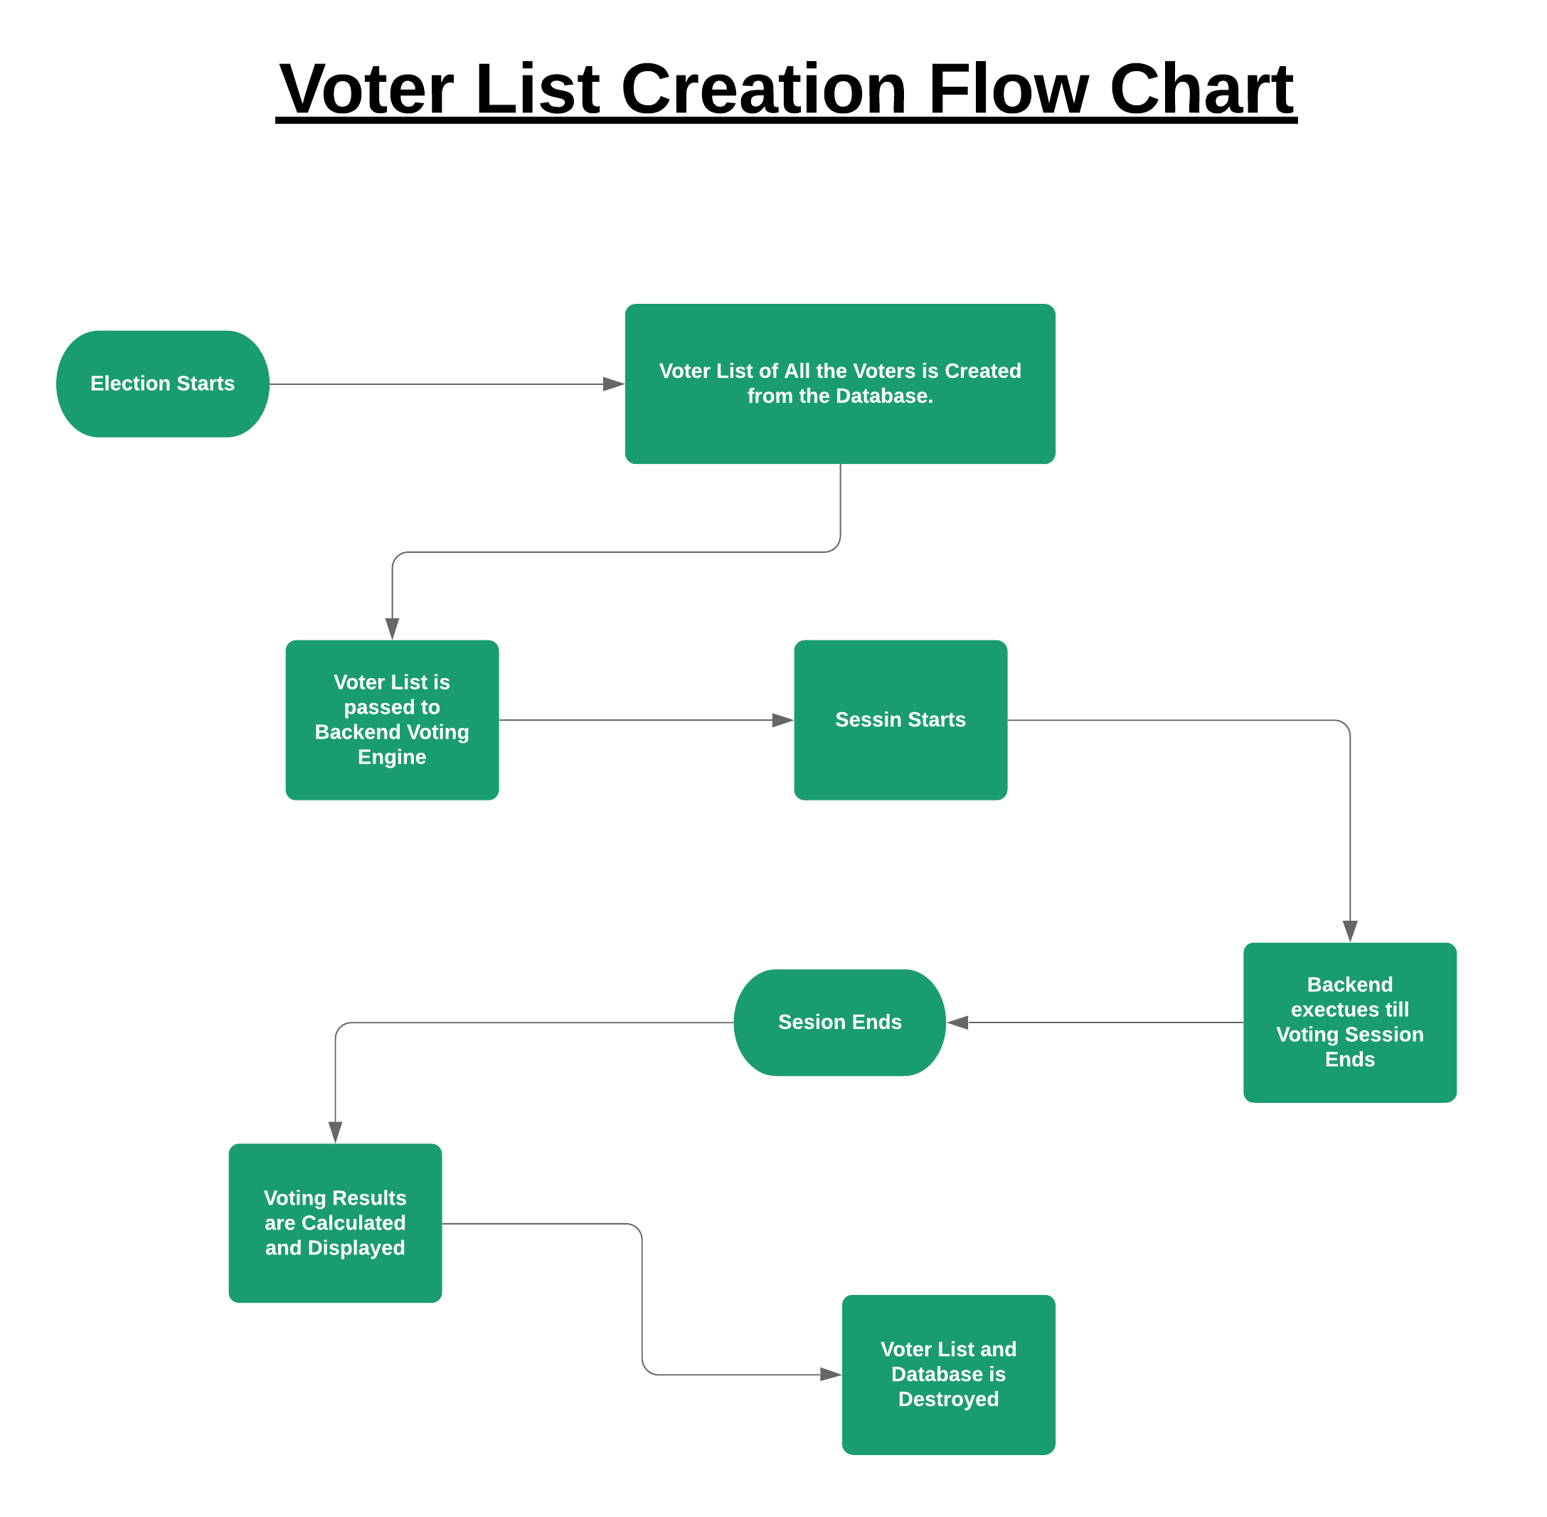

Slide 12
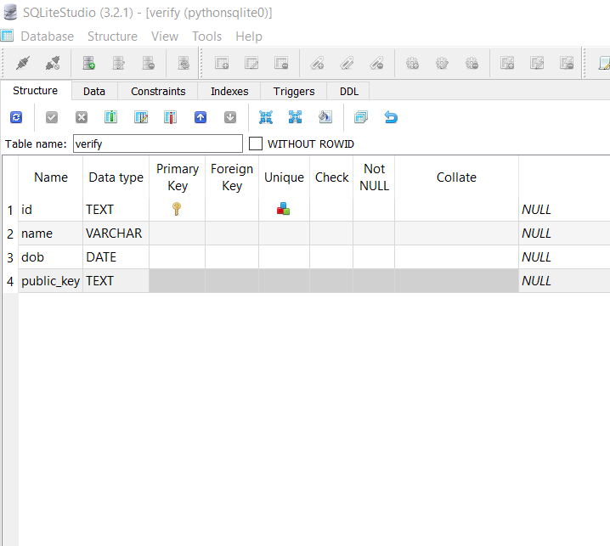
Database Structure

Slide 13
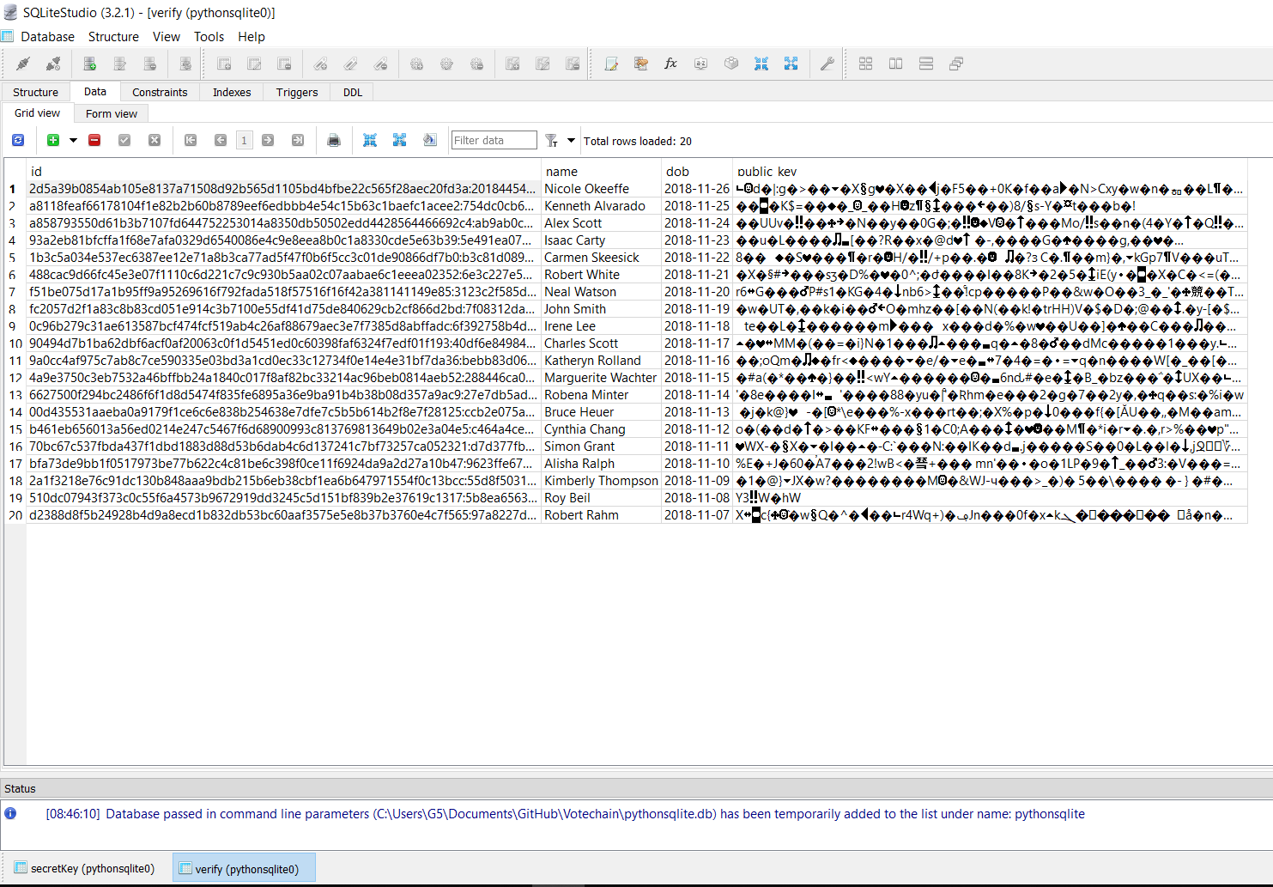
Database

Slide 14
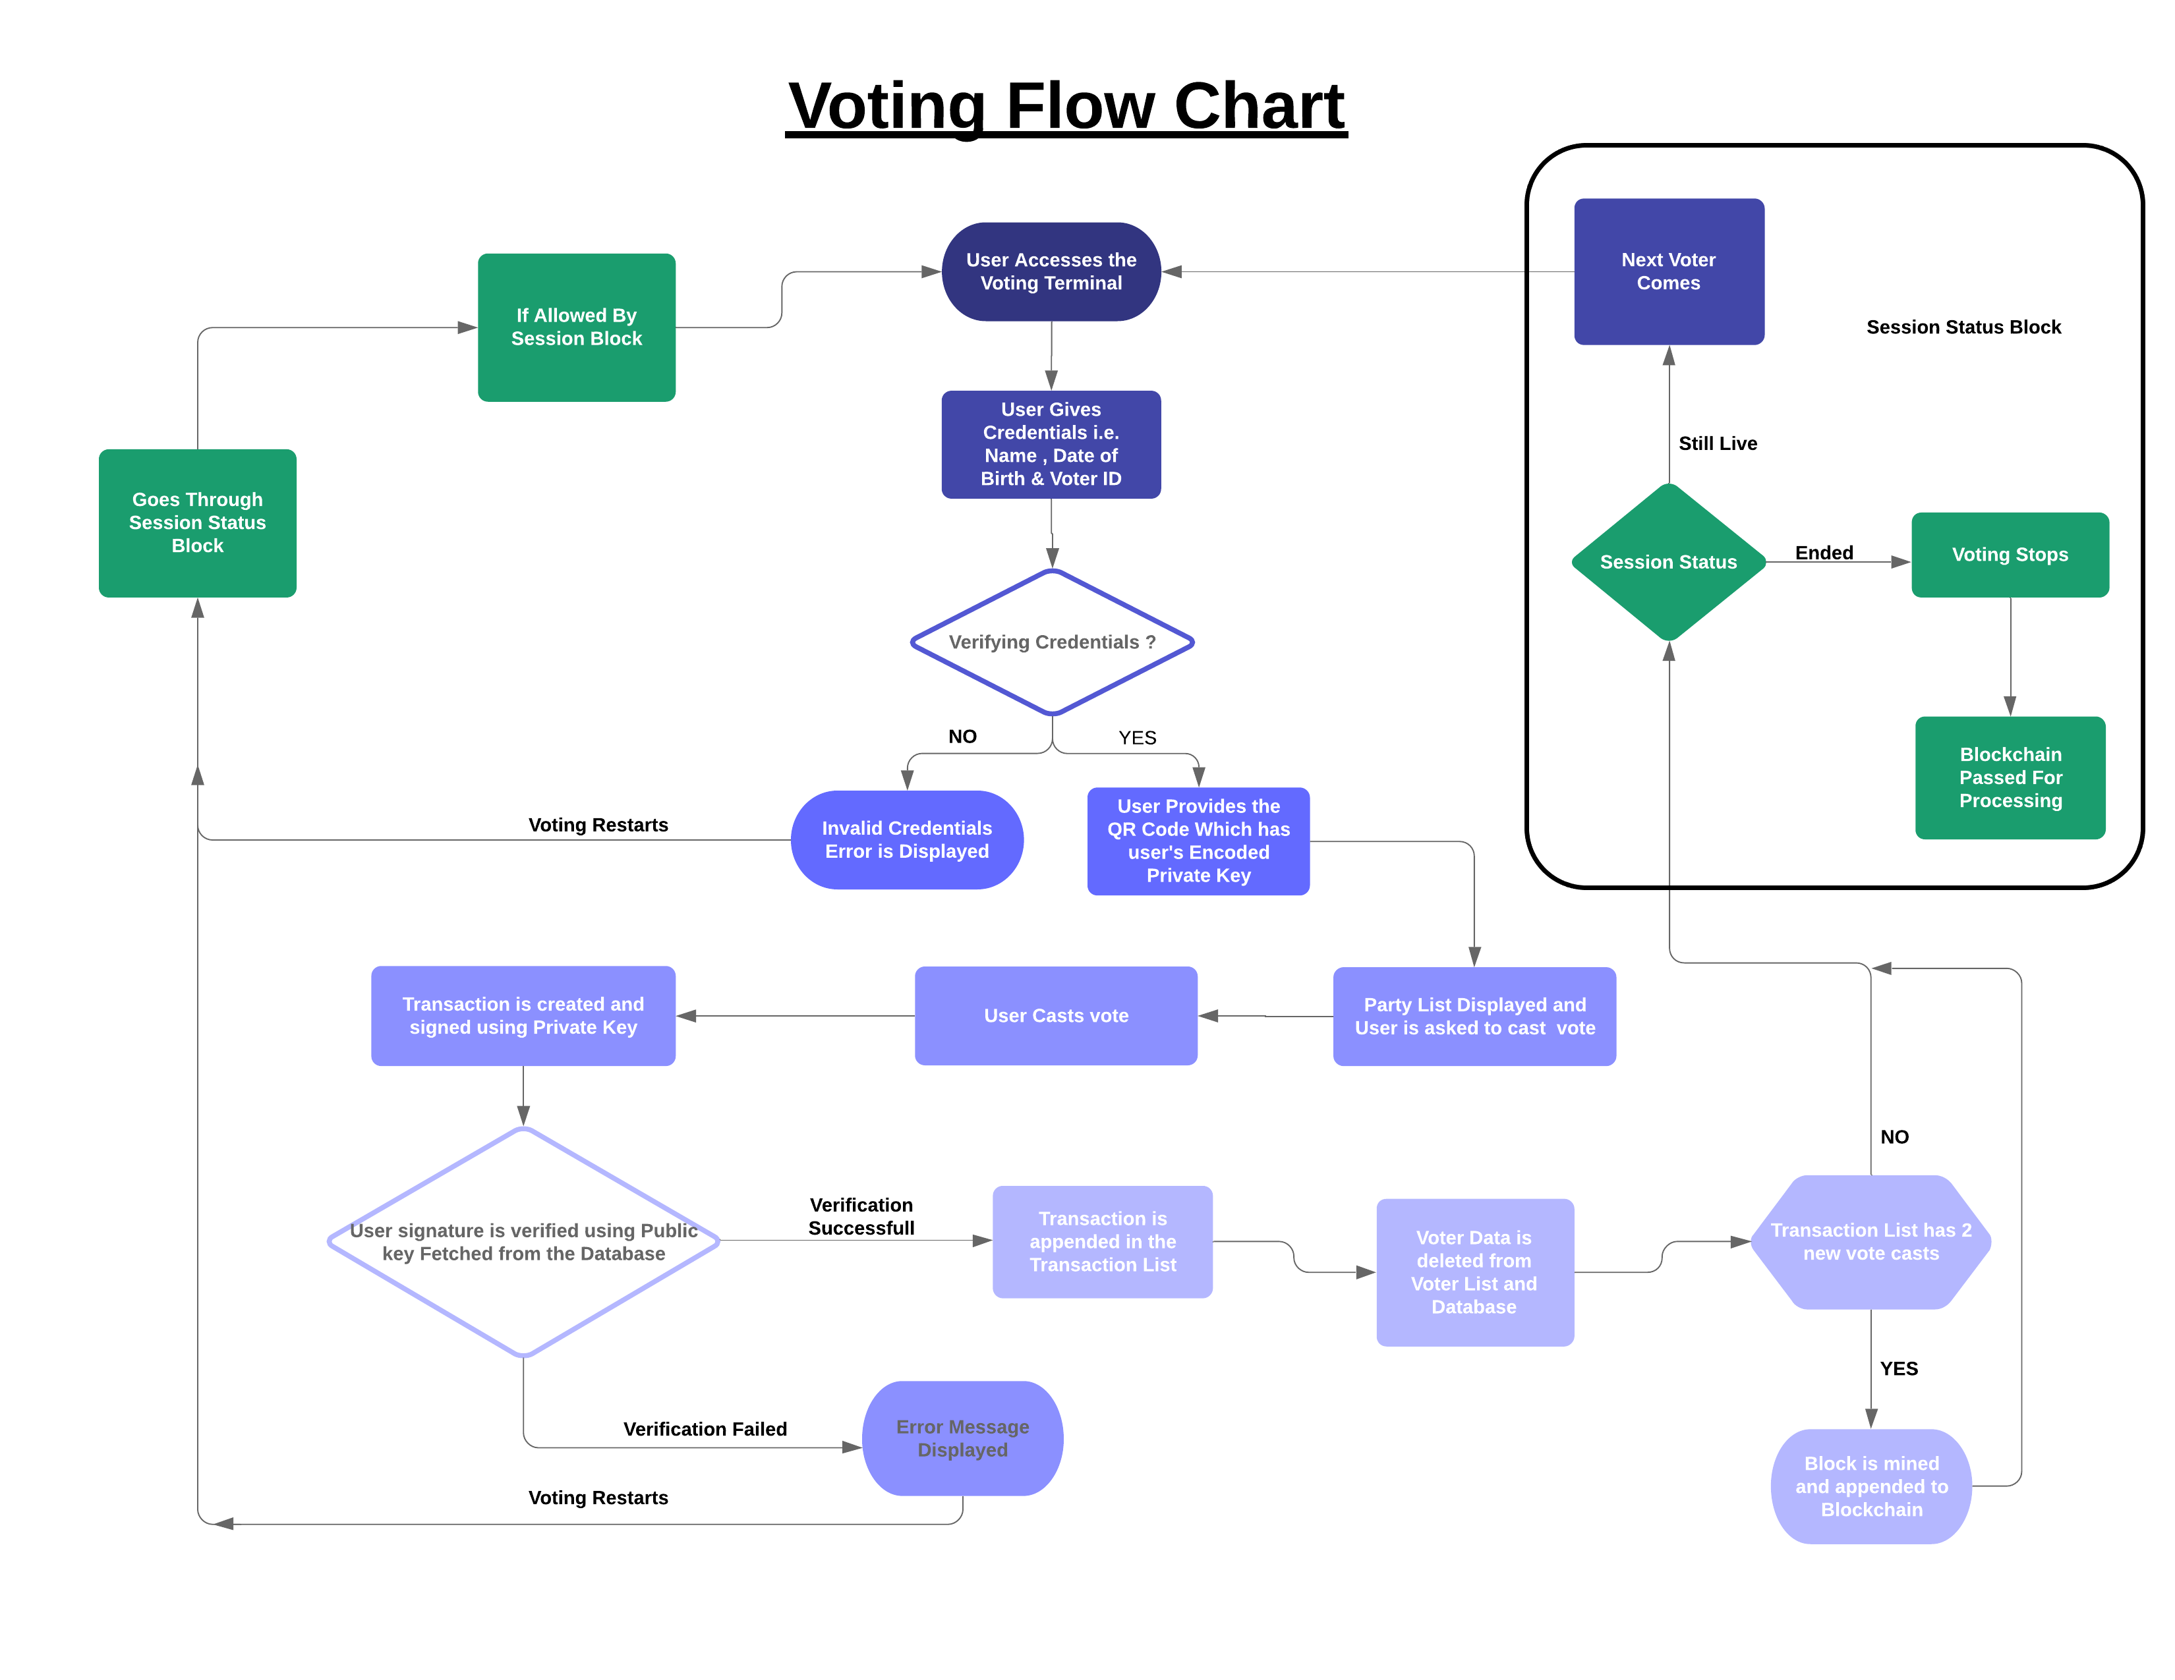

Slide 15
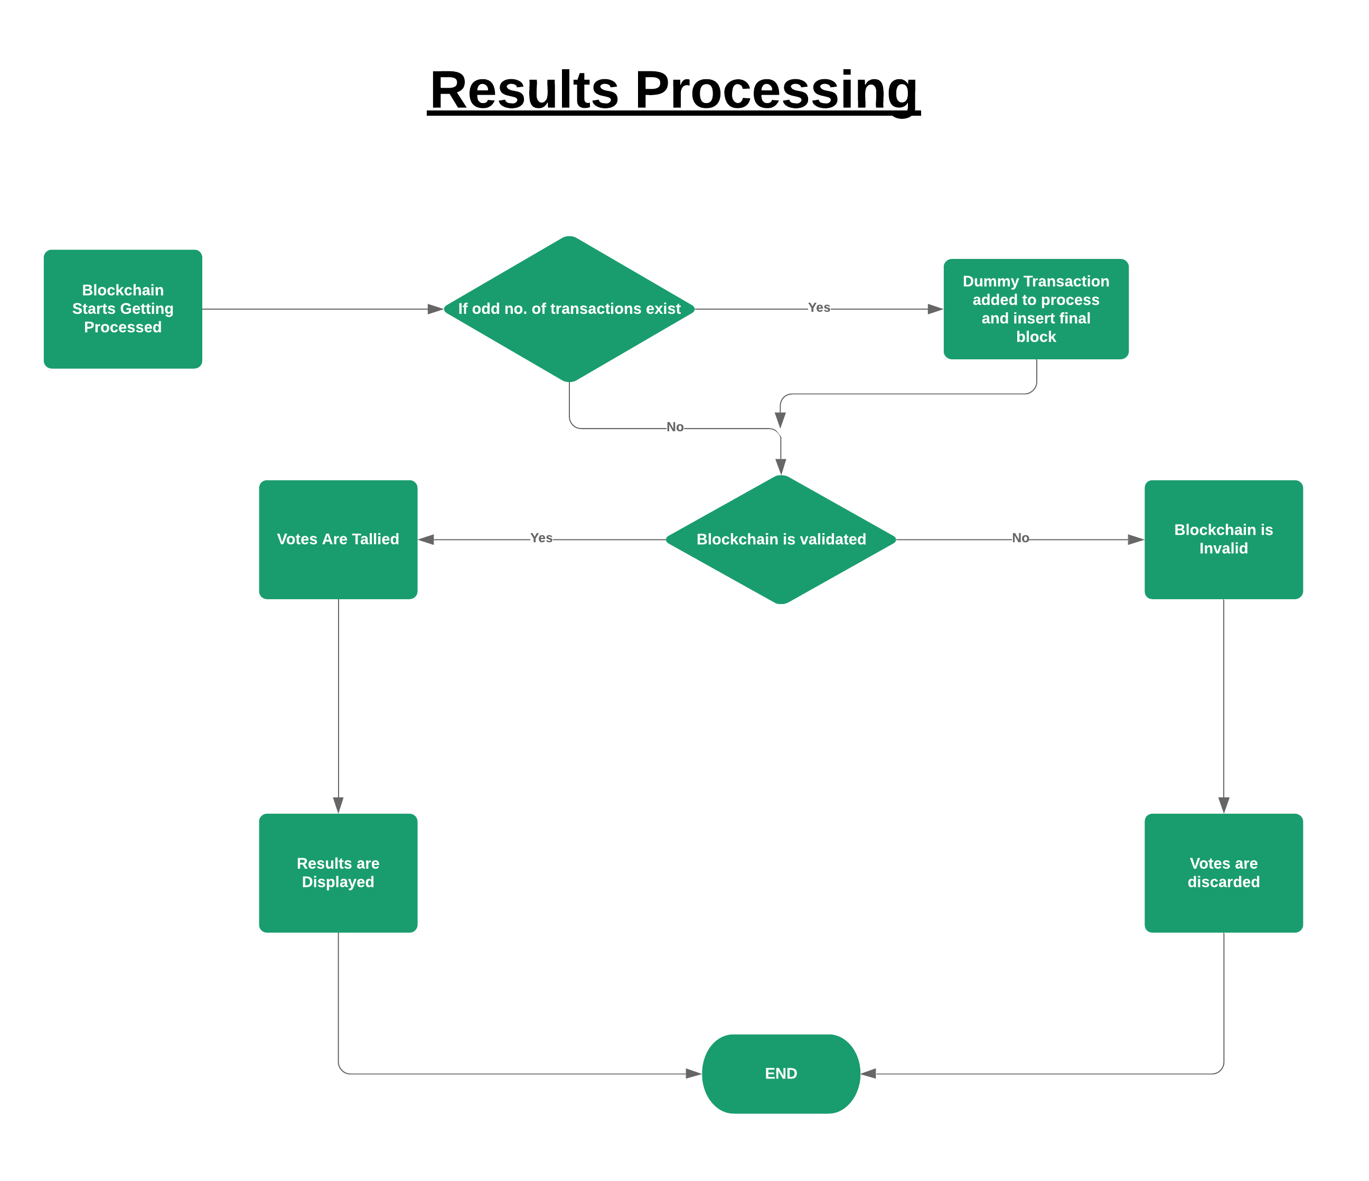

Slide 16
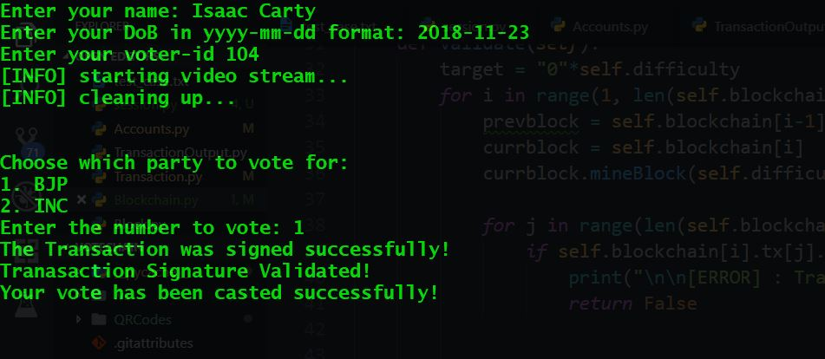
Successful Vote Cast

Slide 17
Successful Vote Cast

Slide 18
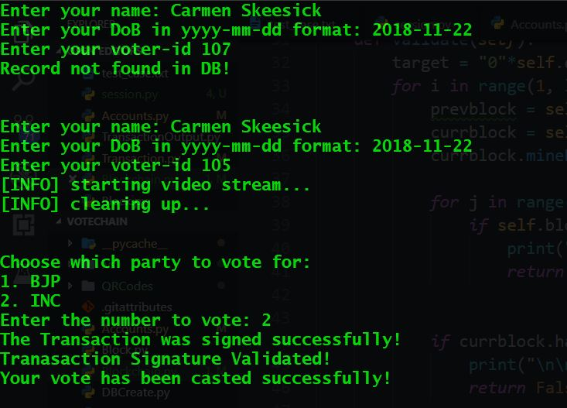
Wrong Credentials Entered

Slide 19
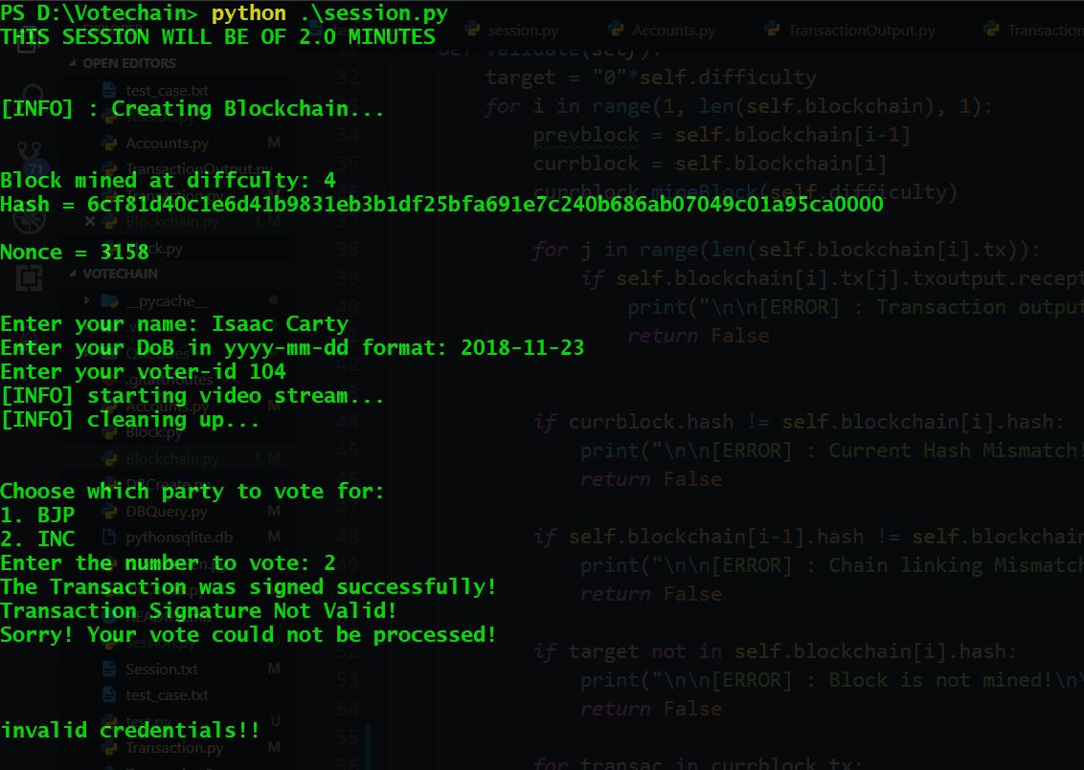
If Wrong QR code Provided

Slide 20
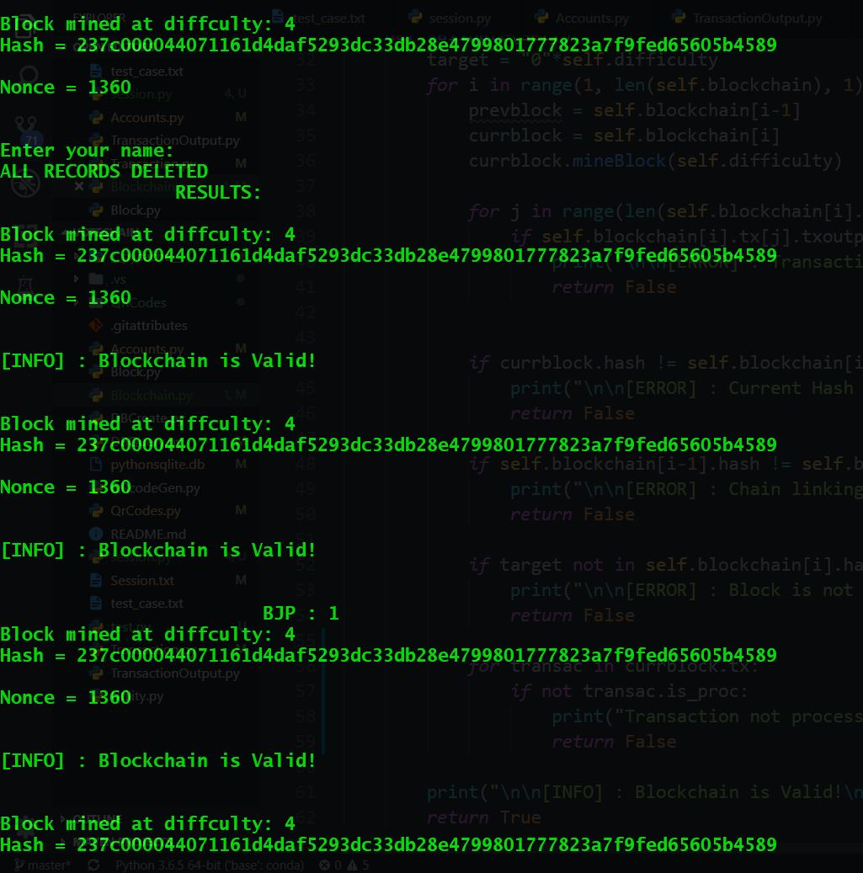
Final Vote Counting – part 1

Slide 21
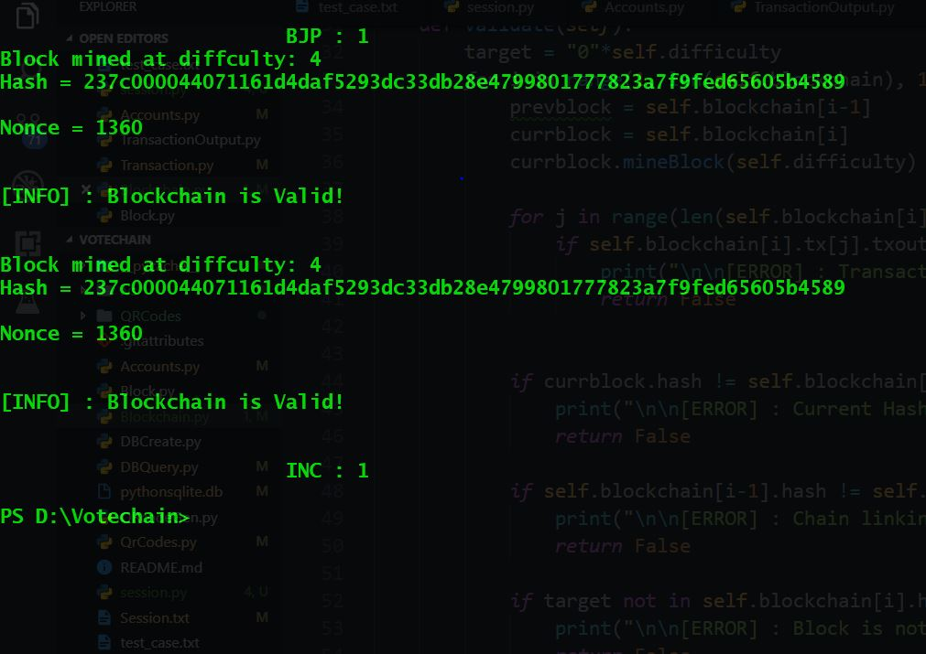
Final Vote Counting – part 2

Slide 22
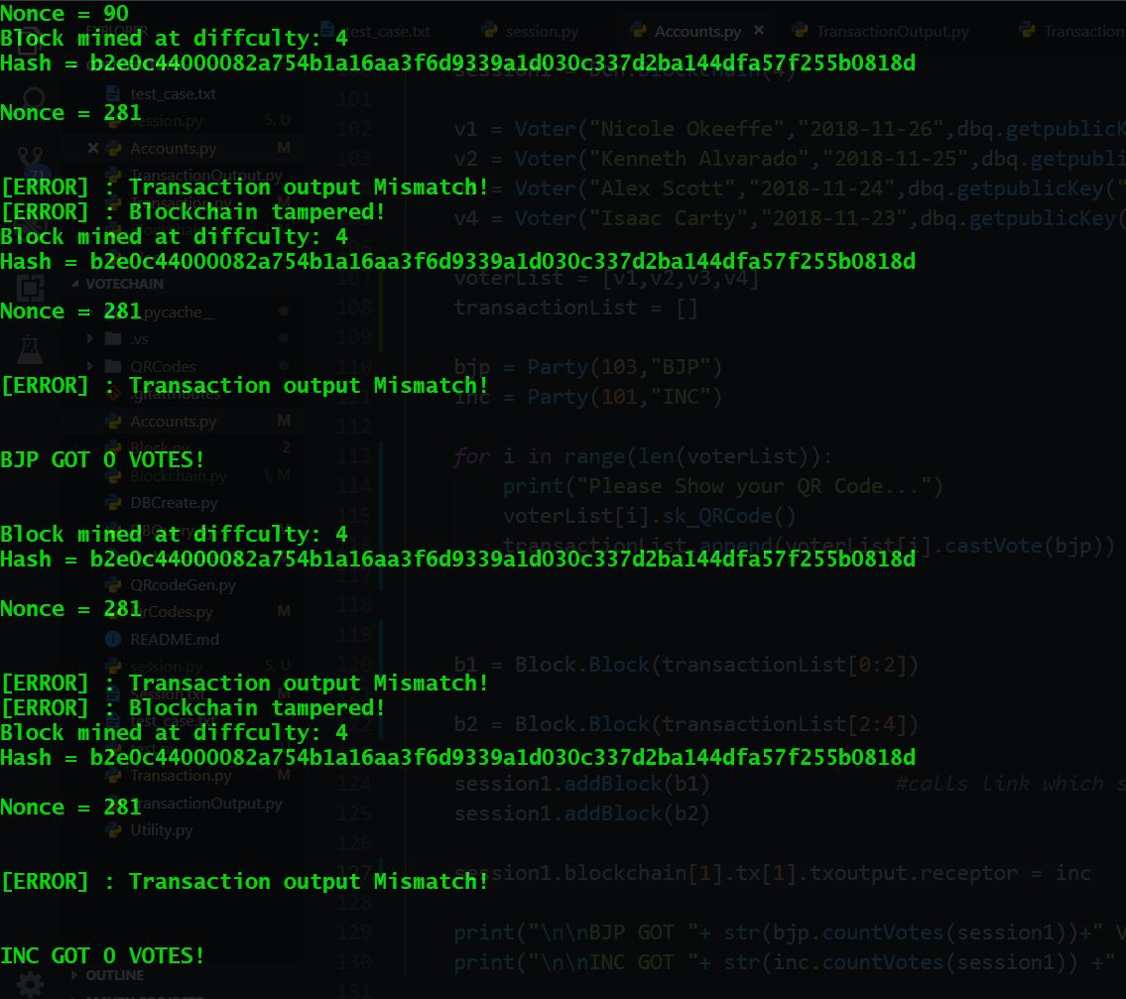
Attempted Tampering of Blockchain

Slide 23
Related projects
decentralized-blockchain-voting by fernandolobato
eos-voter by greymass :
eos-voter is a limited-functionality release of a light wallet being designed for the EOS blockchain. This application can be used to connect to a remote EOS API endpoint to perform producer voting actions and a few basic wallet commands.
BlockVotes by yfgeek :
An e-voting system based on blockchain using ring signature
e-voting by dsx-tech

Slide 24
Security Implementations and Improvements
The data inside the database is hashed and then stored so that none of the details are directly available to the central server hosting the mother database.
The mother database has Name, DoB and Voter ID. Each voting season is simulated by a “session” which copies the mother database, shuffles the database rows and then assigns the key pairs. This removes any pattern appearing in consecutive voting seasons thereby securing it.
Apart from this, the user is handed an encoded private key as QR Code, which is stored in a lookup table. Thereby forming two tables. In order for an attacker to authorize the vote he has to gain access to two different tables as each of them individually has no meaning.

Slide 25
Security Implementations and Improvements
Since the scope of this project lies to voting, it has been tailored/specialized for the purpose. This makes it extremely streamlined and easy to implement compared to other “generic” libraries present.
In other words, You can setup the voting session in about 5-10 lines of codes for finest settings or go for defaults and be ready in 3-6 lines. Thus, it offers better abstraction at the loss of generics.
The block validation requires each individual transaction to be valid, in the same state as processed, matching with the transaction Output in order to be validated adding few more levels of security.
Once a voter casts his vote he/she is removed from the “shuffled database” to make sure multiple voting by a person is not possible.

Slide 26
