Slide 1
Backtracking
Backtracking is an algorithmic technique for solving problems recursively by trying to build a solution incrementally, one piece at a time, removing those solutions that fail to satisfy the constraints of the problem at any point in time.
Backtracking can also be said as an improvement to the brute force approach. So basically, the idea behind the backtracking technique is that it searches for a solution to a problem among all the available options.
Initially, we start the backtracking from one possible option and if the problem is solved with that selected option then we return the solution else we backtrack and select another option from the remaining available options.

Slide 2
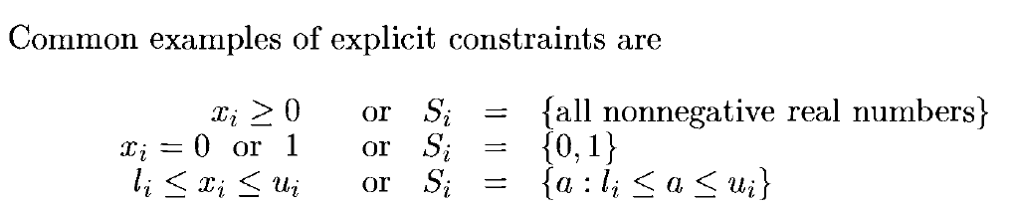
1.Explicit constraints are rules that restrict each Xi to take on values only from a given set.
2.The implicit constraints are rules that determine which of the tuples in the solution space of I satisfy the criterion function.
Thus Implicit constraints describe the way in which the Xi must relate to each other.

Slide 3
General method / backtracking algorithm
Step 1:
Return success if the current position is a feasible solution.
Step 2:
Otherwise, if all paths have been exhausted (i.e., the current position is an endpoint), return failure because there is no feasible solution.
Step 3:
If the current point is not an endpoint, backtrack and explore other points, then repeat the preceding steps.

Slide 4
Example of backtracking approach
N Queen Problem
Sum of subsets
Graph coloring
Hamiltonian Cycle

Slide 5
1. N Queen Problem
An N Queen problem is example of backtracking, here we need to place n queens on a n*n chess board so that no two queens are in attack position , i.,e no two queens are on the same row, column or diagonal.
Lets solve the 4 Queen problem
We need to place 4 queens Q1, Q2, Q3, Q4 in 4*4 box
The time complexity is O(n^2)

Slide 6
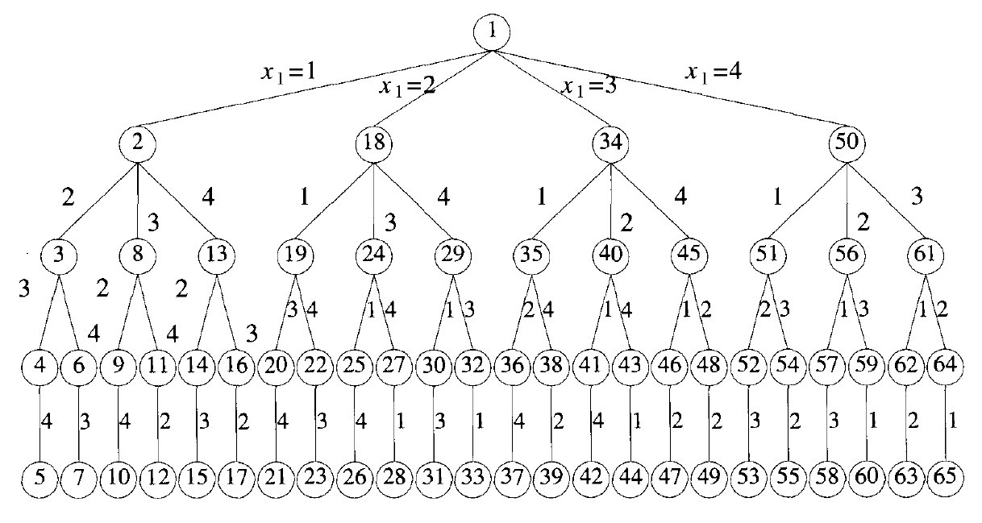
Tree organization of the 4-queens solution space. Nodes are
Numbered as in depth first search

Slide 7
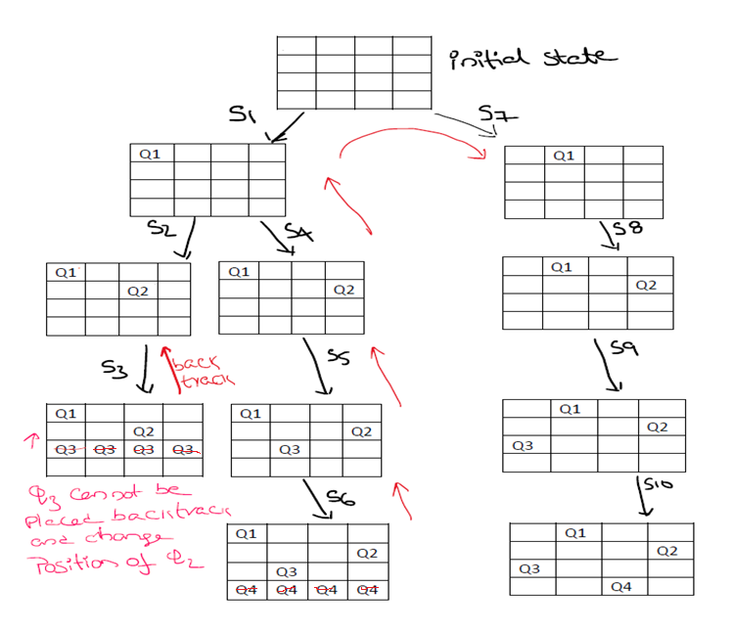
Example of a backtrack solution to the 4-queens problem

Slide 8
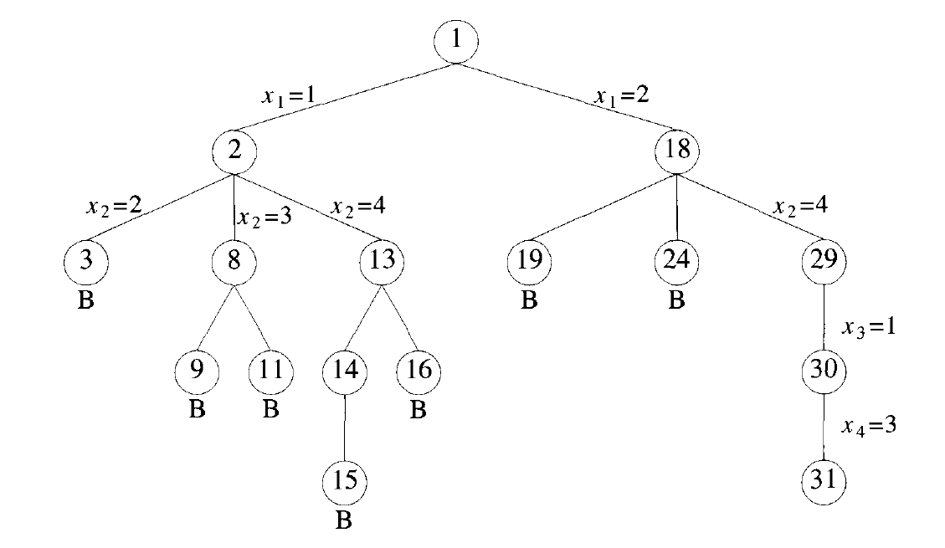
Portion of the tree of above Figure that is generated during backtracking
Solution for 4 queens problem is(2,4,1,3)
and another solution is(3,1,4,2)

Slide 9
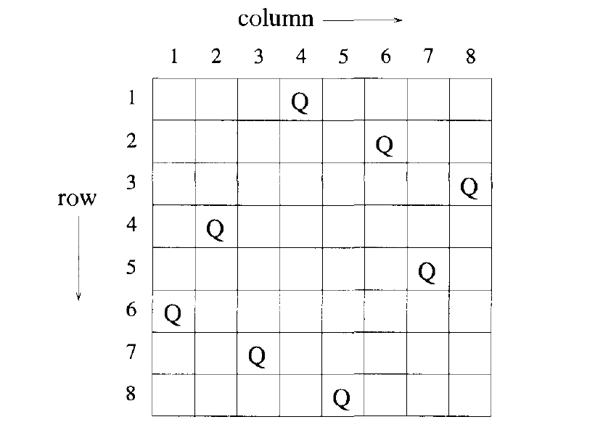
One solution to the 8-queens problem

Slide 10
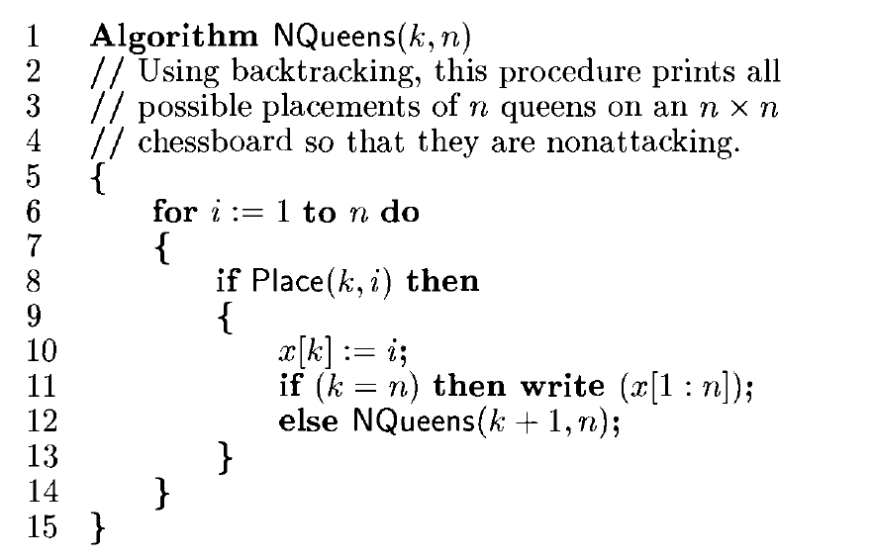

Slide 11
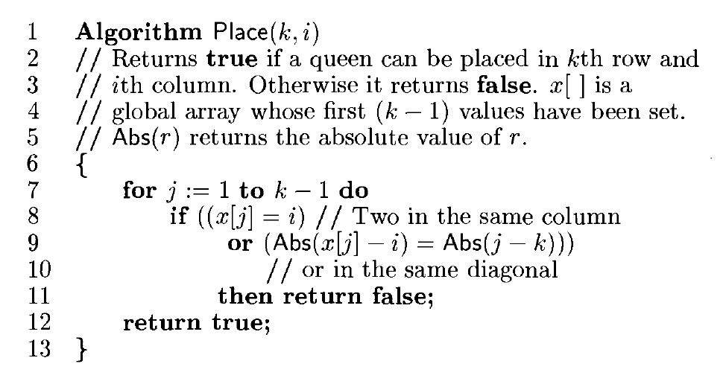

Slide 12
2. Sum Of Sub Sets
The problem is to find a sum of subset from given elements, such that the sum of elements is equal to a given number ‘M’.
Here backtracking approach is used to find a valid subset.
If adding an element is not feasible, we will backtrack to get the previous subset and add other elements to get the solution.
Subset Sum problem using a backtracking approach which will take O(2^N) time complexity

Slide 13
Algorithm Sum of Sub sets
1. Start with an empty set
2. Add an element from the list to the set
3. If the subset is having sum M, then stop with that subset as solution.
4. If the subset is not feasible(subset sum > M) or if we have reached the end of the set, then backtrack through the subset until we find the most suitable value.
5. If the subset is feasible (sum of subset < M) then go to step 2.
6. If we have visited all the elements without finding a suitable subset and if no backtracking is possible then stop without solution.

Slide 14
Consider the sum-of-subset problem, n = 4, Sum = 31, and w1 = 11, w2 = 13, w3 = 24 and w4 = 7. Find a solution to the problem using backtracking. Show the state-space tree leading to the solution.
Sol :
Given Elements = { 11,13,24,7}
Required sum = 31
State space tree
The state space tree is drawn such At level i, the left branch corresponds to the inclusion of number wi and the right branch corresponds to exclusion of number wi.

Slide 15
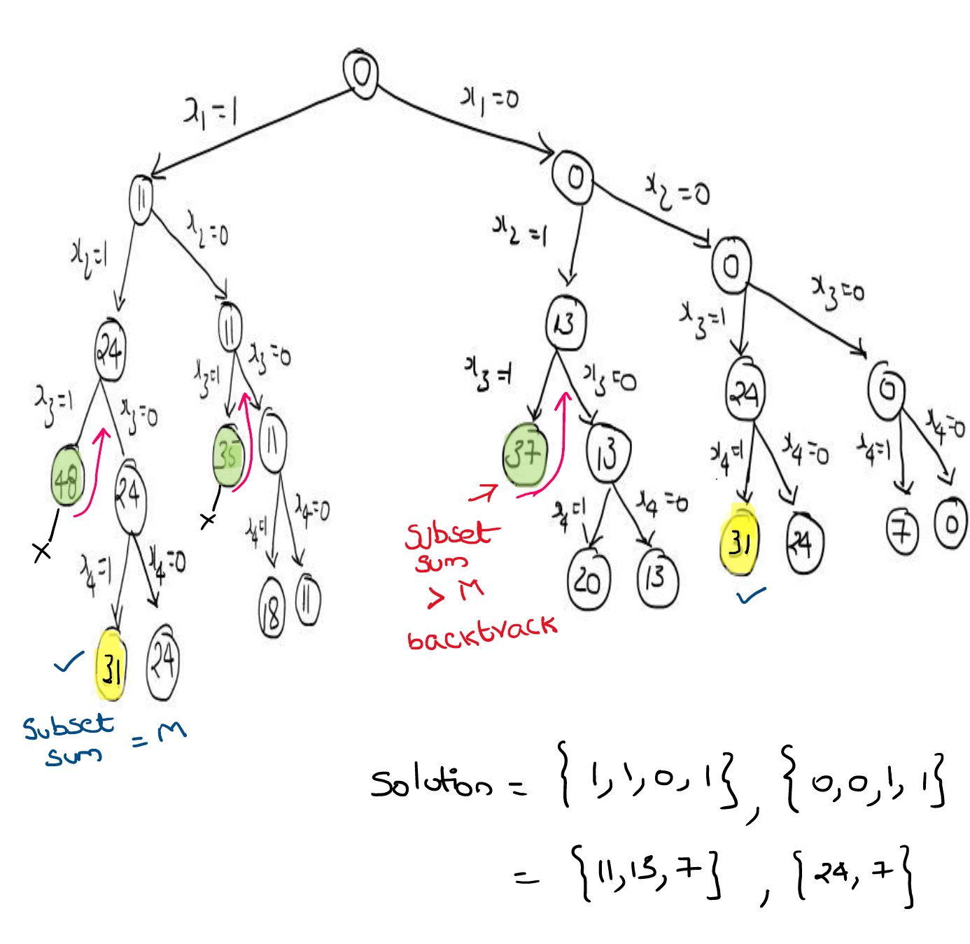
{ 11,13,24,7}
31

Slide 16
3. Graph coloring
Graph coloring is the procedure of assignment of colors to each vertex of a graph G such that no adjacent vertices get same color.
Method to Color a Graph
Different colors:
Confirm whether it is valid to color the current vertex with the current color (by checking whether any of its adjacent vertices are colored with the same color).
If yes then color it and otherwise try a different color.
Check if all vertices are colored or not.
If not then move to the next adjacent uncolored vertex.
If no other color is available then backtrack (i.e. un-color last colored vertex).
Time Complexity: There is a total of O(m^{V}) combinations of colors.

Slide 17
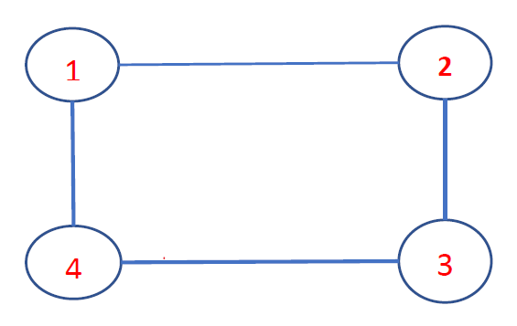
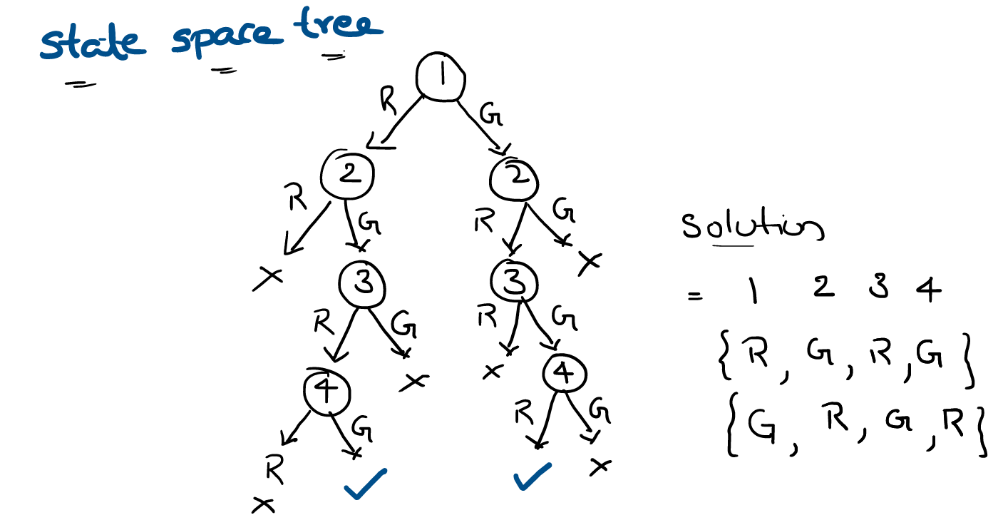
1.Draw the State space tree for following graph, where colors ={R, G}
2.Draw the State space tree for following graph, where colors ={R,G,B}

Slide 18
4. Hamiltonian cycle
Hamiltonian Path in an undirected graph is a path that visits each vertex exactly once. A Hamiltonian cycle (or Hamiltonian circuit) is a Hamiltonian Path such that there is an edge (in the graph) from the last vertex to the first vertex of the Hamiltonian Path. Determine whether a given graph contains Hamiltonian Cycle or not. If it contains, then prints the path.
the time taken to solve the Hamiltonian path problem is mathematically found to be O(N² 2^{N})

Slide 19
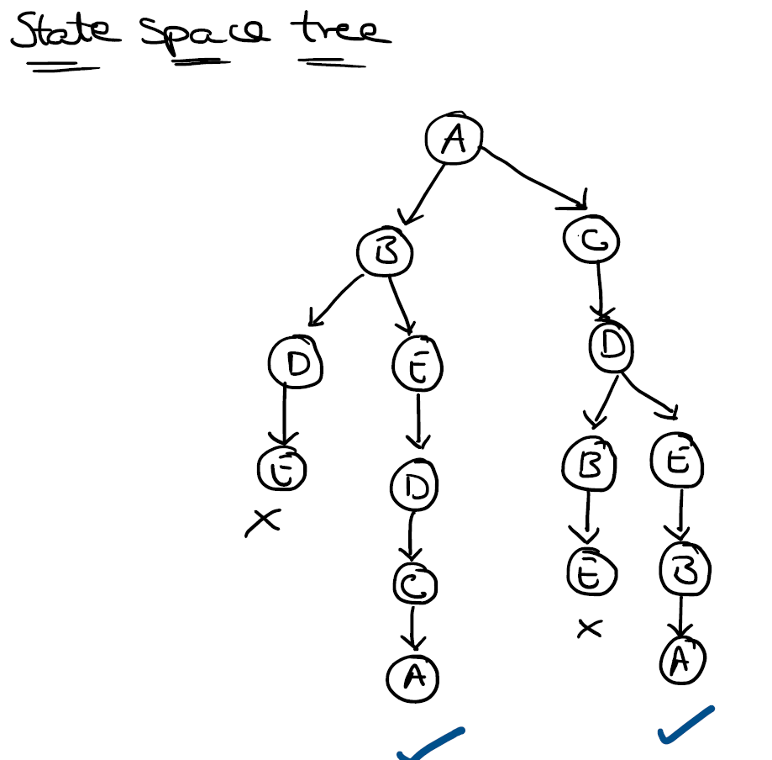
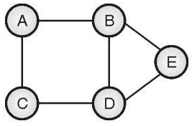
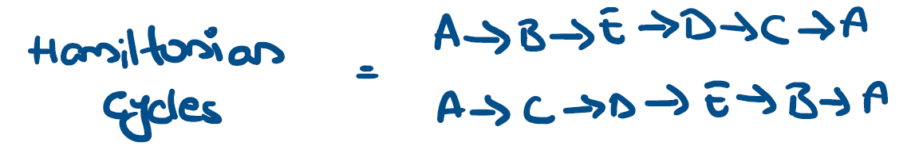
Example : Find the Hamiltonian cycle in following graph and draw the space tree

Slide 20
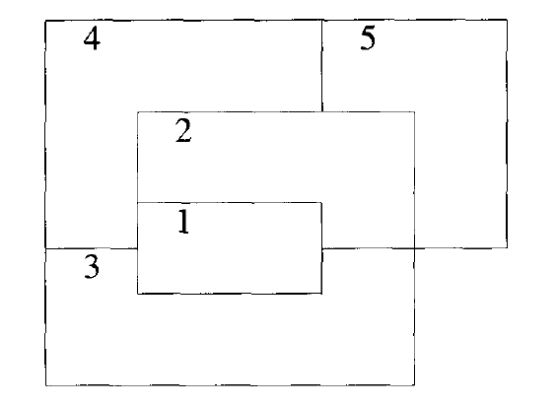
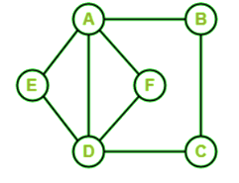
1.Let w = {57, 10,12,15,18,20},m=35.Find all possible subsets of w that sum to m. Do this using SumOfSub.Draw the portion of the state space tree that is generated.
2.Draw the State space tree for following graph, where colors ={R,G,B}
3.In the following graph, we have 6 nodes. Now we have to determine whether this graph is a Hamiltonian graph.

