Slide 1

IILM UNIVERSITY, GREATER NOIDA
School of Computer Science and Engineering
AICTE–EduSkills Virtual Internship
Data Science Master Program | Supported by Siemens
Student Name:
Raj Srivastava
Enrollment Number:
25SCS1003001198
Program & Semester:
B.Tech CSE — 3rd Semester, Section 2CSE2
Organization:
EduSkills Foundation (AICTE) — Siemens Industry Software
June – August 2026

Slide 2
Agenda
1
About the Organizations
5
Week-wise Methodology
2
Problem Statement & Objectives
6
Certifications Earned
3
Scope, Technologies & Tools
7
Expected Outcomes & Grade
4
System Architecture
8
Key Learnings & Conclusion
Data Science Master Virtual Internship | Raj Srivastava
02

Slide 3
About the Organizations
AICTE
National Internship Portal
EduSkills Foundation
Statutory body under the Ministry of Education, Government of India, overseeing technical education.
Government initiative connecting students to verified, structured internships.
ISO-certified skilling partner that designed and delivered this virtual internship program.
Siemens Industry Software
RapidMiner (Altair)
Industry partner supporting the Data Science Master curriculum.
Enterprise data science platform used for all hands-on labs and certification exams.
Data Science Master Virtual Internship | Raj Srivastava
03

Slide 4
Problem Statement & Objectives
Organizations generate vast raw data but often lack in-house skills to convert it into actionable insight — the internship was built around solving exactly this, end to end.
Key Objectives
▸ Identify business problems suited to AI/ML
▸ Access, clean & transform raw data
▸ Build classification, regression & clustering models
▸ Apply advanced automation & scripting
▸ Deploy & monitor models in production-like settings
▸ Administer an enterprise AI platform (AI Hub)
Data Science Master Virtual Internship | Raj Srivastava
04

Slide 5
Scope, Technologies & Tools
Scope
Technologies & Tools
Complete data-science workflow across 8 weeks and 4 competency areas — Applications & Use Cases, Data Engineering, Machine Learning, and Platform Administration — each at Professional and Master levels, within the RapidMiner ecosystem.
RapidMiner Studio
RapidMiner AI Hub
RapidMiner Radoop
Regex, Macros & Web APIs
R & Python integration
Cross-validation & tuning
Data Science Master Virtual Internship | Raj Srivastava
05

Slide 6
System Architecture
Data Layer
Processing Layer
Modelling Layer
Deployment Layer
Administration Layer
Ingestion from files, databases & Web APIs
→
Cleansing, transformation & feature engineering
→
Training, validation & parameter optimization
→
Web services & real-time scoring via AI Hub
→
Users, marketplace & enterprise operations
A layered pipeline mirroring a real enterprise data-science stack, taught progressively across the 8-week program.
Data Science Master Virtual Internship | Raj Srivastava
06

Slide 7
Week-wise Methodology
1
Applications & Use Cases – Professional
2
Data Engineering – Professional
3
Machine Learning – Professional
4
Data Preparation – Master
5
Machine Learning – Master
6
Applications & Use Cases – Master
7
Platform Administration – Master
8
Platform Administration – Master + Final Assessment
Data Science Master Virtual Internship | Raj Srivastava
07

Slide 8
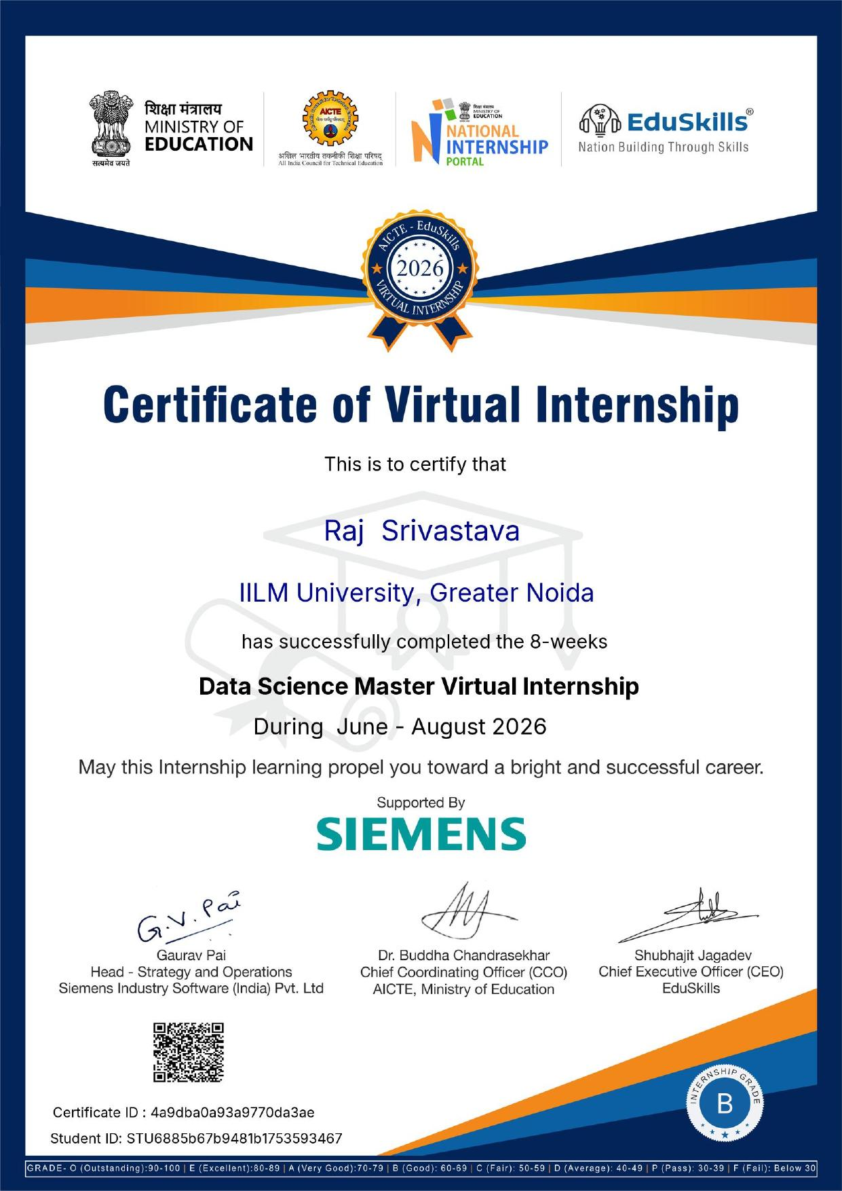
Certifications Earned
7 RapidMiner certifications across Professional & Master levels
Applications & Use Cases
Data Engineering
Machine Learning
Data Engineering
Machine Learning
Applications & Use Cases
Platform Administration
Professional
Professional
Professional
Master
Master
Master
Master
Overall Internship Grade: B (Good, 60–69)
Data Science Master Virtual Internship | Raj Srivastava
08

Slide 9
Expected Outcomes
8-week AICTE–EduSkills internship completed successfully with an overall Grade B
✓
End-to-end working proficiency across the data science lifecycle
✓
Seven verifiable, industry-recognised RapidMiner credentials
✓
Stronger employability through demonstrable, real-world skills
✓
A solid foundation for applying data science in future academic & personal projects
✓
Data Science Master Virtual Internship | Raj Srivastava
09

Slide 10
Key Learnings & Conclusion
This internship strengthened my understanding of the full data science lifecycle — from framing a business problem to deploying and administering a live model. Working within the RapidMiner ecosystem gave me hands-on exposure to industry-grade tooling well beyond classroom theory, and the structured, assessment-driven format built both technical depth and confidence.
Thank You
Raj Srivastava | B.Tech CSE, 3rd Semester | IILM University, Greater Noida

