Slide 1
Linux Memory Allocator
SLOB and usage
-Raj Jhala(121042)

Slide 2
What is SLOB?
SLOB was developed since 2003 by Matt Mackall.
The SLOB (Simple List Of Blocks) allocator is one of three available memory allocators in the Linux kernel.

Slide 3
How SLOB works?
Each SLOB page is broken into individual chunks, which are referred to as blocks (as mentioned in mm/slob.c).
The blocks are referenced from singly linked list within each page.
Approach used in SLOB to reduce the fragmentation is to place all objects within three distinctive lists of different sizes.
Allocation Algorithm used is a first fit.

Slide 4
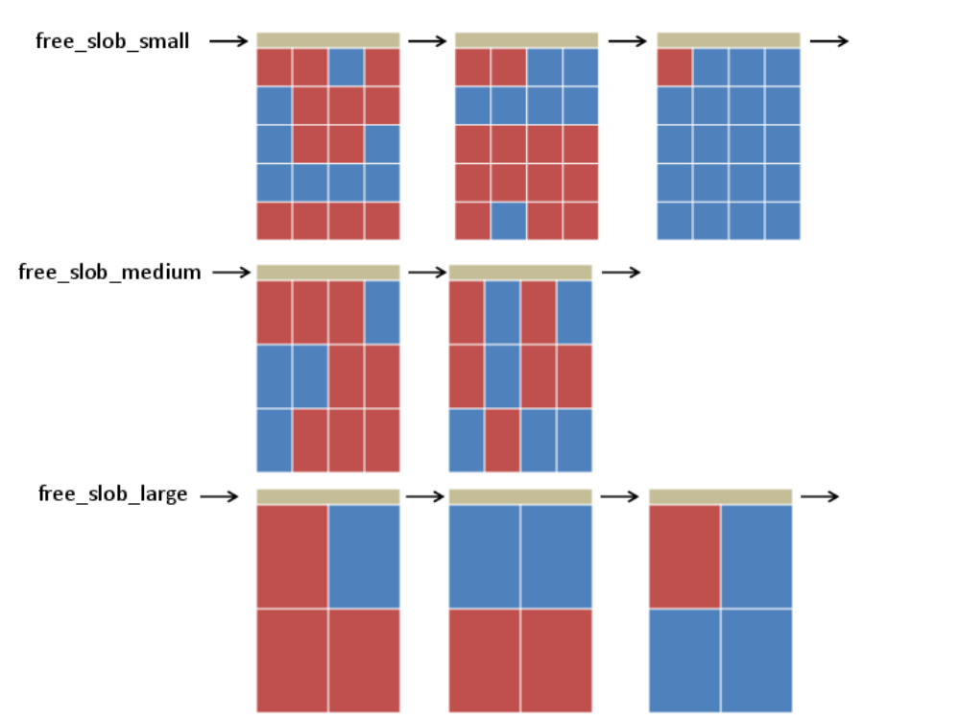
Three list of different sizes like :-
  Less than 256 bytes
  Less than 1024 bytes
  Less than 4096 bytes

Slide 5
Usage
Primarily used Embedded systems(low memory footprint)
-> Embedded Gentoo
->OpenEmbedded
->OpenWrt
->Commercial Embedded devices

Slide 6
Drawback
A major limitation of the SLOB allocator is the high degree to which it suffers from internal fragmentation.
SLOB’s high fragmentation rate is the fact that it uses a simple first-fit algorithm for memory allocation.

Slide 7
References
http://www.vsecurity.com/download/papers/slob-exploitation.pdf
http://phrack.org/issues/66/15.html
http://vulnfactory.org/research/slob.pdf
http://en.wikipedia.org/wiki/SLOB

