Slide 1



HEALTH CARE AND LIFE SCIENCES Portable Braille
PRAGYAN HARDWARE HACKATHON
Victorious Visionaries
Guided by
Spider R&D Club

Slide 2
Aim
The aim of this project is to make a Portable Braille system as an assistive reading device to solve the problem of unavailability of many of the books and texts in Braille script.

Slide 3
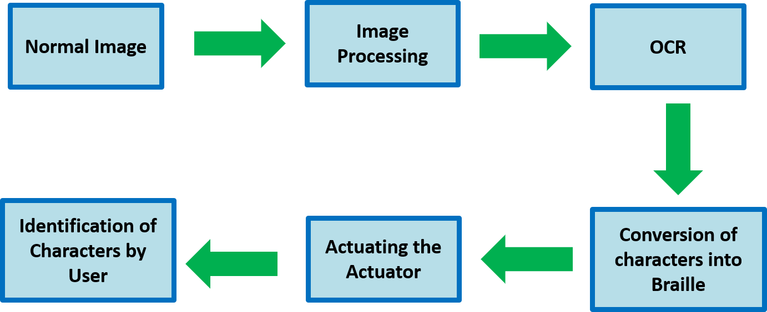
Block Diagram

Slide 4
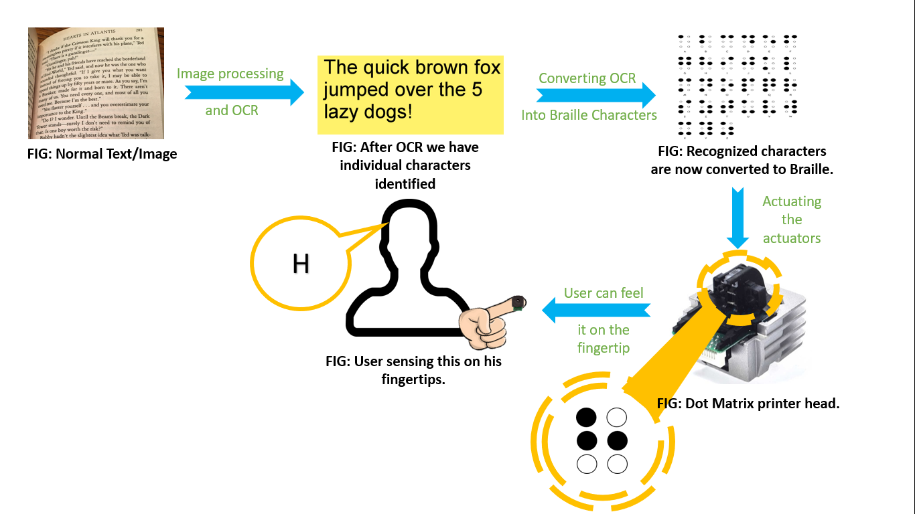
Block Diagram

Slide 5
Why not text to speech?
https://www.theguardian.com/society/2012/feb/14/technology-brings-braille-back-apple
”Learning or reading using Braille – rather than audio – has distinct advantages” say educators.
A survey conducted by Louisiana Tech University's Professional Development and Research Institute on Blindness found that people with sight disabilities who learn to read through Braille have a much higher chance of finding a job.
"Literacy is the foundation for having a job and living an independent life. For reading every day, you cannot just rely on speech.“ says Dr Peichun Yung, a postdoctoral research associate at the electrical and computer engineering department of North Carolina State University.

Slide 6
Why not text to speech?
https://sandysview1.wordpress.com/2016/11/22/commentary-is-braille-still-important/
“To me, inquiring if Braille is necessary is like asking if print is still important. For people who are blind, knowing Braille is the equivalent of knowing to read and write print by someone with sight.” says Sandy.
“What’s most important, it teaches us to spell and the rules of grammar and punctuation. It would be difficult at the very least to learn all of this by simply listening to audio materials.”
In this digital era when many of the books are available in the form of audiobooks, most of the people still prefer to read from printed text material. Same is the case with blind people.

Slide 7
Applications & Impacts
According to the statistics of NCBI(National Centre for Biotechnology Information) of India, there are around 15000 blind schools in the country with about 200,000 blind students. This portable system has a direct impact on them by giving access to all the texts a normal student could get.

Slide 8
Applications & Impacts
A major part of the blind population fall under the age category of senior citizens. These people use Braille for leisure activities, which makes it more difficult for them to get the Braille form of texts they need, like daily newspapers.

Slide 9
Applications & Impacts
According to a Forbes article, the number of books available in Braille is well under 1% of the total literature. According to the website a Braille reader costs around $3000- $15000(₹2,00,000 - ₹10,00,000) which is way too costlier than this portable reader.(₹6000/-)

Slide 10
Progress of Project
Implementation done till now:
Applying perspective transform to get the required part of the image.
Application of OCR algorithm in the transformed image to get output in string format.
Software part of Grade 1 Braille.
Software part of Grade 2 Braille.
(grade 2 still in progress)

Slide 11
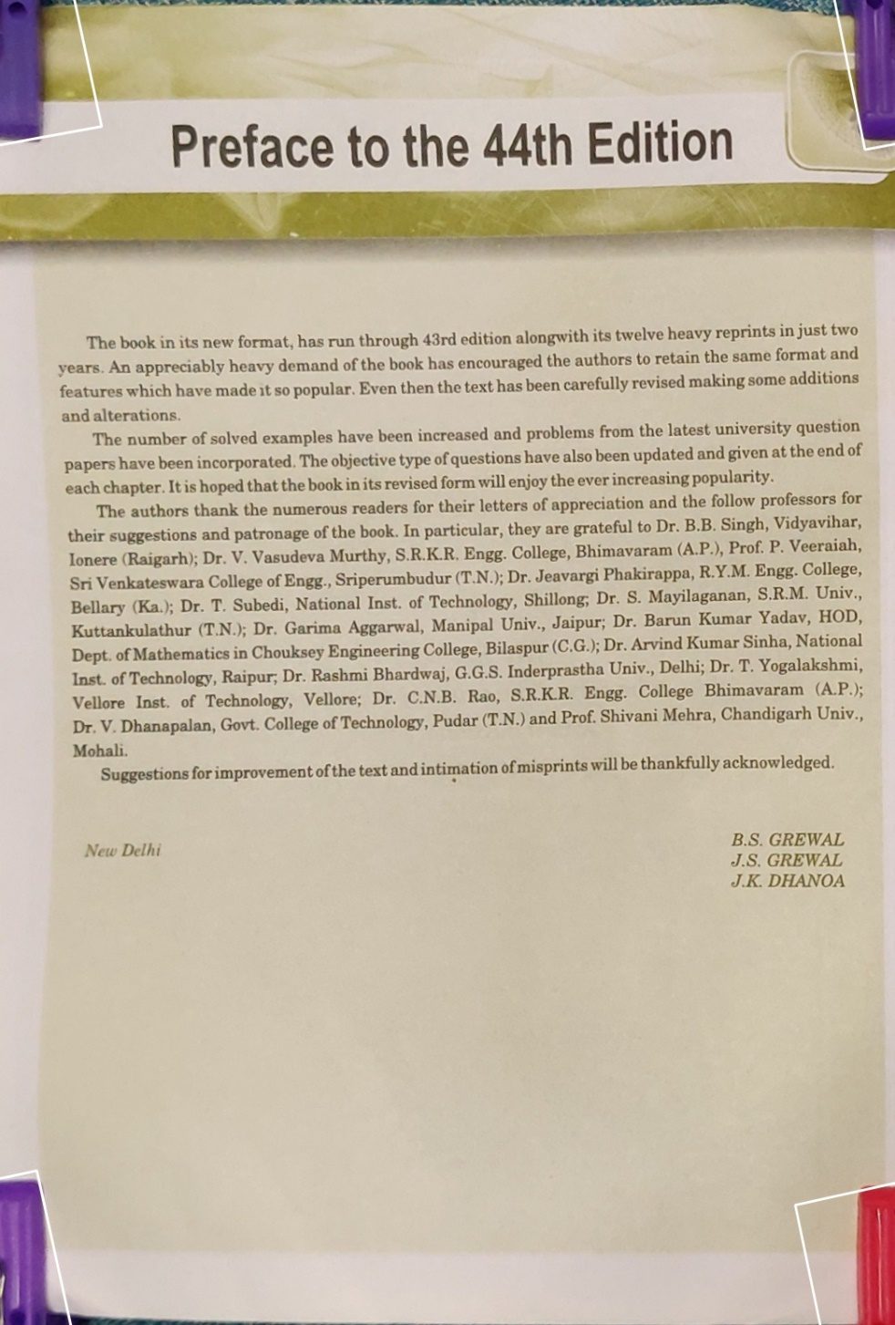
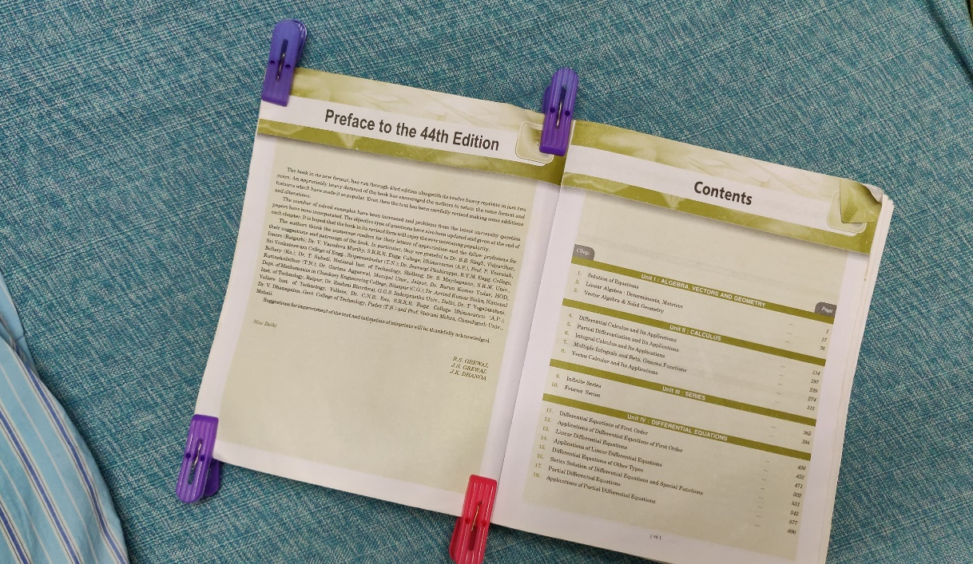
Perspective Transform of the captured image to get the required area (using four clips)

Slide 12

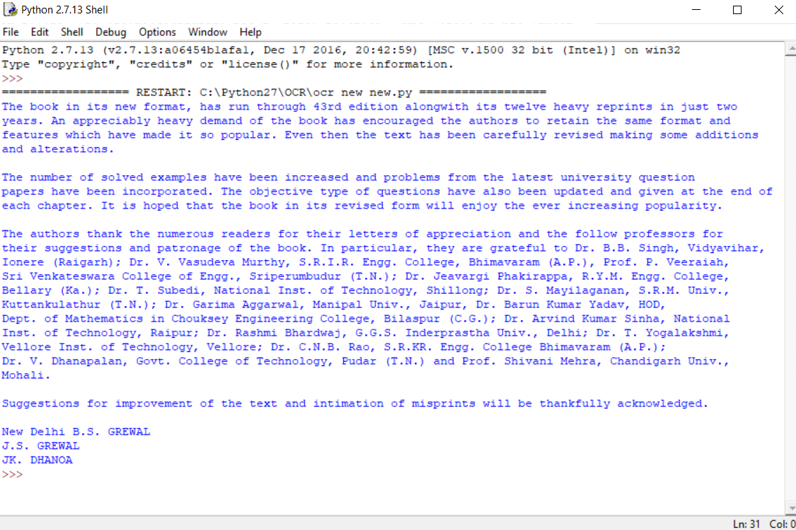
Applying OCR algorithm to the transformed image to get output in string format

Slide 13
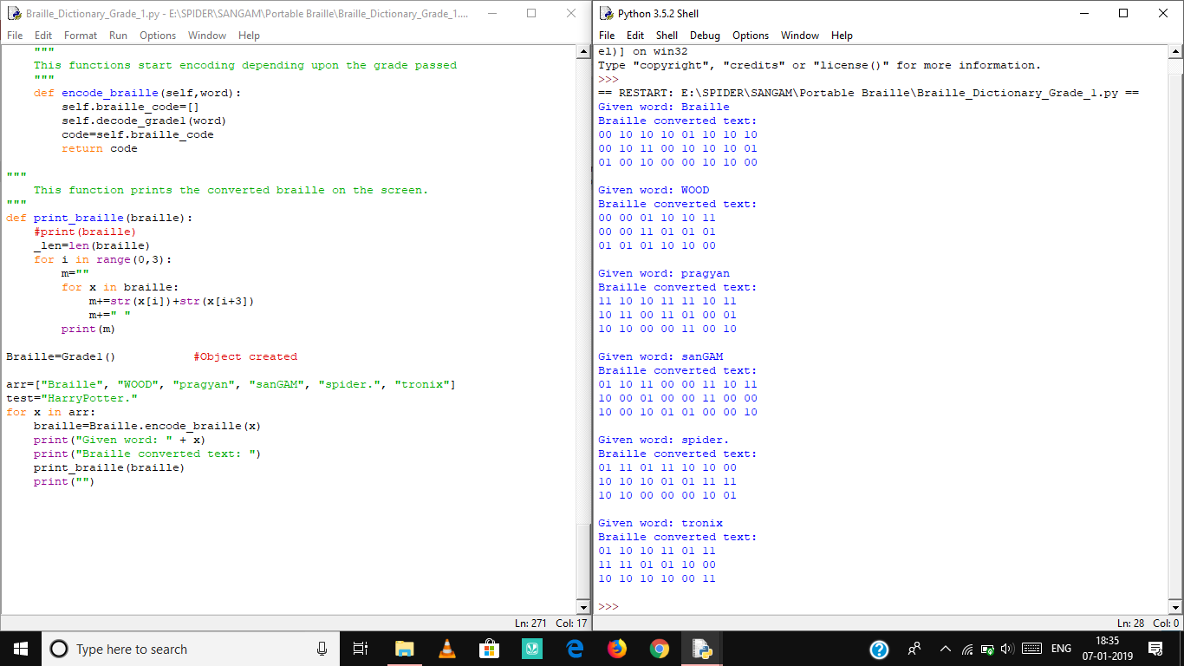
Software Part for Grade 1 Braille

Slide 14
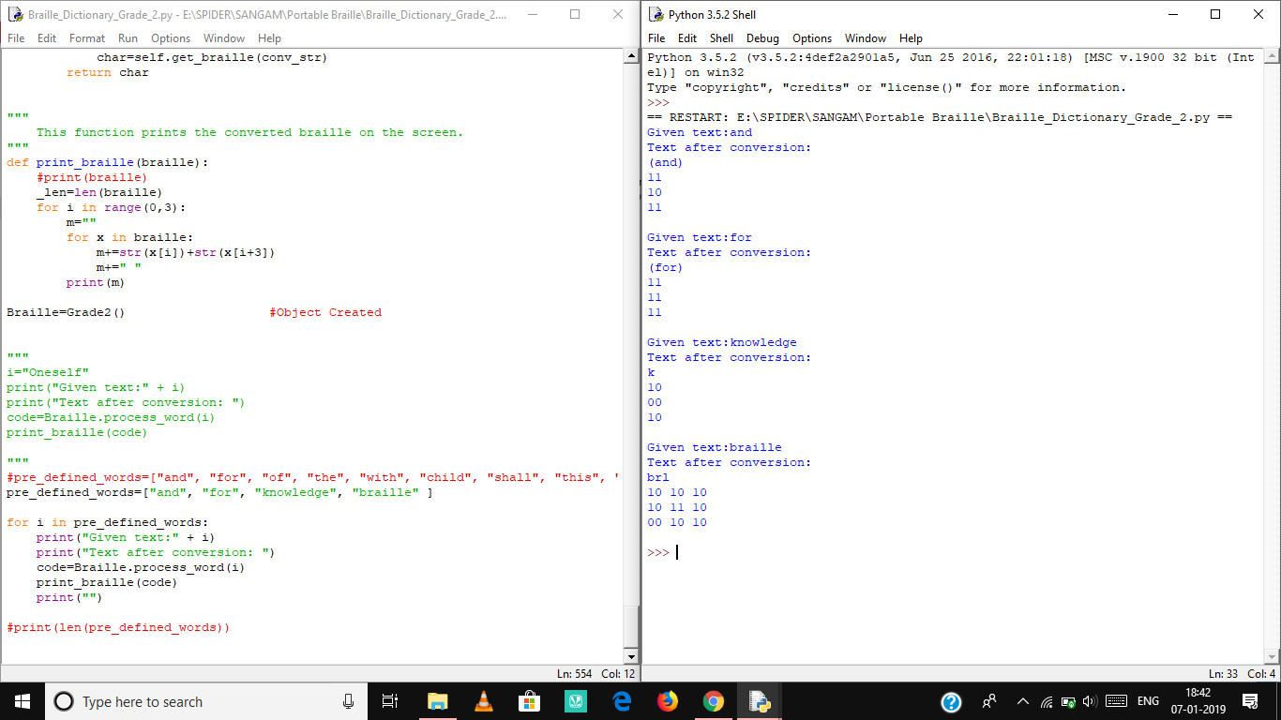
Software Part for Grade 2 Braille

Slide 15


