Slide 1
Group 2 EDA Project
Client : Nicole Johnson

Slide 2
Group 2 EDA Project : Client details
Client name : Nicole Johnson
Client type : Buyer
Client characteristics : Lively, central neighborhood, middle price range, right timing for purchase of property
Goal : To identify right properties to satisfy client requirements
EDA : explore the data and identify patterns which influence the requirements
Filtered features based on requirements

Slide 3
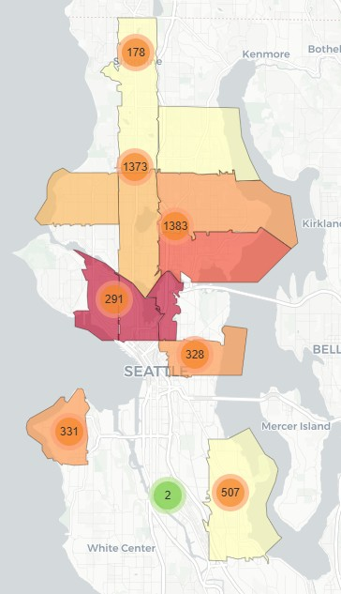
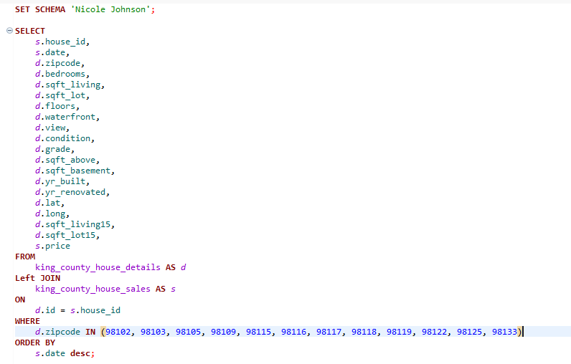
Group 2 EDA Project : filtering the data
SQL activity : Filtration of required data from the raw data
Zip codes were filtered based on the client
requirements : Lively & central neighborhood
Prices and purchase timing wasn’t filtered as the
distribution of prices and time is not easily
fetchable in SQL
property_price_map.html
Filtered features based on requirements

Slide 4
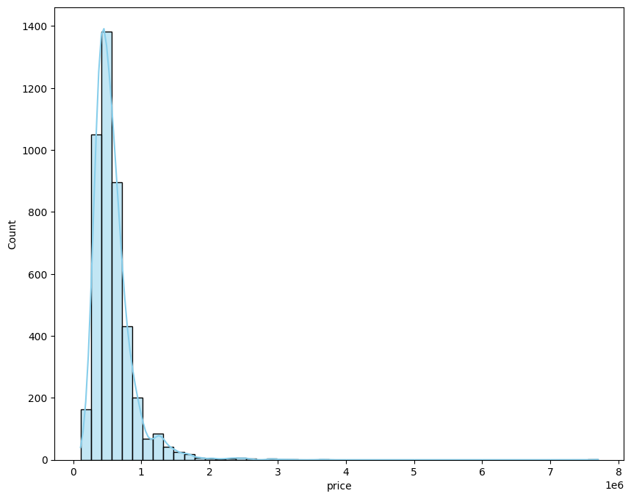
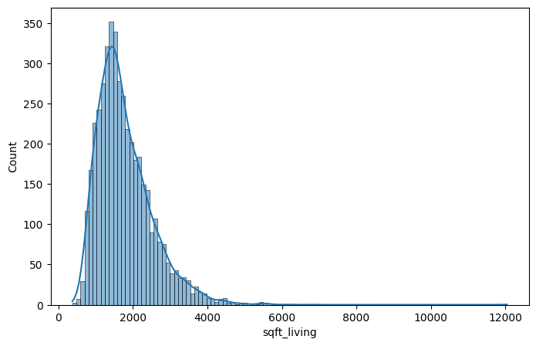
Group 2 EDA Project : EDA
Distribution of prices : right skewed
Most properties are around $ 0.7 million
Distribution of living area (sqft) : right skewed
majority around 1800 sqft

Slide 5
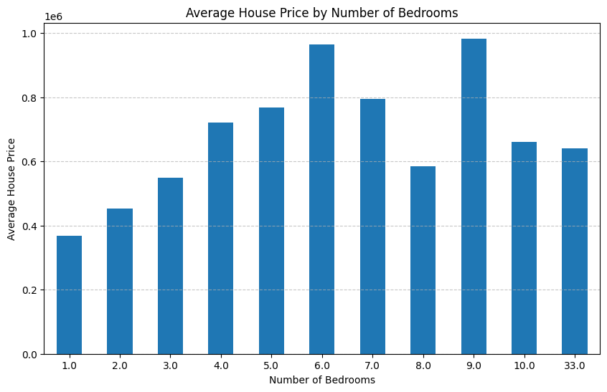
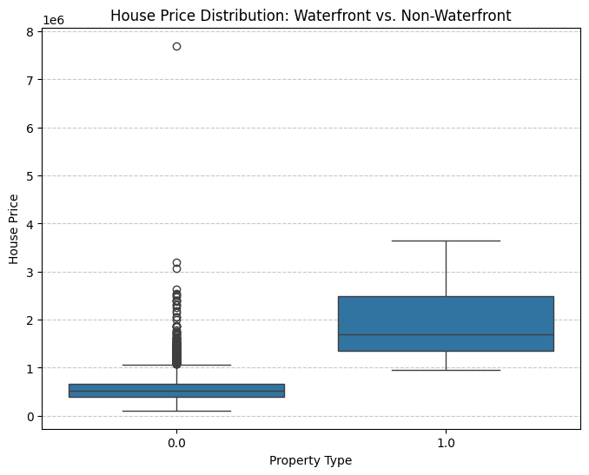
Group 2 EDA Project : Bivariate Analysis
The trend shows an increase in house price with
increase in number of bedrooms
Waterfront view : min. client budget ~ $ 1M

Slide 6
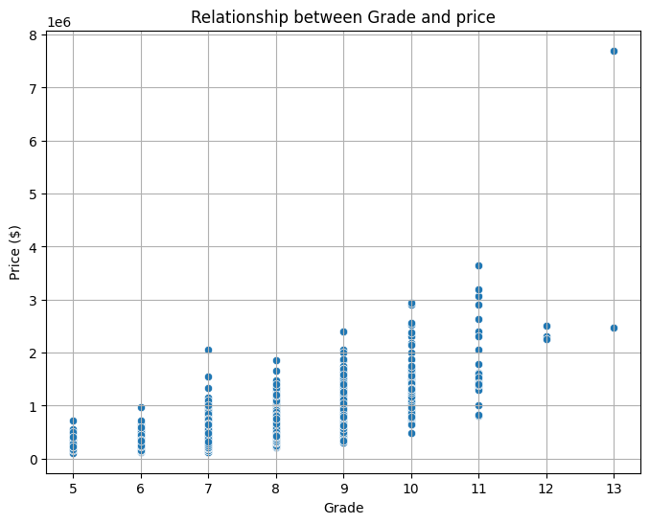
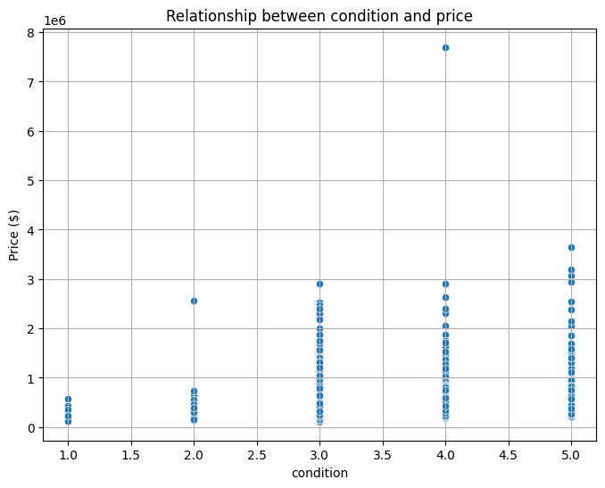
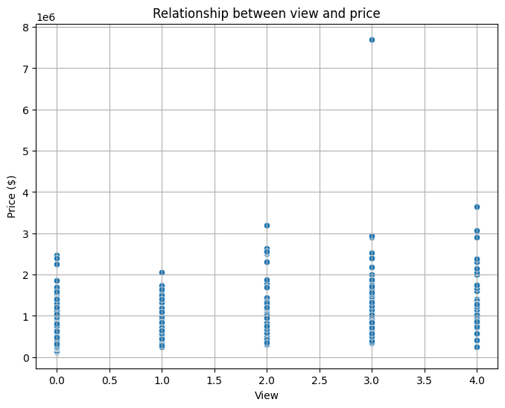
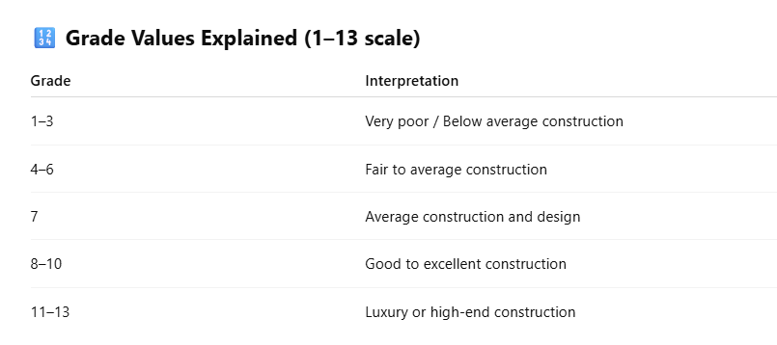
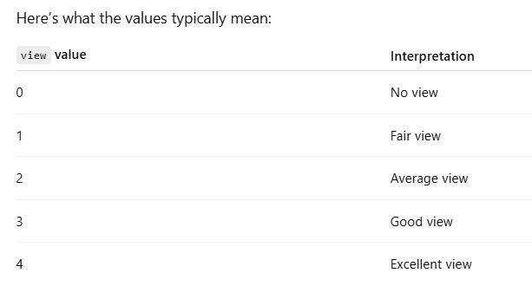
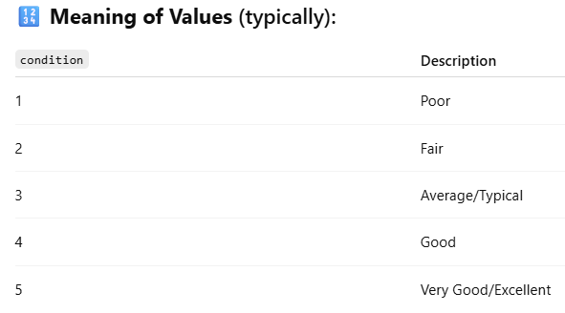
Group 2 EDA Project : Price vs Grade, Condition & View
Decent grade >7 : with prices < $ 1M
Condition > 3 : with prices < $ 1M
view > 2 : with prices < $ 1M

