Slide 1
Group 2 EDA Project
Client : Nicole Johnson

Slide 2

Group 2 EDA Project : Client persona
Client details:
Name : Nicole Johnson
Type : Buyer
Characteristics : Lively, central neighborhood, middle price range, right timing for purchase of property
Goal (why) : To identify right properties to satisfy client requirements
Tool (How) : using phyton data visualization techniques & SQL
EDA (what) : explore the data and identify features which
influence the requirements
Seattle

Slide 3
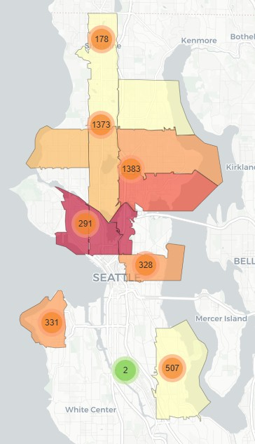
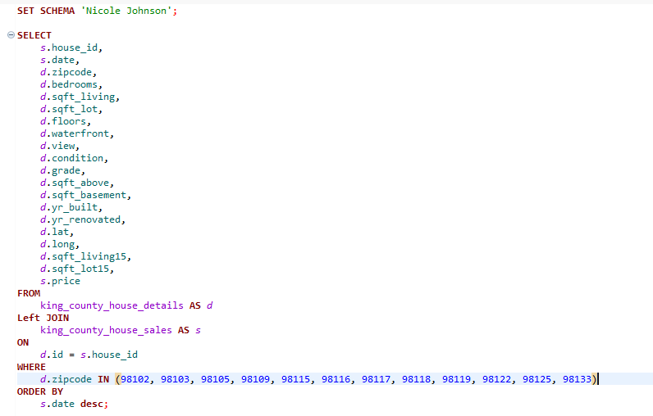
Group 2 EDA Project : Filtering the required data
SQL activity : Filtration of required data from the raw data
Zip codes were filtered based on the client
requirements : Lively & central neighborhood
Prices and purchase timing wasn’t filtered as the
distribution of prices and time is not easily
fetchable in SQL
property_price_map.html
Filtered features based on requirements

Slide 4
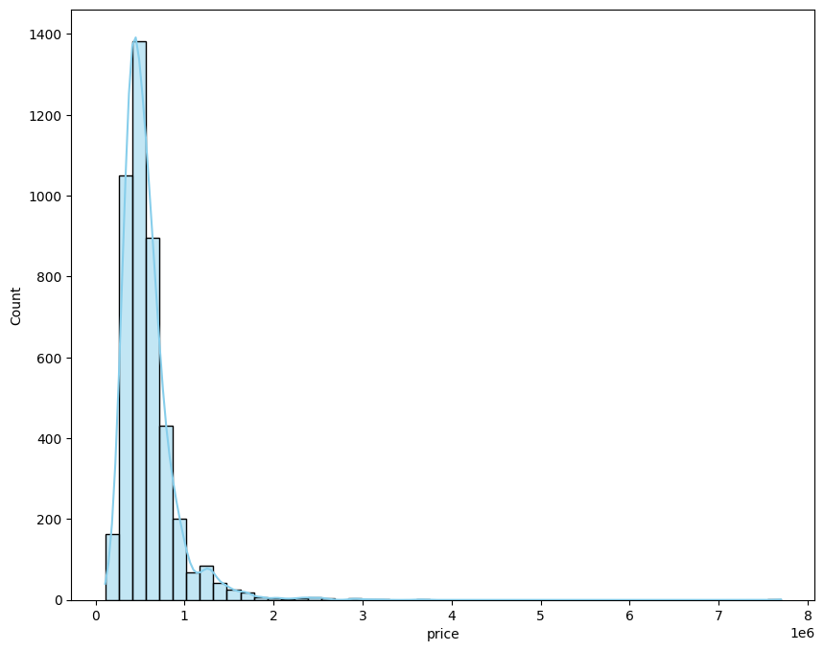
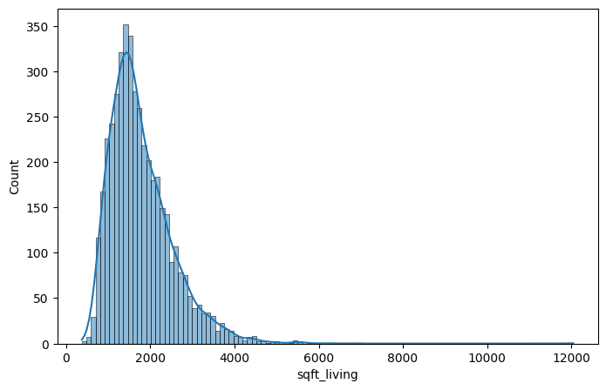
Group 2 EDA Project : Univariate Analysis
Distribution of prices : right skewed
Most properties are around $ 0.7 million
Distribution of living area (sqft) : right skewed
majority around 1800 sqft

Slide 5
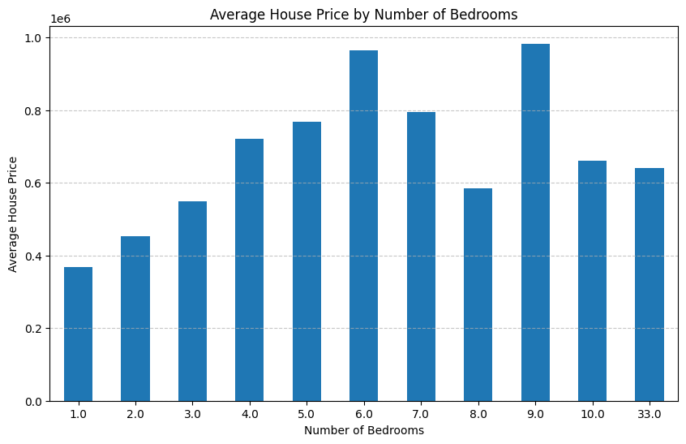
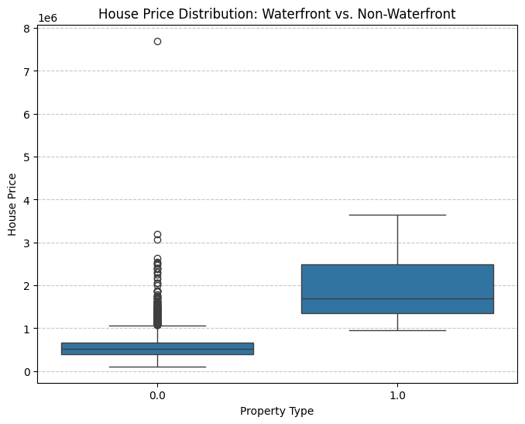
Group 2 EDA Project : Bivariate Analysis
The trend shows an increase in house price with
increase in number of bedrooms
Waterfront view : min. client budget ~ $ 1M

Slide 6
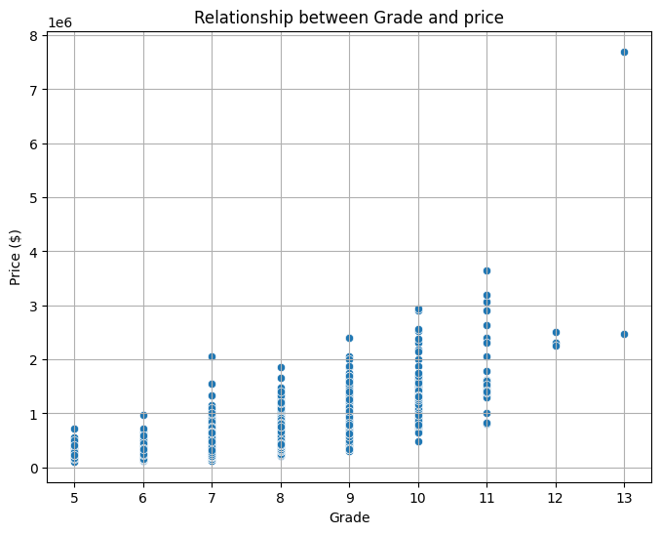
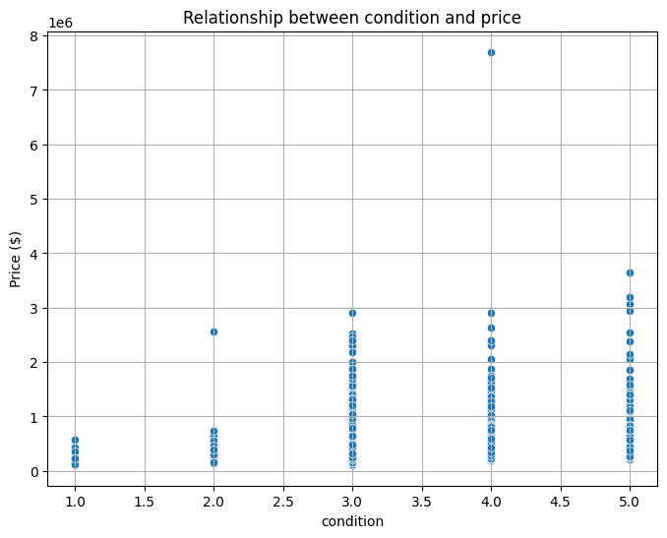
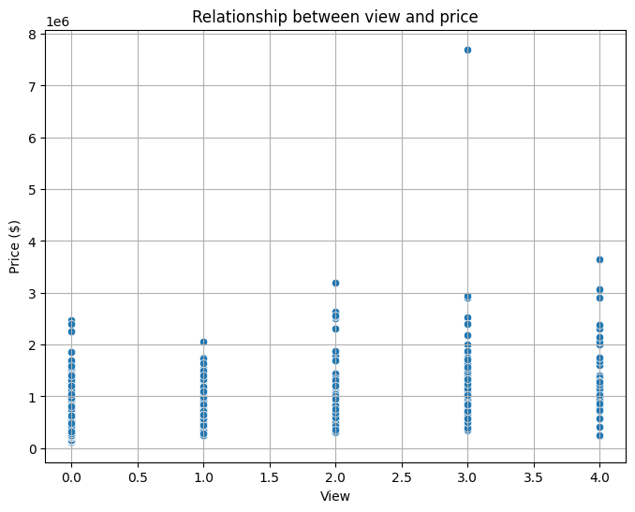
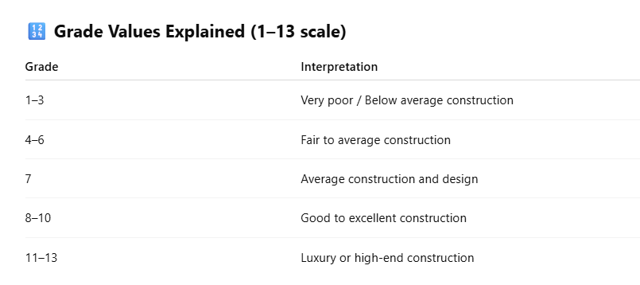
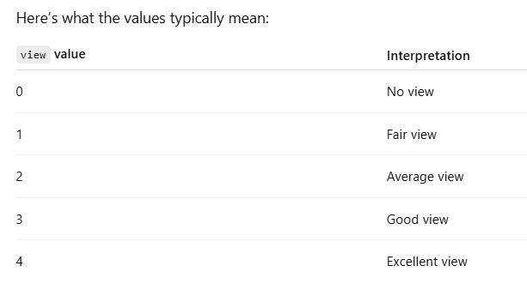
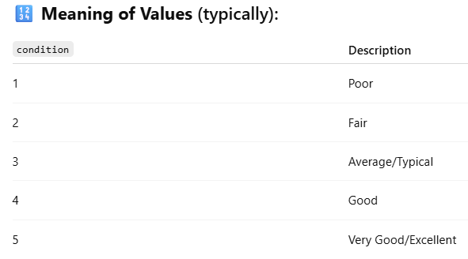
Group 2 EDA Project : Price vs Grade, Condition & View
Decent grade >7 : with prices < $ 0.5 M
Condition > 3 : with prices < $ 0.5 M
view > 3 : with prices < $ 0.5M

Slide 7
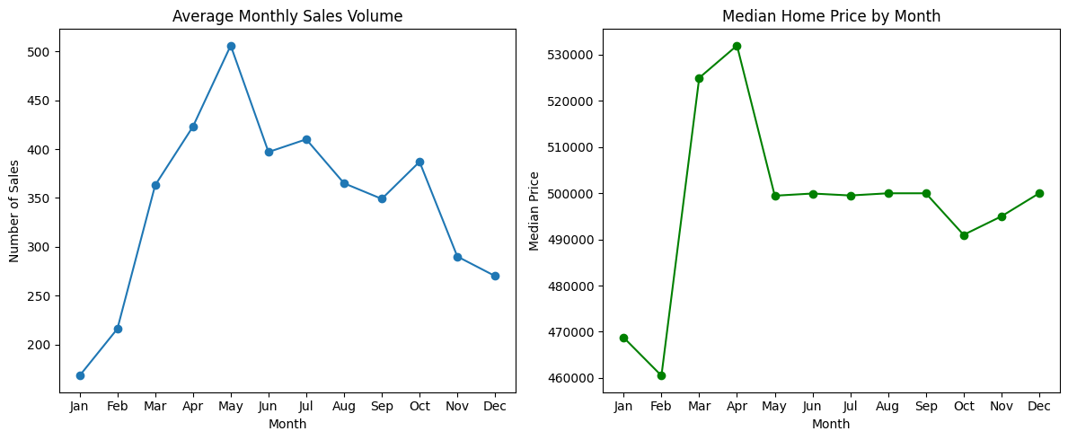
Group 2 EDA Project : Market time for buyer & seller
Market Time
Seller : March – June
Buyer : November - February

Slide 8
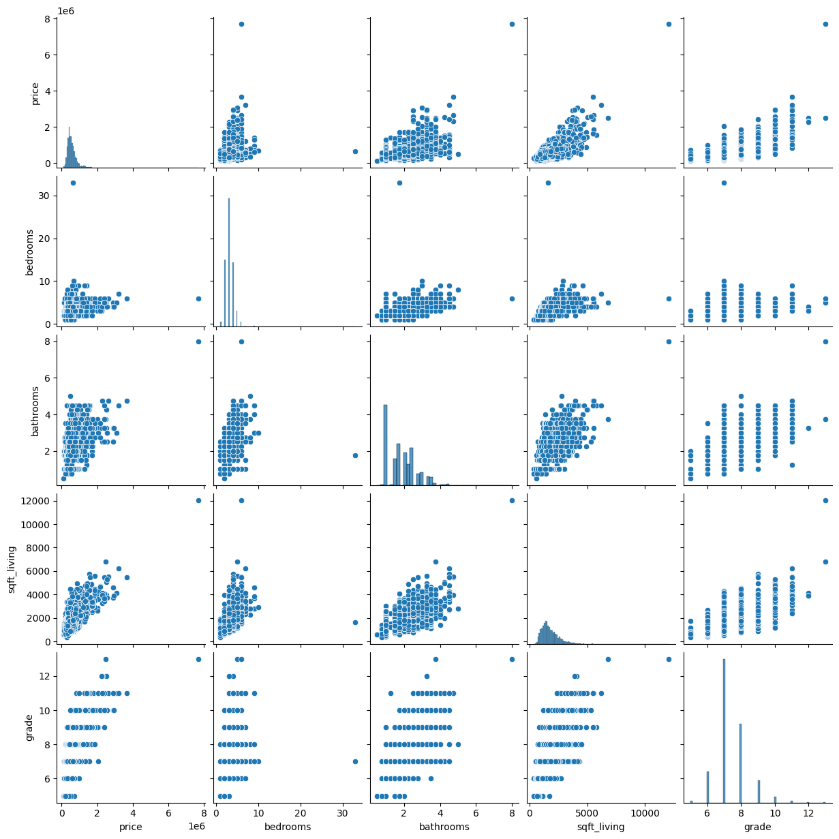
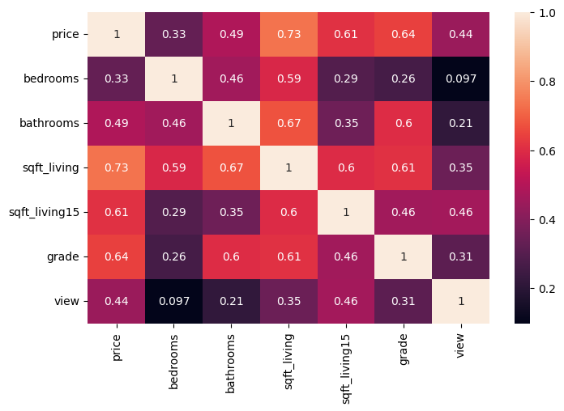
Group 2 EDA Project : Multivariate analysis
r= 0.33
r= 0.49
r= 0.73
r= 0.61
Price influencing features :
Sqft_living
No. of bedrooms & bathrooms
Grade

Slide 9
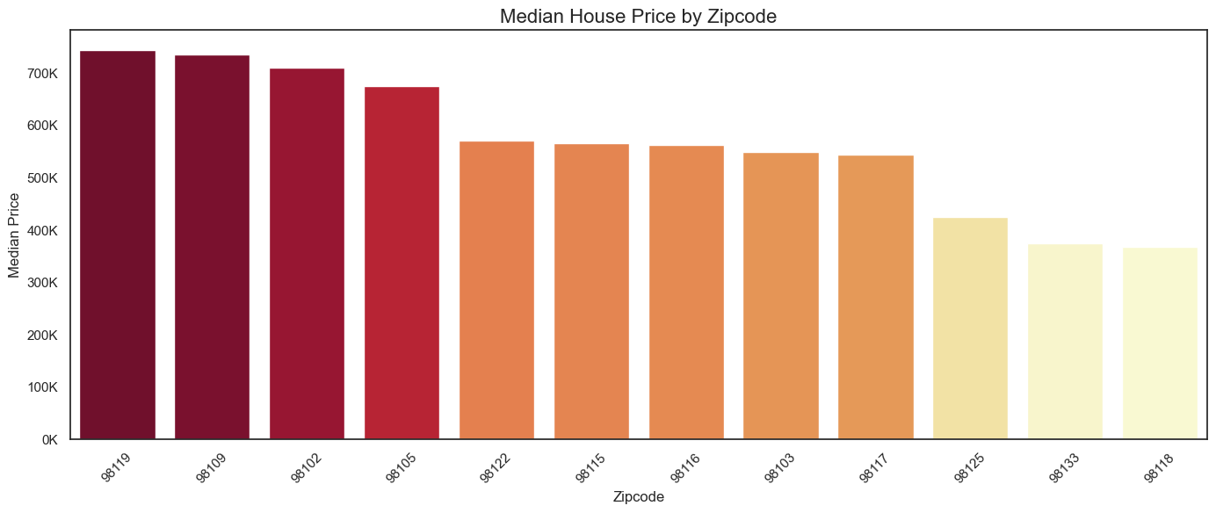
Group 2 EDA Project : House prices across zipcodes
Price differences across zipcodes of up to $300K

Slide 10
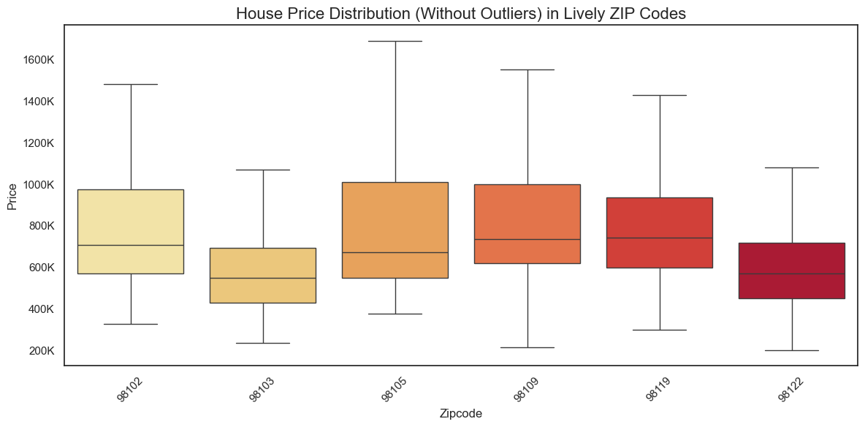
Group 2 EDA Project : House price distribution in lively areas
Dispersion varies greatly by location
→ Use only IQR-range to focus on middle price range

Slide 11
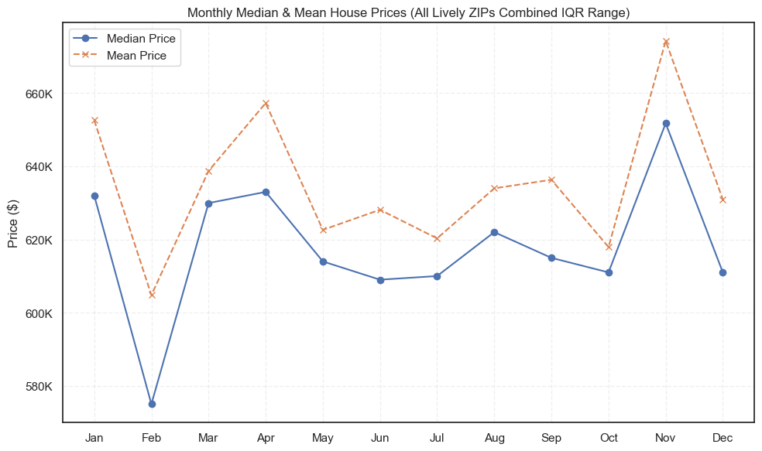
Group 2 EDA Project : House prices over the time
Since the price distribution is right skewed the mean value > median value over the time

Slide 12
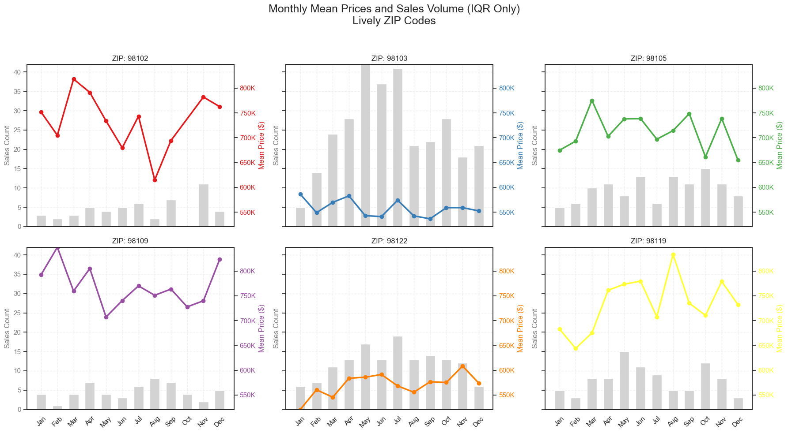
Group 2 EDA Project : sales over the time at zipcodes
Price development and market activity (number of transactions) also different within zipcodes

Slide 13
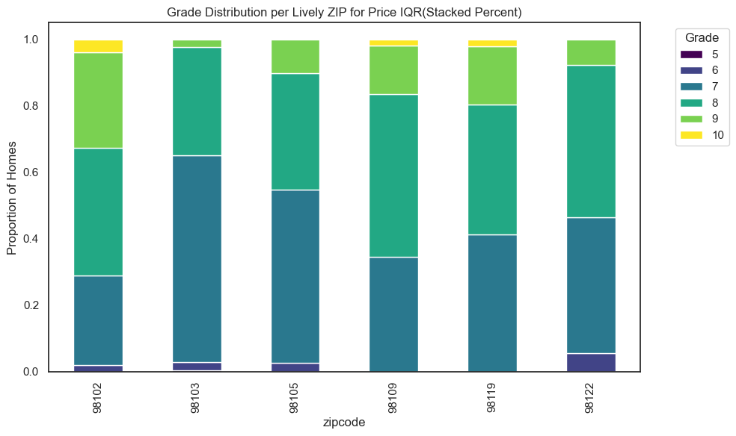
Group 2 EDA Project : House prices at zipcodes with grades
Houses within IQR-range and selected zipcodes offer acceptable quality of housing

Slide 14
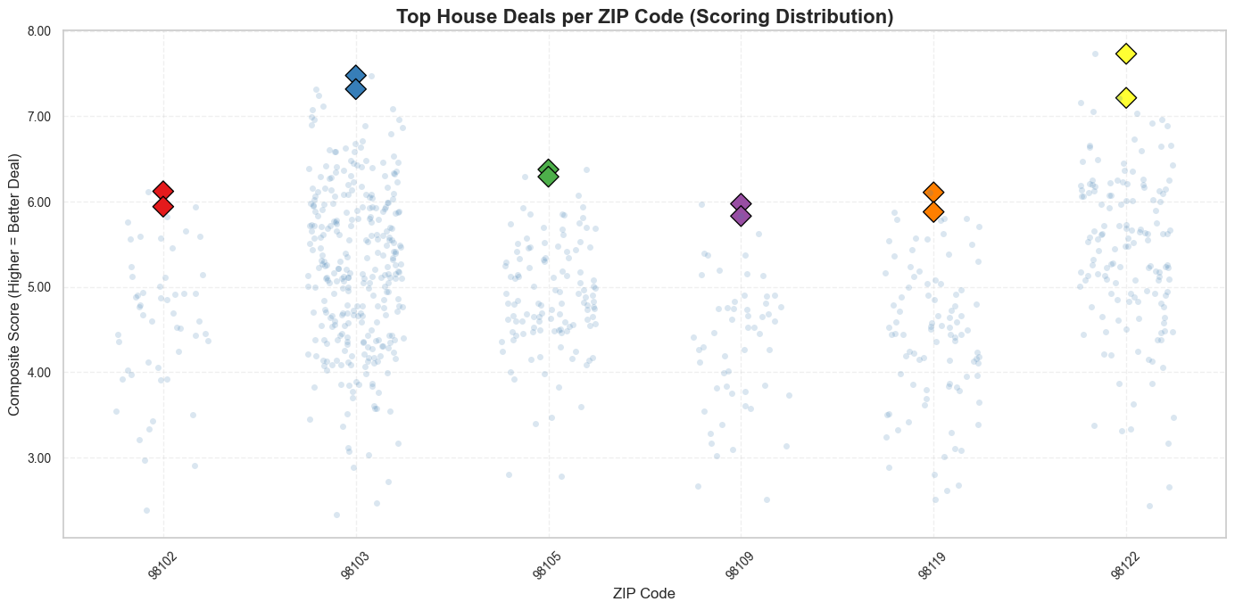
Group 2 EDA Project : Best deals per zipcode
Overall weighted scoring (price, grade, size etc.) of houses shows best available units

Slide 15
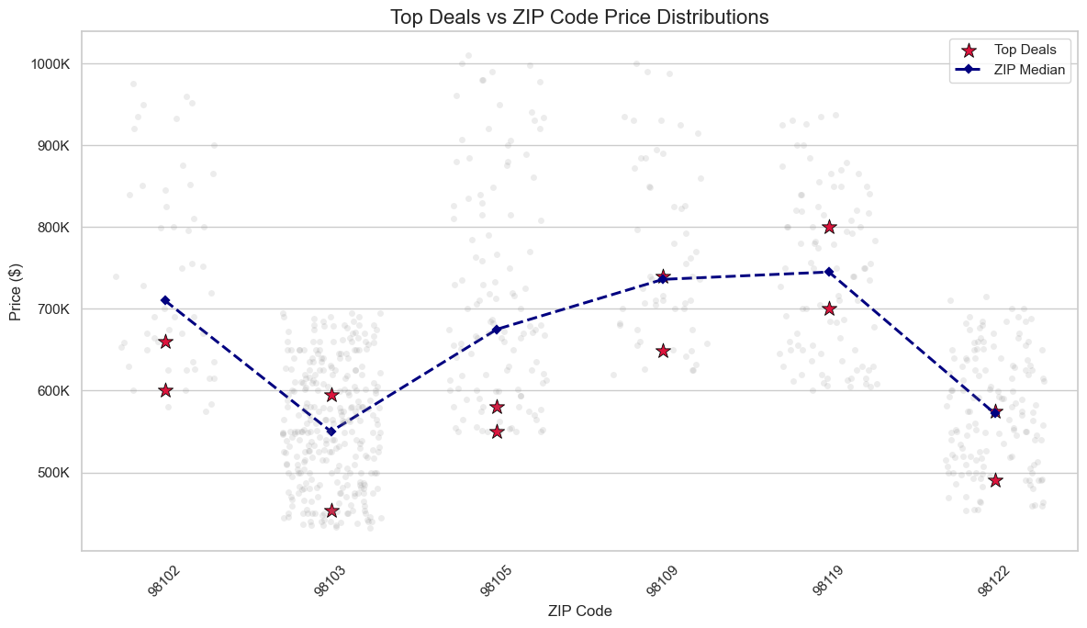
Group 2 EDA Project : Top deals per zipcode
Comparing prices of those houses against the median house price in the area
→ Best value picks

Slide 16
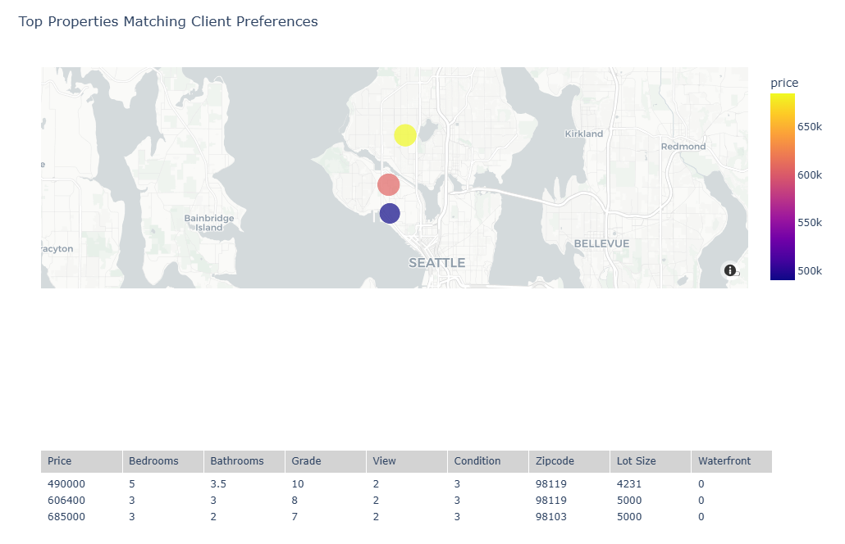
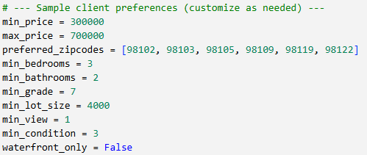
Group 2 EDA Project : Top properties with customization
Properties customized based on the requirements of the features

Slide 17

Group 2 EDA Project : Conclusion
Client ( Buyer ) will have an overview of properties based on his primary requirements
like the location.
Best time to buy : Nov – Feb depending on zipcodes.
Price influencing main features are
Living area (Sqft)
Number bedrooms and bathrooms
Grade of house
Time
The best deals you can find! I love my new home!

