Slide 1
Network Telemetry Framework
Real-Time Network Performance Monitoring | RFC 9232
CS331 Computer Networks | Final Project Presentation
Avinash Reddy
23110123
Gella Jayarama Krishna
23110115
Sowpati Raj Kamal
23110319
Jangam Sanjay
23110144
Pulakurthi Manohar
23110259
Yalla Sai Teja
23110366

Slide 2
Project Motivation & Technical Approach
The Challenge: Periodic SNMP Polling
- Traditional monitoring tools poll network devices on fixed multi-minute intervals (e.g., 5 min).
- Transient congestion bursts and micro-spikes are smoothed out in long averages.
- Centralized polling introduces CPU load and management overhead as network size scales.
The Solution: Continuous Push Telemetry (RFC 9232)
- Edge devices stream performance measurements proactively over persistent gRPC channels.
- High-frequency telemetry generation (2 s interval) exposes transient anomalies in seconds.
- Push model eliminates polling latency and reduces device CPU overhead.
Target Performance Metrics:
1. Bandwidth Utilization: Real-time link capacity consumption (0% to 100%)
2. Throughput Rates: Ingress and egress bitrates in Mbit/s
3. Round-Trip Latency: End-to-end TCP connection response time in ms
4. Interface Health: Monitoring packet errors, discards, and dropped frames
Tools & Core Technologies
• Python 3.12: Core runtime powering backend services, agents, and test harness.
• gRPC & Protobuf: Streaming transport encoding metrics in compact 72-byte payloads.
• FastAPI & Uvicorn: Asynchronous REST backend serving real-time API queries.
• SQLite Database: Embedded persistence layer with Write-Ahead Logging (WAL) mode.
• psutil: Operating-system interface sampling physical host network statistics.
• HTML5 Canvas: Hardware-accelerated browser rendering for real-time charts.
Key Project Deliverables:
• 1. Distributed edge agents supporting physical host and simulated network nodes
• 2. Asynchronous backend ingestion pipeline with decoupled storage queue
• 3. Threshold-based alerting engine with anti-flapping hysteresis logic
• 4. Real-time web dashboard, REST query APIs, and CSV/JSON export capability
• 5. Automated test suite with 30 passing unit and integration test cases
CS331 Computer Networks | Team T018 | Network Telemetry Framework (RFC 9232)
2/6

Slide 3
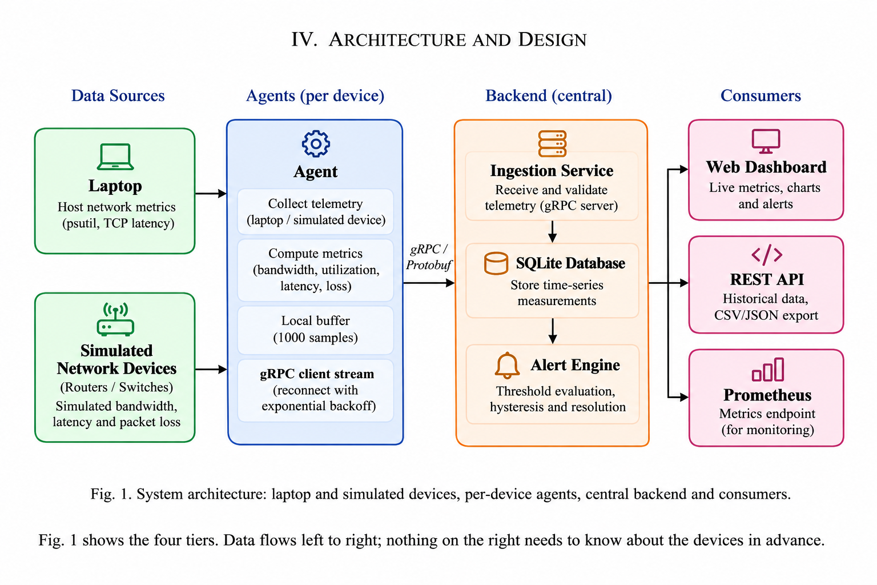
System Architecture & Functional Pipeline
Architectural Highlights:
1. Data Collection Layer:
Dual-collector design: physical host network stats via psutil and TCP latency probing, combined with 5 simulated routers and switches modeling enterprise loads.
2. Transport Layer (gRPC):
Persistent HTTP/2 client stream (Telemetry.Stream). Telemetry messages are encoded in compact Protocol Buffers (~72 bytes) and streamed at 2-second intervals.
3. Ingestion & Storage Layer:
An in-memory queue (capacity 20,000) decouples network reception from disk. SQLite persists telemetry in 500-record batches using Write-Ahead Logging (WAL).
4. Alerting & Visualization Layer:
Hysteresis state machine evaluates thresholds, triggering alerts after 2 breach cycles. Real-time HTML5 canvas dashboard and REST APIs expose telemetry.
CS331 Computer Networks | Team T018 | Network Telemetry Framework (RFC 9232)
3/6

Slide 4
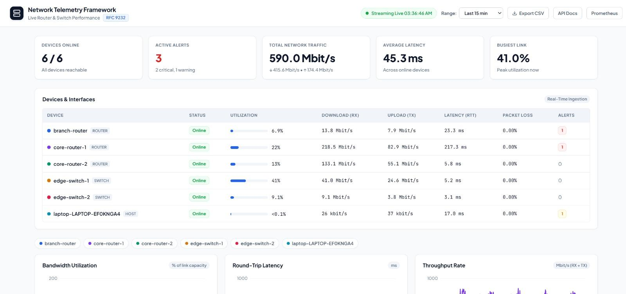
Real-Time Telemetry Dashboard
Dashboard Capabilities:
• KPI Health Overview:
Instant summary cards displaying reachable device count (6/6), active alert counts, total throughput (1.65 Gbit/s), and average latency.
• Interface Utilization Table:
Tabular monitoring of routers, switches, and hosts with live bitrates, round-trip latency, packet loss, and animated utilization gauges.
• Dynamic Sub-0.1% Precision:
Correctly preserves sub-0.1% utilization on idle links rather than rounding down to zero, maintaining telemetry continuity.
• Canvas Trend Visualizations:
Hardware-accelerated HTML5 canvas line graphs plotting Bandwidth Usage, Latency, and Throughput with smooth 2-second updates.
• Historical Data Export:
One-click CSV export engine generating comprehensive, audit-ready telemetry logs for offline analysis in under 0.6 seconds.
CS331 Computer Networks | Team T018 | Network Telemetry Framework (RFC 9232)
4/6

Slide 5
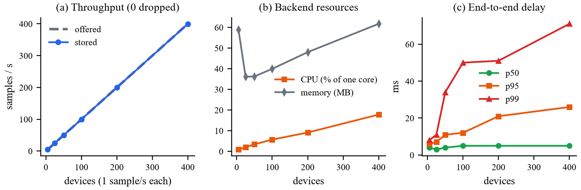
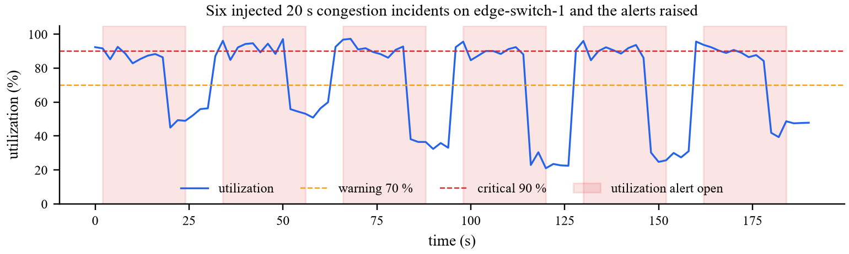
Experimental Evaluation & Results
400 Devices
0 Dropped Packets
Tested with 400 concurrent simulated devices at 1 sample/s with zero data loss.
2.8 Seconds
Mean Alert Time
Injected congestion incidents were detected and alerted in an average of 2.8 seconds.
71% Reduction
Flapping Suppression
Hysteresis state machine eliminated transient noise, cutting false alerts from 101/hr to 29.6/hr.
30 / 30 Passed
Automated Tests
100% test pass rate across Protobuf schemas, database queues, alert logic, and REST APIs.
Summary of Experimental Findings:
1. High Throughput & Zero Loss: The decoupled queue architecture sustains 400 samples/s with zero dropped packets and p95 latency under 26 ms.
2. Alert Reliability: Hysteresis evaluation accurately isolates sustained congestion from transient noise, resolving automatically post-recovery.
CS331 Computer Networks | Team T018 | Network Telemetry Framework (RFC 9232)
5/6

Slide 6
Summary & Conclusions
• Delivered Pipeline: A modular network telemetry framework implementing RFC 9232 principles to collect, transport, store, and visualize performance metrics in real time.
• High-Speed Streaming: Replaces legacy SNMP pull polling with lightweight gRPC HTTP/2 push streaming using compact Protocol Buffers (~72 bytes/sample).
• Empirically Validated: Validated through 30 automated Pytest tests, 400-device scalability benchmarking, and scripted fault-injection scenarios confirming zero data drops.
• Scope & System Boundaries: Implemented as an educational prototype using physical laptop OS metrics (psutil) and simulated enterprise switches/routers without proprietary ASIC hardware.
Future Work:
- Integration with physical network switching hardware (Cisco / Juniper)
- Standard gNMI (gRPC Network Management Interface) schema support
- Mutual TLS (mTLS) transport encryption and token authentication
- Scalable time-series storage backend (TimescaleDB / InfluxDB)
Thank You!
Questions & Discussion
Project Code & Reproducibility:
Repository: https://github.com/Rajkamal065/network-telemetry
Automated Test Suite: python -m pytest tests/ -v (30/30 passed)
Team T018 | CS331 Computer Networks:
• Avinash Reddy (23110123)
• Gella Jayarama Krishna (23110115)
• Sowpati Raj Kamal (23110319)
• Jangam Sanjay (23110144)
• Pulakurthi Manohar (23110259)
• Yalla Sai Teja (23110366)

