Slide 1

Hungry Hungry Hippos : Towards Language Modeling with State Space Models
Rajkamal Ingle
M.Tech CSA

Slide 2
Content
Motivation
Background
Closing Quality Gap With H3
Closing Efficiency Gap With H3
Results
Experiments

Slide 3
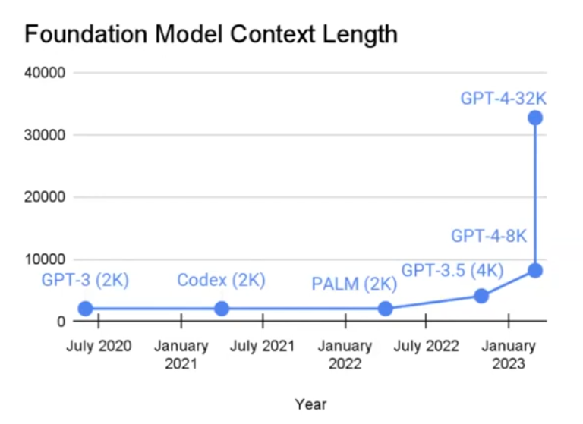
Motivation
DNA Sequencing
Audio Generation
Code Generation
Video Processing
Long Context Window – Desired

Slide 4
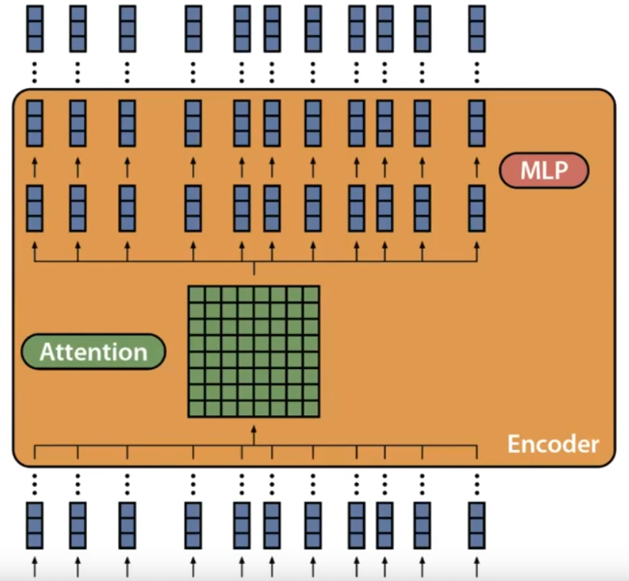
Existing Best Modeling Choices: Transformers, Encoder-Decoder Models
Why not increase their context window?
Use Attention : Comparing Every Token with Every Other Token
Attention grows quadratically in sequence length
Can we replace Attention with a sub-quadratic operator ensuring minimal or no performance degradation?

Slide 5
Background
State Space Models(SSMs)
- Discrete-time State-space representation defines a linear mapping from a discrete input signal u_{i} to a discrete-output signal y_{i} through a state-variable x_{i}.
x_{i} = Ax_{i-1} + Bu_{i}
y_{i} = Cx_{i} + Du_{i}
- These representations are used as a layer in deep learning pipeline, where A,B,C,D are learned from data (gradient-based Optimization)

Slide 6
But SSMs have no nonlinearity in the recurrent update!
SSMs seem a lot like RNNs!
Convolutional View of SSMs
Effectively makes SSMs a series of linear transformations and allow it to be parallelized via
Apart from no nonlinearity, SSMs also have weight matrices with special initialization to ensure stable training! For example: HiPPO in S4D!
They are also computationally more efficient than RNNs!
Food for thought: VGP in SSMs??

Slide 7
Convolutional View of SSMs
For more efficient training, given the entire input sequence of the inputs u¹, u², …,, u^{N}, the output sequence can also be written as the convolutional of the input with filter:
f = [CB, CAB, CA²B, …., CA^{N-1}B]
FFT Convolution Theorem
The Fourier Transform of a convolution of two sequences is the product of their Fourier Transforms. For two sequences say u and f:
u * f = IFFT( FFT(u) . FFT(f) )

Slide 8
Computing Convolution naively through conventional matrix operations is expensive, especially for long kernels - O(N²)
The convolution computation using FFT and IFFT yields a O(NlogN) algorithm
Why is it
Important?
SSMs are a promising primitive
- Recurrent view: fast O(1) generation, no fixed context length
- Convolutional view: Fast Training
- During Training: O(NlogN) in sequence length N
Then, How do SSM-based models fare against Transformer-based models?

Slide 9
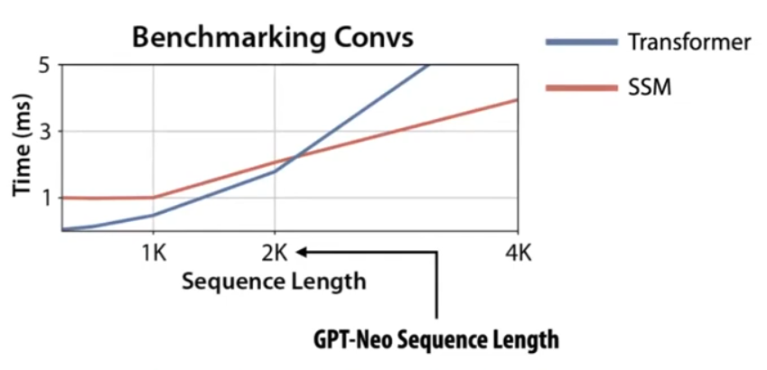
Quality Gap of SSMs:
Efficiency Gap of SSMs:
Model | PPL(OWT)
Transformer | 20.6
S4D | 24.9
GSS | 24.0
Existing SSMs lag transformers in quality on language modeling!
Also lag in runtime efficiency for short sequences!
Though SSMs scale linearly in sequence length instead of quadratically like attention, but still run slower on modern hardware due to poor hardware utilization!
H3 Authors try to understand these gaps and close them!

Slide 10
Closing Quality Gap With H3
Understanding the Gap with Synthetic Languages
1) Induction Head Task: Tests how well a model can recall content after a special token.
2) Associative Recall: similar to induction head task, but requires the model to remember multiple key-value pairs.
Task | Input | Output | Sequence Length | Vocab Size
Induction Head | a b c d e ^ f g h i …... x y z ^ | f | 30 | 20
Associative Recall | a 2 c 4 b 3 d 1 a | 2 | 20 | 10
These tasks mimic ability of recalling information vital for general language modelling tasks!

Slide 11
Task | Random | S4D | GSS | Attention
Induction Head | 5.0 | 35.6 | 6.8 | 100.0
Associative Recall | 25.0 | 86.0 | 78.0 | 100.0
H3
100.0
99.8
Both S4D and GSS fail to model these synthetic tasks
Suggesting they may not have the expressivity for the general language
These failures suggest two missing capabilities:
1) To remember tokens that appear after a particular event
2) ​To compare tokens across the sequence
Attention has both these qualities since, it can compare tokens by constructing the quadratic attention matrix and recall tokens by direct copying!
H3 is designed to exhibit these capabilities to narrow the expressivity gap between SSMs and attention!

Slide 12
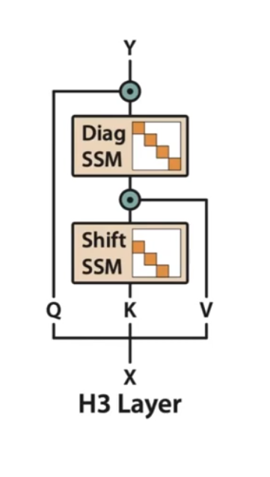
H3 Layer
Stacks two SSMs instead of one
Shift SSM: local lookup across sequence, basically gives the flexibility to the model to remember the previous token
Diagonal SSM: global memory, basically gives the flexibility to the model to remember a token forever
Model decides degree of usage of the above two SSMs using the Multiplicative interactions between outputs denoted by pointwise multiplication
Q . SSM_{diag} (SSM_{shift} (K) . V)

Slide 13
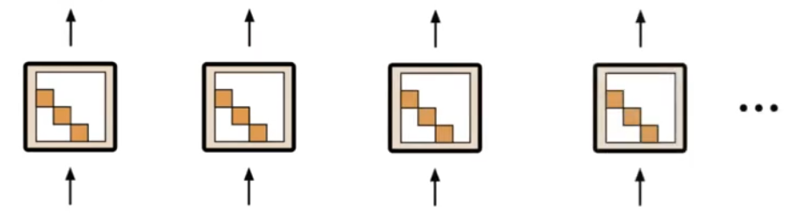
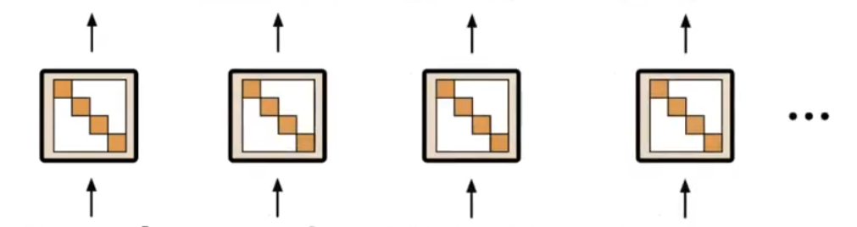
null
Ram
and
Shyam
Shift SSM Helps to Remember Previous Token
Ram
and
Shyam
went
Ram
Ram
Ram
Ram
Diagonal SSM Helps to Remember a Token Forever
Ram
and
Shyam
went

Slide 14
null
null
Shyam
Shyam
Multiplicative Interactions/Gate
To Remember
Select Tokens
Ram
and
Shyam
went
The Multiplicative Interactions with Shift SSM provides another missing capability when combined with shift SSM: comparing tokens across the sequence!

Slide 15
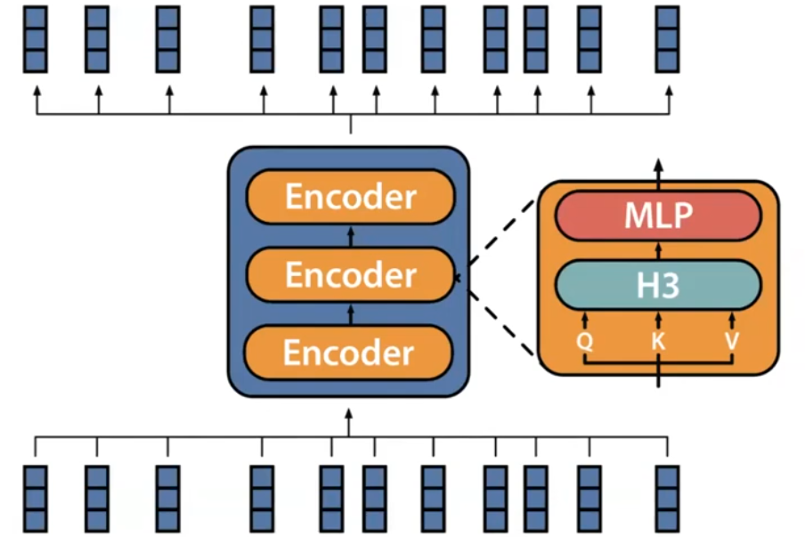
Replace Attention with H3 Layer
H3 + 2 Attn Layer : Keep two attentions along with H3 Layer (one at beginning, one in middle)
Models | H3 | H3 Hybrid + 2 Attn | S4D | GSS | GSS Hybrid (2 Attn) | Transformers
PPL(OWT) | 21.0 | 19.6 | 24.9 | 24.0 | 19.8 | 20.6

Slide 16
Closing Efficiency Gap with H3
FlashConv
- Though FFT is O(nlogn), it is slower than naïve attention practice due to the dedicated specialized/optimized hardware/libraries for attention
- H3 proposes FlashConv which constitutes of following 3 Ideas to fill this gap:
1) Kernel Fusion
2) Block FFT
3) State Passing
Efficiency Gap we intended to address!
Existing Solution is Naive Implementation of:
u * f = IFFT( FFT(u) . FFT(f) )

Slide 17
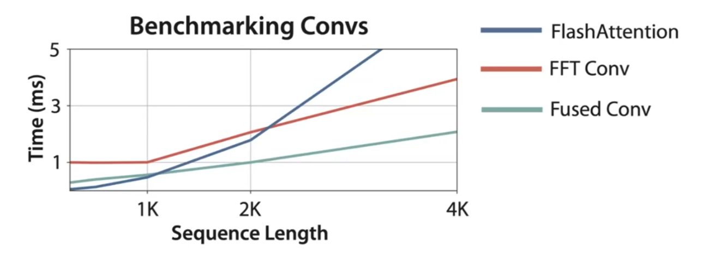
Kernel Fusion
- Motivation: Naïve Implementation involves operations that need to frequently reading and writing intermediate results(as single FFT on GPU is IO bound), can be relatively slow on GPUs
- Rewrite whole operation in CUDA - so that only 1 read and 1 write required at least for sequences that can fit in SRAM
Kernel fusion
reduces memory
I/O overhead - as long as the sequence fits into SRAM(4K/8K)

Slide 18
2. Block FFT
- Single FFT on GPU is usually IO bound, hence, so does the SSM
- Kernel Fusion removes this IO bottleneck and now the bottleneck is compute
- Classical Results show that FFT can be written as a series of block-diagonal matrix multiplications interleaved with permutation
- So, Computation of FFT can leverage the specialized matrix multiply units (for e.g. tensor cores)
- Block FFT does the same!!
Kernel Fusion + Block FFT – Fused Block FFTConv

Slide 19
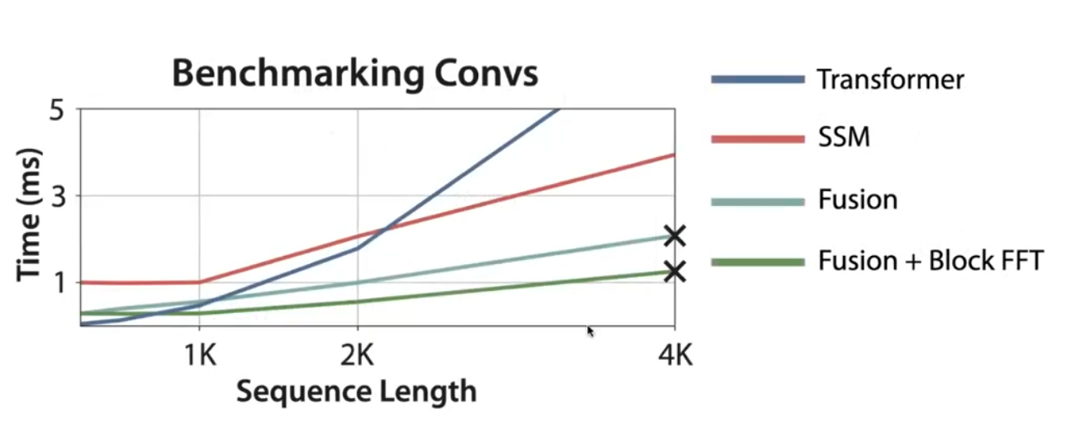
Fused Block FFTConv : Improves Runtime for Short Sequences!
Fused Block FFTConv outperforms Transformers BUT only when the entire sequence can fit into GPU SRAM(fast memory)!
What if sequence length is more than SRAM?

Slide 20
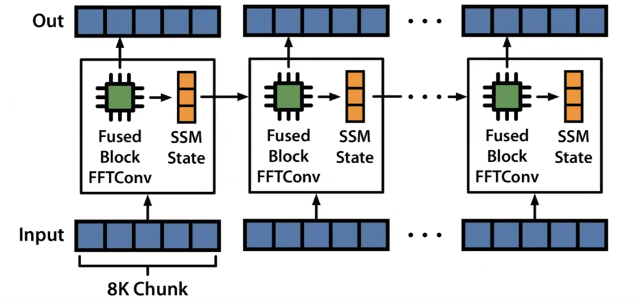
3. State Passing
- Uses Recurrent View of SSMs to Split Input Sequence into chunks that fit the Fused Block FFTConv
- Leverages Convolutional View for Fast Computation and Recurrent View to Scale for Long Sequences!

Slide 21
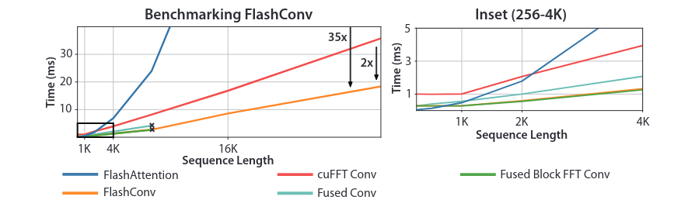
FlashConv Evaluation
FlashConv can speed up any SSMs (not just H3) - Major Contribution of H3!

Slide 22
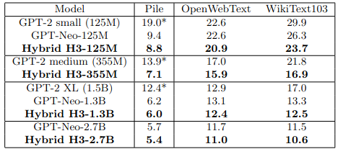
Results
Train Tokens | Hybrid H3 (125M) | Transformer(125M)
5B | 11.8 | 12.7
10B | 10.7 | 11.3
15B | 10.2 | 10.7
H3 Scales in Data!
H3 outperforms Transformers of the same size!
Tokens/s | PL 512 | PL 1024 | PL 1536
Transformer-1.3B | 1340 | 770 | 520
Hybrid-1.3B | 1980 | 1580 | 1240
H3 achieves better SuperGLUE scores than Transformers of the same size in both zero-shot and 3-shot settings!
Fast Generation!
+
Recurrent formulation of H3 allows Infinite Generation!

Slide 23
Experiments
Recall the Task used by Authors:
Task | Input | Output | Sequence Length | Vocab Size
Induction Head | a b c d e ^ f g h i …... x y z ^ | f | 30 | 20
Associative Recall | a 2 c 4 b 3 d 1 a | 2 | 20 | 10
Task Considered for Experiments: Extreme Associative Recall Tasks
What's Extreme? - Let's look at the test sets under consideration!

Slide 24
Testset-1 of 702 samples looks as follows:
a 1 a
a 1 b 2 a
a 1 b 2 c 3 a
….
a 1 b 2 c 3 …. y 25 z 26 a
a 1 b 2 c 3 … y 25 z 26 aa 27 a
a 1 b 2 c 3 … y 25 z 26 aa 27 ab 28 a
….
a 1 b 2 c 3 … y 25 z 26 aa 27 ab 28 … zy 701 zz 702 a
Testset-2 of 702 samples:
"a 1 ([b-z] [0-9])^{k} a" - for kth test sample.
 | Output | Sequence Length | Vocab Size
Testset-1 | 1 | 6-3174 | 36
Testset-2 | 1 | 6-2183 | 36

Slide 25
 | Accuracy(%) GPT-355M | Accuracy(%) H3-355M | Random
Testset-1 | 2.84 | 3.70 | 2.77
Testset-2 | 13.25 | 10.26 | 2.77
Owing to GPT-355M model's limited context window of 1024 tokens, it could not scale its performance beyond 386th sample in Testset-1 and 487th sample in Testset-2, whereas H3 still gives overall consistent performance for both testsets!
It makes sense to improve H3 or SSM models since they deliver their performance invariant to the input sequence length!
H3 1.3B
H3 2.7B
Github Repo: https://github.com/Rajkamal1011/H3_experiments

Slide 26

Thank You!

