Slide 1
Introduction
Table of Content
Kruti Dev Use
Loop Animation for down
Bold Color selection for Attention
Know how to use the Insert
Image insertion
Stock photo online
Gradient in Word
Animations
Stickers
Online stock
Shape creation
Understanding of things
Attentive
Arranged
New Styles

Slide 2

PRARAMBH BATCH
2025-26
iz0 1%& vxj ,d fpfM+;k mM+ ugh ldrj gSA ysfdu tc og mM+us yk;d gks xbZ rc og 25 fdeh0@ ?k.Vk dh j¶rkj ls pyus yxs rks og D;k pht gS tks mls ftank j[ksxhA vkSj esjk cM+k HkkbZ dk mlls D;k fj’rk gSA vxj og fdlh rjg ls pkoy [kk [kkdj ftank jg Hkh ys rc Hkh D;k
Motor vehicle
Electric Train
Flying Jatt
Super Car
FOR MORE INFORMATION LOG ON AND SUBSCRIBE TO THE CHANNEL CALL AT : +91 9120997721
FOR MORE INFORMATION LOG ON AND SUBSCRIBE TO THE CHANNEL CALL AT : +91 9120997721

Slide 3



INDIA
Instgram Id: raj_toyaj
rajkamal420-web.github.io/

Slide 4
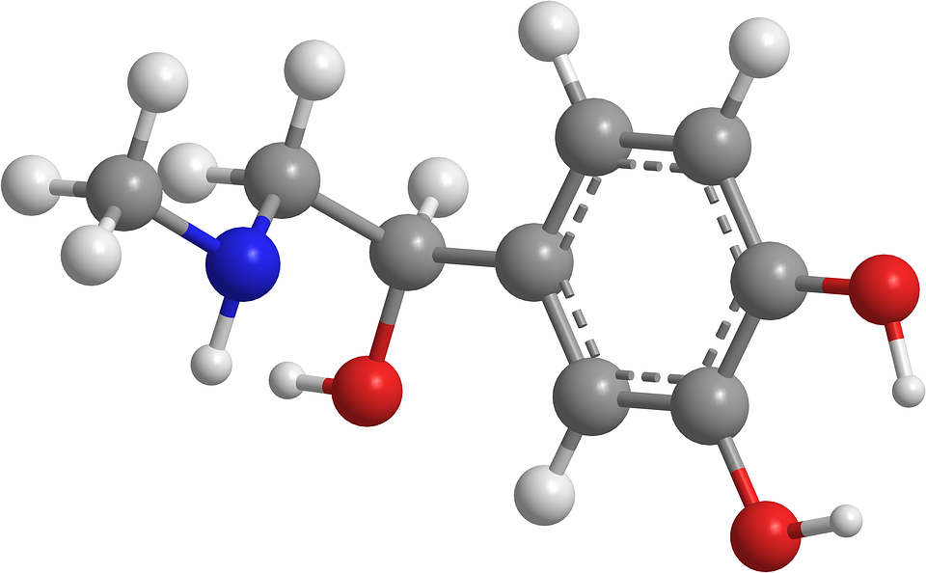
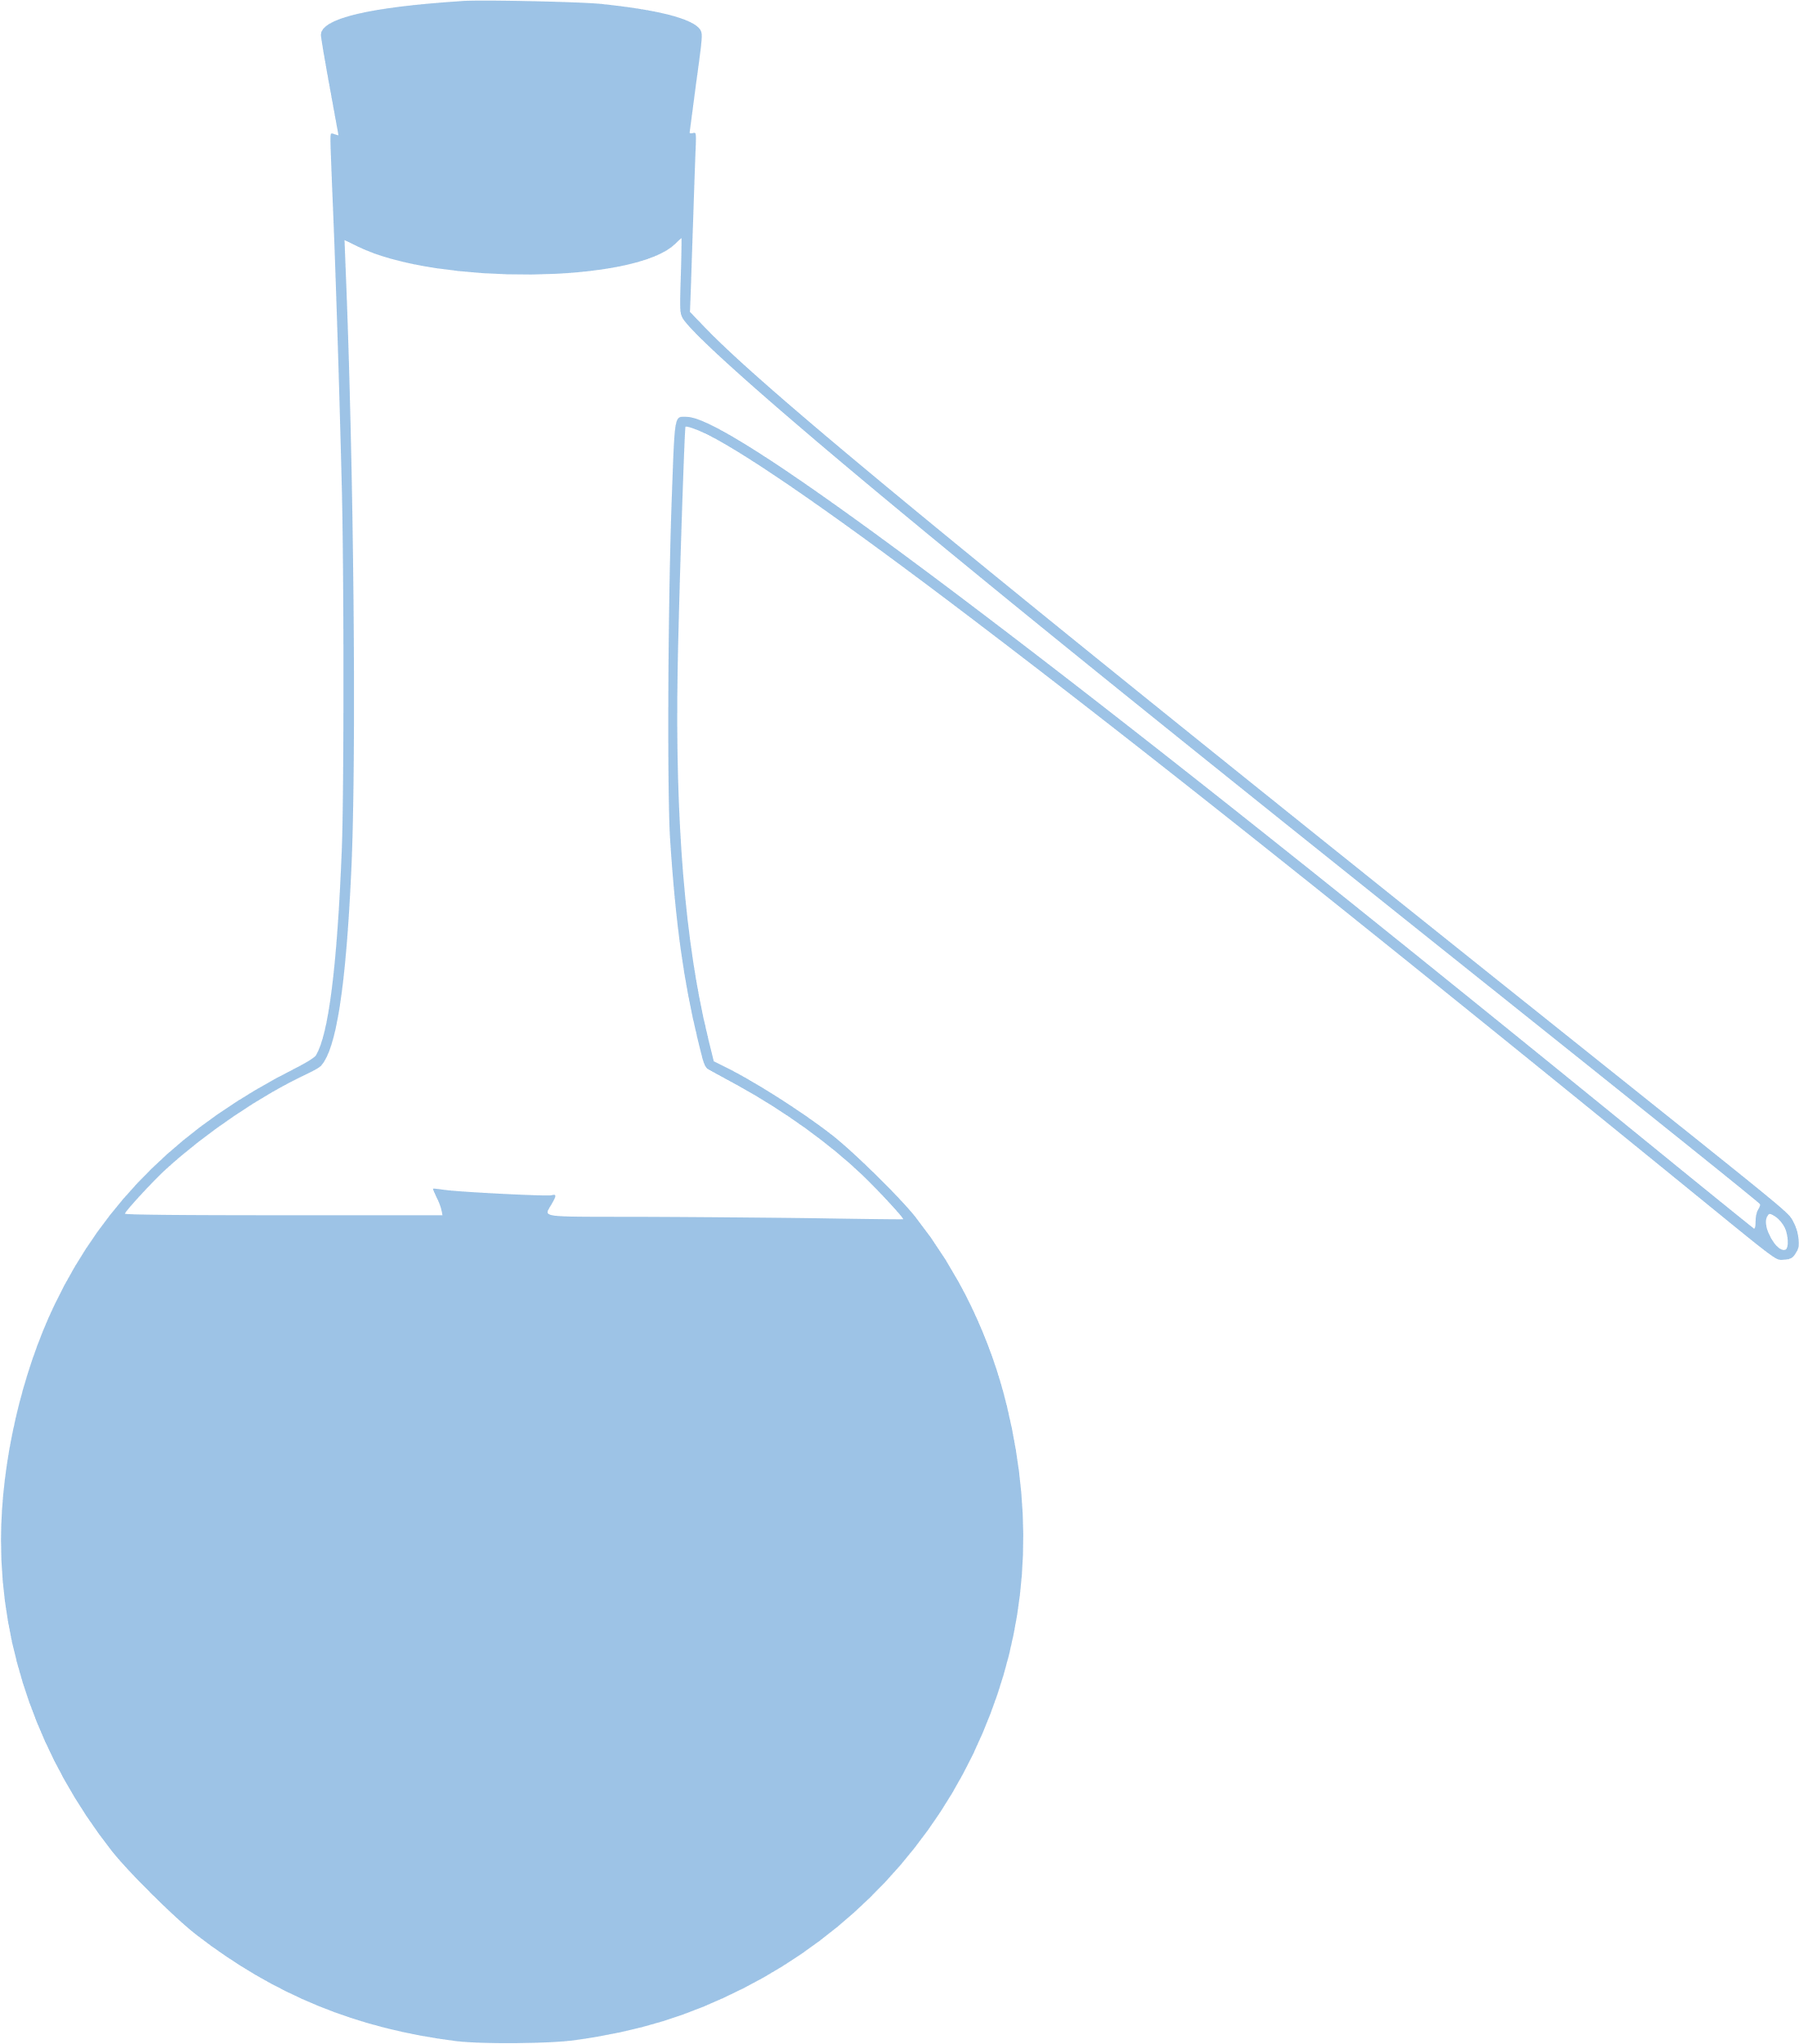

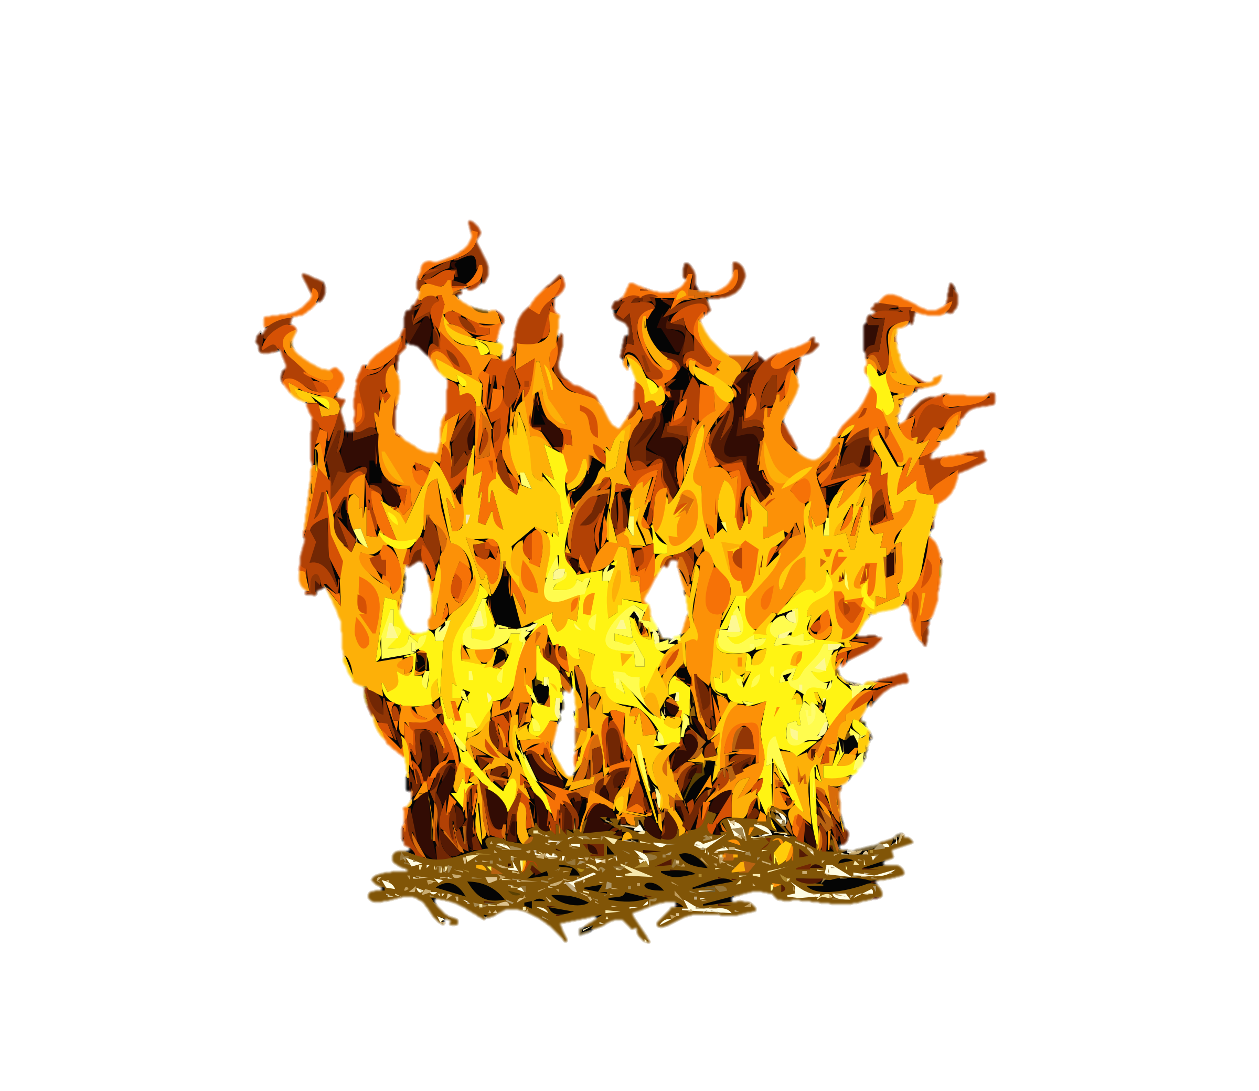
CHEMICALS CREATION
Key Points:
Hiphenisation
Stephenension
Glycogene
Alphnumerical
William Bourner Reaction
Arc Reactor

Slide 5
1. Why I am showing this?

